Slide 1

Linker
Alternatives of Everything

Slide 2

What if we can see immediately the alternatives for everything in the world?

Slide 3
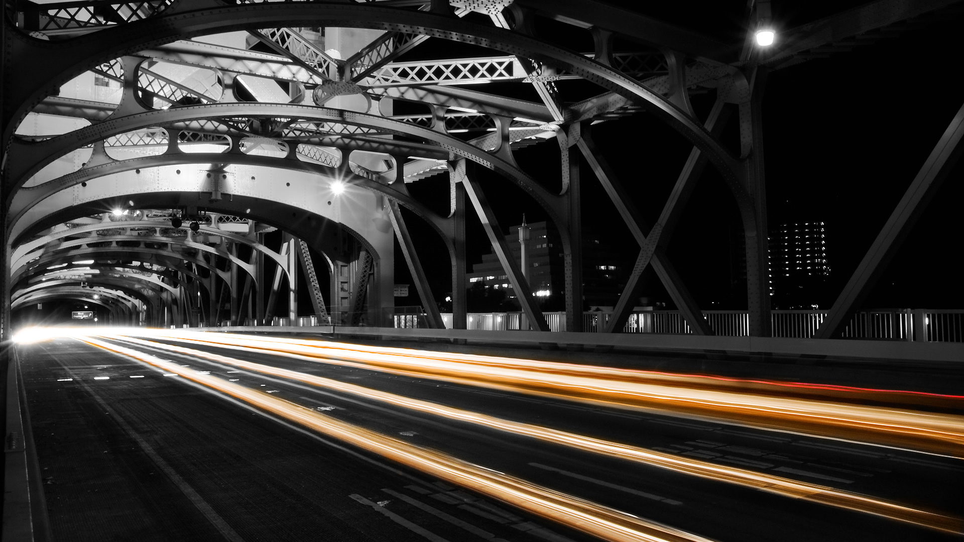
Common structures
Ferrari, Lamborghini and Porsche

Slide 4

2.7 TB
107 million sites
96 million output tuples

Slide 5
Top results
1. Jeep - Dodge (420)
2. Dodge - Jeep (414)
3. Suzuki - Honda (337)
Total amount of references: 5656

Slide 6
Demo

Slide 7

Common structures
Difficult problem to solve
BigData as solution

Slide 8

Outro
Project Linker
https://github.com/haneev/linker

