Slide 1
Predicting Student Success: A Data Mining Approach to Retention
Analysis of Academic, Socio-Economic, and Demographic Factors
Group 3: Sagi Hanesh Varma & Sai Samin Varma Pusapati

Slide 2
Introduction
Phase 1: Diagnostic (EDA)
RQ1 (Academic): How do Approved Units in the 1st Semester vary by final outcome?
RQ2 (Financial): What is the success rate based on Financial Risk Profile (Tuition & Scholarship)?
RQ3 (Demographic): Do Age and Admission Grades significantly differentiate dropouts from graduates?
Phase 2: Predictive (Modeling)
RQ4 (The Solution): Can Machine Learning accurately predict at-risk students in real-time?

Slide 3
Data Overview (Data Structure)
The Dataset
Source: Student Academic Performance Dataset from UCI Machine Learning Repository
Volume: 4,424 Student Records
36 Features Across 3 Categories:
Demographic: Age, Gender, Nationality
Socio-Economic: GDP, Inflation, Scholarship Status
Academic: Grades (1st & 2nd Sem), Tuition Status

Slide 4
Target Variable & Key Insights
Target Classes:
Graduate: Majority class
Dropout: Significant portion (Primary concern)
Enrolled: Minority class
Initial Findings:
High correlation between Tuition Fee Payment and retention.
2nd Semester Performance is a critical milestone.

Slide 5
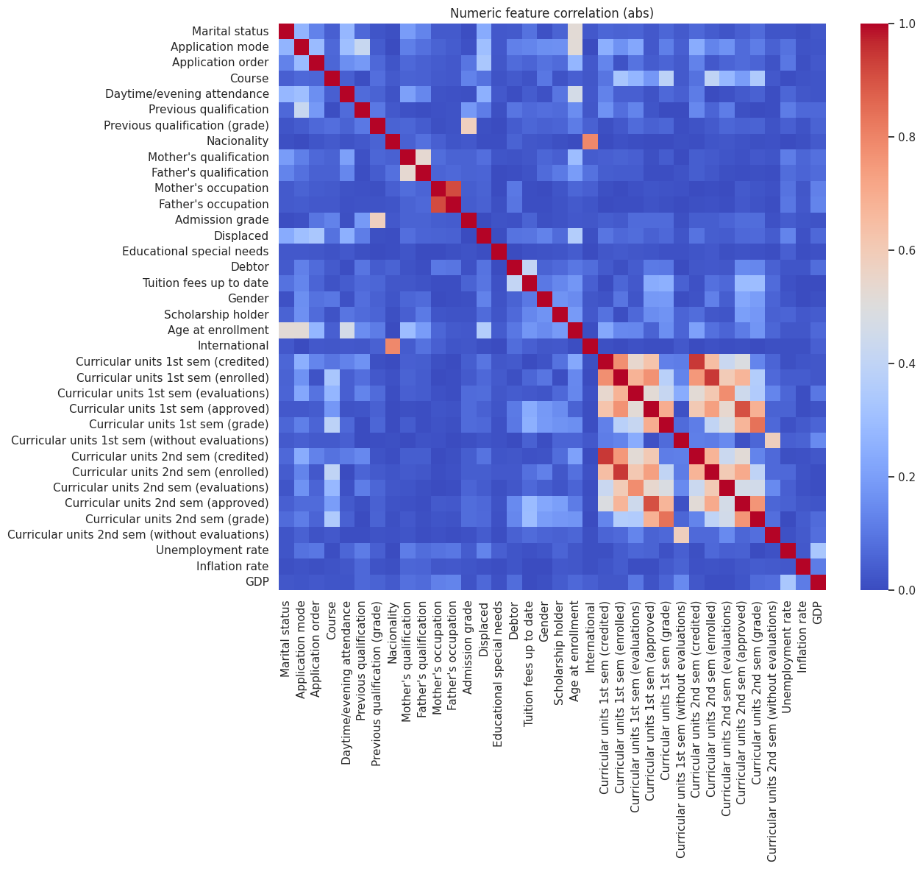

Slide 6
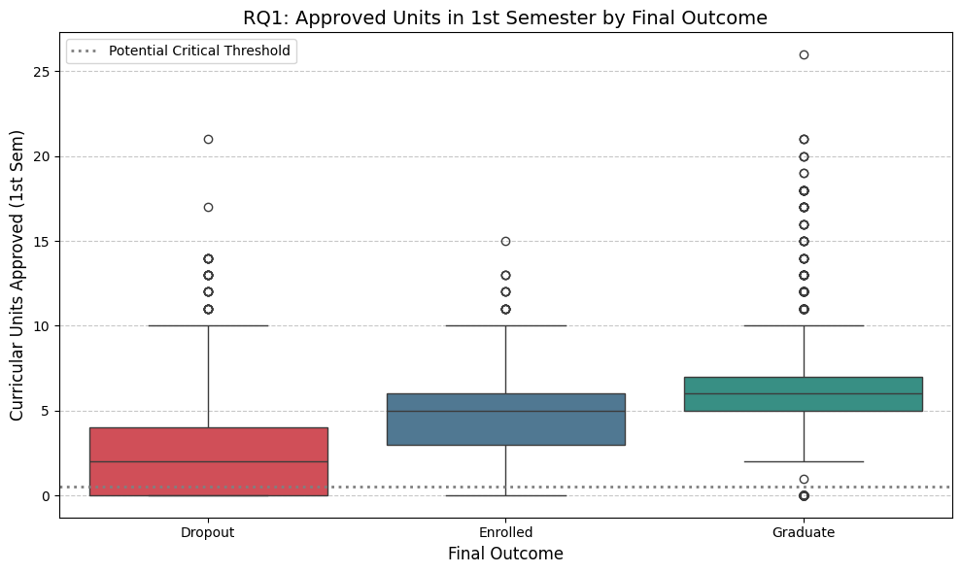
RQ1 - Approved Units in 1st Semester
Approved Units in 1st Semester by Final Outcome
The boxplot shows a distinct gap. Dropouts (Red) have a median near zero for approved units.
Students approving fewer than 50% of units in Sem 1 are at immediate risk.

Slide 7
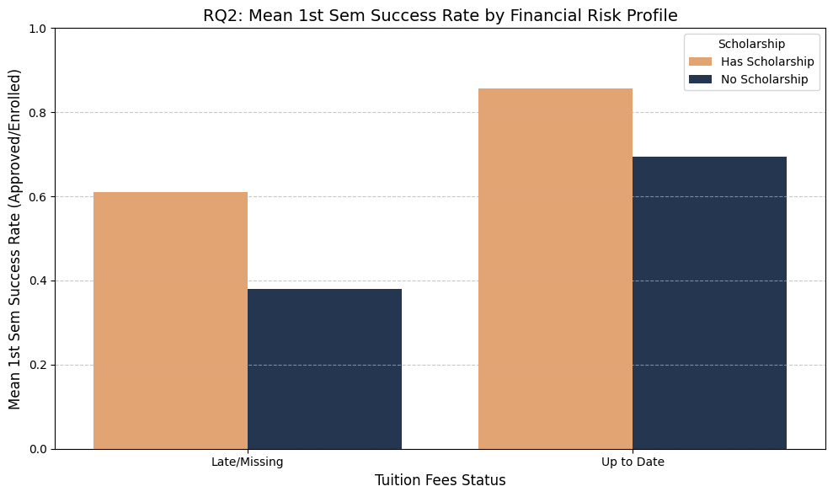
RQ2 - Financial Risk Profile
Mean 1st Sem Success Rate by Financial Risk Profile
Tuition Impact: Students with 'Late/Missing' tuition (Left bars) have drastically lower success rates.
Scholarship Buffer: Scholarship holders (Orange) consistently outperform non-holders, even within the same tuition status.

Slide 8
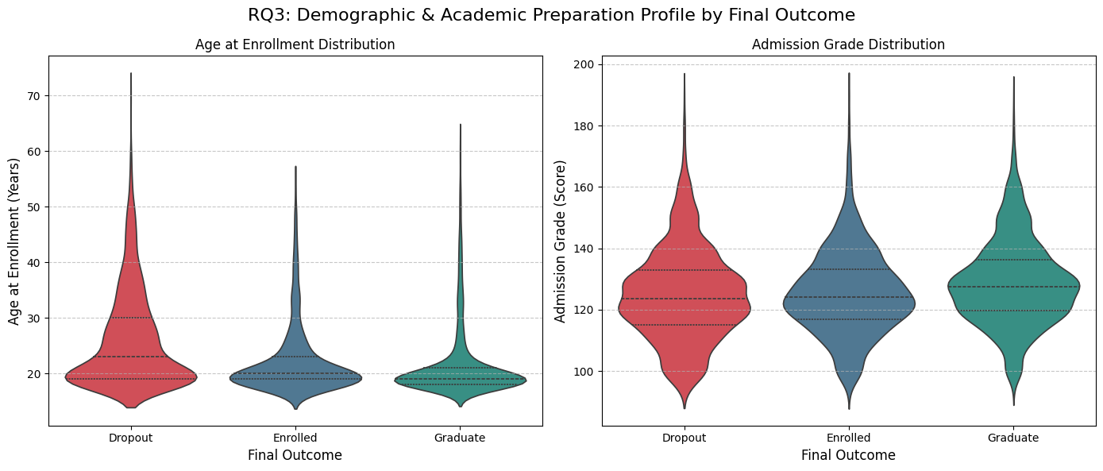
RQ3 - Demographic & Academic Profile
Demographic & Academic Preparation Profile
Age Distribution (Violin 1): Dropouts (Red) show a wider distribution into older ages (delayed enrollment).
Admission Grade (Violin 2): Distributions are surprisingly similar—high school grades are not a strong differentiator.

Slide 9
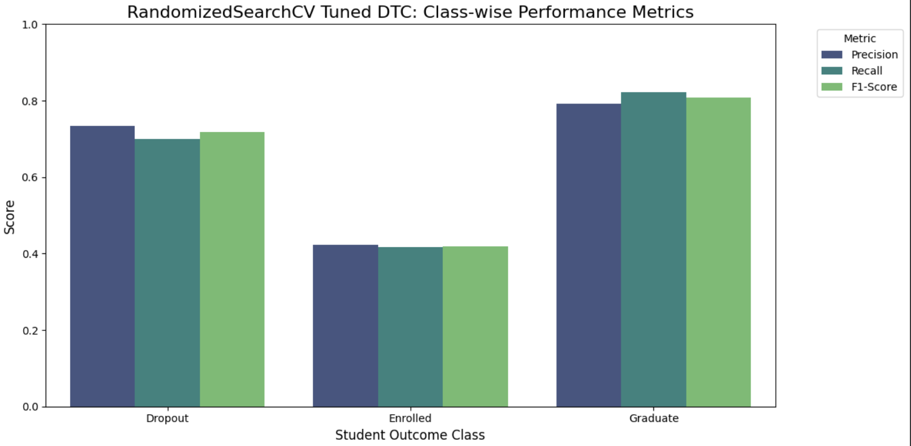
Methods (Process)
From Observation to Prediction
Step 1: Addressing Imbalance
Technique: Hybrid SMOTE-ENN + Targeted Oversampling.
Step 2: Hyperparameter Optimization
Tested: RandomizedSearchCV vs. GridSearchCV.
Result: RandomizedSearch outperformed GridSearch (F1: 0.723 vs 0.693).
Best Params: Max Depth: 6, Criterion: Gini, Class Weight: Balanced.

Slide 10
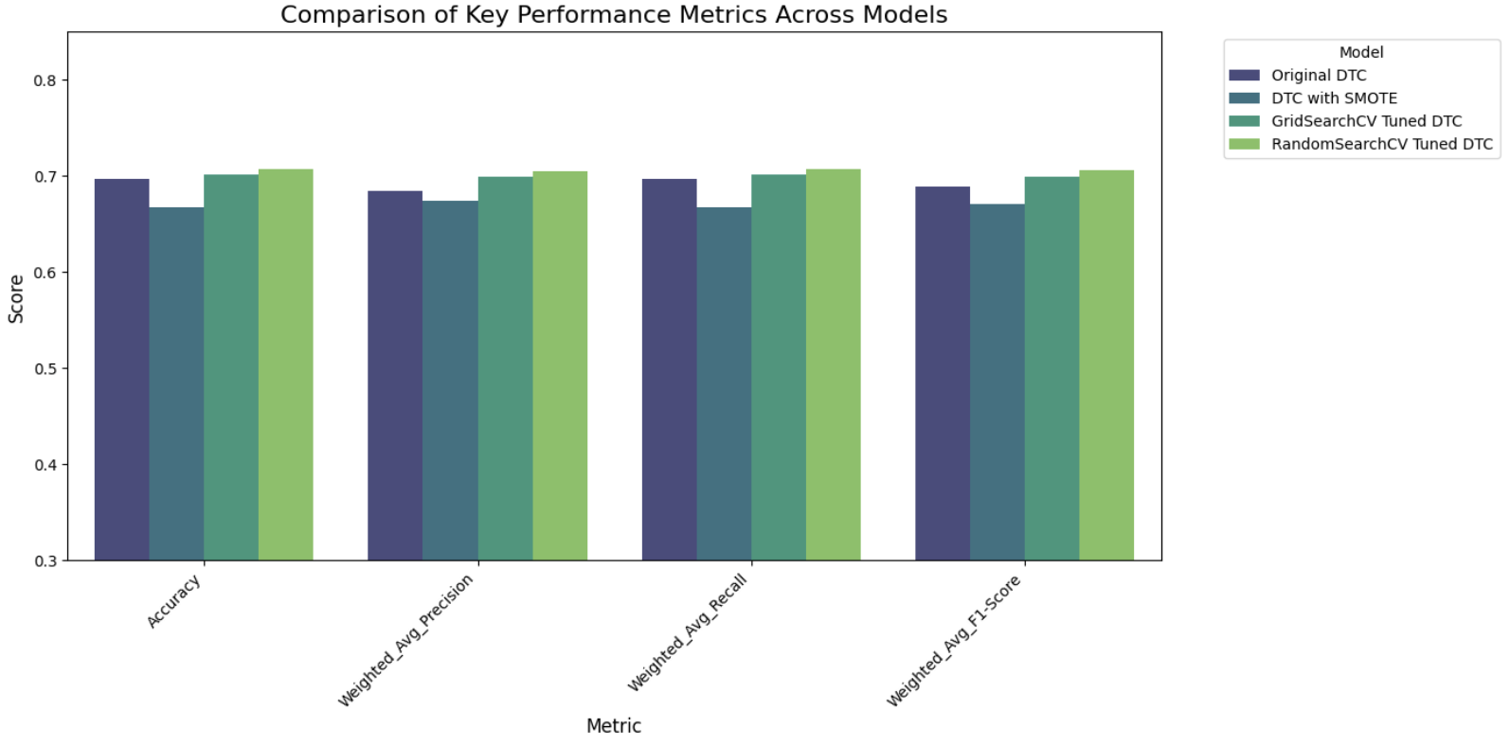
Results (Model Evolution & Performance)
Model Evolution:
Base Model: F1 0.662
Model with SMOTE: F1 0.662
Model with Random search: F1 0.723 (+6.1% Total Improvement)
Final Performance:
Accuracy: 71.99%
Decision Threshold: Shifted to 0.613 (Standard is 0.5).

Slide 11
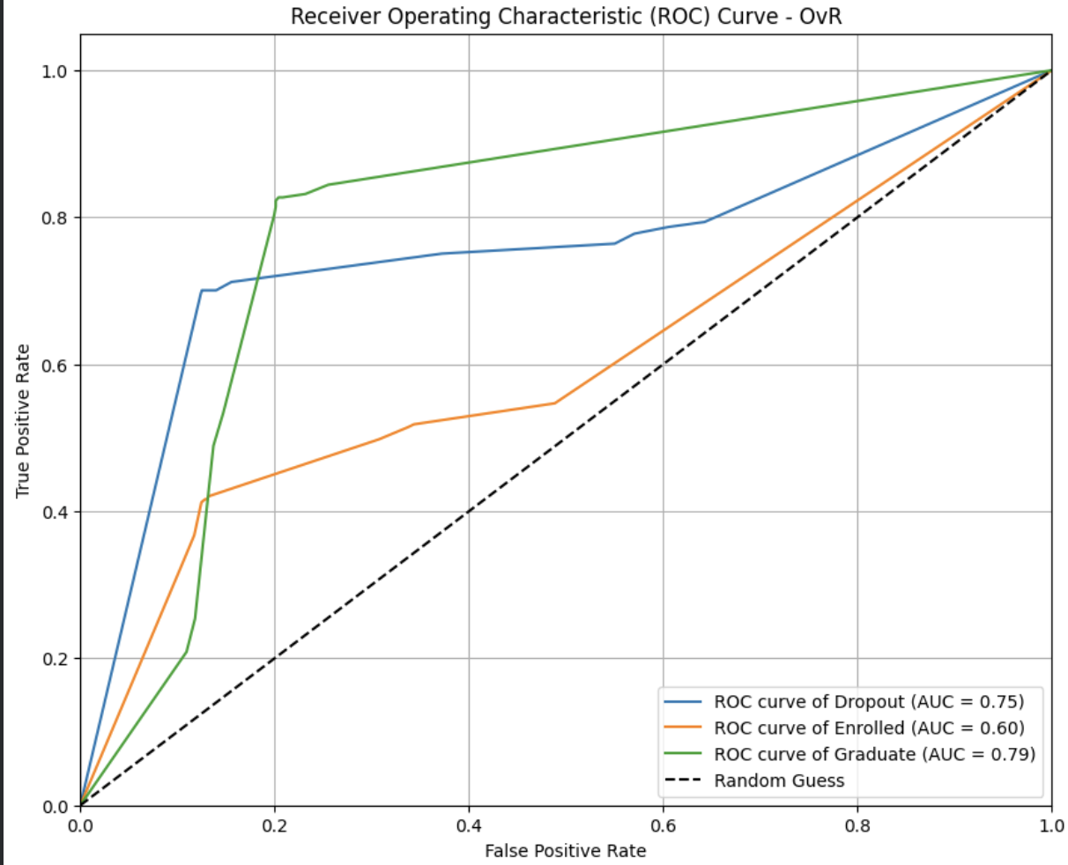
ROC Curve
Despite the initial class imbalance, applying SMOTE oversampling combined with hyperparameter tuning significantly improved the Decision Tree model's ability to classify student outcomes.
Particularly enhancing the recall for the minority 'Enrolled' class, thus providing a more robust and fair predictive system

Slide 12
Conclusions & Recommendations
Summary: Retention is predictable and follows clear patterns.
Strategic Plan:
Financial: Automated counseling triggers for late tuition (Addressing RQ2).
Academic: Intervention for students with <50% approved units in Sem 1 (Addressing RQ1).
Technical: Deploy model to generate weekly "Risk Scores" (Addressing RQ4).

Slide 13
REFERENCES
Martins, M. V., Tolledo, D., Machado, J., Baptista, L. M. T., & Realinho, V. (2021). Early prediction of student's performance in higher education: A case study. Trends and Applications in Information Systems and Technologies, 1, 176–185. _16
Realinho, V., Vieira Martins, M., Machado, J., & Baptista, L. (2021). Predict Students' Dropout and Academic Success [Dataset]. UCI Machine Learning Repository.

Slide 14
Thank You!
Questions?
Data Mining with Information Visualization
University of Texas at Arlington

