Slide 1
MetaSync File Synchronization Across Multiple Untrusted Storage Services
Seungyeop Han (syhan@cs.washington.edu)
Haichen Shen, Taesoo Kim*, Arvind Krishnamurthy, Thomas Anderson, and David Wetherall
University of Washington
*Georgia Institute of Technology

Slide 2

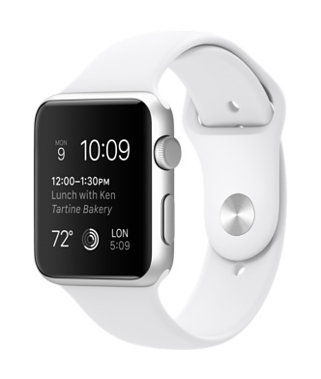






File sync services are popular
400M of Dropbox users reached in June 2015

Slide 3
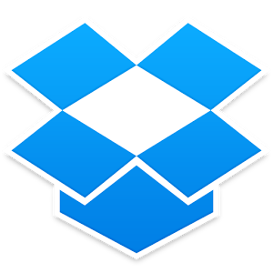




Many sync service providers
Dropbox (2GB)
Google Drive (15GB)
Baidu(2TB)
MS OneDrive (15GB)
Box.net (10GB)

Slide 4
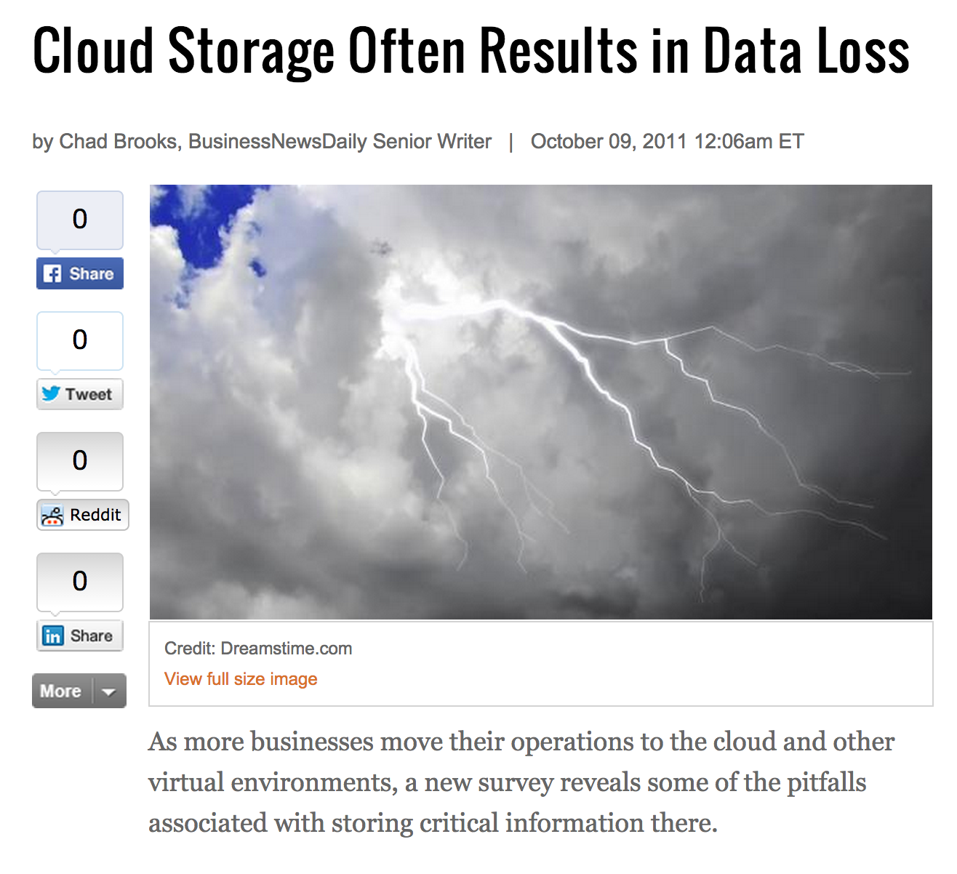
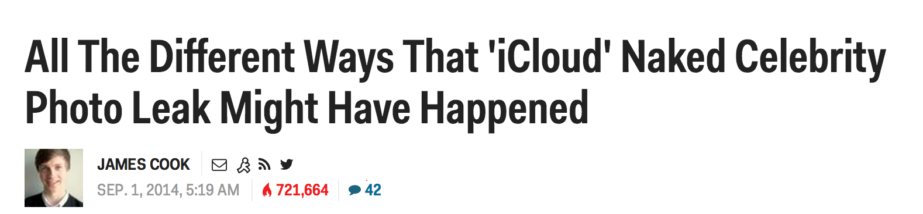
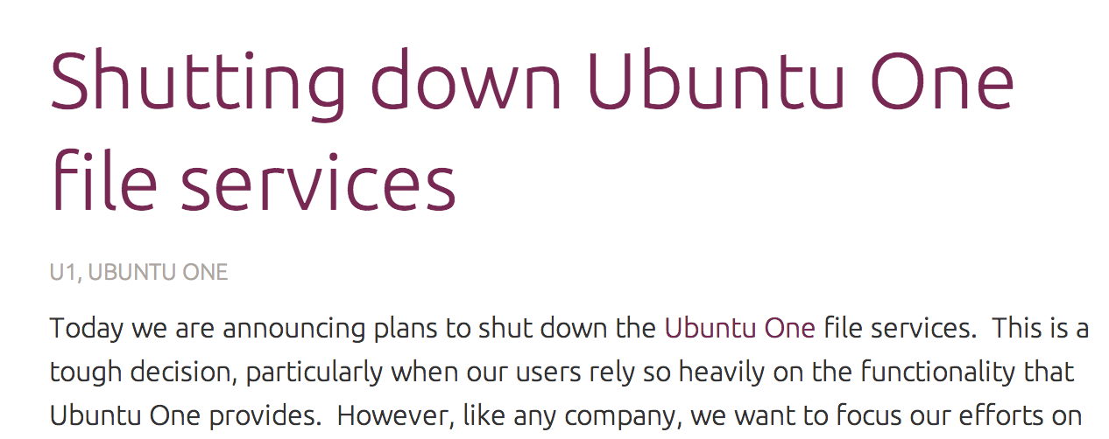
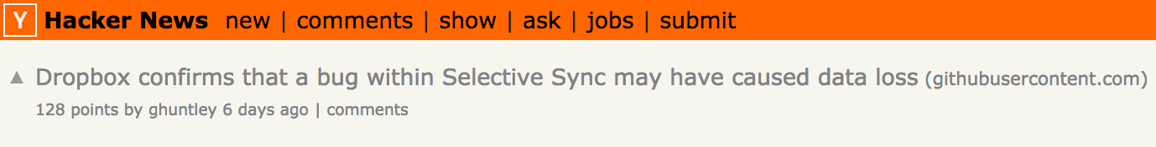
Can we rely on any single service?

Slide 5
Existing Approaches
Encrypt files to prevent modification
Boxcryptor
Rewrite file sync service to reduce trust
SUNDR (Li et al., 04), DEPOT (Mahajan et al., 10)

Slide 6
MetaSync
Higher availability, greater capacity, higher performance
Stronger confidentiality & integrity
MetaSync:
Can we build a better file synchronization
system across multiple existing services?

Slide 7
Goals
Higher availability
Stronger confidentiality & integrity
Greater capacity and higher performance
No service-service, client-client communication
No additional server
Open source software

Slide 8
Overview
Motivation & Goals
MetaSync Design
Implementation
Evaluation
Conclusion

Slide 9
Key Challenges
Maintain a globally consistent view of the synchronized files across multiple clients
Using only the service providers’ unmodified APIs without any centralized server
Even in the presence of service failure

Slide 10
Design Choices
How to manage files?
Content-based addressing & hash tree
How to update consistently with unmodified APIs?
Client-based Paxos (pPaxos)
How to spread files?
Stable deterministic mapping
How to protect files?
Encryption from clients
How to make it extensible?
Common abstractions

Slide 11
Design Choices
How to manage files?
Content-based addressing & hash tree
How to update consistently with unmodified APIs?
Client-based Paxos (pPaxos)
How to spread files?
Stable deterministic mapping
How to protect files?
Encryption from clients
How to make it extensible?
Common abstractions

Slide 12
Overview of the Design
MetaSync
1. File Management
Object
Store
Synchronization
Replication
Backend abstractions
Local Storage
Dropbox
Google
Drive
OneDrive
Remote
Services

Slide 13
Object Store
Similar data structure with version control systems (e.g., git)
Content-based addressing
File name = hash of the contents
De-duplication
Simple integrity checks
Directories form a hash tree
Independent & concurrent updates

Slide 14
Object Store
head = f12…
Dir1
Dir2
Large.bin
abc…
4c0…
20e…
small1
small2
blob
blob
blob
Files are chunked or grouped into blobs
The root hash = f12… uniquely identifies a snapshot

Slide 15
Object Store
old = f12…
head = 07c…
Dir1
Dir2
Large.bin
Large.bin
abc…
4c0…
20e…
1ae…
small1
small2
blob
blob
blob
blob
Files are chunked or grouped into blobs
The root hash = f12… uniquely identifies a snapshot

Slide 16
Overview of the Design
MetaSync
2. Consistent update
Object
Store
Synchronization
Replication
Backend abstractions
Local Storage
Dropbox
Google
Drive
OneDrive
Remote
Services

Slide 17
Updating Global View
Head
Current root hash
Client1
Prev
Previously synchronized point
Global
View
v0 ab1…
Client2
Prev
Head
master

Slide 18
Updating Global View
v1 c10…
Client1
Prev
Head
Global
View
v0 ab1…
Client2
Prev
Head
master

Slide 19
Updating Global View
Head
Client1
Prev
Global
View
v0 ab1…
v1 c10…
Client2
Prev
Head
master

Slide 20
Updating Global View
Head
Client1
Prev
Global
View
v0 ab1…
v1 c10…
Client2
Prev
Head
master

Slide 21
Updating Global View
v2 f13…
Client1
Prev
Head
Global
View
v0 ab1…
v1 c10…
Client2
Prev
Head
v2 7b3…
master

Slide 22
Updating Global View
v2 f13…
Client1
Prev
Head
Global
View
v0 ab1…
v1 c10…
v2 7b3…
Client2
Prev
Head
master

Slide 23
Updating Global View
v3 a31…
Client1
Prev
Head
Global
View
v0 ab1…
v1 c10…
v2 7b3…
Client2
Prev
Head
master

Slide 24
Consistent Update of Global View
Dropbox
Google
Drive
OneDrive
MetaSync
MetaSync
root= f12…
root= b05…
Need to handle concurrent updates, unavailable services based on existing APIs

Slide 25
Paxos
Multi-round non-blocking consensus algorithm
Safe regardless of failures
Progress if majority is alive
Proposer
Acceptor

Slide 26
Metasync: Simulate Paxos
Use an append-only list to log Paxos messages
Client sends normal Paxos messages
Upon arrival of message, service appends it into a list
Client can fetch a list of the ordered messages
Each service provider has APIs to build append-only list
Google Drive, OneDrive, Box: Comments on a file
Dropbox: Revision list of a file
Baidu: Files in a directory

Slide 27
Metasync: Passive Paxos (pPaxos)
Backend services work as passive acceptor
Acceptor decisions are delegated to clients
New root = 1
S1
New root = 2
S2
Accepted root = 1
fetch(S1)
S3
fetch(S2)
Clients
Passive Storage Services

Slide 28
Paxos vs. Disk Paxos vs. pPaxos
Disk Paxos: maintains a block per client
Gafni & Lamport ’02
Acceptor
Acceptor
Acceptor
…
computation
disk blocks
append-only
Propose
Accept
Propose
Check
Propose
Check
Proposer
Proposer
Proposer
Paxos
Disk Paxos
pPaxos
require
Requires acceptor API
# msgs
O(acceptors)
O(clients x acceptors)
O(acceptors)

Slide 29
Overview of the Design
MetaSync
3. Replicate objects
Object
Store
Synchronization
Replication
Backend abstractions
Local Storage
Dropbox
Google
Drive
OneDrive
Remote
Services

Slide 30
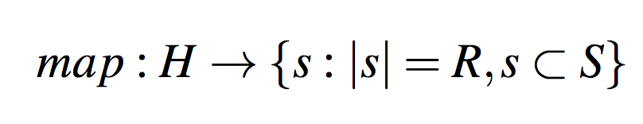
Stable Deterministic Mapping
MetaSync replicates objects R times across S storage providers (R<S)
Requirements
Share minimal information among services/clients
Support variation in storage size
Minimize realignment upon configuration changes
Deterministic mapping
E.g., map(7a1…) = Dropbox, Google

Slide 31
Implementation
Prototyped with Python
~8k lines of code
Currently supports 5 backend services
Dropbox, Google Drive, OneDrive, Box.net, Baidu
Two front-end clients
Command line client
Sync daemon

Slide 32
Evaluation
How is the end-to-end performance?
What’s the performance characteristics of pPaxos?
How quickly does MetaSync reconfigure mappings?

Slide 33
Evaluation
How is the end-to-end performance?
What’s the performance characteristics of pPaxos?
How quickly does MetaSync reconfigure mappings?

Slide 34
End-to-End Performance
Synchronize the target between two computers
 | Dropbox | Google | MetaSync
Linux Kernel 920 directories 15k files, 166MB | 2h 45m | > 3hrs | 12m 18s
Pictures 50 files, 193MB | 415s | 143s | 112s
(S = 4, R = 2)
Performance gains are from:
Parallel upload/download with multiple providers
Combined small files into a blob

Slide 35
Latency of pPaxos
Latency is not degraded with increasing concurrent proposers
or adding slow backend storage service

Slide 36
Latency of pPaxos
Latency is not degraded with increasing concurrent proposers
or adding slow backend storage service

Slide 37
Conclusion
MetaSync provides a secure, reliable, and performant files sync service on top of popular cloud providers
To achieve a consistent update, we devise a new client-based Paxos
To minimize redistribution, we present a stable deterministic mapping
Source code is available:
http://uwnetworkslab.github.io/metasync/

