Slide 1
Practical Predictive Analytics Seminar
2021-09-30
Basic Data Manipulation and Exploration Tools and Language - Python
Nick Hanewinckel, FSA, CERA, MAAA, AVP and Lead Data Scientist - SCOR
Sidharth Sadani, ASA, Senior Data Scientist - SCOR

Slide 2
Basic Data Manipulation and Exploration Tools and Language - Python
Agenda
Intro to Python – setup, environments, package management, notebooks
Getting Started: pandas, loading data, and more
Basic Data Analysis and Manipulation
Transformations, Encodings, and Pipelines
Introduction to Data Visualization

Slide 3
Follow Along at Home
All code used (and further examples), as well as the .yml file to recreate our environment are on GitHub
https://github.com/hanewinckel/ppas-python

Slide 4
What is Python?
A Multi-paradigm, object-oriented, functional, procedural, interpreted (i.e. not compiled) language
A general programming language – i.e. not “statistics” or “data-science”-specific
A high-level language with the goal of interpretability
Core philosophy:
Beautiful is better than ugly
Explicit is better than implicit
Simple is better than complex
Complex is better then complicated
Readability counts

Slide 5
Why Python?
Readability
Extensive support within the data science community
Variety of IDEs (e.g. Jupyter Notebook)
Common language – relatively easy integration with APIs
Many available packages for extra functionality

Slide 6

Why not R?
Wait!
But…
Not getting into an R/Python debate!
I have used R in professional practice to great success!
I even like Rstudio better than JupyterLab
Increasing use of Python
Many useful tools and models (e.g. keras, xgboost, Spark) are either native to or better implemented for Python
May be easier to integrate into existing IT systems
Python skills more common in market*
Notes:
R is also a high-level, readable, object-oriented, functional, procedural, interpreted language
Actuaries/statisticians may be divided, but those from a dev background are more likely to be familiar with Phtyon
Some data scientists even believe that Jupyter has the ability to make you more stupider.

Slide 7
Setup
What we use
Python 3.x
JupyterLab (Jupyter Notebook is good too!)
Anaconda is a great software package containing both as well as DS libraries
miniconda is a smaller version of the above
Install for “just me” to avoid the need for admin rights
Links
https://www.anaconda.com/
https://www.python.org/
https://jupyter.org/
Notes:
We will not go over installation, etc since everyone will have differen operating systems, IT requirements, etc
Assume we are up and running with jupyter lab

Slide 8
(virtual) Environments and Packages
Package – reusable, repeatable code module(s) giving new functionality. Examples:
pandas: data analysis (DataFrames)
scikit-learn: machine learning tools and models
datatable: similar to pandas, but running in c (a compiled language) behind the scenes for speed
Couldn’t these packages conflict? Or be affected by updates?
lol, tell me about it
How do you keep them from breaking?
Containing packages in a project-specific virtual environment isolates them from each other
Virtual environment?
conda is an open-source package management system
There is also one called pip
Trust me, conda is better, but you may have to sometimes use pip for packages not yet available in a conda channel (e.g. latest datatable)

Slide 9
How do I get a package?
Examples with real-life packages in command line shell (cmd, linux (bash), etc)
conda install python | This does the job most of the time
conda install -c conda-forge scikit-learn | Sometimes you need to specify the channel
pip install datatable | Deprecated pip method (still usable)
python –m pip install datatable | Updated pip method call

Slide 10
All-in-one: Create Environment With All Needed Packages
Clone this project for all you need. In your shell: git clone git@github.com:hanewinckel/ppas-python.git
You now have a folder called ppas with all subdirectories you see in GitHub
You can create the environment from the config subdirectory:
conda env create –f config/ppas_environment.yml
New environment gets its name from the .yml file itself (ppas), so no need for the –n argument!

Slide 11

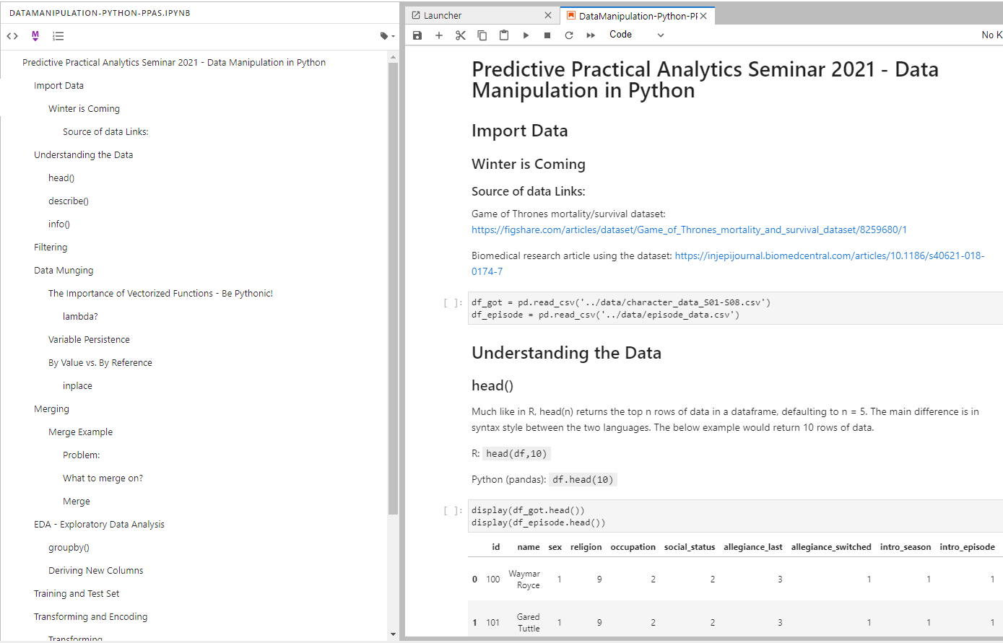

What is a notebook (.ipynb)?
What is it?
Example in Juypyter Lab
Report Text
A dream for auditability (results derived directly from source)
Combines project documentation, code, and code results in once
Markdown = lightweight markup language with:
Text Formatting
Section Hierarchy and Table of Contents
Equations (See above)
Much more
Code results can be anything: plots, tables, pictures, etc
Generate report in html, markdown, , (gorgeous) PDF, or even Word (but…like…why?)
Code Cells
Code Output
Warning: ‘dark mode’ only approved for slick, super-cool actuaries/data scientists
Notes:
You can see the table of contents at left of the notebook

Slide 12
pandas, Data Loading, and More!

Slide 13
A Game of pandas
GOT Data
Code
Survival/mortality data in the repo (and publicly)
Data from Game of Thrones
The show, not the books
Read and do some preliminary EDA
df_got = pd.read_csv(
'../data/character_data_S01-S08.csv’)
df_episode = pd.read_csv(
'../data/episode_data.csv’)
display(df_got.head())
display(df_episode.head())
df_got.describe()
df_got.info()
Note the object model
Does its reference chain remind you of vba?
Not only can you indent when continuing a line, you have to. Python uses significant indentation.
Notes:
Talk about this object model
That read_csv() is returning a pandas data frame, we assign it. Now we have those data frames.
The period is referencing an object belonging to the parent object. In this case, the methods (functions) defined for a data frame (describe, head)

Slide 14
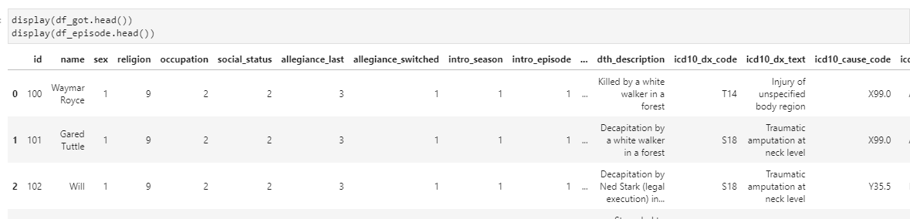

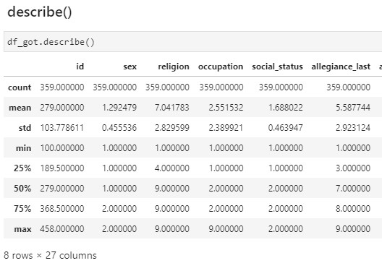
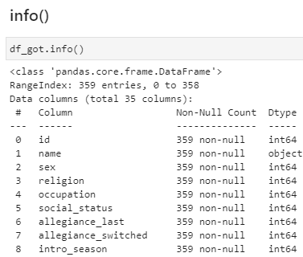
The results

Slide 15
Filtering
Nest
#1 inside #2
Essential in Every Case
A Recipe
df[<logical statement>]
returns a Series of True/False values
(1 True/False value x row)
df[<Series of True/False Values>]
returns the True rows from the DataFrame
Notes:
By now, life ins data is perfect, error free, and the business is stable over time so no need to adjust ;)
Point out you can’t start at 0, but Python does and THIS IS DIFFERENT FROM R

Slide 16
The Late Seasons
Suppose you wanted to analyze past Season 2 of GOT
df_got[df_got['intro_season'] > 2]
Chain logicals with & and |¹, but separate with ():
df[(df[condition1])&((df[condition2])|(df[condition3]))]
And / Or

Slide 17
Pythonic Code and Vectorized Functions
Take advantage of:
list comprehension: [for statement] faster than a for loop
Built-in functions
ex: pd.df.apply() & pd.Series.str.replace()
python map() with lambda()¹
Temporary anonymous function you define. map(lambda x: x+5,df[‘column’]) will add 5 to each element of column due to the lambda function x+5
Notes:
Don’t let the terms scare you – this just means: take advantage of the language’s functions. Looping tends to be less efficient than ingrained methods.
Built-in functions are often fastest
They may be compiled in faster languages like C

Slide 18
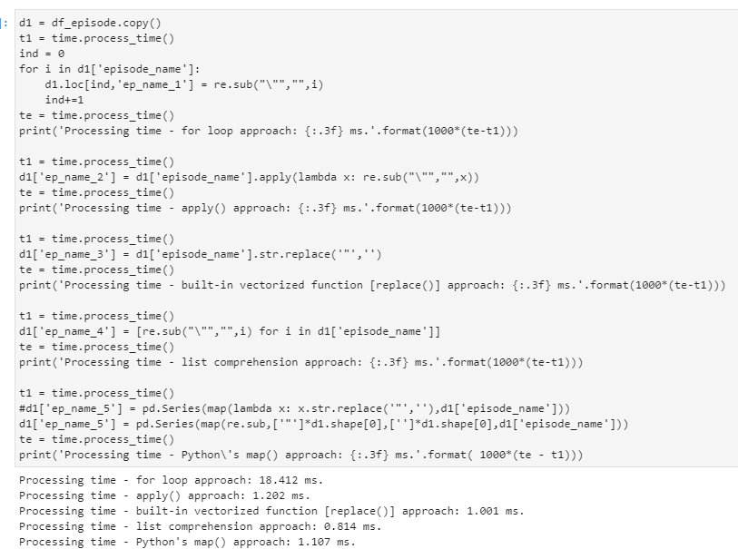
Pythonic Race
Time to switch to JupyterLab
Notes:
This is a thing on GOT!
Speaking of races, we’ll go much faster on JupyterLab!
It’s getting hard to see here, and we can zoom in on Jupyter!

Slide 19
By Value / By Reference
By Value
Refers to the value a variable stores in memory
The original object remains unchanged
By Reference
Refers to the actual object
The original object can change
- This is true for a chain of references!
Examples:
pandas functions that use the default inplace=False argument
Objects (including pandas dataframes and series) that use the .copy() function
Examples:
pandas functions that use the inplace=True argument
Assigning value to a pandas DataFrame or Series without .copy()
Chain of references:
df1 = df
df1[‘column’] = 5
Changes ‘column’ of df!
df1 “points” to df.

Slide 20
Merging, EDA, Transforming, Encoding
This will be illustrated in JupyterLab

Slide 21
Plotting
This will be illustrated in JupyterLab
We use seaborn – a high-level interface for matplotlib.
For more ideas in seaborn, see https://seaborn.pydata.org/

Slide 22

Questions?
Notes:
Used various methods to strip quotation marks from the episode names in the episodes dataset
The code is complex. Check out on github

