Slide 1
Matroid-Based TSP Rounding for Half-Integral Solutions
Heather Newman (CMU) and Sherry Sarkar (CMU)
IPCO 2022
Joint work with: Anupam Gupta (CMU), Euiwoong Lee (U. Michigan), Jason Li (Simons and UC Berkeley), Marcin Mucha (Warsaw)

Slide 2
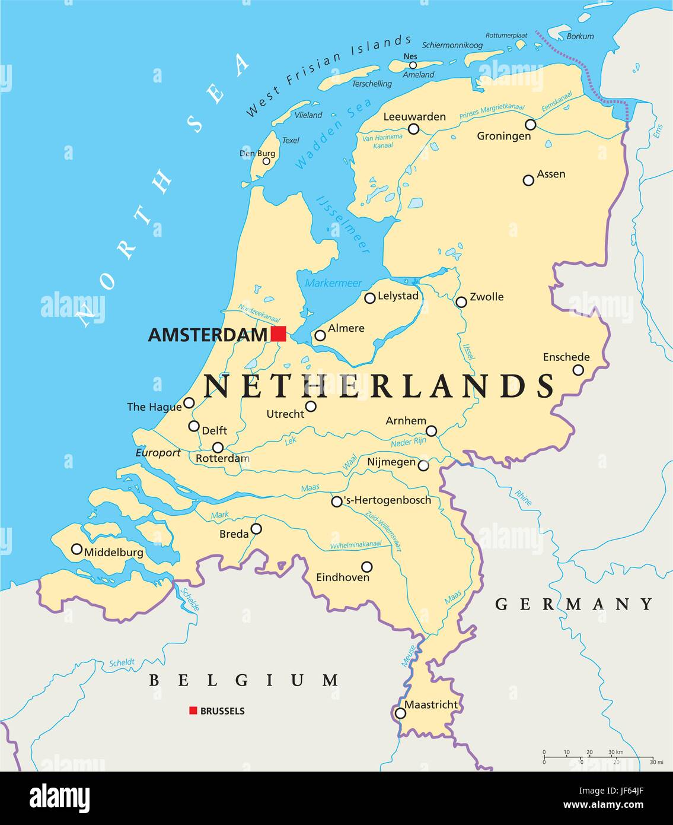
The Traveling Salesperson Problem
The problem. Input – n points in a metric space.
Output – shortest tour traversing all n points (Hamiltonian tour)
Christofides-Serdyukov algorithm (1976) yields a ³⁄2 approximation (which remained the best for decades)!
NP-hard to approximate length of shortest tour by a factor of ¹²³⁄122

Slide 3
Christofides-Serdyukov Algorithm
Minimum spanning tree T (cost OPT)
+
Min weight perfect matching on set O of odd degree vertices of T (cost ½ OPT)
=
Eulerian tour (cost ³⁄2 OPT)
↓
(shortcutting)
Hamiltonian tour (cost ³⁄2 OPT)

Slide 4
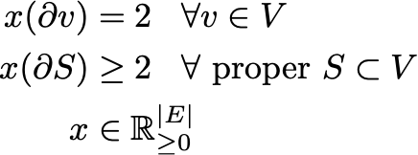


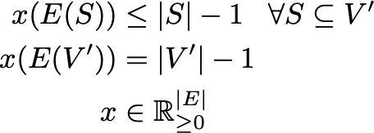
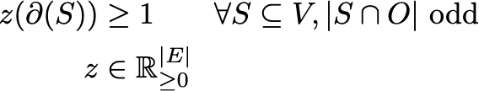
Fractional Version of Christofides-Serdyukov
Subtour Elimination Polytope (LP-TSP)
* = exact formulation
Spanning Tree Polytope (LP-SPT)*
O-join Dominator Polytope (LP-Ojoin)*
For us: O = odd degree vertices of a spanning tree T
O-join = subset E’ of edges such that E’ ⋃ E(T) is Eulerian (generalization of perfect matching on O)
Consequence: ³⁄2 integrality gap on LP-TSP!

Slide 5
Motivating Conjecture
What is the integrality gap of LP-TSP?
Conjecture (Schalekamp, Williamson, van Zuylen, 2014): integrality gap is attained on instances where LP-TSP has optimal half-integral solutions (x_{e} ∈ {0, ½, 1}).
WLOG, half-integral solution implies support graph is 4-regular, 4 edge-connected

Slide 6
Our Main Result
Theorem: Let x be a half-integral solution to LP-TSP with cost c(x). There is a randomized algorithm that rounds x to an integral solution whose cost is at most (1.5 - 𝜺)·c(x), where 𝜺 = 0.001695.
Previously:
Karlin, Klein, Oveis Gharan, 2019 (KKO19): 𝜺 = 0.00007 for half-integral solutions to LP-TSP
Karlin, Klein, Oveis Gharan, 2021 (KKO21): 𝜺 = 10⁻³⁶ for general solutions to LP-TSP
We will use the Christofides-Serdyukov Framework: find a spanning tree T with expected cost OPT_{LP-TSP}, an O-join with expected cost < ½ OPT_{LP-TSP}

Slide 7

Step 1: Sample spanning trees for 4-regular, 4 edge-connected graphs with no proper min-cuts (all min-cuts are singleton cuts, all proper cuts have size at least 6)
Goal: Sample a spanning tree T such that any given edge is even with constant probability (w.c.p.)

Slide 8
A Desirable Property: Even Edges
Goal: Sample a spanning tree T respecting marginals with the property that every edge is even with constant probability (w.c.p.)
Even edge: both endpoints have even degree in T
x in LP-TSP → z = ^{x}⁄2 in LP-Ojoin
Lower cost of O-join by decreasing z on even edges

Slide 9

Making a Feasible O-join: Graphs with no proper min cuts
We win at even edges.
For all even edges, z = ^{x}⁄3 = ⅙ .
Otherwise, take z = ^{x}⁄2 = ¼
O-join Dominator Polytope (LP-Ojoin)
All proper cuts have mass at least ⅙ ᐧ 6 = 1
All singleton cuts that are odd in T still have mass ¼ ᐧ 4 = 1
z is a feasible O-join!
If any edge is even with probability p → fractional O-join with expected cost (½ − ^{p}⁄6)OPT_{LP-TSP}.
There exists a Hamiltonian tour with cost at most (³⁄2 − ^{p}⁄6)OPT_{LP-TSP}.

Slide 10
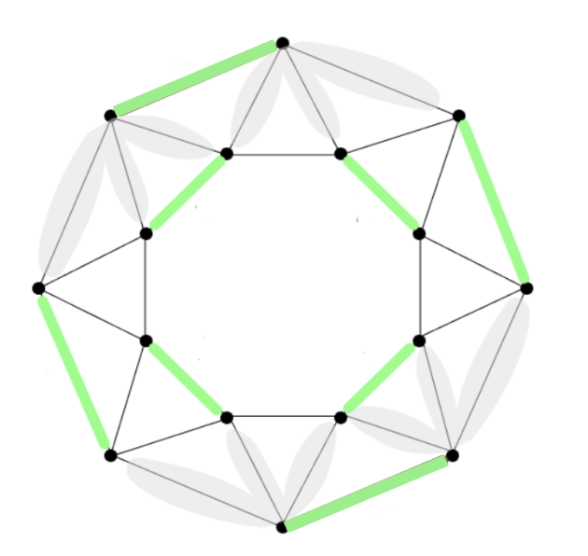
Shifting Strategy
Key Technique: Randomly shift ½ - valued x to 1,⅓ -valued y
Sample perfect matching M with marginals ^{x}⁄2 = ¼.
E[y]=x
y(e) = 1 for e ∈ M, y(e) = ⅓ o.w.
1
⅓
⅓
⅓
⅓
⅓
⅓
⅓
⅓
⅓
1
1
1
⅓
⅓
⅓
⅓
⅓
No proper min cuts → y in LP-TSP
y in LP-TSP implies y in r-tree matroid polytope (spanning tree plus one edge)
Use y as marginals for tree samplers
⅓
1
⅓
1
1
⅓
⅓
⅓
⅓
⅓
⅓
⅓
⅓
1
(after Haddadan and Newman, 2019)

Slide 11
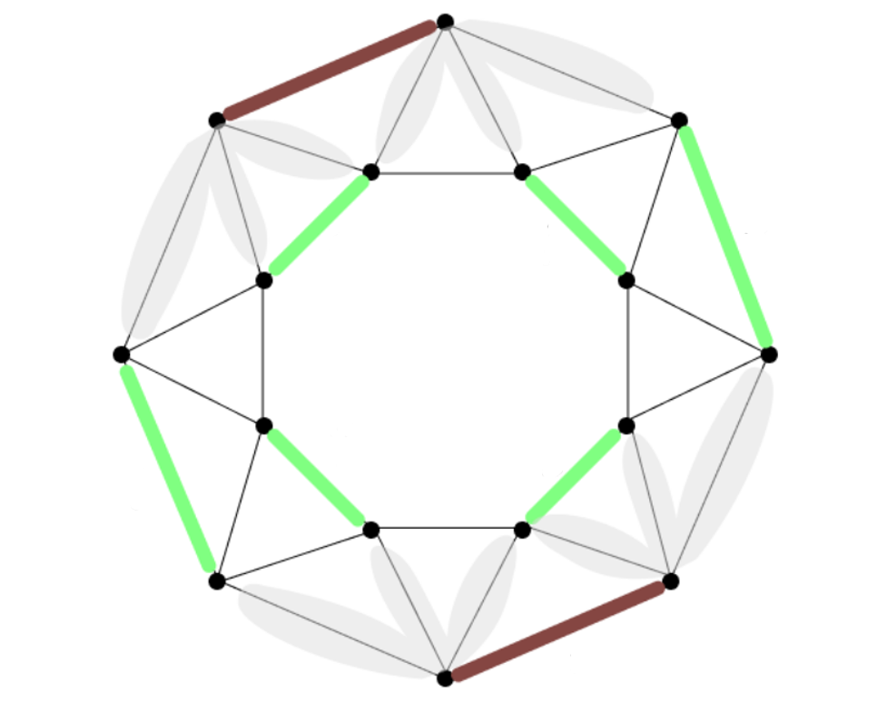
Sampler 1 via Matroid Intersection*
even edge
1
⅓
⅓
⅓
⅓
⅓
1
Matroid intersection polytope is integral
Intersect r-tree matroid and partition matroid
⅓
1
1
⅓
⅓
⅓
1
⅓
1
1
⅓
Upshot: every edge in the MatInt Sampler is even w.c.p.!
⅓
⅓
⅓
⅓
1
M = green edges
even edge
*Haddadan and Newman, 2019, handle |V| even; we extend to |V| odd

Slide 12
Sampler 2 via Max Entropy
KKO19 sample trees from the max entropy distribution subject to respecting the marginals x.
Key Technique: we instead sample from a distribution respecting y, the shifted solution
Use negative correlation properties to show every edge is even w.c.p.
Using marginals x instead of y does not seem to yield that every edge is even w.c.p.

Slide 13
Upshot: we have two samplers, MatInt and MaxEnt, for 4-regular, 4 EC graphs with no proper min cuts, each with the property that every edge is even w.c.p.

Slide 14
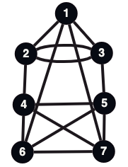
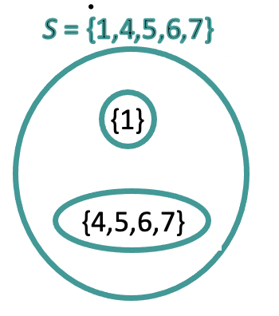
Pieces for Sampling: Contracted Graphs*
G
* KKO19 sample from these pieces as well

Slide 15
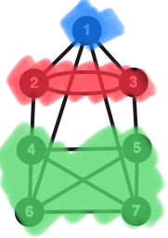
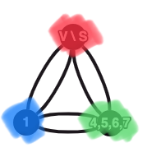

Pieces for Sampling: Contracted Graphs
Contract each child, then contract the remaining vertices
external vertex
Edge (1,6) settled at S
G

Slide 16
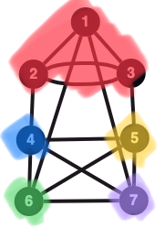
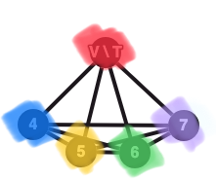
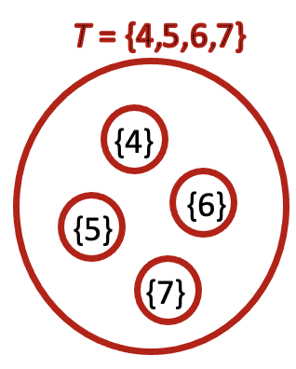

Pieces for Sampling: Contracted Graphs
Contract each child, then contract the remaining vertices
external vertex
external vertex
Edge (1,6) settled at S
(1,6) external
G

Slide 17
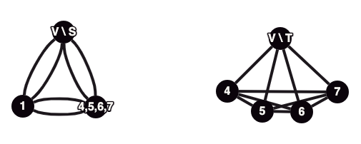
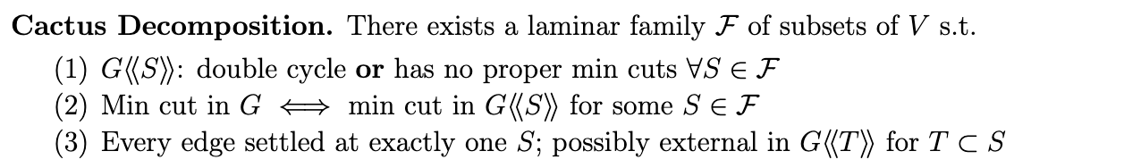
Pieces for Sampling: Contracted Graphs
Contract each child, then contract the remaining vertices
external vertex
external vertex
Edge (1,6) settled at S
(1,6) external
G

Slide 18
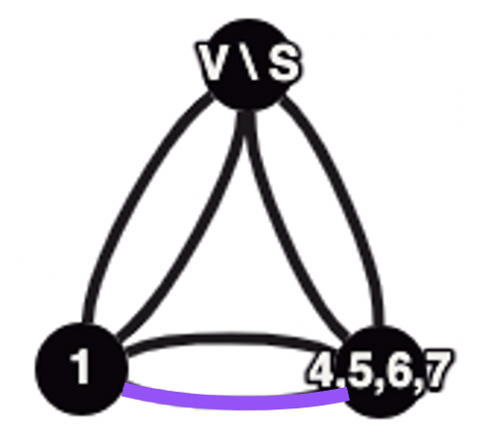
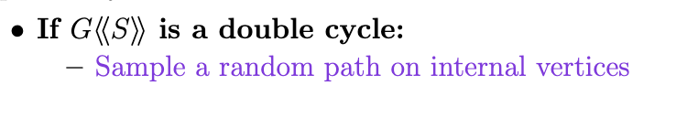
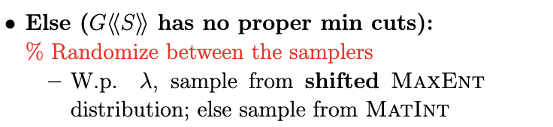
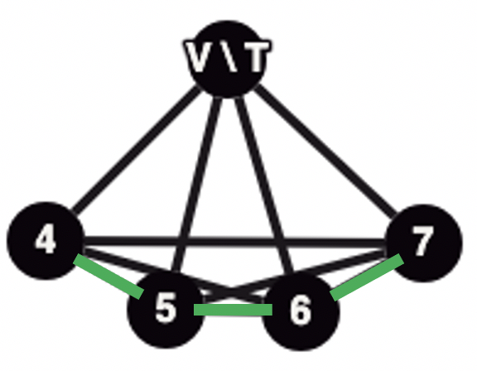
Our Algorithm

Slide 19
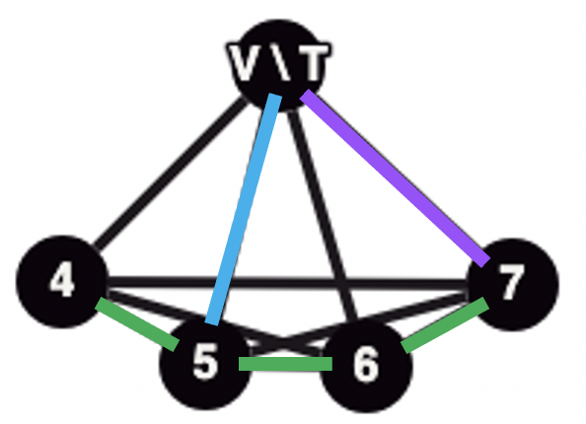
Even-at-Last (EAL) Property
For case of no proper min cuts, we desired every edge is even w.c.p.
Generalization: every edge is “even-at-last (EAL),” i.e. even at the level at which it is settled, w.c.p.
EAL edge: both endpoints even in T
Lower z_{e} = ¼ → no O-join constraints corresponding to cuts at this level become violated
Stronger property than KKO19 - proves every min cut contains an edge that is EAL w.c.p.

Slide 20
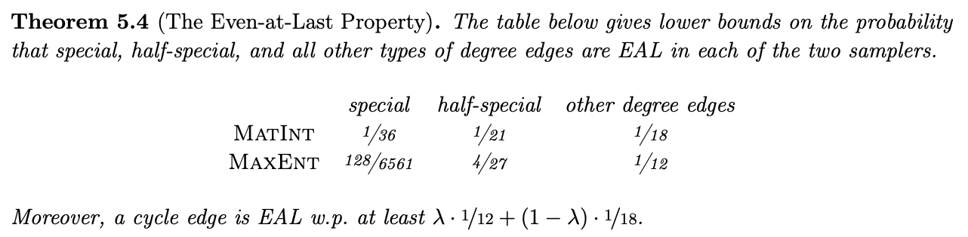
Even-at-Last (EAL) Property

Slide 21
Beating ½ : Construction of Fractional O-join
Reduction Scheme:
Assume each edge is EAL w.p. p
Reduce an edge from z_{e} = x_{e} / 2 = ¼ when it is EAL
Feasibility:
This initial reduction scheme will make z infeasible
Raise some z_{e} values (“charge”) to correct for deficient cuts, but show there is still a net reduction on each edge

Slide 22
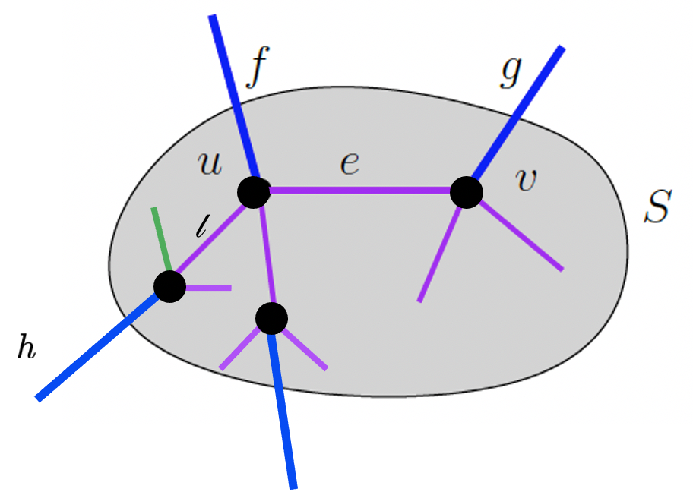
Flow-based Charging Argument
✓
✓
e EAL → reduce
-𝝉
No cuts deficient

Slide 23
Flow-based Charging Argument
KKO 19: distribute charge uniformly
New approach: set up a flow problem to distribute the charge from the blue edges across the internal edges such that the charge that any edge receives is minimized
To gain from flow formulation, need to treat K₅ separately in the sampler and reduction scheme
-𝛃
f reduced and 𝜹(u) odd in T
✕
↓
𝜹(u) deficient
↓
charge

Slide 24
Flow-based Charging Argument
KKO 19: distribute charge uniformly
New approach: set up a flow problem to distribute the charge from the blue edges across the internal edges such that the charge that any edge receives is minimized
To gain from flow formulation, need to treat K₅ separately in the sampler and reduction scheme
KKO19: distribute charge uniformly
-𝛃
Why can we do better?
+ ^{𝛃}⁄3
New approach: set up a flow problem to distribute the charge from the blue edges across the internal edges such that the charge that any edge receives is minimized
To gain from the flow formulation, need to treat K₅ separately in the sampler and reduction scheme
+ ^{𝛃}⁄3
+ ^{𝛃}⁄3
-𝛃

Slide 25
Conclusion
Techniques
Shifting from a half-integral solution to a 1-⅓ solution gives:
A matroid intersection sampler that allows us to “hand-pick” even edges
A max entropy sampler that has a stronger property of evenness than in KKO19
Flow-based charging argument leads to improvements in lowering the cost of the O-join
Treating the K₅ case separately enables a gain from flow-based charging
Questions
Can the techniques be extended beyond half-integral solutions?

Slide 26
Thank You!

