Slide 1
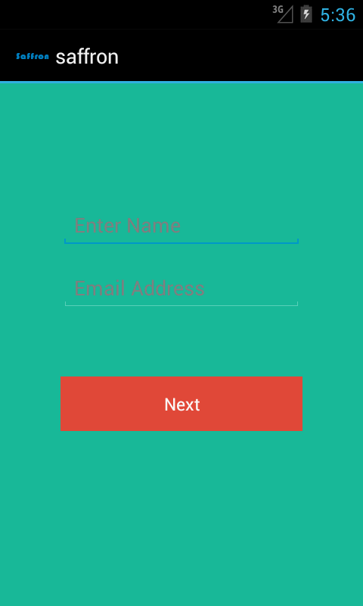
Customer name and email address is send to next activity main_activity using intent class.

Slide 2
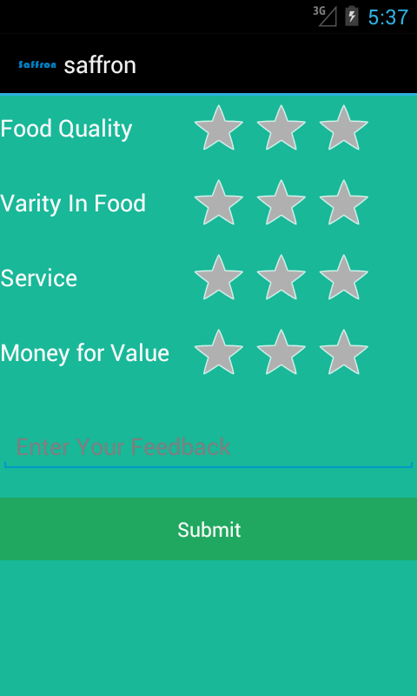
Customer gave rating and write feedback after that all this information is send to server by creating http connection to it.
PHP page receives information from post event and send email to the owner/manager of restaurant.

