Slide 1
Git
Fei Han

Slide 2
Contents
What is Git?
Install Git?
Git Concepts and Architecture
Making change to files
Use Git with a real project
Undoing changes
Ignoring files
Navigating the commit tree
Branching
Merging branches
Stashing changes
Remote

Slide 3
What is Git?
Git is a software keeps track of changes
Especially text changes
Version1, version2,
Version control system (VCS)
For source code management (SCM)

Slide 4
Examples of Version Control
Non-source code
File naming (v1, v2…)
Microsoft Word’s Track changes
Adobe photoshop’s history
Wikis
Undo: control+z (Windows), command+z (Mac)

Slide 5
History
Source Code Control System (SCCS)
1972, closed source, free with Unix
Revision Control System (RCS)
1982, open source
Concurrent Version System (CVS)
1986-1990, open source
Many people work together
Apache Subversion (SVN)
2000, open source

Slide 6
History
BitKeeper SCM
2000, closed source, proprietary
Distributed version control
“Community version” was free
Used for source code of the Linux kernel from 2002-2005
Controversial to use proprietary SCM for an open source project
April 2005, the “community version” not free anymore

Slide 7
Git
April 2005
Created by Linus Torvalds
Replacement for BitKeeper to manage Linux kernel source code
Distributed version control
Open source and free
Compatible with Unix-like systems (Linux, Mac OS X, and Solaris) and Windows
Git is a hit

Slide 8
Distributed Version Control
Different users (or teams of users) maintain their own repositories, instead of working from a central repository
Changes are stored as “changes sets” or “patches”
Tracks changes, not versions
Different form CVS and SVM, which track versions
Change sets can be exchanged between repositories
No single master repository; just many working copies
Each with their own combination of change sets

Slide 9
Distributed Version Control
No need to communicate with a central server
Faster
No network access required
No single failure point
Encourages participation and forking of projects
Developers can work independently
Submit change sets for inclusion or rejection

Slide 10
Who should use Git?
Anyone wanting to track edits
Review a history log of changes made
View difference between versions
Retrieve old versions
Anyone needing to share changes with collaborators
Anyone not afraid of command-line tools

Slide 11
Installing Git
http://git-scm.com
Github instructions
Tool - Bit Bash
git --version
2.17.0
Which git

Slide 12
Configuring Git
System level
/etc/gitconfig
Program Files \Git\etc\gitconfig
User level
~/.gitconfig
$HOME\.gitconfig
Project level
my_project/.git/config

Slide 13
Configuration
System
git config --system
User
git config --global
Project
git config
Git config --global user.name “Fei Han”
Git config --global user.email “feihan@umbc.edu”
To Check: git config user.name, git config user.email

Slide 14
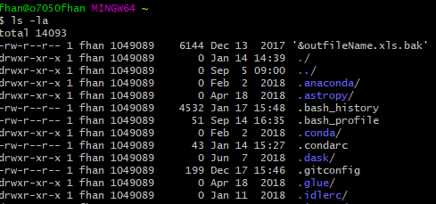
Check configuration
$ ls -la
See .gitconfig
$ cat .gitconfig

Slide 15
Git Auto-completion
…
Using Git Help
$git help

Slide 16
Getting Started
Initializing a repository
Go to the folder you want track
$git init
$ls
$ls -la
$ls -la .git

Slide 17
Perform your first commit
$git add .
$git add file.txt
$git commit -m “initial commit”
Make changes
Add the changes
Commit changes to the repository with a message
One shortcut: add and commit files in one comment
$git commit -am “message”

Slide 18
Writing a commit message
Short single-line summary (less than 50 characters)
Optionally followed by a blank line and a more complete description
Write commit message in present tense, not past tense
Fix bug or fixes bug, not fixed bug
Bullet points are usually asterisks or hyphens
Can add “ticket tracking numbers” from bugs or support requests
Can develop shorthand for your organization
[css, js]
“Bugfix”
“#38405-”

Slide 19
Commit message best practice
Be clear and descriptive
Bad: “fix type”
Good: “Add missing > in project section of HTML”
Bad: “update login code”
Good: “Change user authentication to use Blowfish”

Slide 20
View the commit log
$git log
$git log -n 1 the last commit
$git log --since=2012-06-05
$git log --until==2015-05-05
$git log --author== “Fei”
$git log --grep= “init” #global regular expression search

Slide 21
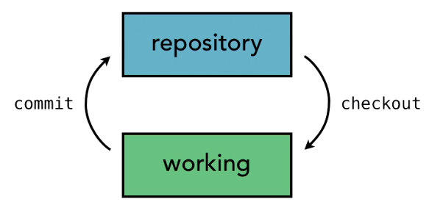
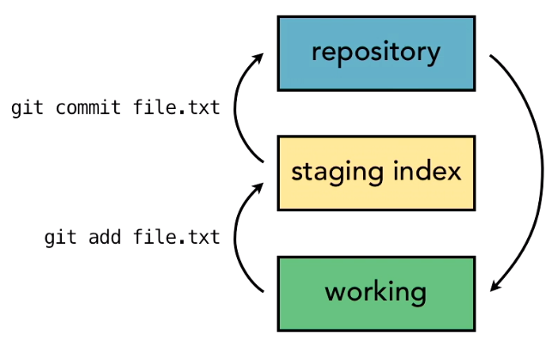
Git concepts and Architecture
Two-tree architecture
The three tree architecture
Git use this architecture
Two-step process

Slide 22
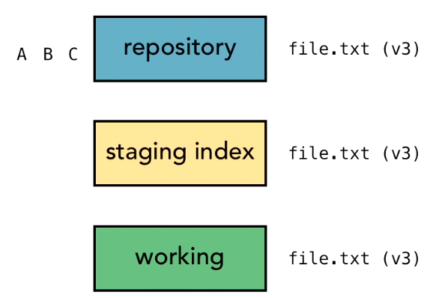
Git Workflow

Slide 23
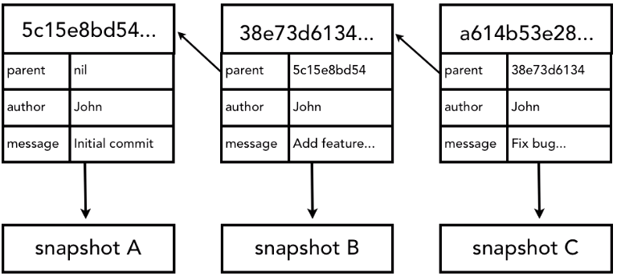
Use Hash Values (SHA-1)
Git generates a checksum for each change set
Checksum algorithms convert data into a simple number
Same data always equals same checksum
Data integrity is fundamental
Changing data would change checksum
Git uses SHA-1 algorithm to create checksums
40-character hexadecimal string (0-9, a-f)

Slide 24
HEAD
Pointer to “tip” of current branch in repository
Last state of repository, what was last checked out
Points to parents of next to commit
Where writing commits takes place
$cd .git
$cat HEAD

Slide 25
Making Changes
$git status
$git add new_file.txt
$git log

Slide 26
Compare changes with diff
$git diff
$git diff filename.txt
Compare files in repository and the file in staging index.
$git diff --staged
Compare files in staging index with file in repository.

Slide 27
Deleting Files
After deleting a file(s), use
$git rm fileName.txt

Slide 28
Rename in Git
$git mv path/old_name.txt path2/new_name.txt

Slide 29
Undoing Changes
Undo changes to the files in working directory from repo
$git checkout -- file_name.txt
Undo changes to the files in staging index (unstage some specific file(s))
$git reset HEAD path/file_name.txt

Slide 30
Amending Commits Message
Only can change the last commit
$git commit --amend -m “new message”
Revert a commit: revert anything done in a commit
$git revert SHA...

Slide 31
Use reset to undo many commits
By default git control HEAD. Git reset change the HEAD
Soft
Does not change staging or working directory, only repository set to early version
Mixed (default)
Changes staging index to match repository, does not change working directory
Hard
Change staging index and working directory to match repository

Slide 32
reset
$git reset --soft SHA
$git reset --mixed SHA
$git reset --hard SHA

Slide 33
Remove untracked file from working directory
$git clean -n
$git clean -f

Slide 34
Ignore files
project/.gitignore
Very basic regular expression
? * [aeiou] [0-9]
Negate expressions with !
*.php
!index.php #do not ignore this file
Ignore all files in a directory with trailing slash assets/videos/
Comment lines begin with #, blank lines are skipped

Slide 35
Demo
$nano .gitignore
In the file,
Tempfile.txt
*.txt
log/*.log

Slide 36
Idea to what to ignore
Compiled source file
Packaged and compressed files
Logs and databases (files change often)
OS generated files
User-uploaded assets (images, PDFs, videos)

Slide 37
Ignoring files globally
Ignore files in all repositories
Settings not tracked in repository
User-specific instead of repository-specific
In user directory, set the file
Edit file .gitignore_global_ first, then confit the file as
$git config --global core.excludesfile ~/.gitignore_global_
Git will not ignore files already tracked even the file is in ignore file.

Slide 38
Stop tracking file
When a file is being tracked, use
$git rm --cached file_name.txt
To remove the file_name.txt from staging index to stopping tracking.

Slide 39
Tracking empty directory
Git is designed to be a file-tracking system
Track files
Track the directories it takes to get to files
Ignore directories with no files
Solution: put a tiny file in the folder
$touch folder/.gitkeep

Slide 40
Navigating the commit tree
Tree-ish
Full SHA-a hash
Short SHA-1 hash
At least 4 characters
Unambiguous (8-10 char)
HEAD pointer
Branch reference, tag reference
Ancestry
Parent commit
HEAD^, acr2383^, HEAD^^,...
HEAD~1, HEAD~: going back 1
HEAD~2, HEAD~3,...

Slide 41
Exploring tree listings
$git help ls-tree
$git ls-tree HEAD
$git ls-tree master

Slide 42
Commit log
$git log --oneline
$git log --oneline -3
$git log --since= “2019-01-01”
$git lot --since= “two weeks ago” --until= “3 days ago”
$git log --since=5.weeks --until=3.days
$git log graph
$git log --oneline --graph --all --decorate

Slide 43
Viewing commits
$git log --oneline
$git show SHA
$git show --format=oneline HEAD

Slide 44
Comparing commits
$git log --oneline
$git diff SHA
$git diff SHA file_name.txt
$git diff --stat --summary SHA..HEAD
$git diff --ignore-space-change _SHA..HEAD

Slide 45
Branch
Branches are cheap
Try new ideas
Isolate features or sections of work
One working directory
Fast context switching
$git branch
.git/refs/heads contains all branches
$git branch New_feature
$git branch

Slide 46
Switching branches
$git checkout new_feature
$git branch
Create and switch branches at the same time
$git log --oneline
$git checkout -b shorten_title #create a new branch and switch to it
$git branch

Slide 47
Compare Branches
$git branch
$git diff branch1..branch2
Compare if one branch completely contains other branches
$git branch --merged

Slide 48
Rename Branches
$git branch
$git branch -m old_branch new_branch
Delete a branch
$git branch -d name_of_branch
$git branch --delete name_of_branch

Slide 49
Configuring the command prompt to show the branch
On Windows
$export PS1= ‘\W$(__git_ps1 “(%s)”) > ’
$nano .bash_profile
Save the command into this file, and save the file in the user directory

Slide 50
Merging Codes
$git branch
Example, at branch master,
$git merge seo_title $git branch --merged

Slide 51
Fast-forward merges vs real merges
Fast-forward merges happens when the master branch has no new commit after current branch occurs.
$git merge branch_name
Do the fast-forward merge

Slide 52
Merge conflicts
When the same content is modified in different branches, automatic merging files to merge this two branch on the this file.
Three ways to resolve conflicts:
Abort merge $git merge --abort
Resolve the conflict manually (most time)
Use a merge tool (many tools) $git mergetool --tool=NameOfTool

Slide 53
Git log graph
$git log --graph --oneline --all --decorate

Slide 54
Strategies to reduce conflicts
Keep lines short
Keep commits small and focused
Beware stray edits to whitespace
Spaces, tabs, line returns
Merge often
Track changes to master

Slide 55
Remote repository
Local and remote repositories
Setting up a GitHub account
http://github.com
Most popular Git host
Free and inexpensive hosting plans
Many great features

Slide 56
GitHua
…or create a new repository on the command line
echo "# Test" >> README.md git init git add README.md git commit -m "first commit" git remote add origin https://github.com/hanfei28/Test.git git push -u origin master
…or push an existing repository from the command line
git remote add origin https://github.com/hanfei28/Test.git git push -u origin master

Slide 57
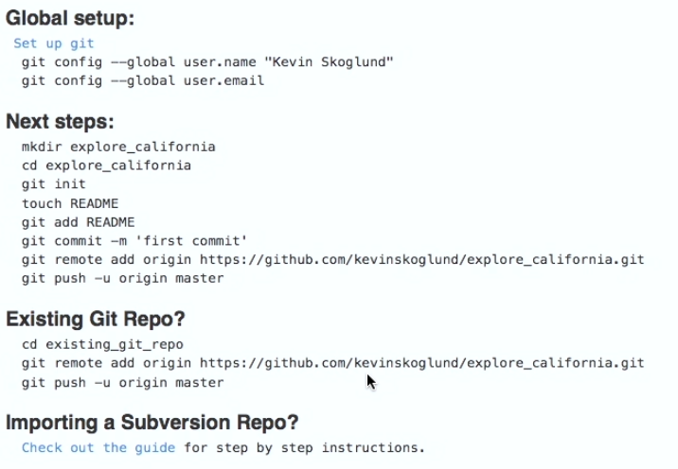

Slide 58
Git remote
$git remote #chech any existing remotes
$git remote add <alias> <url>
$git remote add origin https://github.com/hanfei28/Test.git
$git remote
$git remote -v
$car .git/config
$git remote rm orignin

Slide 59
Create a remote branch
$git push -u origin master #push a branch to remote repository
$ls -la .git/refs/remotes/origin/master
$cat .git/refs/remotes/origin/master
$git branch -r #remote branches
$git branch -a #local branches

Slide 60
Cloning a remote repository
Get existing repository online
$pwd
$git clone URL

Slide 61
Tracking Remote Branches
$git push -u origin master
If -u is not used, git will not track any remote branch.
Example:
$git branch non_tracking
$git push origin non_tracking

Slide 62
Pushing changes to a remote repository
$git commit -am “message”
$git log --oneline
$git log --oneline origin/master
$git diff master..origin/master
$git push ⇐=> $git push origin master

Slide 63
Fetching changes from remote repositoty
$git fetch origin
Always fetch before you work
Fetch before you push
Fetch often

Slide 64
Merging in fetched changes
Remote branch is just a branch like other branches
$git merge origin/master
git Pull = git fetch + git merge
Super convenient

Slide 65
Check Out Branches
$git branch -r

Slide 66
Deleting a remote branch

Slide 67
Enabling collaboration

Slide 68
A Collaboration Workflow
At Lynday’s side
$git checkout master
$git fetch
$git merge origin/master
$git checkout -b feedback_form origin/feedback_form
$git log
$git show laksjd2
$git commit -am “Add tour selector to feedback form
$git fetch
$git push
$git checkout master
$git fetch
$git merge origin/master
$git checkout -b feedback_form
$git add feedback.html
$git commit -m “Add customer feedback form”
$git fetch
$git push -u origin feedback-form

Slide 69
My work
$git fetch
$gir log -p feedback_form..origin/feedback_form
$git merge origin/feedback_form
$git checkout master
$git fetch
$git merge origin/master
$git merge feedback_form
$git push

Slide 70
Setting up alias for common commands
In user directory, .gitconfig
$git config --global alias.st “status”
$git config --global alias.co “checkout”
$git config --global alias.ci “commit”
$git config --global alias.br “branch”
$git config --global alias.dfs “diff --staged”
$git config --global alias.logg “log --graph --decorate --oneline --abbrev-commit --all”

Slide 71
Using SSH keys for remote login
How to setup SSH?

Slide 72
Git Hosting
Git Hosting Companies
Github
Bitbucket
Gitorious
Git Self-hosting
Gitosis (development stopped)
Gitolite

