Slide 1
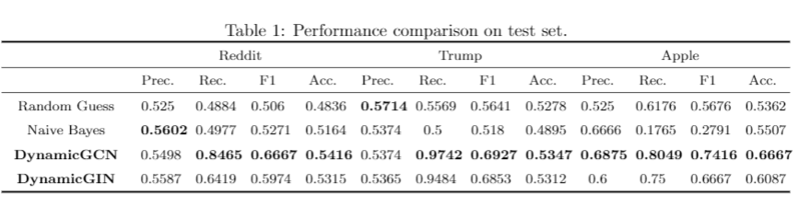
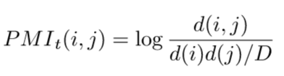

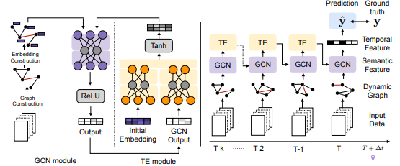
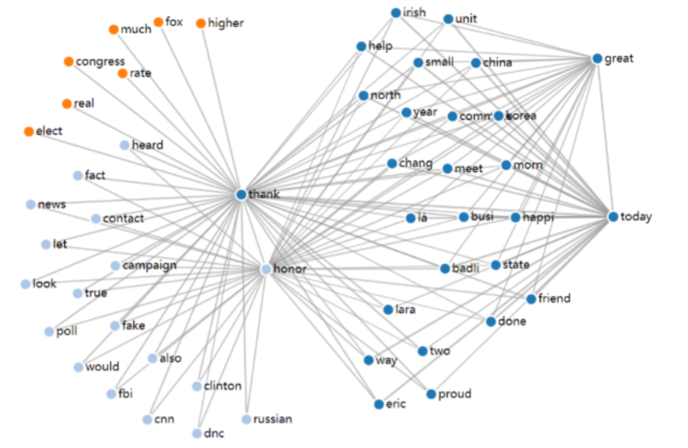
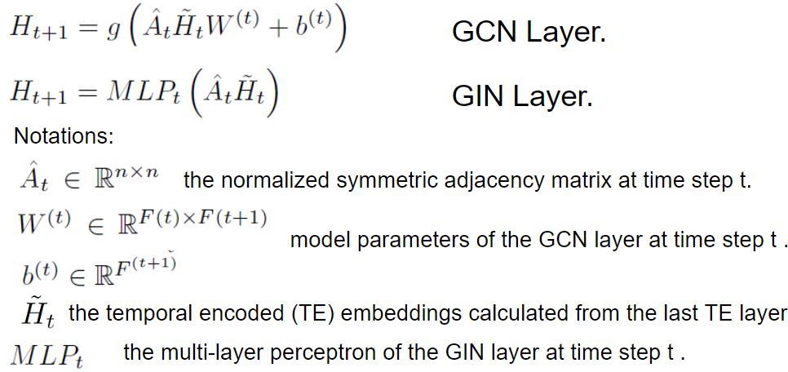

Contextual Information Based Market Prediction using Dynamic Graph Neural Networks
Feng HAN¹, Lanqing XUE¹ and Zhiliang TIAN^{1,} Jianyue WANG² {lxueaa, fhanab, ztianac,jwangen}@ust.hk
¹: Department of Mathematics, HKUST ²: Department of Business, HKUST
1. Introduction
3. Document-based point-wise mutual information (PMI)
5. Analysis
Stock-related news can shadow the confidence and expectations of various stakeholders. From risk management to return volatility, shares or trade strategies will be adapted accordingly. Stock prices will change due to the supply-demand relationship changes, interest rates, investors, political in a dynamic macroeconomics environments.
d(i,j): total number of articles containing word i,j at time t.
d(i): the total number of articles containing i.
2. Dataset
“Thank you Brock – it is my honor. We (@FEMA) have never had the support that we have had from this President. @FEMABrock. – Sat Sep 15 20:41:45 +0000 2018
Reddit top news:
Ranked by Reddit users’ votes, only the top 25 headlines are considered for a single date. (Range:2008-06-08 to 2016-07-01). We aim to predict the Dow Jones Industrial Average (DJIA) trend.
Trump’s twitter:
We crawl some twitters of Trump from 2009 to 2018.
News about apple:
The dataset here consists of Stock Value of Apple(AAPL) from 2006 to 2016 and News summary, abstract and snippets on News featuring Apple during the same period.
DynamicGNN framework
4. Graph Neural Network and Optimization
Data Cleaning
m days of time series input to predict the stock price of the next day n x n dimension adjacent matrices for each day, n is the number of all the words in m days
Setting for each dataset
Reddit: m=7. n: 7*25 articles to predict DJIA goes up or down.
Trump: m=7. n: twitter in 7 days to predict DJIA goes up or down.
Apple: m=2. n: words from 2*7 days of news summaries. We predict whether the AAPL goes up or down.
More datasets to evaluation
Instead of a particular stock, we can try more indices such as SNP, MSCI World, FTSE All-World, etc.
More possibilities to explore
We have implemented DynamicGIN, however, we might have tried the combination of other variants of the state-of-the-art neural networks given more time
6. Conclusion
Data Preprocessing
Stop word
Words that appears too often gives no information: “a”, ”the”.
Word stemming
Word with the same meaning or root. Transfer them to the initial root word: “work”, ”works”, ”worked”
We conduct a series of experiments to apply DynamicGNN to stock trend prediction. The results show both DynamicGCN and DynamicGIN are effective compared to machine learning method given limited data.As far as we know, adopting dynamic graph embedding into finance industries with twitter data have great potential.

Slide 2
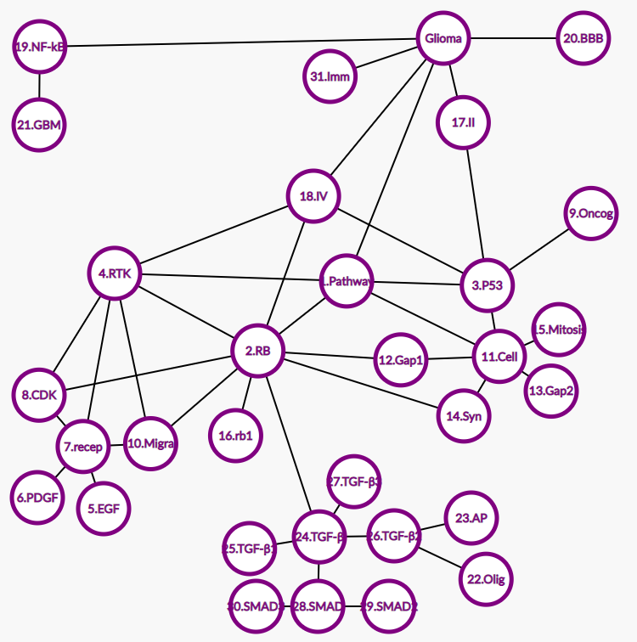
Biomedical system: Control system of glioma cancer – Feng HAN 20407369 fhanab@connect.ust.hk
Edge:
0 and 1, 17, 18, 19, 20, 31
1 and 2, 3, 4, 11
2 and 4, 8, 10, 12, 14, 16, 18, 24
3 and 9, 11, 17, 18
4 and 7, 8, 10, 18
7 and 5, 6, 8, 10
11 and 12, 13, 14, 15
19 and 21
24 and 25, 26, 27, 28
26 and 22, 23
28 and 29, 30
Glioma Nodes
1.Biological pathway of cell proliferation
2.Retinoblastoma (RB) pathway
3.Tumor protein (P53) pathway
4.RTK pathway
5.Epidermal growth factor (EGF)
6.Platelet-derived growth factor (PDGF)
7.EGF, PDGF receptor
8.Cyclin dependent kinase (CDK)
9.Oncogene
10.Migration and survival
11.Cell cycle
12.Gap 1 phase
13.Gap 2 phase
14.Synthesis phase
15.Mitosis phase
16.rb1 gene
17.Grade II glioma
18.Grade IV glioma
19.NF-kB inhibitor
20.Blood-brain barrier (BBB)
21.Glioblastoma multiform (GBM)
22.Oligonucleotide
23.AP 12009
24.TGF-β
25.TGF-β1
26.TGF-β2
27.TGF-β3
28.SMAD
29.SMAD2
30.SMAD3
31.Immune system
Explanation:
This networks reveals the known pathways of glioma formation, which mainly governed by RB, P53 and RTK. In each pathway, several factors and cell receptors are included to regulate the cell cycles, proliferation and apoptosis. While these three pathways may collaborate to suppress formation of cancer. Nevertheless, the mutation or failure of each pathway can enhance the existence of tumor. Besides, blood-brain barrier (BBB) is a main resistance in glioma elimination, which is a natural barrier of brain protection.
Discussion and implication:
For tumor cells, they have proliferation error during cell cycle, which due to abnormal function of each pathway or receptor failure within those pathways. RB, p53, and RTK pathways have distinct functionalities, while some works show potential interactions among these pathways that reinforce or negate other pathways. However, its exact mechanism in glioma development and progression and its interaction with the three pathways remain unknown.

