Slide 1
z-index
Menubar: 10
Viewport: 1
CameraViewport: 4
Neditor: 5
Background: 3
Text: 2
Siderbar1: 4
Siderbar2: 4

Slide 2
值改变时发出信号
接收触发信号，更改场景中物体的状态
KEYBOARD_TRIGGER
NEditor
FACE_TRIGGER
editor/js/bt/NEditor.js
editor/js/bt/NEditorGlobal.js
ast (abstract syntax tree)
FACE_INFORMATION
FaceSignalLoop()
结合语法树修改
导入的素材
editor/js/face/FaceUtils.js
editor/js/Sidebar.Project.js
asset
一直更改人脸信息
Notes:
System logic

Slide 3
X
var viewSize = container.dom.offsetHeight / 50; var aspectRatio = container.dom.offsetWidth / container.dom.offsetHeight; var left = -aspectRatio * viewSize / 2; var right = aspectRatio * viewSize / 2; var top = viewSize / 2; var bottom = -viewSize / 2; editor.DEFAULT_CAMERA.left = left; editor.DEFAULT_CAMERA.right = right; editor.DEFAULT_CAMERA.top = top; editor.DEFAULT_CAMERA.bottom = bottom; editor.DEFAULT_CAMERA.updateProjectionMatrix();
Y
Viewport.js
Camera position
this.DEFAULT_CAMERA = new THREE.OrthographicCamera( -20, 20, -20, 20, -100, 100 ); this.DEFAULT_CAMERA.name = 'Camera'; this.DEFAULT_CAMERA.position.set( 0, 0, -50 ); this.DEFAULT_CAMERA.up.set( 0, -1, 0 ); this.DEFAULT_CAMERA.lookAt( new THREE.Vector3() );
Editor.js
Notes:
World cooridnate

Slide 4
Title
Delete Button
Output
Others, e.g., +/- button
Box
Text
Number
…
Input
Notes:
Node Editor

Slide 5
BBW
Mainly in Viewport.js

Slide 6
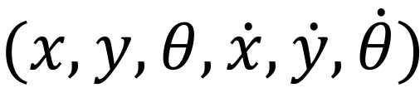
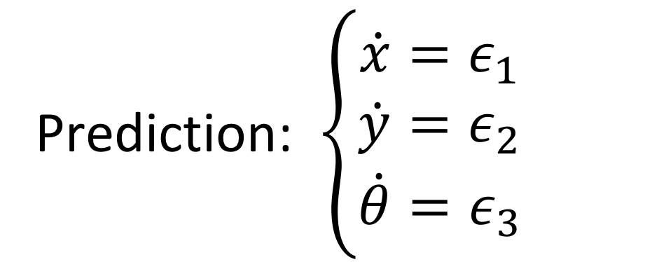
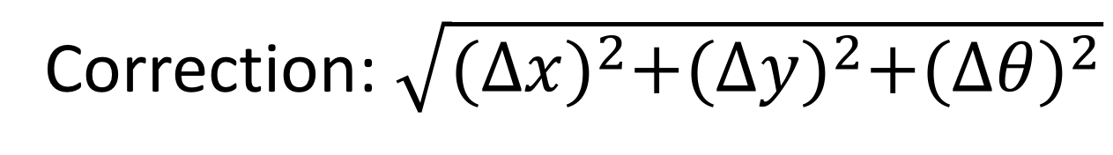
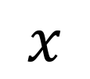
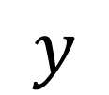

Face Tracking
$$(x, y, θ,\dot{x},\dot{y},\dot{θ})$$
$$x$$
Prediction: $\left\{\begin{matrix}\dot{x}=ε_{1} \\ \dot{y}=ε_{2} \\ \dot{θ}=ε_{3}\end{matrix}\right.$
$$θ$$
$$y$$
Correction: $\sqrt{{(∆x)}^{2}+{(∆y)}^{2}+{(∆θ)}^{2}}$

Slide 7
Control / Robot
Compared to control, robot delete
Several UI parts, including menu, node editor, modal
Face tracking
Siderbar.Camera.js

