Slide 1
Car-Type Recognition
Fine-grained make / model / year from a single photo (196 classes)
540 Module 1 Project
Live demo: https://HanfuZhao781-car-recognition.hf.space
Code: https://github.com/hanfuzhao/Module1-CarRecognition

Slide 2
Problem & Motivation
1
- Identify a car's exact make / model / year from one photo, e.g. Aston Martin Virage Coupe 2012.
- Fine-grained: 196 classes that differ by a grille, a badge, or a single model year.
- Powers real products: marketplace listings, insurance intake, instant valuation.
- Two failure modes that matter in production:
- Look-alikes (rebadged twins, same-model trims) cap achievable accuracy.
- Bad user photos: a confident wrong answer is worse than an honest "I'm not sure."

Slide 3
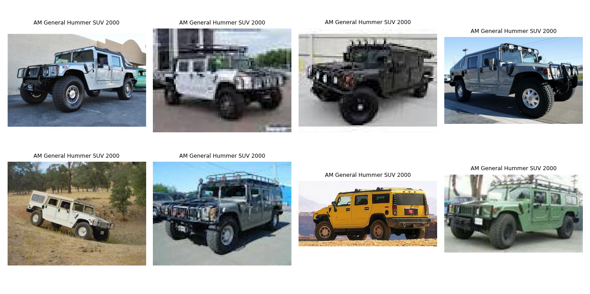
Data: Stanford Cars
2
- 8,144 training and 8,041 test images, 196 classes.
- Source: Stanford Cars (tanganke mirror on Hugging Face).
- Near-balanced (max/min = 2.83), so robustness, not long-tail, is the experiment.
- Mirror also ships 7 corruption variants, used for the robustness test.

Slide 4
Approach: three models
3
- Naive baseline: majority / random (performance floor).
- Classical: HOG features into a linear SVM (no learned features).
- Deep (deployed): frozen ImageNet ResNet50 features + a trained MLP head.
- Freezing the backbone keeps the shipped artifact ~4.6 MB; backbone fetched at runtime.
Novelty = insight, not chasing SOTA:
profile corruption robustness, and add confidence-gated abstention that targets the two failure modes.

Slide 5
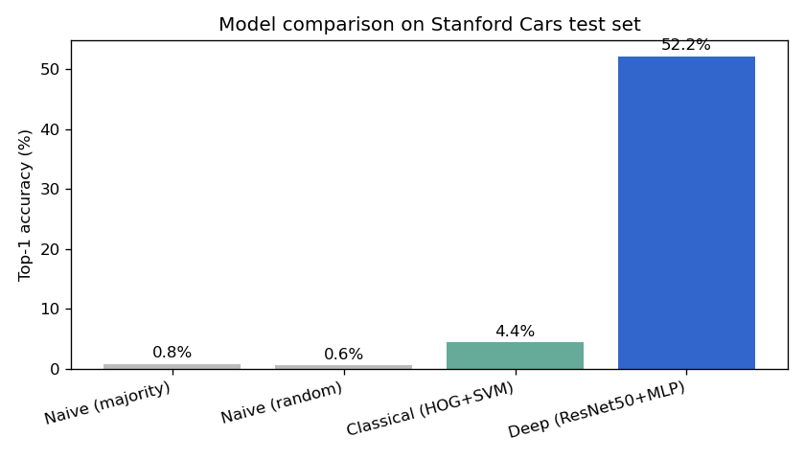
Results (test set, 8,041 images)
4
- Naive majority: 0.85%
- Classical HOG + SVM: 4.41%
- Deep ResNet50 + MLP: 52.16% top-1
- Deep top-5: 79.98%
- Transfer learning does the real work; hand-crafted HOG cannot crack fine-grained recognition.

Slide 6
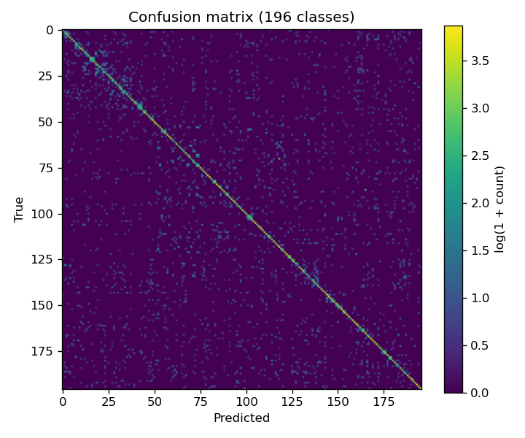
What the model learned
5
- Top confusions are not random:
- Chevrolet Express vs GMC Savana (16)
- Dodge vs Mercedes Sprinter (14)
- Audi TTS vs Audi TT (12)
- The Express/Savana and Sprinter pairs are literally the same van sold under two brands.
- Errors sit at the edge of what is visually separable, evidence the model learned real structure.

Slide 7
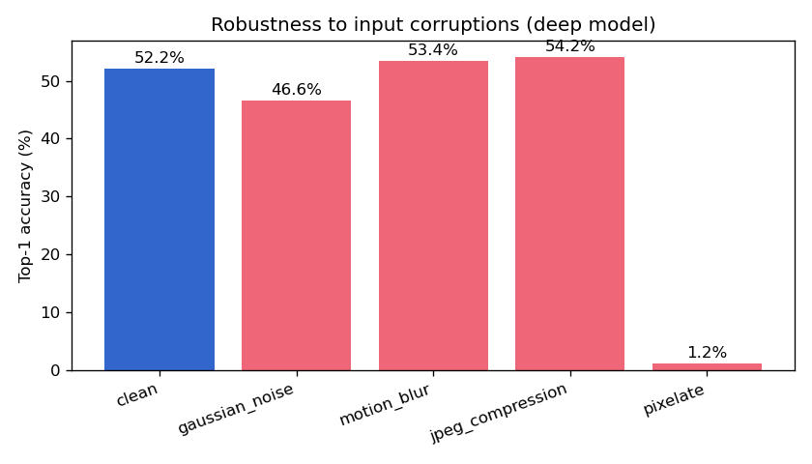
Experiment: corruption robustness
6
- Robust to JPEG (+2pt) and motion blur (+1pt).
- Gaussian noise costs ~6pt.
- Pixelation is catastrophic: -51pt, near chance.
- Deployment warning: thumbnails / over-compressed inputs fail silently.

Slide 8
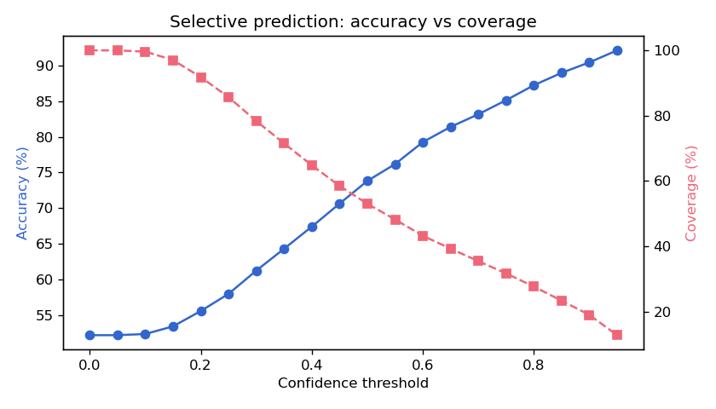
Experiment: confidence gating
7
- Abstain on low-confidence inputs to trade coverage for accuracy.
- 79% accuracy at 43% coverage.
- 90% accuracy at 19% coverage.
- A 52% model becomes a 90%-on-accepted experience, with no retraining.
- Shipped in the app: threshold 0.40 asks the user for a clearer photo.

Slide 9
An honest, deployable assistant
- Three models on real data: deep model reaches 52% top-1 / 80% top-5.
- Learned real structure; failure analyzed (pixelation collapse).
- Confidence gating turns it into a 90%-on-accepted product experience.
- Live, public, inference-only web app.
Live demo: https://HanfuZhao781-car-recognition.hf.space
Code: https://github.com/hanfuzhao/Module1-CarRecognition

