Slide 1
Car Review Sentiment Analyzer
Per-aspect sentiment for owner reviews, with evaluation at the core.
Can Machines Understand Us Reliably? Module 2 Hackathon
Hanfu Zhao
Live demo: https://HanfuZhao781-car-review-sentiment.hf.space
Code: https://github.com/hanfuzhao/Module2-CarReviewSentiment

Slide 2
The problem
Platforms like Dongchedi turn thousands of owner reviews into per-dimension ratings for engine, comfort, and value that buyers trust.
Those ratings come from a sentiment model. Misread one review and the error is averaged into a public rating thousands of people see.
Two notorious failure modes:
- Negation, the brakes are not good
- Sarcasm, great, another trip to the dealer this week
So this is a sentiment classifier where the real work is measuring where it breaks.

Slide 3
Approach: 3 models plus transfer learning
Data: 36,518 real Edmunds owner reviews. 3-class labels from the 1 to 5 star rating.
Naive
majority class
the floor
Classical
TF-IDF plus logistic
regression
DistilBERT
fine-tuned
DEPLOYED
Transfer learning: start from distilbert-base-uncased, pretrained on general English, add a sentiment head, fine-tune on car reviews.
Plus a per-aspect breakdown, lexicon-routed clauses scored by the same model.

Slide 4
Data augmentation
The catch: the data is 86% positive. A model that always says positive scores about 86% accuracy and is useless.
To rescue the starved minority classes, EDA, Easy Data Augmentation:
- synonym replacement with WordNet
- random word swap and random deletion
- back-translation, English to German to English, for paraphrase diversity
The interesting question is not whether to augment, it is when it helps. Evaluation answered that.

Slide 5
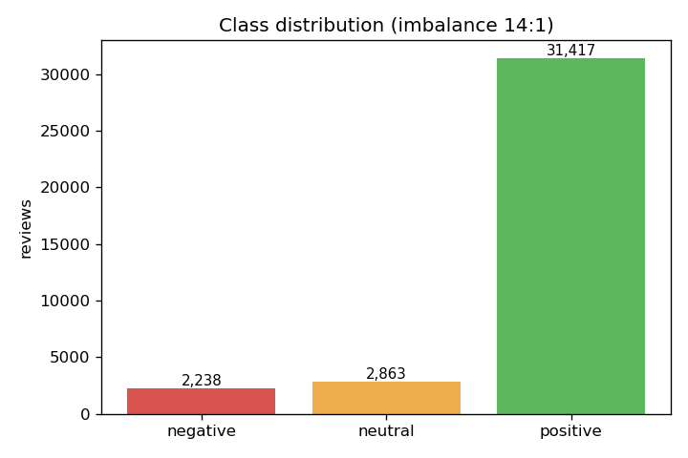
Results: accuracy lies
Model | Accuracy | Macro-F1 | Neg. recall
Naive, majority | 86% | 30.8% | 0.0%
Classical TF-IDF | 85% | 57.2% | 38.4%
DistilBERT, deployed | 87% | 56.6% | 34.8%
Naive: 86% accuracy, 0% negative recall. Accuracy is the wrong metric on imbalanced data.
What matters is macro-F1, which shows transfer learning working:
30.8% to 57.2% to 56.6% naive to classical to DistilBERT
14 to 1 class imbalance

Slide 6
When does augmentation help?
Cold-start regime, a newly-launched car with only 1,200 reviews, realistic for Dongchedi:
Classical model
macro-F1: 31.9% to 40.2%
Augmentation wins
Transformer
macro-F1: 51.1% to 46.3%
Already strong, no help
Same technique, opposite verdict. Only rigorous evaluation could tell them apart.

Slide 7
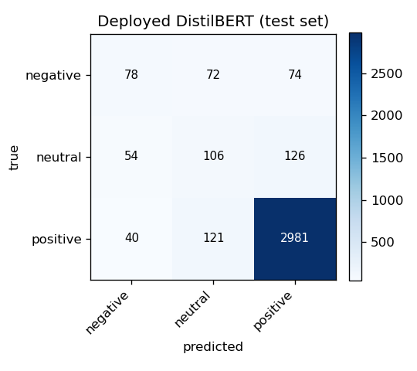
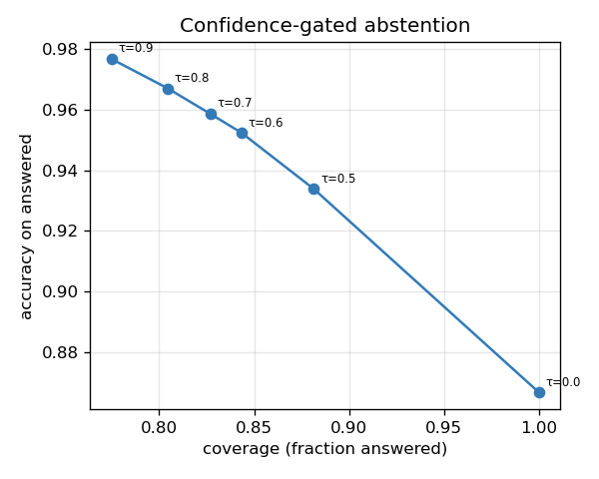
Stress tests reveal the hard limits
Hand-built linguistic stress tests expose what aggregate accuracy hides:
- Negation: affirmative 70% versus negated 0%
- Sarcasm: 100% misread as positive
The deployable fix, confidence-gated abstention:
accuracy 86.7% to 97.7% at 77% coverage
low-confidence reviews are flagged for a human.

Slide 8
Live demo
Paste a review to get overall sentiment plus the per-aspect breakdown, all from one review.
- Mixed review: engine positive, fuel economy negative, price negative, comfort positive
- Not bad: deep model correct, classical model wrong, the model gap shown live
- Heavy negation: the app abstains. Sarcasm: confidently wrong, the honest frontier
Try it live: https://HanfuZhao781-car-review-sentiment.hf.space
Accurate, honest, and deployable. Thank you.

