Slide 1
BushBurg
Survival in Africa

Slide 2
Mobile Games Recent Years*
Top 10 grossing: $4,778,085/day (est.)
40% of app downloads
30% greater than any other category
2017 forecast: $4 billion
* Data from statistica.com

Slide 3
Amapalo
Seeds of a Mobile Game Company
Bring about a new genre: charity gaming
Utilize the social structure of the platform
Engage youth in worldly understanding

Slide 4
Amapalo Background
Personal experience with mission trips to Zambia
Background in business, communications, & software
No game development or design history

Slide 5
BushBurg in a Nutshell
Survival and management simulation
Many citizens with different traits
Player skill = faster advancement (no losing)
Hazards and risk management
Social reinforcement paradigm
Players can build communities and trade
Purchases help others in community

Slide 6
BushBurg: The Endgame
Players invest in the community
The donations have real-world effects
Players benefit from the in-game analogs of those effects

Slide 7
Coming up…
Design perspective
How much of that can we actually do?
What should the approach be?
How should the game work?
Demo
Implementation perspective
What engine should we use?
How will the pieces be put together?
What are the pitfalls?
Conclusion

Slide 8
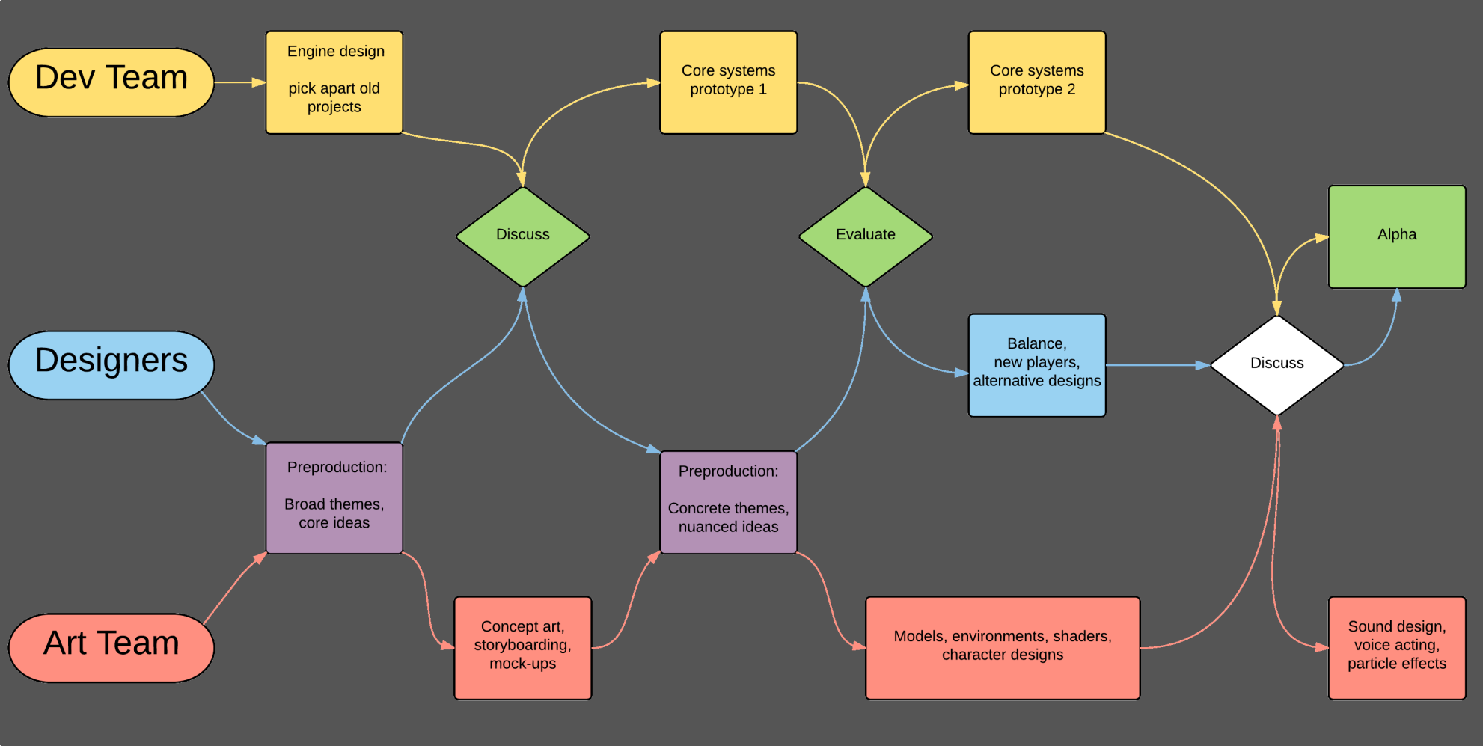
Game Development Pipeline
Design – How much can we actually do?

Slide 9
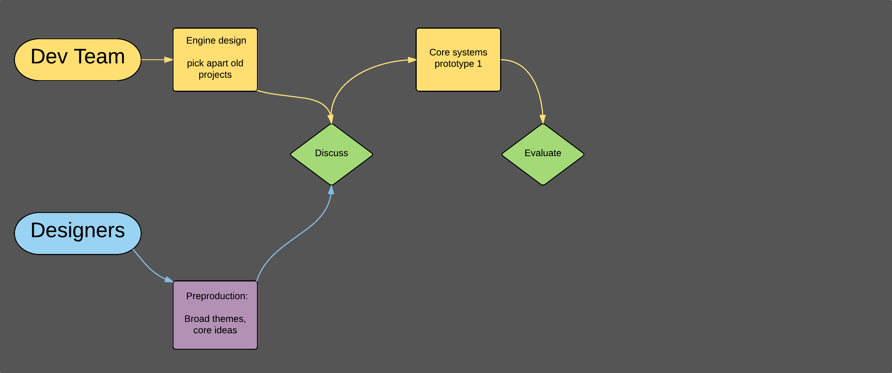
Realistic Pipeline
Design – How much can we actually do?

Slide 10
Core Systems Prototype
Vertical dive into a single system
Explore its strengths/weaknesses fully
Introduce complexity as time allows
Ignore surface elements
No graphics, no sound
Feedback systems for debugging, not fun
Evaluate structural concerns
Does this system scale properly with numbers?
Can new code mesh well?
Design – How much can we actually do?

Slide 11
What to Prototype?
A system that…
does not rely on others
can be given a win condition
does not need outside resources
Design – What should the approach be?

Slide 12
Constraints of Endgame
Touch screen interface (low precision)
Low session times
Limited UI space
Bias toward success
Low barrier to entry
Design – What should the approach be?

Slide 13
Core System: Citizen Management
Each citizen has traits (attributes)
Attributes suited to different tasks
Better allocation = faster progress
Citizens get tired and hungry
Working a task fatigues primary attributes
Attributes recovered by doing other things
The goal: Make money
Crops and animal products can be sold
Win by selling better products faster
Design – How should the game work?

Slide 14
Citizen Attributes
Efficiency attributes:
Strength, Dexterity, Endurance
Speed of task completion
Quality attributes:
Perception, Focus, Acumen
How good the result of the task will be
Recovery
Rate of recovery for other attributes
Design – How should the game work?

Slide 15
Citizen Attributes Ctd.
Task effects on attributes
Primary: Fatigued during task
Secondary: Cannot recover
Unused: Recovers during task
Design – How should the game work?

Slide 16
Crops and Cooking
Crops have unique traits as well
Attribute matchups
Restoration upon eating (quality matters)
Value when sold
Fatigue rate and production rate
Crops can be cooked into meals
Improve the value and restoration
Impart temporary ‘buffs’ to attributes (quality)
Design – How should the game work?

Slide 17
Choosing a Platform
Must do graphical ‘heavy-lifting’
Far too time-consuming for our scope
Most engines do this
Should facilitate change in platform
Development and testing on PC for now
Mobile/tablet comes later
Should be ‘futureproof’
Active community helps troubleshooting
Engine devs must keep up on compatibility
Implementation – What engine should we use?

Slide 18
Easy Choice: Unity
Includes editor
Spatial manipulation
File organization
Fast code-to-testing procedure
We have experience!
Implementation – What engine should we use?

Slide 19
Unity Engine: Structure
Editor is an abstraction of object oriented design
Every class inherits from GameObject class, ‘is-a’ GameObject
Amounts to coding with libraries
Implementation – How do the pieces fit together?

Slide 20
Unity Engine: Components
Prewritten classes
Control core functions, like rendering & collisions
Accessed through methods
Scripts
Attached to objects as components
All our code goes in these
Implementation – How do the pieces fit together?

Slide 21
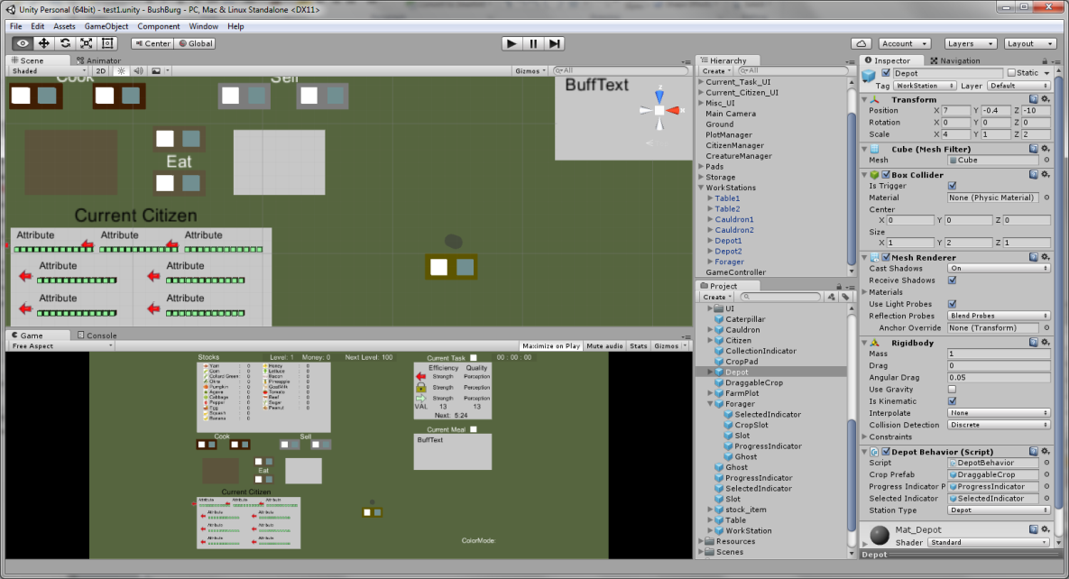
Unity Engine: Editor
Implementation – How do the pieces fit together?

Slide 22
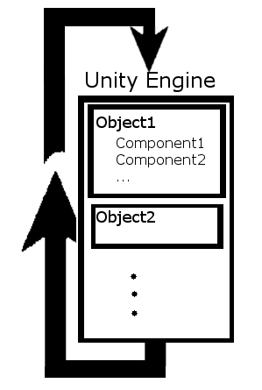
Unity Engine: Game Loop
‘Runs’ each object & components once per loop
Loops as fast as it can
Interactions between objects are governed by scripts
Implementation – How do the pieces fit together?

Slide 23
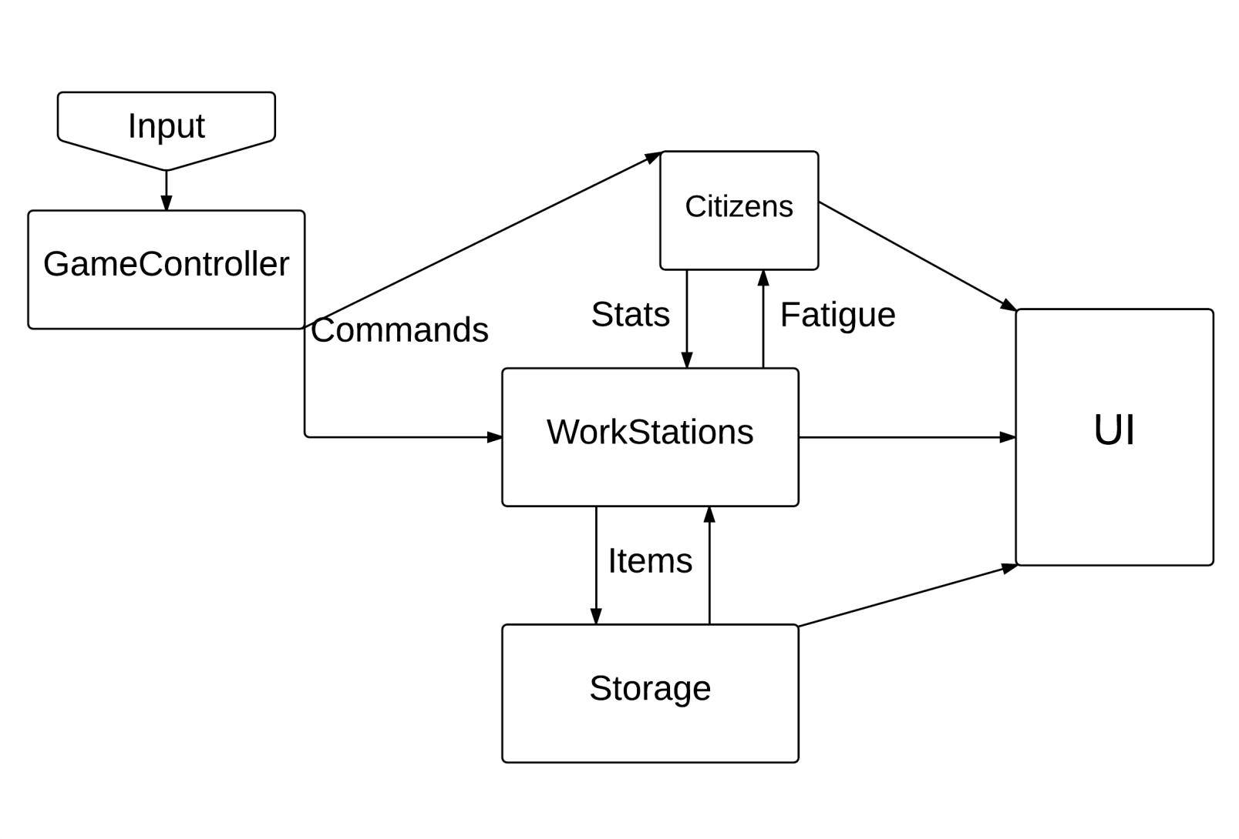
Our Object Heirarchy
Implementation – How do the pieces fit together?

Slide 24
Traps in Unity
The easiest code is almost always inefficient
Must run at 30+fps on a phone
Polling should be avoided
Retrieving components is expensive
Bad practices can’t be easily untangled
Implementation: What are the pitfalls?

Slide 25
Keeping the Wheel Invented
Heavy use of libraries taxes memory
Hard to get back into after a few days off
“Did I compensate for that?”
Documentation should be verbose
Very hard to maintain this on a schedule
Script size can get out of control
Consider multiple scripts on one object
This means careful organization/more docs
Implementation: What are the pitfalls?

Slide 26
Project Goals Juxtaposed
Amapalo
Forge a new genre of mobile gaming
Raise money for African charities
Inspire a younger generation to give
Us
Develop a basic gameplay loop
Test the prototype system and find its weaknesses
Offer practical advice for moving forward
Leave a starting point for future teams
Thanks for listening

