Slide 1
BushBurg: Survival in Africa
Status Report

Slide 2
What is BushBurg?
Amapalo – upstart mobile game company
Interest based on mission trips to Zambia with church
Strong background in business, but not games
“Farmville meets Oregon Trail”
From Farmville – focus on cultivation, social context
From Oregon Trail – Randomized setbacks, small community feel
Disney Version
Not a game about suffering, no ultimate failure

Slide 3
Our Role
Develop systems prototype (proof of concept)
No graphics/sound
Single Player
Set up for later expansion by hired team
Foster understanding of the market and this game’s possible role in it
Advice on viability
Anticipations of technical needs/possible pitfalls

Slide 4
Required Features
Constraints
Touch interface, limited UI space
Low session time required (but not limited)
Market/gameplay goals
Motivation for long term investment
Slow increase in complexity
Perception of fairness
Bias toward success

Slide 5
Milestone 1
Modular foundation
Structural setup
Playable all the way through development
One set of mechanics to test and balance at a time
Beginnings of Simulation
‘Slotted’ Assignment
Five possible tasks
Simple progression

Slide 6
Attribute System
Each citizen has 9 Attributes, 7 involved in Milestone 1
Efficiency attributes(strength, dexterity, endurance)
how fast they work
Quality attributes (perception, focus, acumen)
how well they do at the task
A recovery attribute
how fast they recover lost attributes

Slide 7
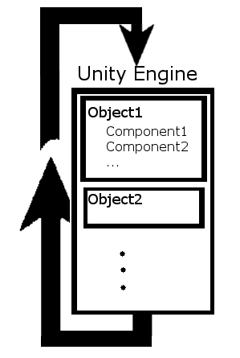
Unity Game Loop
Objects treated like OOP classes
Components inherit from GameObject, etc.

Slide 8
Components as Libraries
Most components are created by the engine and cannot be modified
Values are changed through functions like most OOP libraries
Classes we create are called Scripts
Treated as components
Assigned to specific objects
Contain all specific behaviors we desire

Slide 9
Components as Libraries, cont.
Components can be utilized to make our work easier, but often have limitations
Collider components will automatically check for collisions, but cannot be called manually
We have no control or knowledge of the order of execution of objects
Getting components in runtime is expensive

Slide 10
Finding the Right Object
Three ways to find an object during runtime:
Search through all objects(bad)
Find by name (good if only one exists)
Store references on events(best)
Automated collision detection is a very good way to get references

Slide 11
Using 3D Objects for a 2D Game
Functions as 2D if viewed orthographically
Computation overhead is increased, but not significant with simple shapes
Able to change camera angle to get a feel for oblique perspectives if needed
More experience with 3D tools

