Slide 1

ANALYZING CITI BIKE USAGE TRENDS IN NEW YORK CITY
FELICIA FAITH HANGGE
SPRING 2025

Slide 2




INTRODUCTION
METHODOLOGY
RESULTS
FUTURE WORK
Project Overview & Purpose of Analysis
Data Source, Dataset & Tools Used
Insights, Visuals & Key Takeaways
Recommendations & Opportunities for Further Analysis

Slide 3
PRojecT overview
This project explores Citi Bike usage data from October 2024 to identify trends in how riders interact with New York City’s biggest bike-sharing system with over millions of rides each month. The insights gained from this analysis are intended to help Citi Bike and Lyft optimize bike distribution, enhance user experience, and improve their marketing strategies.
PuRpose of analysis
The purpose of this analysis is to better understand how, when, and where Citi Bikes are being used across New York City. By identifying patterns in rider types, trip durations, station activity, and bike preferences, the analysis aims to help Citi Bike and their parent company Lyft make smarter business decisions and improve their company using solutions backed up by data.

Slide 4
DaTa & MeThodology
DATASET: CITI BIKE TRIP DATA FROM OCTOBER 2024
https://citibikenyc.com/system-data
Over one million rows
Includes timestamps, station names, user types,
bike types, etc.
TOOLS USED:
The analysis was completed using a Jupyter Notebook with the following Python packages:
pandas for data cleaning, manipulation, and analysis
matplotlib for data visualization

Slide 5
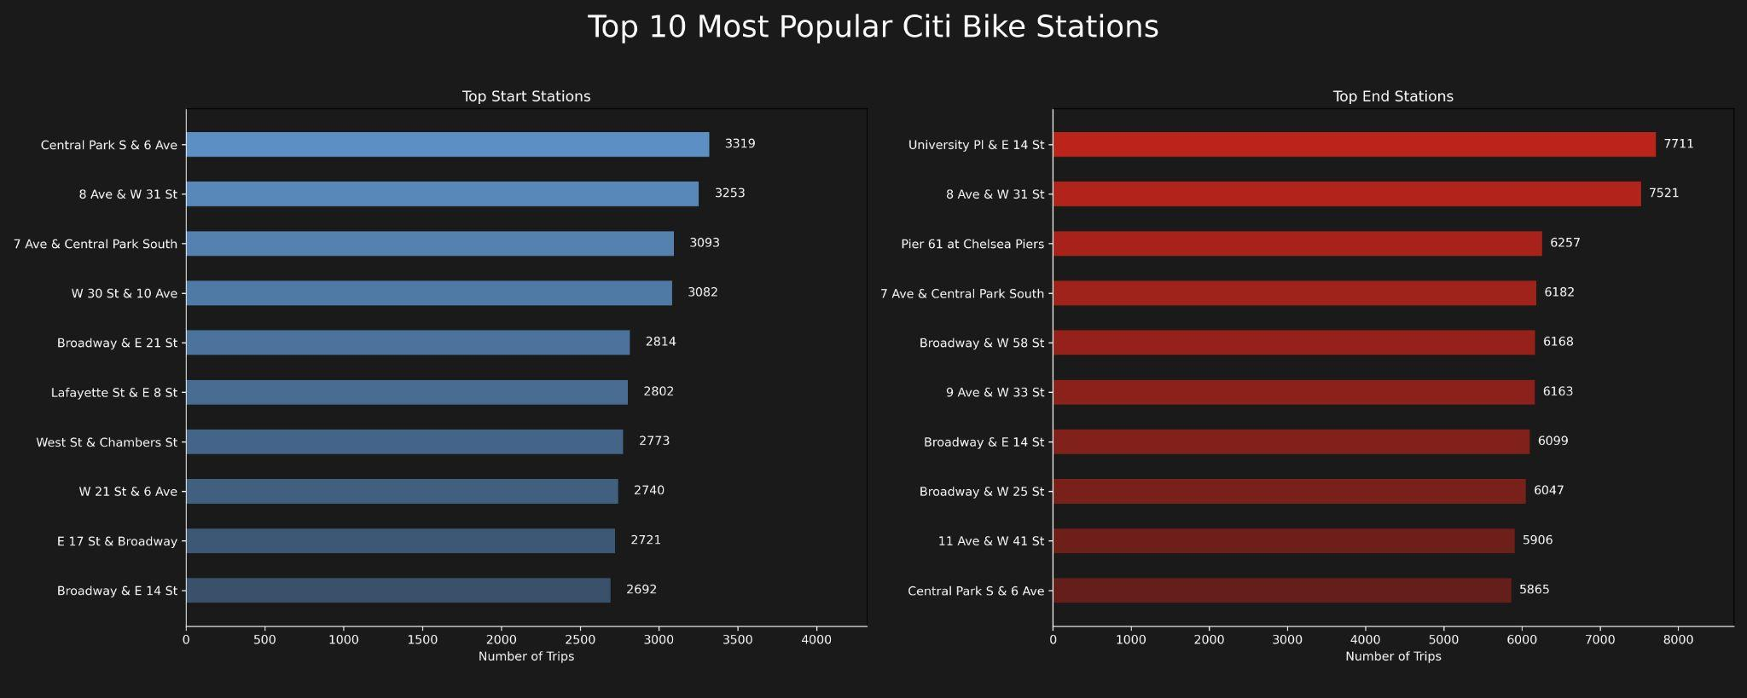
QuesTion #1: WhaT sTaRT And end STaTions Are The MosT and LeasT PopulaR?
Notes:
Most popular start stations are Central park, 8th ave, 14th street most popular
most popular end stations are university place, broadway, and chelsea piers
Least used are locations in the bronx and queens that only had 1-3 ride in the whole month compared to blank with 7000+ rides
Popularity is concentrated in Manhattan — outer borough stations may be underused or poorly placed.

Slide 6
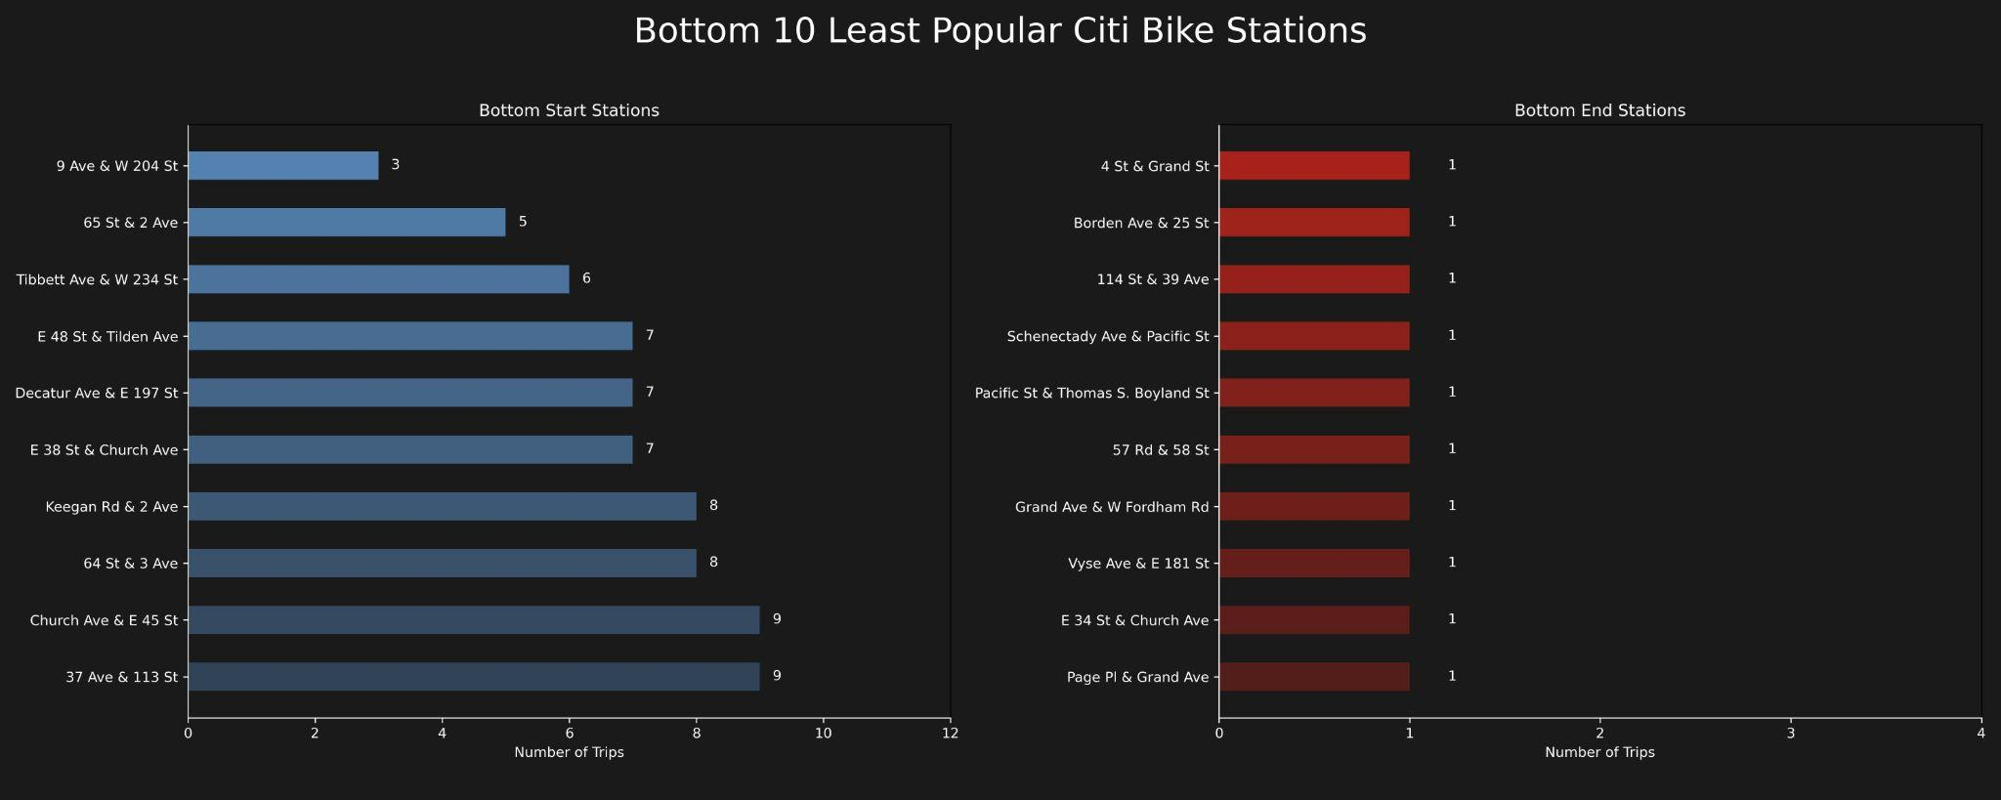
QuesTion #1: What start and end Stations are the Most and Least Popular?
Notes:
Most popular start stations are Central park, 8th ave, 14th street most popular
most popular end stations are university place, broadway, and chelsea piers
Least used are locations in the bronx and queens that only had 1-3 ride in the whole month compared to blank with 7000+ rides
Popularity is concentrated in Manhattan — outer borough stations may be underused or poorly placed.

Slide 7
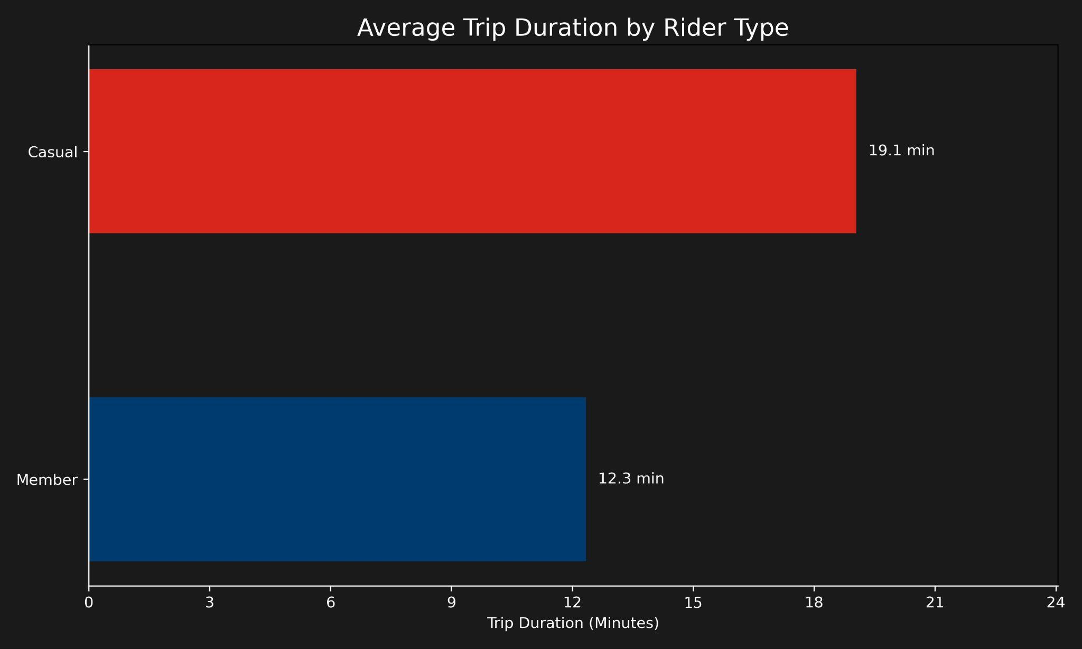
QuesTion #2: Which Types of RIders have the longesT Trip duraTion?

Slide 8
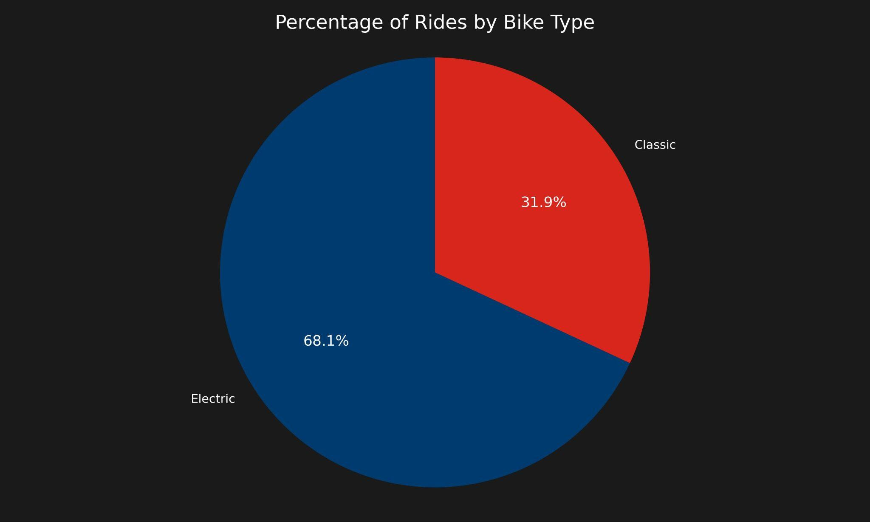
QuesTion #3: WhaT peRcenTage of Rides are Taken on Each bike Type (classic vs elecTRic)?

Slide 9
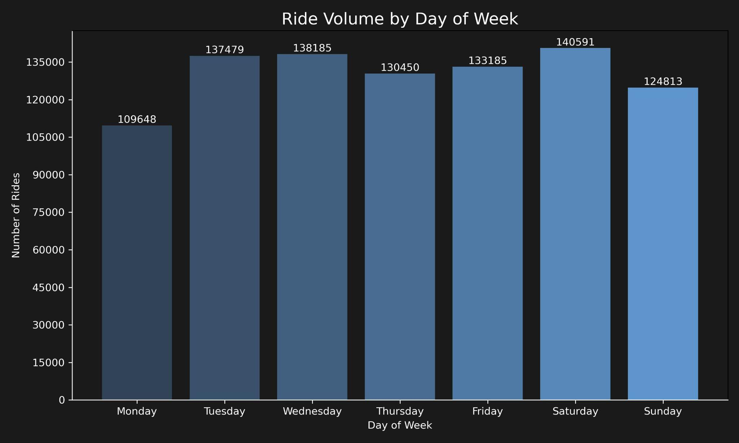
QuesTIon #4: WhaT DaYS OF THe WeeK aND TIMES of day have The highesT Ride volume and duraTion?

Slide 10
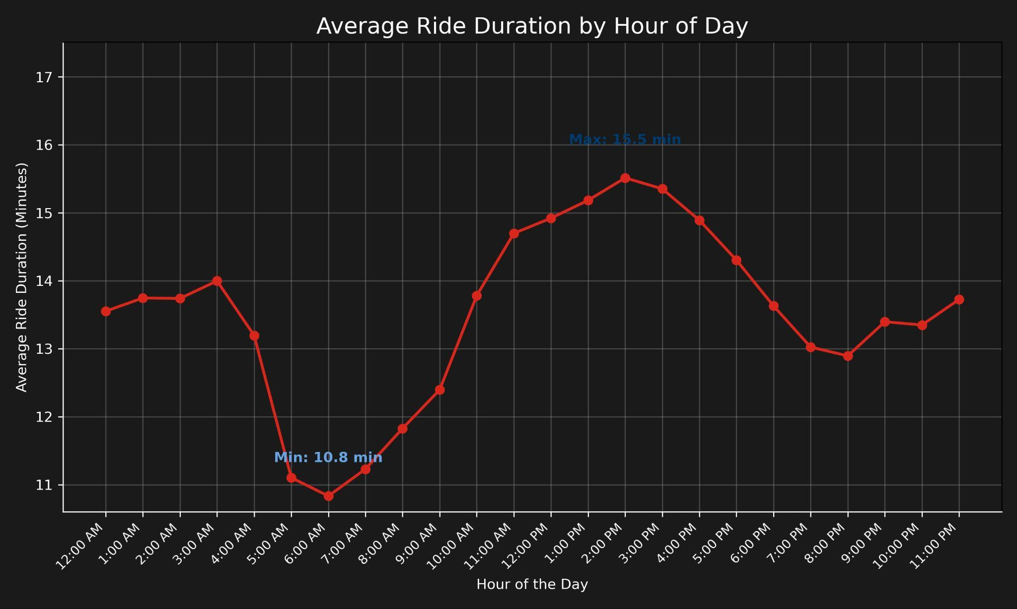
Question #4: What days of the week and times of day have the highest ride volume and duration?

Slide 11
FUTURE WORK & RECOMMENDATIONS FOR CITI bike / lyfT
Increase the number of total electric bikes, particularly at the most popular/busiest stations.
Introduce marketing strategies including weekday promotions targeting casual riders to improve usage during non peak times.
Reallocate resources away from consistently underused stations and focus on inventory management at busier stations
Expand staffing and maintenance support during peak weekend hours and peak locations.
Integrate weather data to analyze its impact on ride volume and trip duration and use predictive modeling to forecast demand by station and hour.

