Slide 2
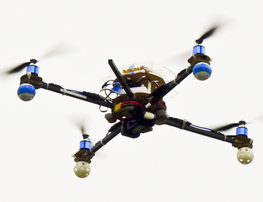
(x, v_{x})
(y, v_{y})
(z, v_{z})

Slide 3

Position Prediction
Kinematic equation is used in position prediction
d | Displacement or change in position
v_{o} | Original velocity, the velocity at the start of the acceleration
a | Acceleration, this is a constant acceleration
t | Time

Slide 4







Position Prediction
Current position (P)
Position prediction (X)
Accelerator (acc)
Velocity (v)
Velocity prediction (v₁)
Time ($∆$t)
$$x=vx.{∆t+\frac{1}{2}ax.∆t}^{2}$$
$$vx1=ax.∆t$$
$$y=vy.{∆t+\frac{1}{2}ay.∆t}^{2}$$
$$vy1=ay.∆t$$
$$z=vz.{∆t+\frac{1}{2}az.∆t}^{2}$$
$$vz1=az.∆t$$

Slide 5
Position Correction

