Slide 1




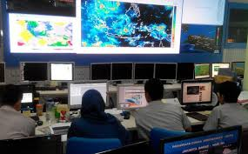
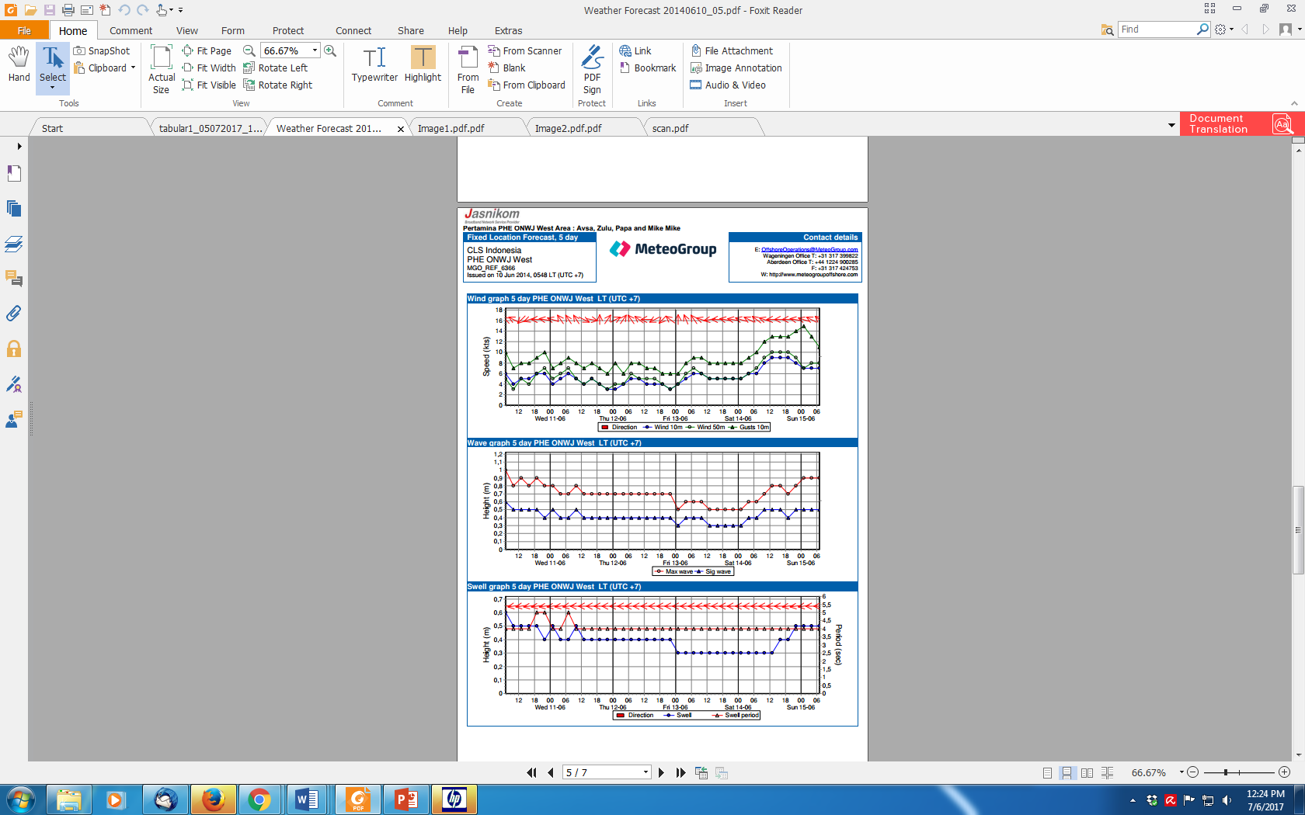
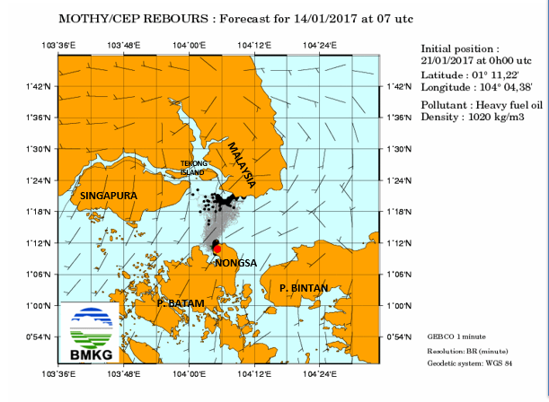
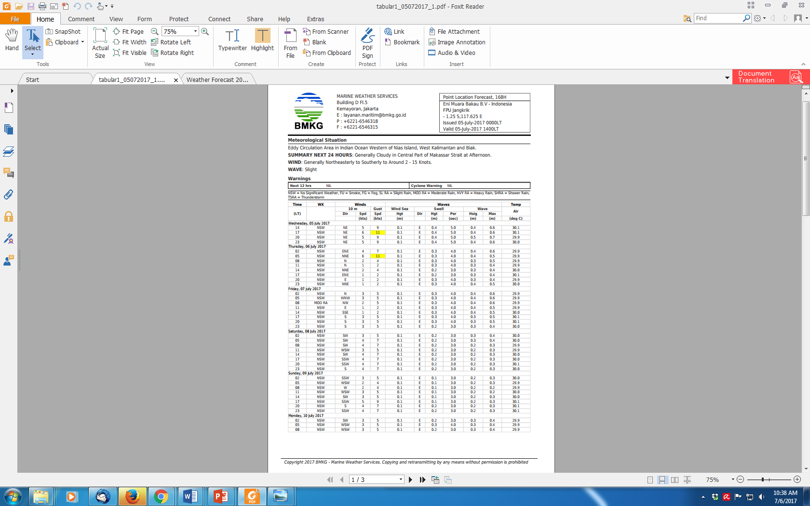
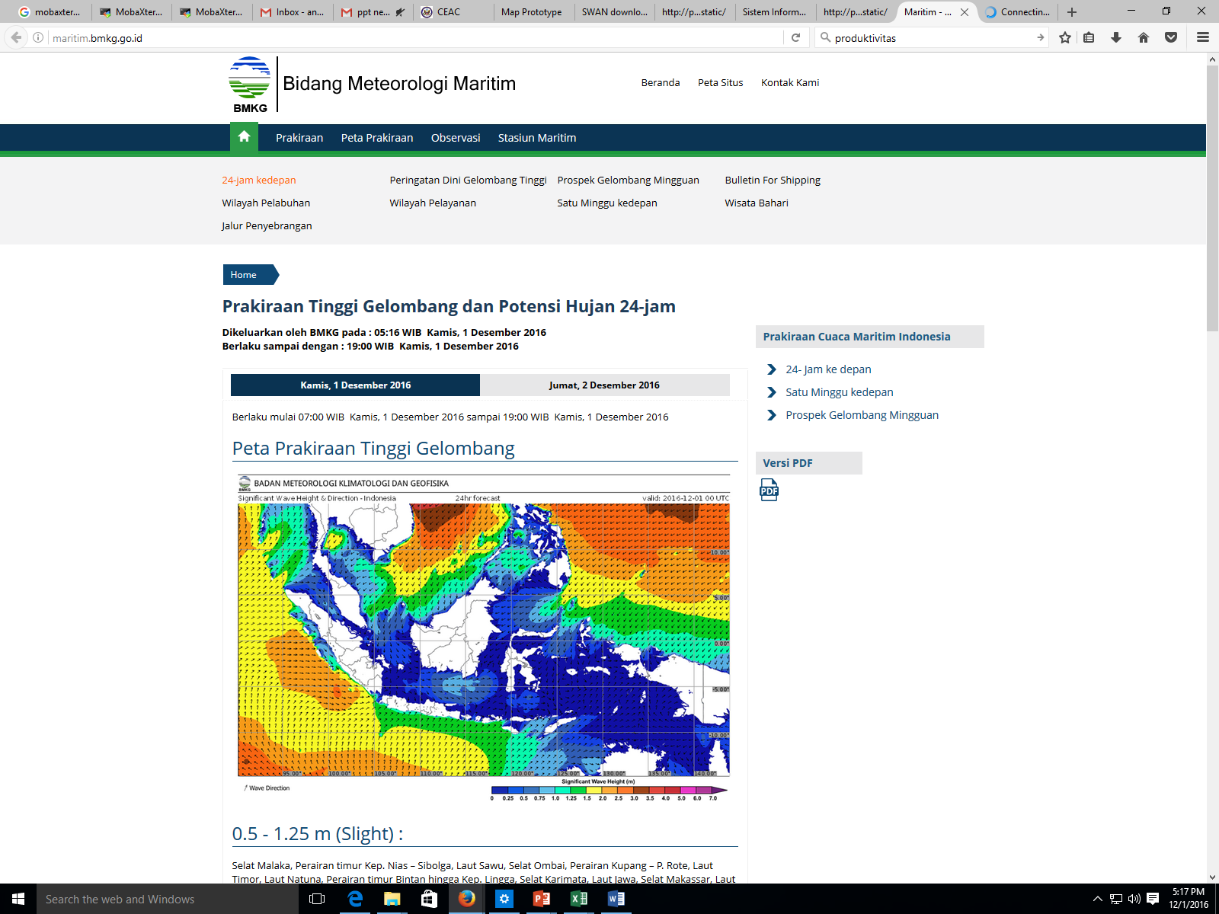
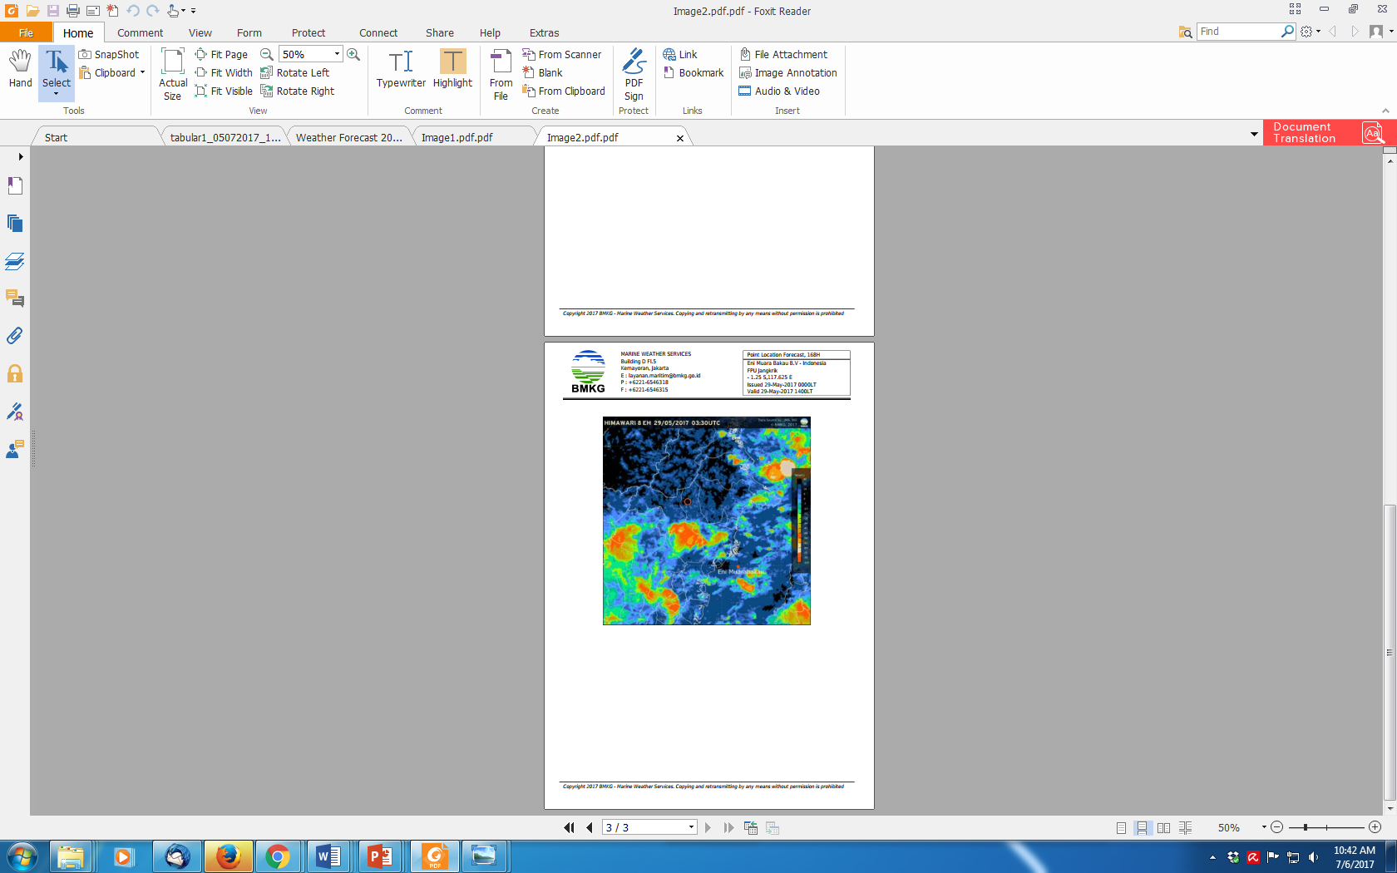
R HARP LIBRARY
WIDO HANGGORO & UMMU MA’RUFAH

Slide 2

HARP
https://github.com/harphub
Hirlam Aladdin R Packages
Developed in consortia consisting participants from Europe and North Africa
R based tool for analyzing, visualisation and verification
Works for different forecast and observation data formats

Slide 3
HARP and sqlite tables
Harp verification functions use data from sqlite tables
First step in harp is to convert forecast and observation data to sqlite format
It is faster to access and filter the data from databases than from text files or grib/netcdf files
Sqlite tables can be stored for longer time and big model files can be removed

Slide 4
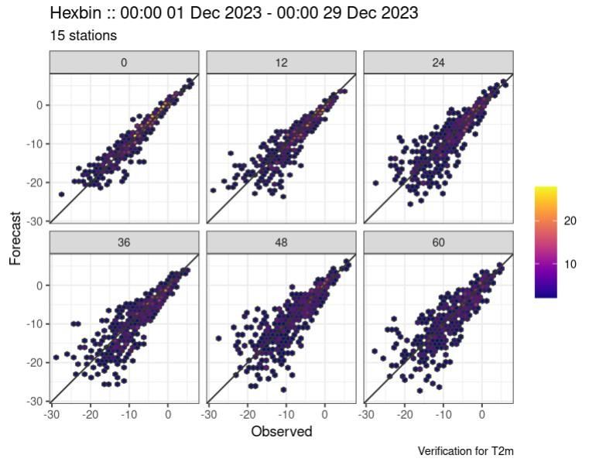

Forecast Data
NetCDF
GRIB
Observation Data
csv
xls
txt

Slide 5
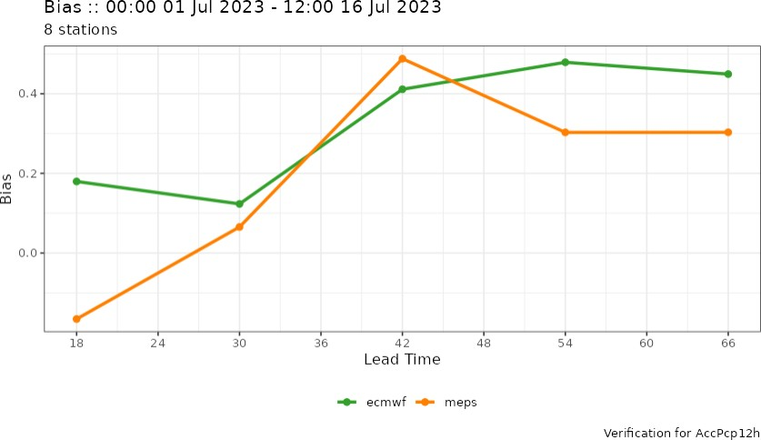
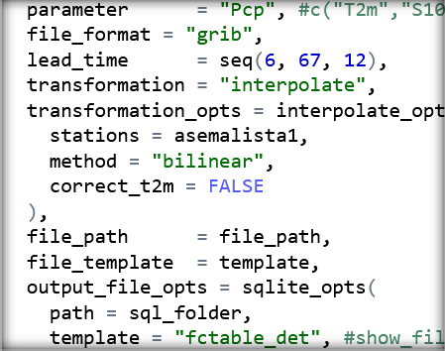
Harp Processes
Preparing the data
Interpolate forecasts to station points and save them in sqlite format
Convert observations to sqlite
Verification process
Read forecasts and observations from sqlite files
Verifying different parameters
Plotting verification scores
Data to Sqlite

Slide 6
Read Point Observation
read_obs() function works for vobs and csv formats
Uses read_<file-format>() function
Can be used to convert observations to SQlite format
File names must contain date and time

Slide 7
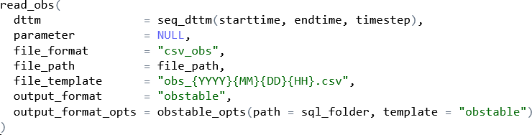
read_obs
https://rdrr.io/github/harphub/harpIO/man/read_obs.html
Example:
dttm: a vector of date time
strings to read
parameters: names of obs parameter (NULL takes all from file)
file_path: parent path to all observation data
file_template: template for the file names
Useful functions:
show_file_templates()

Slide 8
Format and naming of csv files
Each file contains observations from one date and time (UTC time) for all stations
file_template should be "obs_{YYYY}{MM}{DD}{HH}.csv", where YYYY = year, MM = month, DD = day, and HH = hour
Each file should have columns for valid_dttm, wmo, lat, lon, elevation and wanted parameters
valid_dttm = observation date and time (UTC) in form {YYYY}{MM}{DD}{HH}
wmo = wmo number or other station ID
lat = latitude
lon = longitude
elevation = station elevation
TA_PT1M_AVG = temperature (Kelvins)
WS_PT10M_AVG = wind speed (m/s)
PRA_PT6H_ACC = accumulated precipitation (mm/6 hours)
PRA_PT12H_ACC = accumulated precipitation (mm/12 hours)
RH_PT1M_AVG = relative humidity (%)
PA_PT1M_AVG = air pressure (hPa)
Column names for observation parameters can be also different (eg. TA for temperature)
Missing information is marked as NA

Slide 9
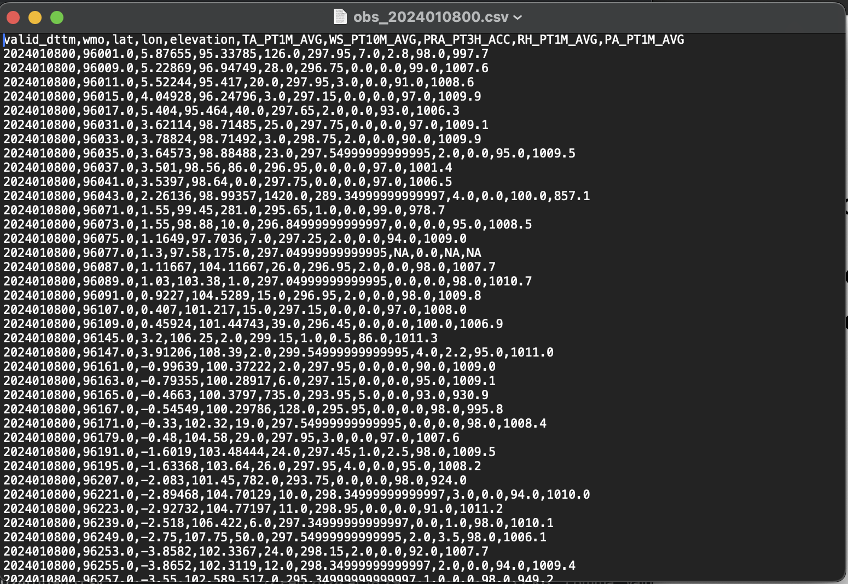

Slide 10
Read Forecast Data (WRF)
read_grid()
generic function to read gridded data from a file
read_forecast()
can be used to interpolate gridded forecast data and output data to Sqlite
file names must contain date and time of analysis time (when forecast is started to run)
preferably all leadtimes in same file
File formats: grib, netcdf
Interpolation methods: nearest, bilinear

Slide 11
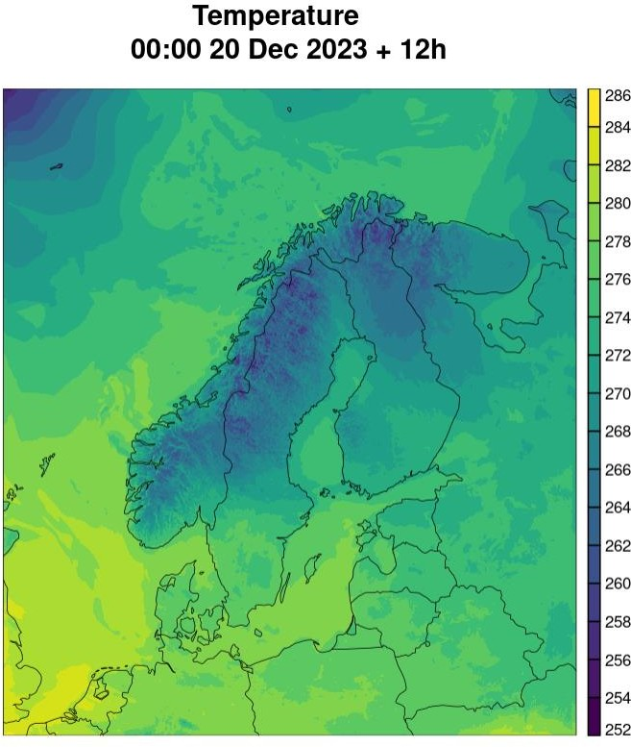
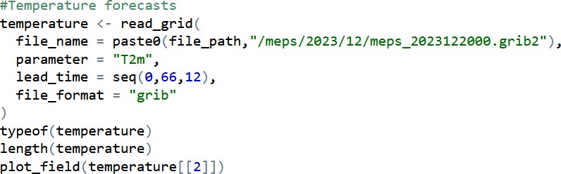
Example of read_grid function
https://rdrr.io/github/andrew-MET/harpIO/man/read_grid.html
read grib data from a file and plot the geofield with plot_field function
Temperature (T2m) parameter selected
Leadtimes from 0 to 66 hours, every 12 hours

Slide 12
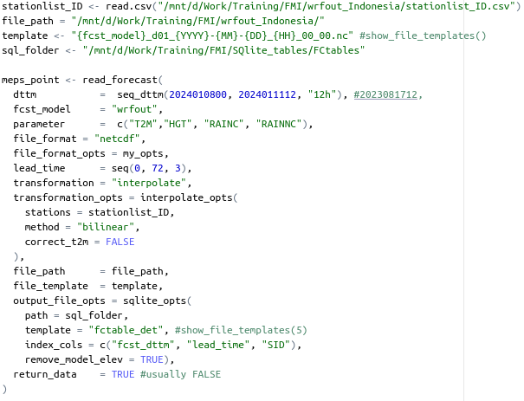
Example of read_forecast function
https://rdrr.io/github/andrew-MET/harpIO/man/read_forecast.html
netcdf format
Stations are needed for interpolation
file_path: parent path of model data

Slide 13
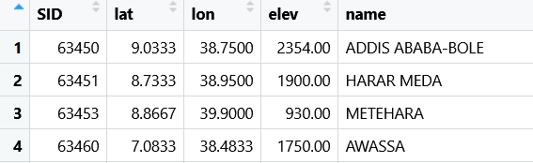
Station list
To interpolate to station points you need station list that contains columns: SID, lat, lon, elev, name
Harp has build in station list in the variable station_list
It contains SYNOP stations from all around the world, but not
every local station and it is not updated regularly
Best way is to create your own station list and save it as csv

Slide 14
Some basic sqlite3 commands
Open sqlite file using sqlite3
wrf@ip-xxxx]$ sqlite3 FCTABLE_T2_202004_00.sqlite
For listing available dot commands
sqlite> .help
See tables and columns in the sqlite file
sqlite> .schema
See all the data from table called ”FC”
sqlite> select * from FC;
Select data with conditions
sqlite> select * from FC where SID=63895 and lead_time < 24;
Exit from sqlite3
sqlite> .exit

Slide 15
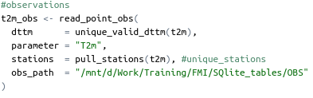
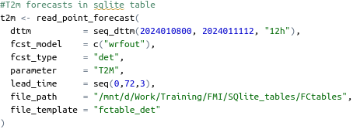
Verification Process
Read in forecast and observation data from sqlite files
https://rdrr.io/github/andrew-MET/harpIO/man/read_point_forecast.html
https://rdrr.io/github/andrew-MET/harpIO/man/read_point_obs.html
Forecast files in FCTABLE and observations in OBS tables
read_point_forecast()
read_point_obs()

Slide 16


Join forecast and observation data
join_to_fcst() function
This function finds all forecast - observation pairs (by valid_dttm, SID, units)
It is possible to convert temperature to degrees °C using mutate() function

Slide 17
Verification function
det_verify()
https://rdrr.io/github/andrew-MET/harpPoint/man/det_verify.html
Summary score

Slide 18
Plotting verification scores (Continuous predictand)
Scatter plot
plot_point_verif(verif_data = verif_t2m, score = hexbin)

Slide 19
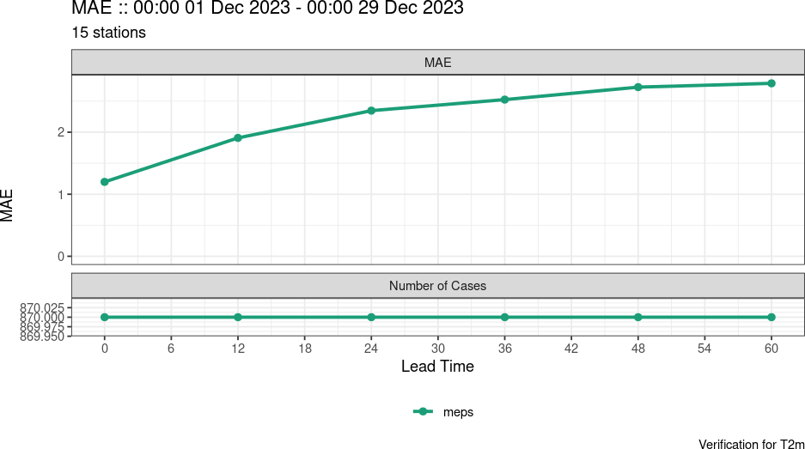
Mean absolute error (mae)
plot_point_verif(verif_data = verif_t2m, score = mae)

Slide 20
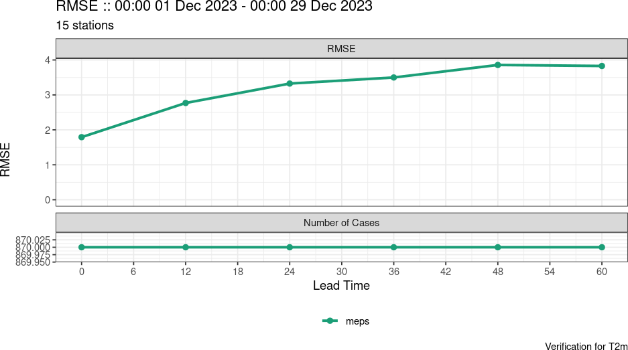
Root mean squared error (rmse)
plot_point_verif(verif_data = verif_t2m, score = rmse)

Slide 21
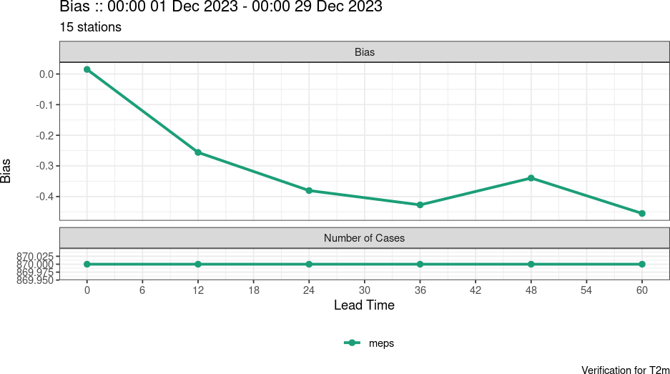
Mean error / bias
plot_point_verif(verif_data = verif_t2m, score = bias)

Slide 22
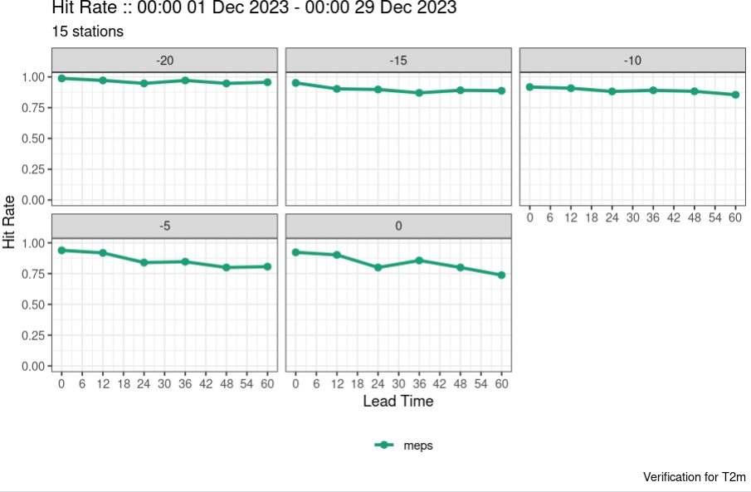
Plotting verification scores (Categorical predictand)
Hit rate
plot_point_verif(verif_data = verif_t2m, score = hit_rate, facet_by = vars(threshold), plot_num_cases = FALSE)

Slide 23
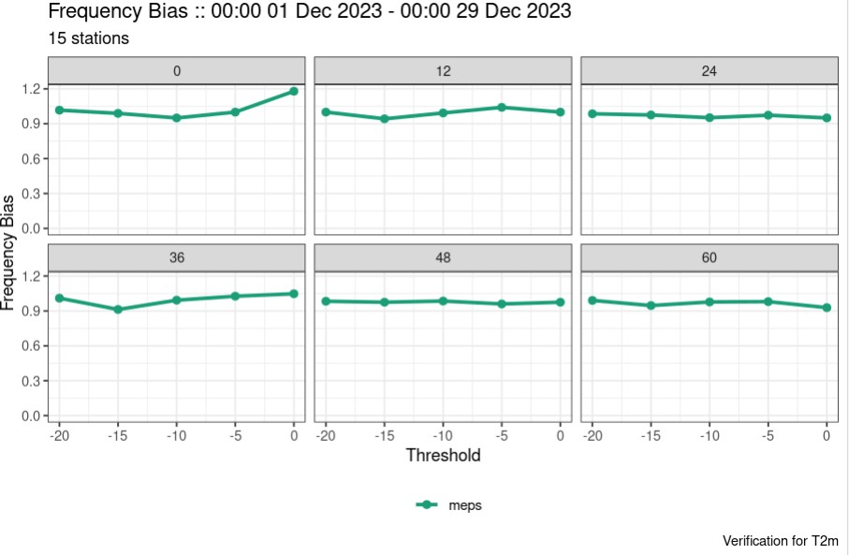
Frequency bias
plot_point_verif(verif_data = verif_t2m, score = frequency_bias, x_axis = threshold, facet_by = vars(lead_time))

Slide 24
Terima Kasih

