Slide 1


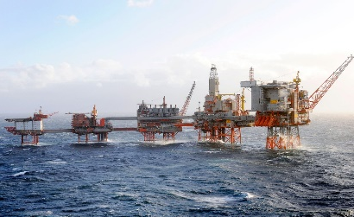

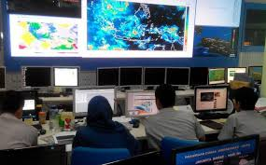
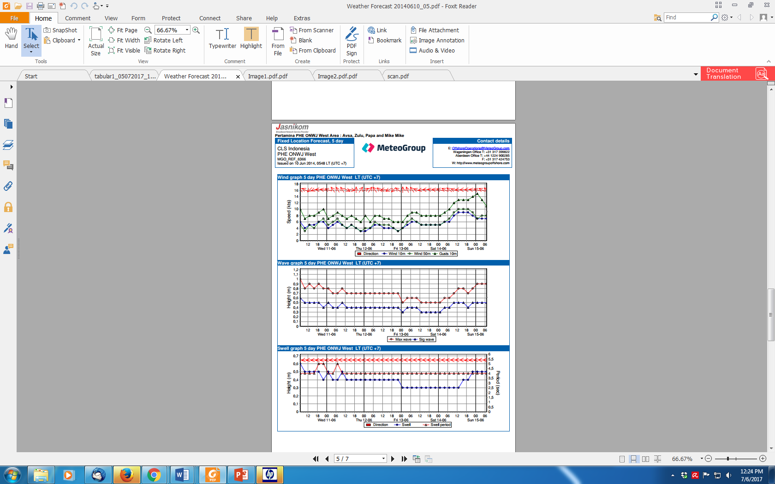
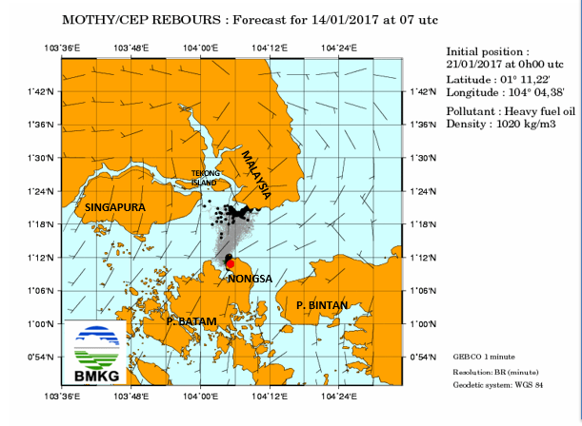
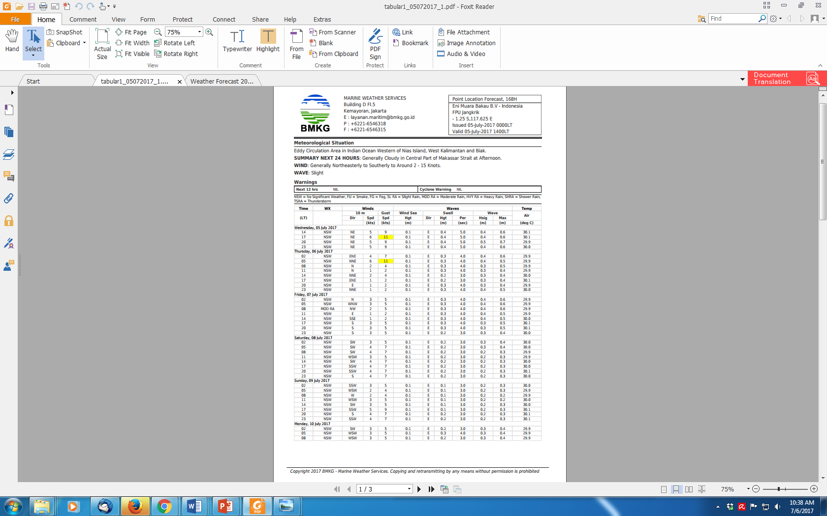
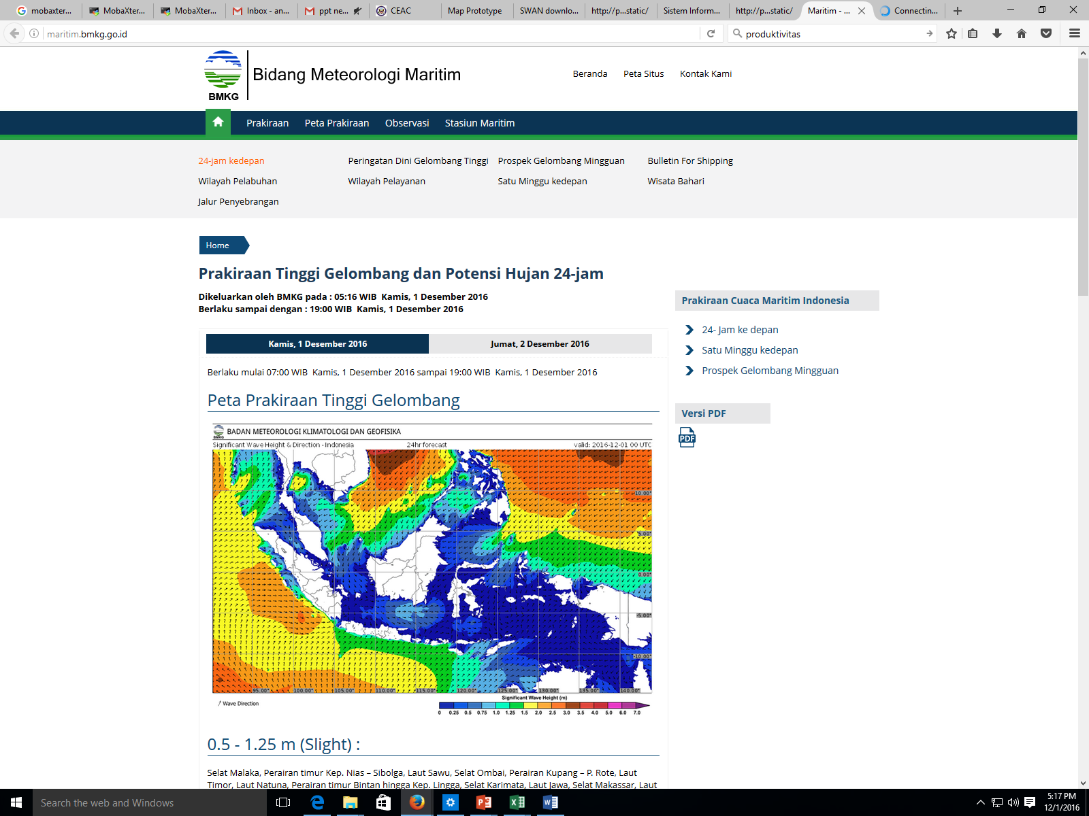
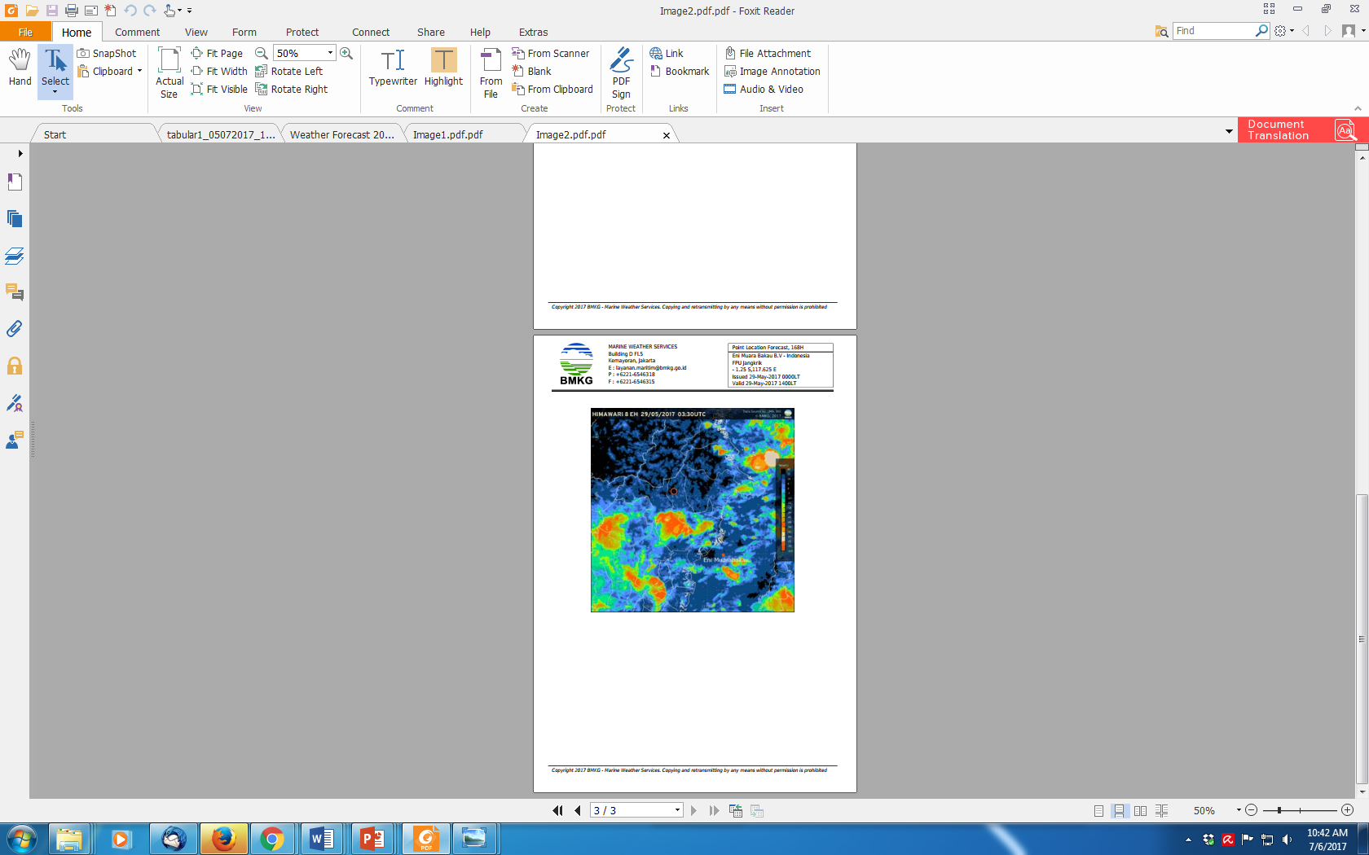
USING R FOR NETCDF DATA ANALYSIS
WIDO HANGGORO

Slide 2
Introduction to NetCDF
What is NetCDF?
Common Uses
Advantages
Why use R for NetCDF
R’s Strength
NetCDF in R
Integration
Installing Required Packages
Exploring a NetCDF File
Reading Data from NetCDF Files
Working with Raster Data
Manipulating and Analyzing NetCDF Data
Visualizing NetCDF Data
Saving and Exporting Data
Hands-On Example

Slide 3
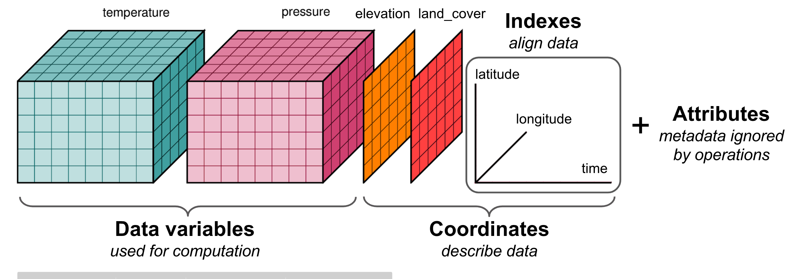
Introduction to NetCDF
NetCDF (Network Common Data Form) is a set of software libraries and self-describing, machine-independent data formats that support the creation, access, and sharing of array-oriented scientific data.

Slide 4

NetCDF is set of software of libraries and machine-independent data formats that support creations, access and sharing of array-oriented scientific data.
First released in 1989
NetCDF is widely used in University Earth Science community.
Used for IPCC datasets
Used by NASA and other large
data producers

Slide 5

NetCDF Convention’s
The NetCDF User's Guide recommends some conventions (ex. "units" and "Conventions" attributes).
Conventions are published agreements about how data of a particular type should be represented to foster interoperability.
Most conventions use attributes.
Use of an existing convention is highly recommended. Use the CF Conventions, if applicable.

Slide 6
A netCDF file should use the global "Conventions" attribute to identify which conventions it uses.
The CF Conventions are becoming a widely used standard for atmospheric, ocean, and climate data.
The NetCDF Climate and Forecast (CF) Metadata Conventions, Version 1.3, describes consensus representations for climate and forecast data using the netCDF-3 data model.
http://cf-pcmdi.llnl.gov/documents/cf-conventions/1.3/cf-conventions.html

Slide 7
NetCDF Advantages
Scalable - It provides efficient access to subsets of the data
Appendable - You can easily add new data without redefining the structure
Shareable - It’s a common format that’s independent of the coding language and operating system.
Self-describing - The source file contains both a description of the data’s organization and the data itself.
Community - The tools are made available by a community of users
Notes:
With a NetCDF file, we don’t need to repeat the latitude and longitude values for each day, nor the dates for each location.

Slide 8
Why R for NetCDF?
R’s Strengths: R is excellent for data manipulation, analysis, and visualization.
NetCDF in R: R provides packages like ncdf4, RNetCDF and raster to interact with NetCDF files.
Integration: Easily integrates with other tools and formats in R.

Slide 9
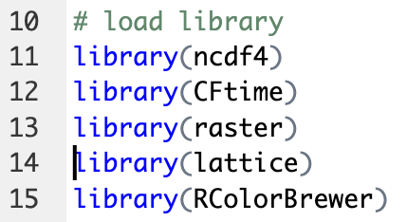
Reading NetCDF

Slide 10
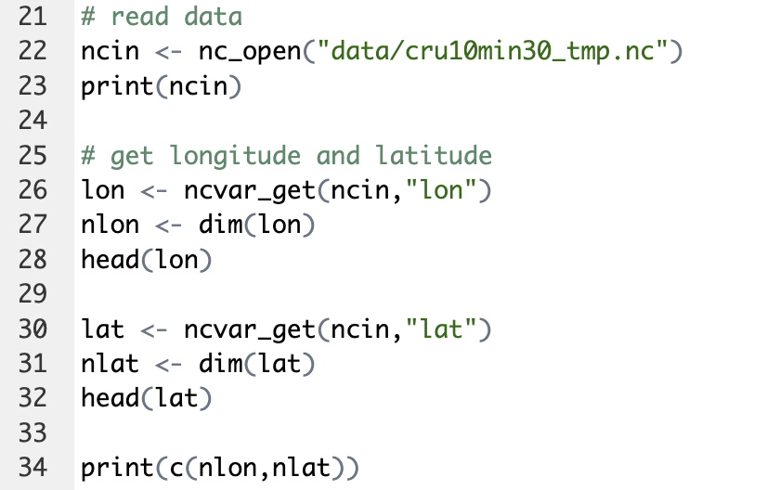
ncdf4

Slide 11
Terima Kasih

