Slide 1
Plot Compression in Chia Blockchain
Diego Escondrillas (A20528684)
Hendra Wijaya (A20529195)

Slide 2


Introduction
Chia Network:
Open-source
Aims to address scalability and energy consumption limitations
PoST
Farming processes:
Plotting
Harvesting

Slide 3


Introduction
Plotting:
Creating plots
Plot → File containing hashes
Generated using disk space
Plotting options:
MadMax
Bladebit
Default plotter
Plot size → K parameter

Slide 4





Introduction
Farming → Creating blocks
Farmers wait for a challenge to be called out → Check plots
Higher number of plots → Higher probability of winning

Slide 5



Background
PoW:
Miners solve puzzles computational power
PoS:
Miner is selected beforehand
PoST:
Trades computing power for storage

Slide 6





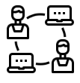

Motivation
More users more data/plots unwieldy Blockchain size
Plot Compression

Slide 7
Proposed
Solution
System requirements | Minimum | Recommended | Testbed
CPU | 4 cores | 8 cores | 6 cores
RAM | 16GB | 32GB | 32GB
Boot drive | SSD SATA | SSD NVMe | SSD NVMe
Temporary directory | – | HDD 8TB | HDD 4TB
Final directory | HDD | SSD | HDD
Compare performance of plotters:
Chia Proof of Space 1.0.11
BladeBit Plotter 2.0.1 (Disk plot)
madMAx Plotter (1.1.6-2092041)

Slide 8
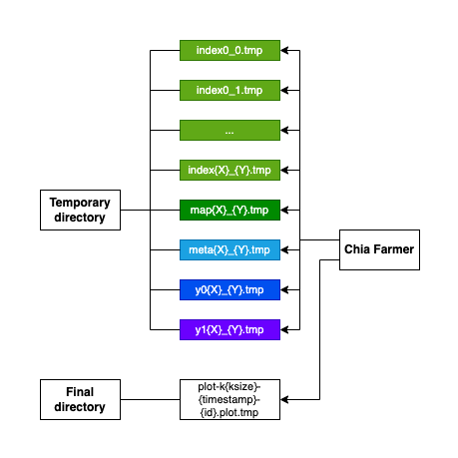
Evaluation
Plotting: Phase 1
Create temporary files.
Fill with cryptographic hashes.
Up to 5x bigger size than final plot.

Slide 9
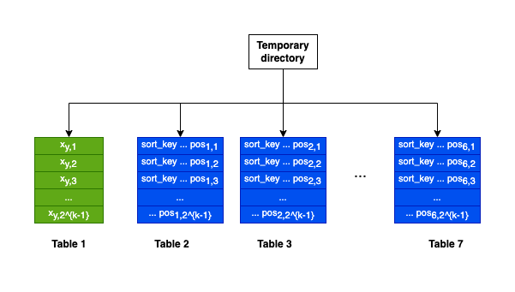
Evaluation
Plotting: Phase 2
Backpropagation.
Sort tables and keep sorted indices.
Remove unused data in the process.

Slide 10
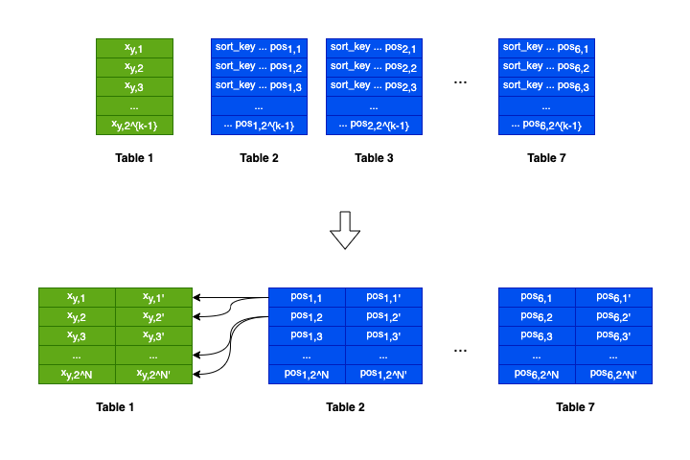
Evaluation
Plotting: Phase 3
Lossless compression.
Merge all columns to double-pointers.

Slide 11
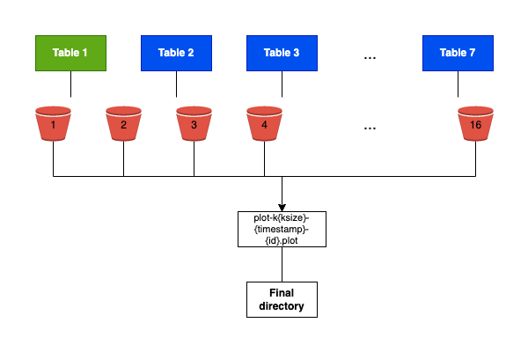
Evaluation
Plotting: Phase 4
Divide 16 buckets for sorting.
Write final plot file.
Remove temporary files.

Slide 12
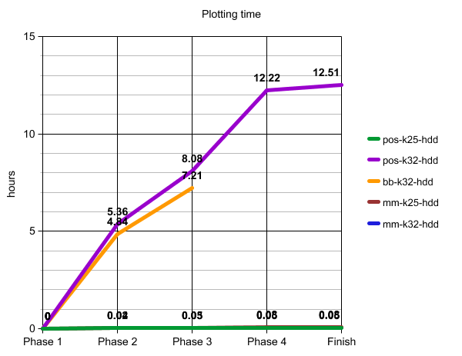
Evaluation
Findings
pos: Proof of Space.
bb: BladeBit.
mm: madMAx
hdd: Hard disk drive.

Slide 13


Related work
Chia´s plot compression is new
There isn´t much research

Slide 14




Conclusion
Plotting is a costly process
Compression reduces size of plots
Tradeoff between computation and storage

Slide 15
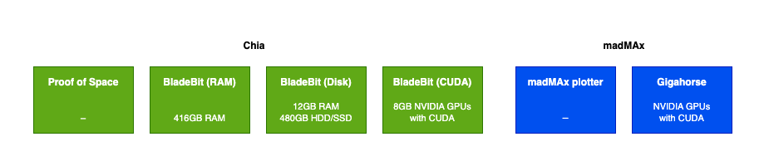
Conclusion
Future Work
Explore other compression techniques.

Slide 16
THANK YOU!
QUESTIONS?

