Slide 1
CS579 – Introduction
Hendra Wijaya (A20529195)

Slide 2
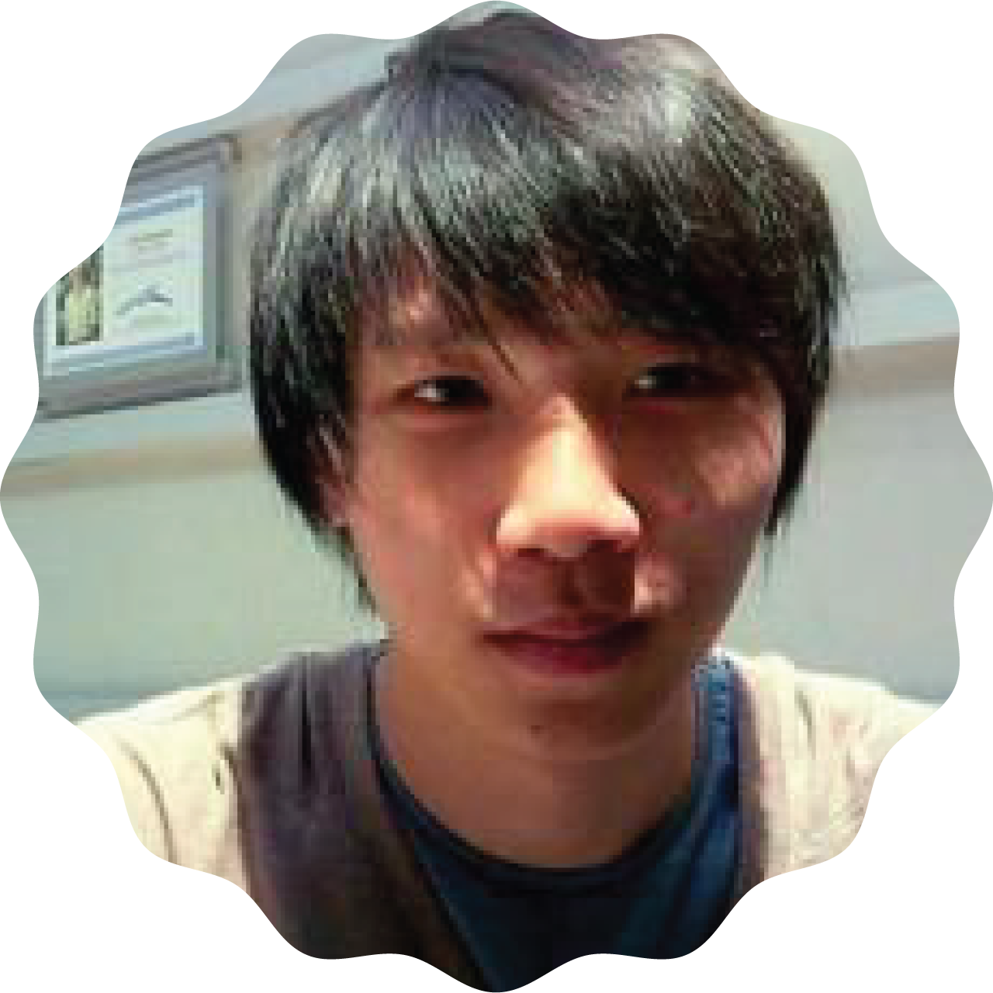
Fun fact:
I am obsessed with the Kotlin programming language
I prefer to eat a slice of pizza with a fork and a knife. Some people find this offensive. 🍕
Hi!
I’m Hendra from Indonesia. 🇮🇩

