Slide 1
JSON and JSON-Schema vs. XML

Slide 2
Table of Contents
Comparison of XML and JSON
JSON
JSON Schema

Slide 3
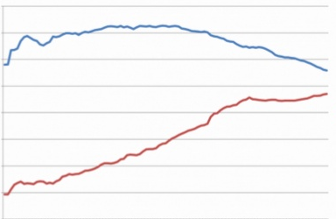

Trends in XML and JSON usage
80%
70%
60%
50%
40%
30%
20%
10%
0%
XML
JSON
2006 2007 2008 2009 2010 2011 2012 2013
Based on directory of 11,000 web APIs listed at Programmable Web, December 2013
Wow! I better have expertise in both XML and JSON

Slide 4
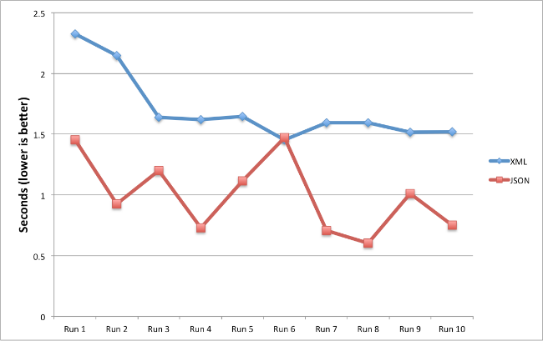
Mobile Performance

Slide 5
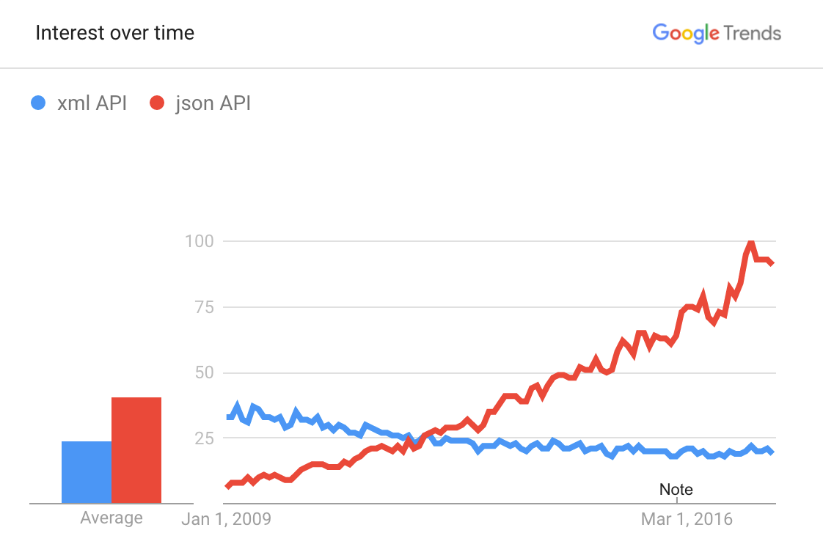

Slide 6
XML is a data format
XML is a way of structuring data … XML is a data format.

Slide 7
JSON is a data format
JSON is a way of structuring data … JSON is a data format.

Slide 8
Example of XML-formatted data
The below XML document contains data about a book: its title, authors, date of publication, and publisher.
<Book> <Title>Parsing Techniques</Title> <Authors> <Author>Dick Grune</Author> <Author>Ceriel J.H. Jacobs</Author> </Authors> <Date>2007</Date> <Publisher>Springer</Publisher> </Book>

Slide 9
Same data, JSON-formatted
{ "Book": { "Title": "Parsing Techniques", "Authors": [ "Dick Grune", "Ceriel J.H. Jacobs" ], "Date": "2007", "Publisher": "Springer" } }

Slide 10
XML and JSON, side-by-side
{ "Book": { "Title": "Parsing Techniques", "Authors": [ "Dick Grune", "Ceriel J.H. Jacobs" ], "Date": "2007", "Publisher": "Springer" } }
<Book> <Title>Parsing Techniques</Title> <Authors> <Author>Dick Grune</Author> <Author>Ceriel J.H. Jacobs</Author> </Authors> <Date>2007</Date> <Publisher>Springer</Publisher> </Book>

Slide 11
Creating lists in XML and JSON
{ "Book": { "Title": "Parsing Techniques", "Authors": [ "Dick Grune", "Ceriel J.H. Jacobs" ], "Date": "2007", "Publisher": "Springer" } }
<Book> <Title>Parsing Techniques</Title> <Authors> <Author>Dick Grune</Author> <Author>Ceriel J.H. Jacobs</Author> </Authors> <Date>2007</Date> <Publisher>Springer</Publisher> </Book>

Slide 12
An XML document is a tree
Book
Authors
Title
Date
Publisher
Author
Author
Parsing Techniques
Dick Grune
Ceriel J.H. Jacobs
2007
Springer

Slide 13
A JSON Object is a tree
Book
Authors
Title
Date
Publisher
[“Dick Grune”, “Ceriel J.H. Jacobs”]
Parsing Techniques
2007
Springer

Slide 14
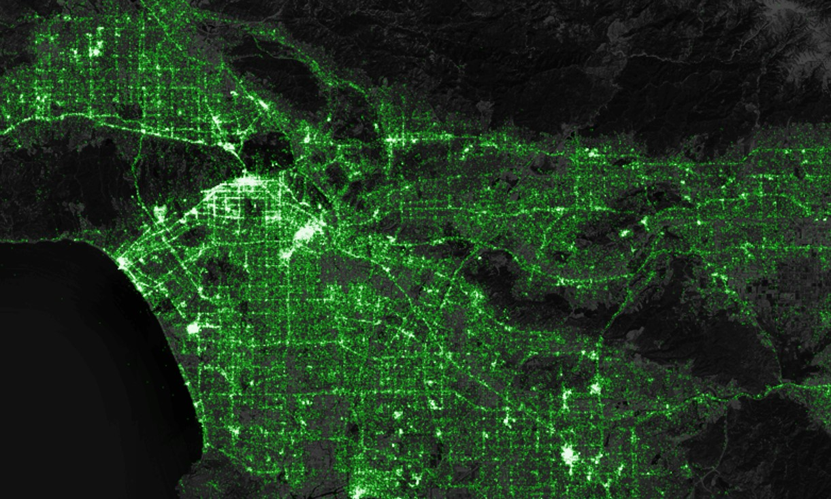
JSON used to store location of tweets (Eric Fisher)
https://www.mapbox.com/blog/twitter-map-every-tweet/

Slide 15
JSON used to store location of tweets (cont.)
Tracking geotagged tweets from Twitter’s public API for the last three and a half years.
There are about 10 million public geotagged tweets every day, which is about 120 per second.
The accumulated history adds up to nearly three terabytes of compressed JSON and is growing by four gigabytes a day.
The map on the previous slide shows what 6,341,973,478 tweets look like on a map.
Using this program to parse the JSON and pull out just each tweet’s username, date, time, location, client, and text:
https://github.com/ericfischer/twitter-json

Slide 16
The JSON data format

Slide 17
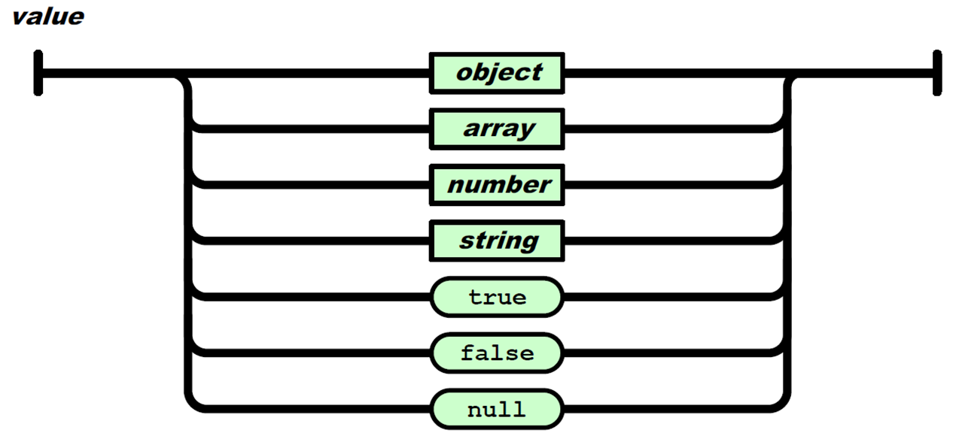
JSON value
A JSON instance contains a single JSON value. A JSON value may be either an object, array, number, string, true, false, or null:
Acknowledgement: This “railroad” graphic comes from the JSON specification, as do the railroad graphics on the next several slides.

Slide 18
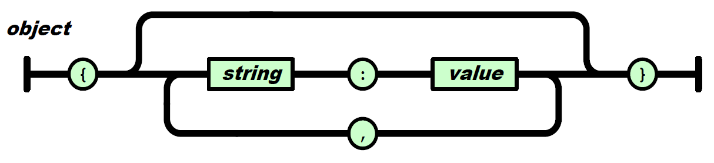
JSON object
A JSON object is zero or more string-colon-value pairs, separated by comma and wrapped within curly braces:
Example of a JSON object:
{ "name": "John Doe", "age": 30, "married": true }

Slide 19
Empty object
A JSON object may be empty.
This is a JSON object: { }

Slide 20
No duplicate keys
You should consider JSON objects as containing key/value pairs.
Just as in a database the primary keys must be unique, so too in a JSON object the keys must be unique.
This JSON object has duplicate keys:
{ "Title": "A story by Mark Twain", "Title": "The Adventures of Huckleberry Finn" }

Slide 21
JSON parsers have unpredictable behavior on JSON objects with duplicate keys
A JSON object whose names are all unique is interoperable in the sense that all software implementations receiving that object will agree on the name-value mappings. When the names within an object are not unique, the behavior of software that receives such an object is unpredictable. Many implementations report the last name/value pair only. Other implementations report an error or fail to parse the object and some implementations report all of the name/value pairs, including duplicates.
RFC 7159
This web site (https://web.archive.org/web/20151004063037/http://fadefade.com/json-comments.html) describes a JSON parser that ignores the first key/value pair and as a result a form of covert channel is generated.

Slide 22
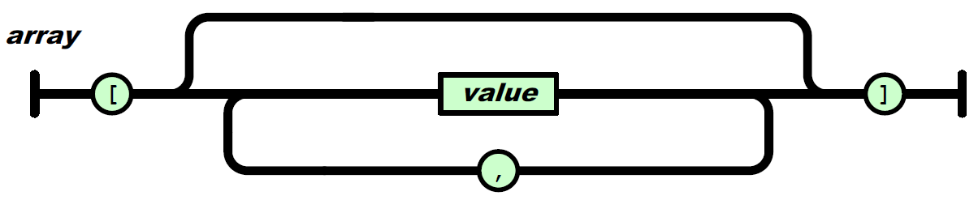
JSON array
A JSON array is used to express a list of values. A JSON array contains zero or more values, separated by comma and wrapped within square brackets:
{ "name": "John Doe", "age": 30, "married": true, "siblings": ["John", "Mary", "Pat"] }
Example of a JSON array

Slide 23
Empty array vs. array with a null value
[ ] [ null ]
Array with one item in it.
Array with no items (empty) in it.

Slide 24
Array of objects
Each item in an array may be any of the seven JSON values.
{ "name": "John Doe", "age": 30, "married": true, "siblings": [ {"name": "John", "age": 25}, true, "Hello World" ] }
The array contains 3 items. The first item is an object, the second item is a boolean, and the third item is a string.

Slide 25
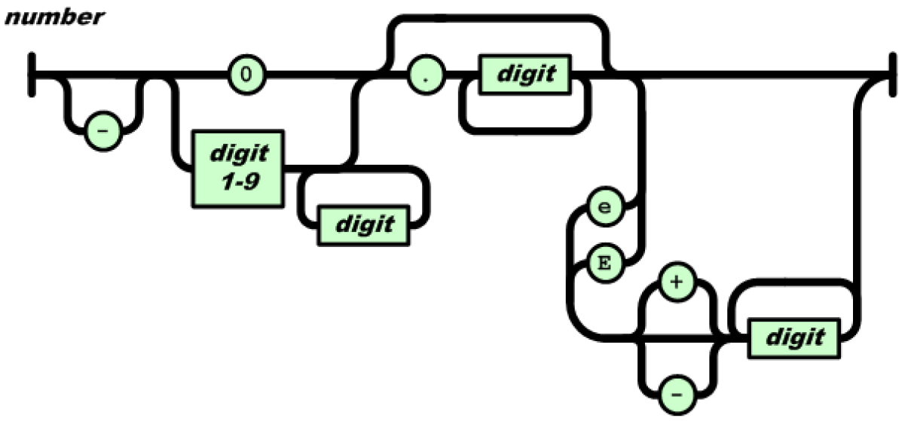
JSON number
A number is an integer or a decimal and it may have an exponent:
{ "name": "John Doe", "age": 30, "married": true, "siblings": ["John", "Mary", "Pat"] }
Example of a JSON number

Slide 26
JSON string
A string is a sequence of Unicode characters wrapped within quotes (").
{ "name": "John Doe", "age": 30, "married": true, "siblings": ["John", "Mary", "Pat"] }
Example of a JSON string

Slide 27
These characters must be escaped
If any of the following characters occur within a string, they must be escaped by preceding them with a backslash (\):
quotation mark ("),
backslash (\),
the control characters U+0000 to U+001F

Slide 28
Other JSON values
The values true, false, and null are literal values; they are not wrapped in quotes.
{ "name": "John Doe", "age": 30, "married": true, "siblings": ["John", "Mary", "Pat"] }
Example of a JSON boolean

Slide 29
Good use-case for null
Some people do not have a middle name, we can use null to indicate “no value”:
{ “first-name": "John", “middle-name": null, “last-name": “Doe" }

Slide 30
This is a legal JSON instance
42

Slide 31
so is this
"Hello World"

Slide 32
and so is this
true

Slide 33
and this
[ true, null, 12, "ABC" ]

Slide 34
Whitespace is irrelevant
{ "name": "John Doe", "age": 30, "married": true }
equivalent
{"name":"John Doe","age":30,"married":true}

Slide 35
String delimiters: JSON vs. XML
JSON strings are always delimited by double quotes.
XML strings (such as attribute values) may be delimited by either double quotes or single quotes.

Slide 36
7 simple JSON components, assemble to generate unlimited complexity
false
null
true
object
array
string
number

Slide 37
Tools of the Trade
Postman
https://jsonformatter.curiousconcept.com
https://codebeautify.org/jsonviewer

