Slide 1
SQLite and Android

Slide 2
SQLite
Embedded RDBMS
ACID Compliant
Size – about 257 Kbytes
Not a client/server architecture
  Accessed via function calls from the application
Writing (insert, update, delete) locks the database, queries can be done in parallel

Slide 3
SQLite
Datastore – single, cross platform file (kind of like an MS Access DB)
  Definitions
  Tables
  Indicies
  Data

Slide 4
SQLite Data Types
This is quite different than the normal SQL data types so please read:
http://www.sqlite.org/datatype3.html

Slide 5
Storage classes
NULL – null value
INTEGER - signed integer, stored in 1, 2, 3, 4, 6, or 8 bytes depending on the magnitude of the value
REAL - a floating point value, 8-byte IEEE floating point number.
TEXT - text string, stored using the database encoding (UTF-8, UTF-16BE or UTF-16LE).
BLOB. The value is a blob of data, stored exactly as it was input.

Slide 6
android.database.sqlite
Contains the SQLite database management classes that an application would use to manage its own private database.

Slide 7
android.database.sqlite - Classes
SQLiteCloseable - An object created from a SQLiteDatabase that can be closed.
SQLiteCursor - A Cursor implementation that exposes results from a query on a SQLiteDatabase.
SQLiteDatabase - Exposes methods to manage a SQLite database.
SQLiteOpenHelper - A helper class to manage database creation and version management.
SQLiteProgram - A base class for compiled SQLite programs.
SQLiteQuery - A SQLite program that represents a query that reads the resulting rows into a CursorWindow.
SQLiteQueryBuilder - a convenience class that helps build SQL queries to be sent to SQLiteDatabase objects.
SQLiteStatement - A pre-compiled statement against a SQLiteDatabase that can be reused.

Slide 8
android.database.sqlite.SQLiteDatabase
Contains the methods for: creating, opening, closing, inserting, updating, deleting and quering an SQLite database
These methods are similar to JDBC but more method oriented than what we see with JDBC (remember there is not a RDBMS server running)
Methods

Slide 9
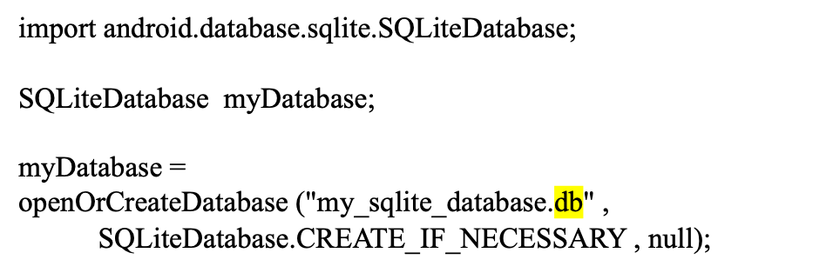
openOrCreateDatabase( )
Methods
This method will open an existing database or create one in the application data area

Slide 10
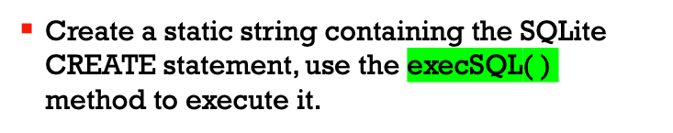
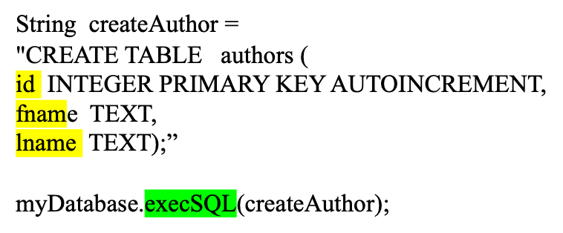
Creating Tables
create table( )

Slide 11
insert( )
long insert(String table, String nullColumnHack, ContentValues values)
import android.content.ContentValues;
ContentValues values = new ContentValues( );
values.put("firstname" , "J.K.");
values.put("lastname" , "Rowling");
long newAuthorID = myDatabase.insert("tbl_authors" , "" , values);

Slide 12
update( )
int update(String table, ContentValues values, String whereClause, String[ ] whereArgs)
public void updateBookTitle(Integer bookId, String newTitle) {
ContentValues values = new ContentValues();
values.put("title" , newTitle);
myDatabase.update("tbl_books", values ,
"id=?" , new String[ ] {bookId.toString() } );
}

Slide 13
delete( )
int delete(String table, String whereClause, String[] whereArgs)
public void deleteBook(Integer bookId) {
myDatabase.delete("tbl_books" , "id=?" ,
new String[ ] { bookId.toString( ) } ) ;
}

Slide 14
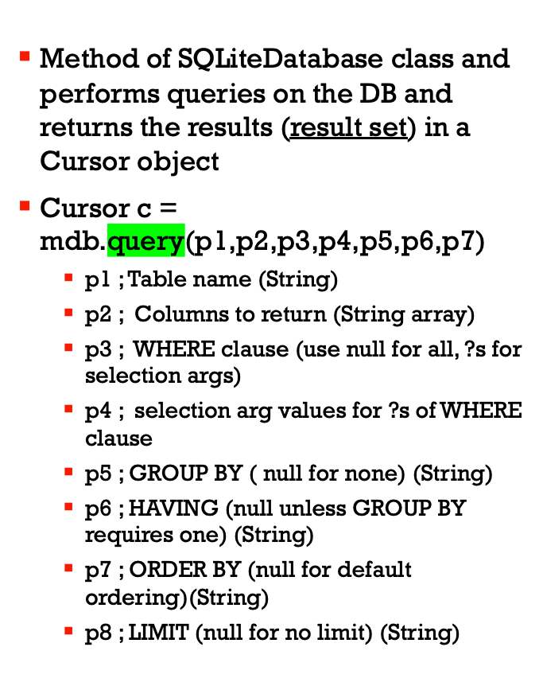
Queries

Slide 15
Simple Queries
SQL - "SELECT * FROM ABC;"
SQLite - Cursor c = mdb.query(abc,null,null,null,null,null,null);
SQL - "SELECT * FROM ABC WHERE C1=5"
SQLite - Cursor c = mdb.query(
abc,null,"c1=?" , new String[ ] {"5"},null,null,null);
SQL – "SELECT title,id FROM BOOKS ORDER BY title ASC"
SQLite – String colsToReturn [ ] {"title","id"};
String sortOrder = "title ASC";
Cursor c = mdb.query("books",colsToReturn,
null,null,null,null,sortOrder);

