Slide 1
SQLite part 2

Slide 2
SQLite Databases
-Reading from DB
Review
Use a cursor to read from db after calling query() method.
Points to individual rows from table.
Extract row data using getInt(), getString(), etc. depending on datatype.
Traverse rows using moveNext(), moveToFirst(), etc on the cursor object.

Slide 3
SQLite Databases
-Reading from DB
Review
// Declare subclass of SQLiteOpenHelper
DatabaseHelper mDbHelper = new DataBaseHelper(this);
// Create and/or open db to read from
db = mDbHelper.getReadableDatabase();
// List items for columns to query
String[] authors = {
Authors.AuthorEntry._ID,
Authors.AuthorEntry.COLUMN_FIRST_NAME,
Authors.AuthorEntry.COLUMN_LAST_NAME};

Slide 4
SQLite Databases
-Reading from DB
Review
Cursor cursor = db.query(
Authors.AuthorEntry.TABLE_NAME,
authors,
null,
null,
null,
null,
null);
while(cursor.moveToNext())
{
//can extract the data from current row here
}

Slide 5
SQLite Databases
-Writing to DB
ContentValue class lets you put information inside an object in the form of Key-Value pairs for columns and their value.
The object can then be passed to the insert() method of an instance of the SQLiteDatabase class to insert or update your WritableDatabase.
Review

Slide 6
SQLite Databases
-Writing to DB
//Create/Open an editable database
SQLiteDatabase db = mDbHelper.getWritableDatabase();
Review

Slide 7
SQLite Databases
-Writing to DB
ContentValues values = new ContentValues();
values.put(Authors.AuthorEntry.COLUMN_ FIRST_NAME, fnameString);
values.put(Authors.AuthorEntry.COLUMN_ LAST_NAME, lnameString);
Review

Slide 8
SQLite Databases
-Writing to DB
long newRowId = db.insert(Authors.AuthorEntry.TABLE_NAME, null, values);
if (newRowId == -1) {
Toast.makeText(this, "Error saving author!", Toast.LENGTH_SHORT).show();
}
Review

Slide 9
SQLite Databases
-Updating DB
public boolean updateData(String id, String fname, String lname) {
SQLiteDatabase db = this.getWritableDatabase();
ContentValues contentValues = new ContentValues();
contentValues.put(COL_1, id);
contentValues.put(COL_2, fname);
contentValues.put(COL_3, lname);
db.update(TABLE_NAME, contentValues, "ID = ?", new String[]{id});
return true;
}
Review

Slide 10

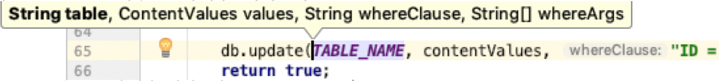
SQLite Databases
-Updating DB
Review

Slide 11
SQLite Databases
Windows users download sqlite from this site:
https://sqlite.org/download.html

Slide 12
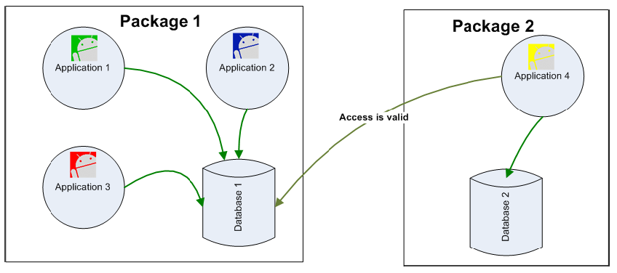
SQLite Databases
Database Visibility
Any Application can access an SD stored database. All it's needed is knowledge of the path where the database file is located.

Slide 13
SQLite CLI
Using SQLITE Command Line Interface (CLI)
The Android SDK contains a command line interface to SQLITE databases.
To open/Create a database use the command
C:> sqlite3 myNewDatabase
You may directly reach the Emulator's data folder and operate on existing databases.
Assume an emulator is running.
We will use adb shell and run-as command to tap in the emulator's internal memory

Slide 14
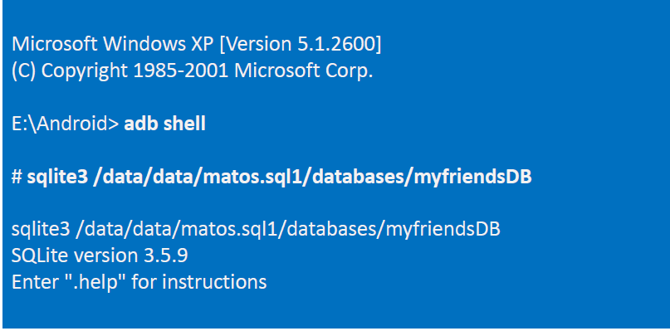
SQLite CLI
Using SQLITE Command Line
After opening the DOS command window/Mac terminal type the following commands:

Slide 15
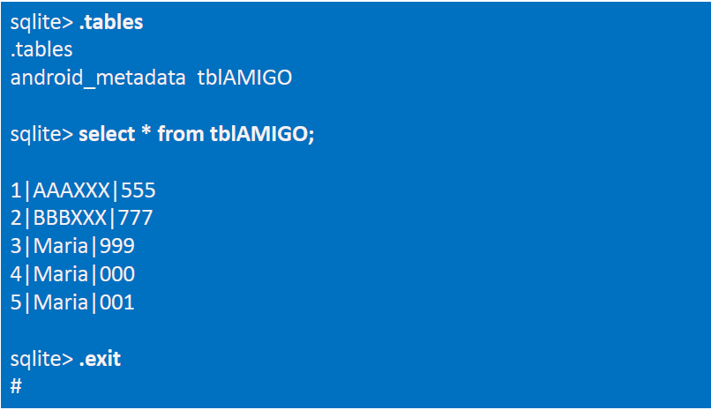
CLI
After opening the DOS command window type the following commands:

Slide 16
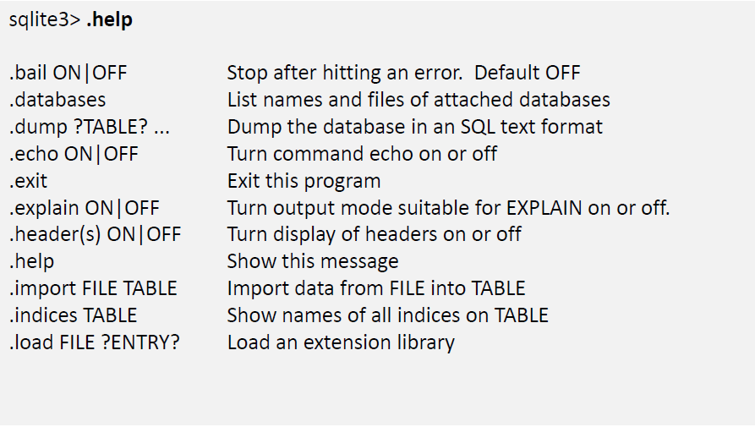
SQLite Commands
Summary of SQLITE3 commands

Slide 17
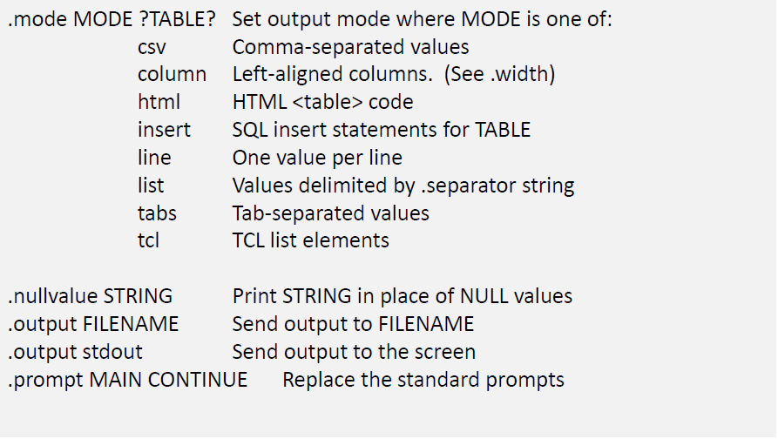
SQLite Commands
More SQLITE3 commands

Slide 18
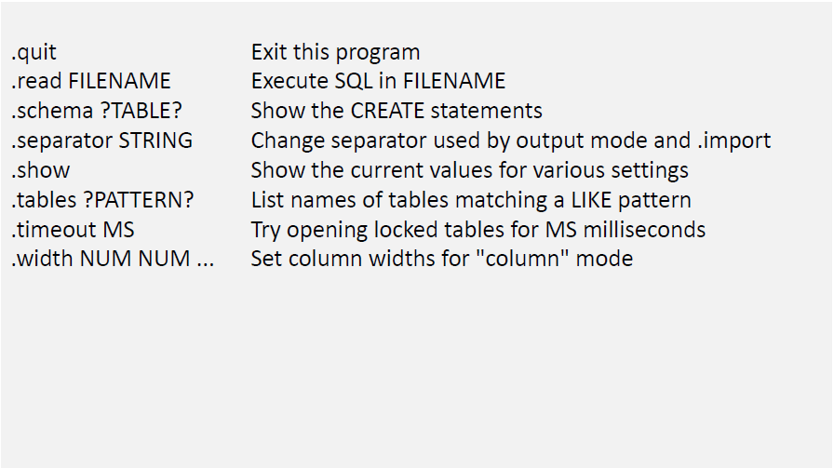
SQLite Commands
More SQLITE3 commands

Slide 19
SQLite GUI Tools
Using GUI Tools for SQLITE
DB Browser for SQLite

Slide 20
SQLite GUI Tools
Using GUI Tools for SQLITE

Slide 21

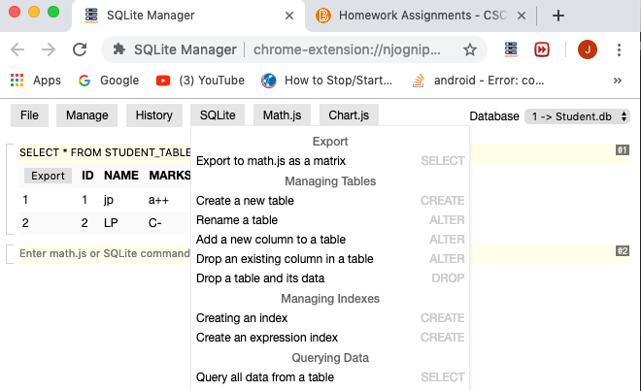
SQLite Manager (Chrome extension -> formerly a FF like plugin!)

Slide 22
Import / Export from emulator
In order to move a copy of the database in and out of the Emulator's storage space and either receive or send the file into/from the local computer's file system you may use the commands:
adb pull <full_path_to_database> and
adb push <full_path_to_database>.

Slide 23
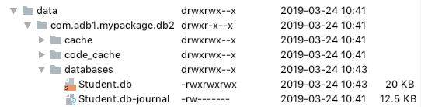
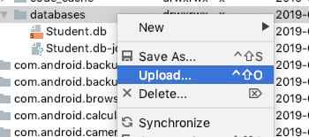
Import / Export from emulator
Or… if API 23 or less, right click on file to download (export)! Likewise, after tweaking, Upload (import)!
Notice privileges!

Slide 24
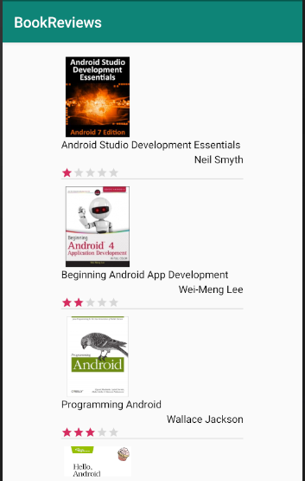
Things to Come!

