Slide 1
Android’s LogCat

Slide 2
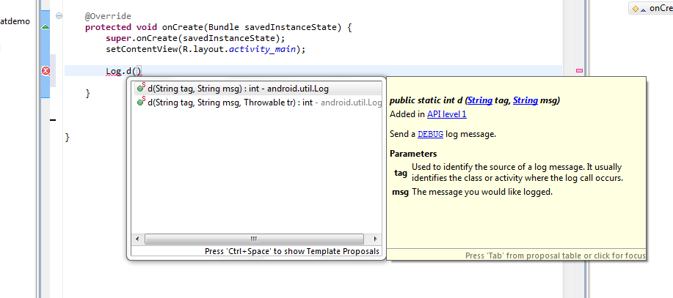
Type Log.d and view the drop-down help – the parameters are tag and msg

Slide 3
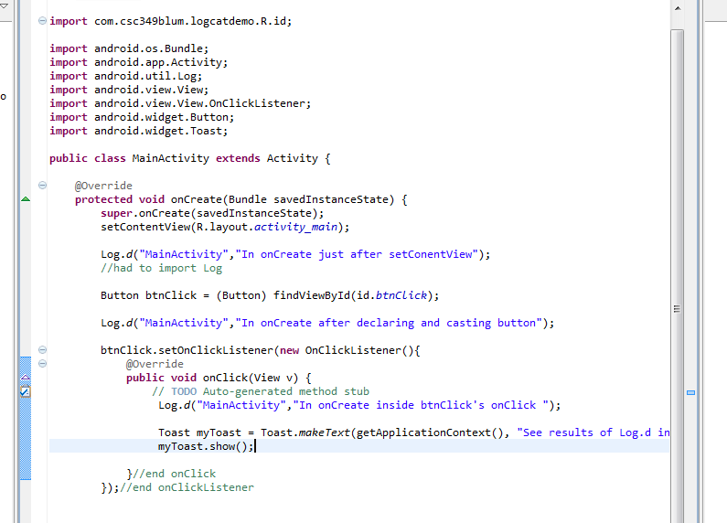
Some code with Log.d

Slide 4
Some code with Log.d
private static final String TAG = SomeActivity.class.getSimpleName();
Log.d(TAG, "some description");

Slide 5
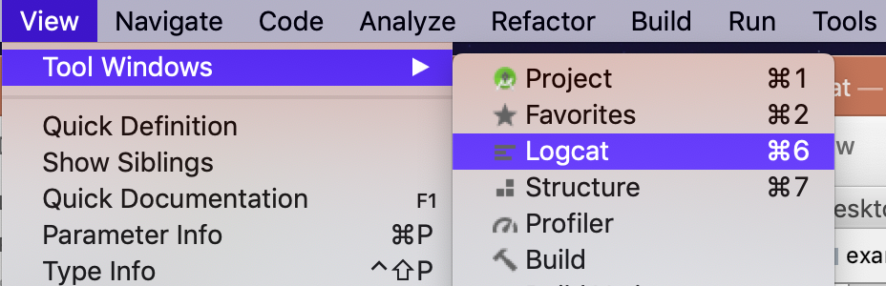
Windows/Show View/Other

Slide 6
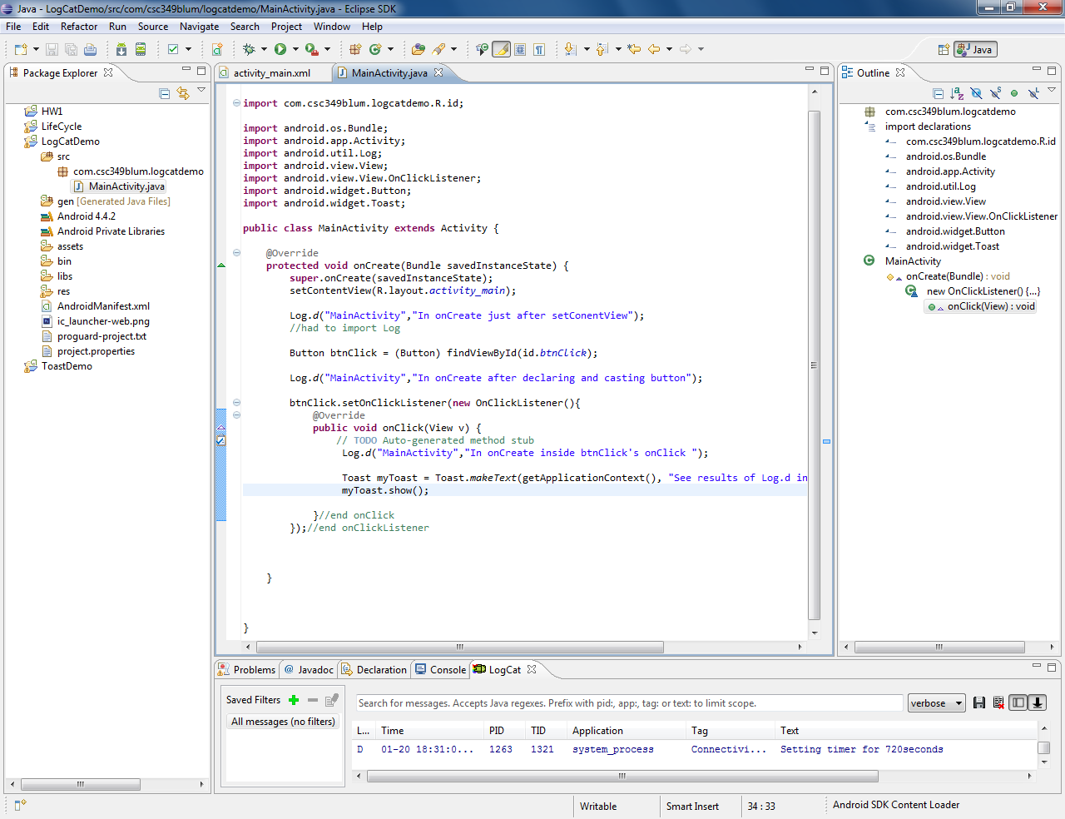
LogCat appears at bottom

Slide 7
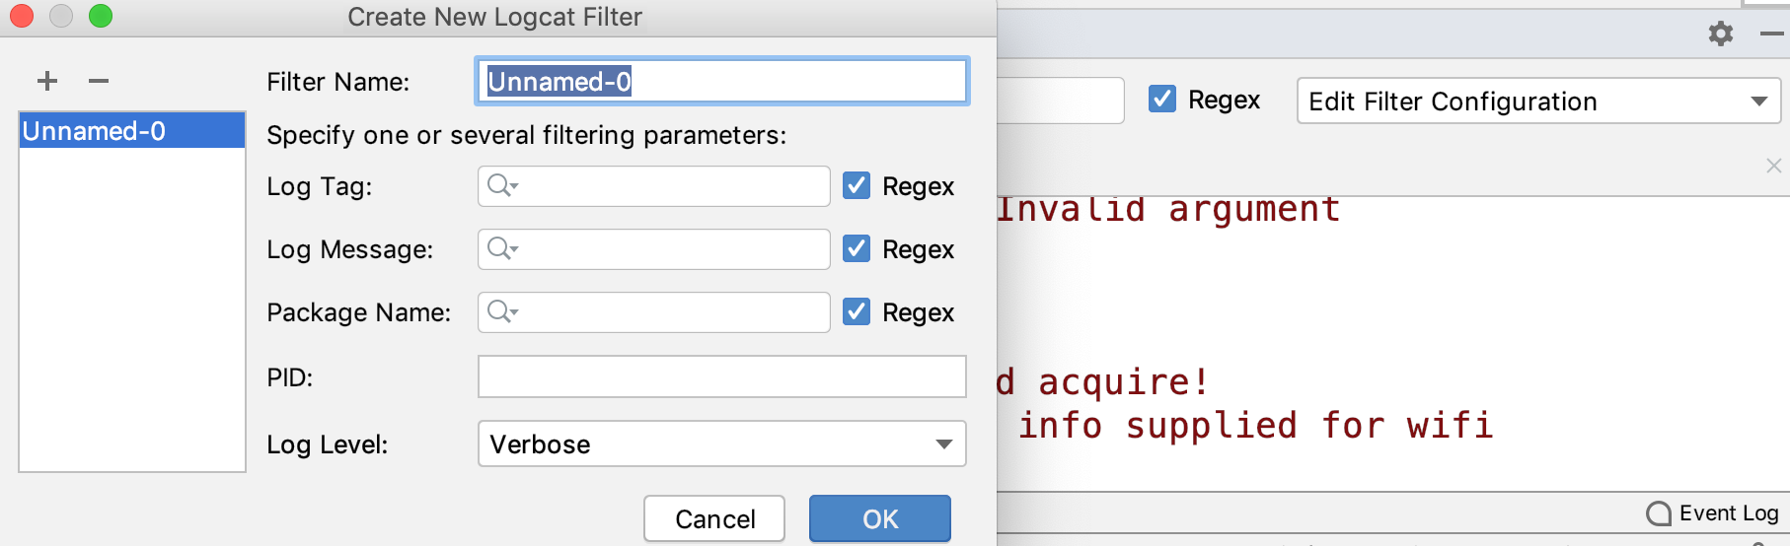
You might need a LogCat filter

Slide 8
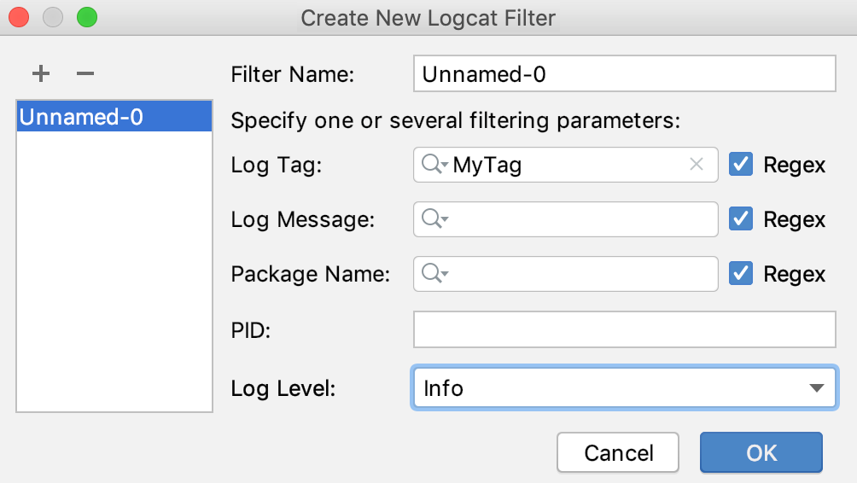
You might need a LogCat filter (set up)

Slide 9
You might need a LogCat filter (coding)
protected void onCreate(Bundle savedInstanceState) {
super.onCreate(savedInstanceState);
setContentView(R.layout.activity_main);
playList = findViewById(R.id.listView);
new AsynDataClass().execute();
countVal=1;
Log.i("MyTag", (countVal++) + "");
}
private class AsynDataClass extends AsyncTask<String, Void,
String> {
HttpURLConnection urlConnection;
@Override
protected String doInBackground(String...params ) {
Log.i("MyTag", (countVal++) + "");

Slide 10
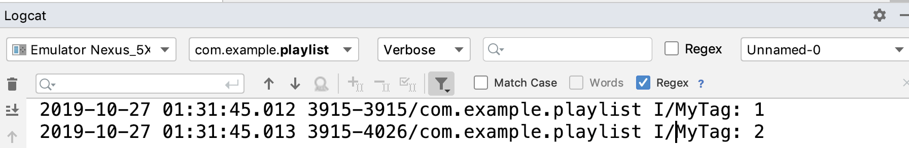
You might need a LogCat filter (result output)

Slide 11
Using CLI for LogCat filter
$adb logcat -s "TAGNAME"

Slide 12
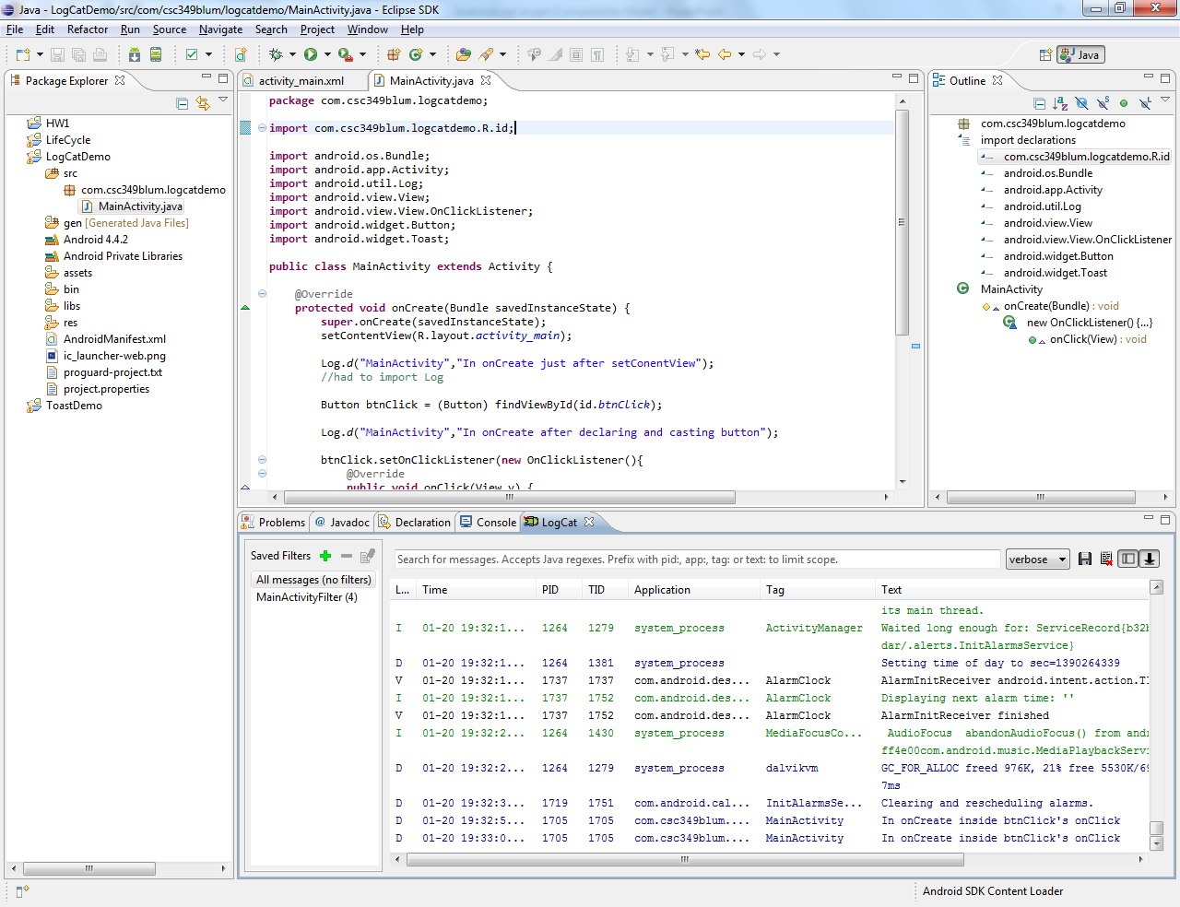
LogCat without filter

Slide 13
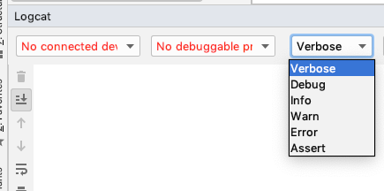
LogCat- class messages (or modes)
Log is a logging class that you can utilize in your code to print out messages to the LogCat. Common logging methods include:
v(String, String) (verbose)
d(String, String) (debug)
i(String, String) (information)
w(String, String) (warning)
e(String, String) (error)
a(String, String) (assert)

Slide 14
Code Examples/Displays
Code…
Log.i("MyActivity", "MyClass.getView() — get item number " + position);
Displays…
I/MyActivity( 1557): MyClass.getView() — get item number 1

