Slide 1
Quality

Slide 2
Terms
As is
Use at your own risk
No warranty
Not responsible for incidental or consequential damages

Slide 3
Quality Defined
The degree to which a set of inherent characteristics fulfills requirements. (PMBOK, p. 718)
Per Brian: I don’t like this definition as it does not relate specifically and directly to addressing customer needs. See next slide.

Slide 4
Juran on quality
Juran defined quality as “fitness for use”
Highlights from Juran on Quality Leadership:
https://bit.ly/2UnO6DE
16 minutes
https://www.mountaingoatsoftware.com/blog/what-is-quality

Slide 5
Juran’s use of the Pareto principle:
Juran would apply the Pareto principle to quality issues (for example, 80% of a problem is caused by 20% of the causes). This is also known as "the vital few”
https://en.wikipedia.org/wiki/Joseph_M._Juran

Slide 6
Demings’ 14 points on quality (1 of 2)
Create constancy of purpose for improving products and services.
Adopt the new philosophy.
Cease dependence on inspection to achieve quality.
End the practice of awarding business on price alone; instead, minimize total cost by working with a single supplier.
Improve constantly and forever every process for planning, production and service.
Institute training on the job.
Adopt and institute leadership.

Slide 7
Deming’s 14 quality points (slide 2 of 2)
Drive out fear.
Break down barriers between staff areas.
Eliminate slogans, exhortations and targets for the workforce.
Eliminate numerical quotas for the workforce and numerical goals for management.
Remove barriers that rob people of pride of workmanship, and eliminate the annual rating or merit system.
Institute a vigorous program of education and self-improvement for everyone.
Put everybody in the company to work accomplishing the transformation.

Slide 8
3 ways to set quality targets
https://www.youtube.com/watch?v=89hDhhi8tDQ (3 min)

Slide 9
Juran on quality
Juran’s Quality Control Handbook 4th ed

Slide 10
“fitness of use” includes these involved stakeholders (p. 1.1)
The various department functions, e.g. product development, purchasing, manufacture, inspection, sales, customer service, and various support functions
The various levels of management, from top executives through supervisors
The various staff specialties associated with policies, objectives, planning, organizing, & improving & controlling quality
Practitioners in a variety of industries & processes

Slide 11
More definitions of quality from Juran (p. 2.2)
Quality consists of those product features which meet the needs of customers and thereby provide satisfaction
Quality consists of freedom from deficiencies
(see next few slides)

Slide 12
Product is the… (p. 2.2)
Output of any process like software

Slide 13
Product feature…(p. 2.2)
A property which is possessed by a product and which is intended to meet certain customer’s needs.

Slide 14
Customers (p. 2.2)
External Customers: Not members of the company producing the product or service
Internal Customers: when organizations supply goods or services to others within the same company
Users: Customers who use the product as an input to their processes, merchants who resell the product, and customers who carry out the ultimate use of the product.

Slide 15
Product Satisfaction…(p. 2.3)
Product features which do respond to customers needs are said to provide “product satisfaction.”
Better product satisfaction can improve market share!

Slide 16
Conformance to specification and standards (p. 2.3)
Meeting customer needs
Freedom from deficiencies

Slide 17
Product Deficiency… (p. 2.3)
Late deliveries, field failure of goods, scrap or rework and design changes.

Slide 18
Product dissatisfaction…. (p. 2.3)
This is the result of product deficiencies.

Slide 19
PMBOK 6th ed. on Quality pp. 271 - 306
Quality Management includes the processes for incorporating the organization’s quality policy regarding planning, managing, and controlling project and product quality requirements in order to meet stakeholder’s objectives

Slide 20
p. 273
“Overworking the project team may result in decreased profits and increased levels or overall project risks, employee attrition, errors and rework.”
“Rushing … quality inspections may result in undetected errors, decreased profits, and increased post implementation risks”

Slide 21
A main idea of quality (p. 274)
“Prevention is preferred over inspection!”

Slide 22
A main idea of quality (p. 274)
“It generally costs much less to correct mistakes before” the product goes into production.

Slide 23
Cost of quality (p. 274) (see next slide)
“all costs incurred over the life of the product by investing in preventing” defects

Slide 24
Costs of quality per Google
Quality planning.
Supplier evaluation.
New product review.
Error proofing.
Capability evaluations.
Quality improvement team meetings.
Quality improvement projects.
Quality education and training.

Slide 25
It is a central idea of quality that is cheaper and most effective to … (p. 275)
Identify and correct defects in the process!

Slide 26
Trends (p. 275)
Customer satisfaction through looking at fitness of use.

Slide 27
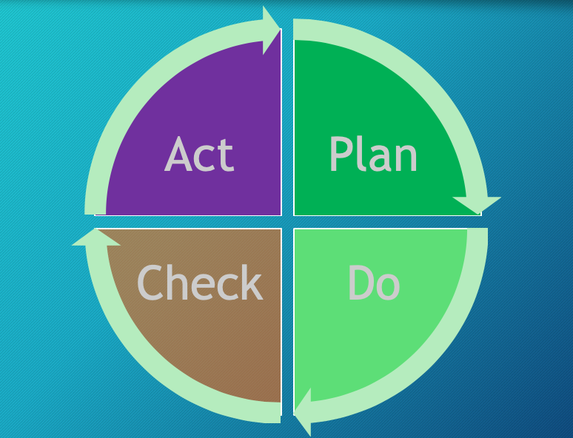
Trends continued (p. 275)
https://www.youtube.com/watch?v=947wRN72Wg0 4 min

Slide 28
Trends continued (p. 275)
Quality is a management responsibility though providing resources
Mutual beneficial partnership with suppliers

Slide 29
Tailoring considerations (p. 276)
Pre-existing quality policies
Industry standards
Continuous improvement
Stakeholder engagement

Slide 30
How to meet your quality targets
https://www.youtube.com/watch?v=TDj0RBjYAdk (5 min)

Slide 31
8.1 Plan Quality Management Plan (p. 277)
The process of identifying quality requirements and/or standards for the project and its deliverables, and documenting how the project will demonstrate compliance with quality requirements and/or standards.
The value is that it provides guidance and direction on how quality will be managed and verified throughout the project

Slide 32
Costs of Quality (p. 282)
Prevention costs
Appraisal costs ( to ensure that their products and services meet customer expectations and regulatory requirements.)
Failure costs

Slide 33
Cost of conformance:$ spent to avoid failures (p. 282)
Prevention costs
Training
Equipment
Time to do it right the first time
Appraisal Costs
Testing
Inspections

Slide 34
Cost of nonconformance: $ spent because of failures (p. 282)
Internal failure costs
Rework
Scrap
External Failure Costs
Liabilities
Warranty work
Lost business
Damage or death to humans

Slide 35
Data representation (p. 284)
Flowcharts
Mind mapping
For an good video of quality flowcharting see = https://www.youtube.com/watch?v=wLkvvqypq1E
5 minutes

Slide 36
8.2 Manage Quality (p. 288)
The process of translating the quality management plan into executable activities…
The values of this process are that it increases the probability of meeting the (project’s) quality objectives as well as identifying ineffective processes and causes of poor quality.

Slide 37
Quality Metrics p718
A description of a project or product and how to measure it.
Metrics are meaningless without context; we give context to metrics by applying SMART goals to them

Slide 38
Quality Checklists p718
A structured tool used to verify that a set of steps has been performed.
Pilots use these all the time – pre-flight checklist

Slide 39
8 Basic Quality Tools
Cause and effect diagrams
Flowcharts
Check lists
Pareto Diagrams
Control charts
Scatter diagrams
5 Whys
Notes:
For more information on this topic, see the PMBOK Guide 8.1.2.3.

Slide 40
Cause and Effect Diagrams (p. 294)
Ishikawa or fishbone
Major cause categories
People
Process
Equipment
Effect:
Problem to be resolved
Major cause categories
Material
Environment
management
Good related vide: https://www.youtube.com/watch?v=JbRx5pw-efg 7 minutes
Notes:
For more information on this topic, see the PMBOK Guide 8.1.2.3.

Slide 41
5 Whys
Y
Y
Y
Y
Y

Slide 42
Flowcharting
Archive
Data Update
New Marketing
Campaign
New Customer Leads
Confirm Lead
Status
Contact Leads
Data
Status
Qualify
Sales
Lead
Sales Process
Lead
Conversion
Client Project
Launch
Data
Archive
Order
Fulfillment
Cycle
Lean:https://www.emsstrategies.com/dm090203article2.html
Notes:
For more information on this topic, see the PMBOK Guide 8.1.2.3.

Slide 43
Pareto Chart
500
100%
375
75%
250
50%
Total Number of Failures
125
25%
50
10%
Skills
Tractor
Light
USB
Interface
MISC
Notes:
For more information on this topic, see the PMBOK Guide 8.1.2.3.

Slide 44
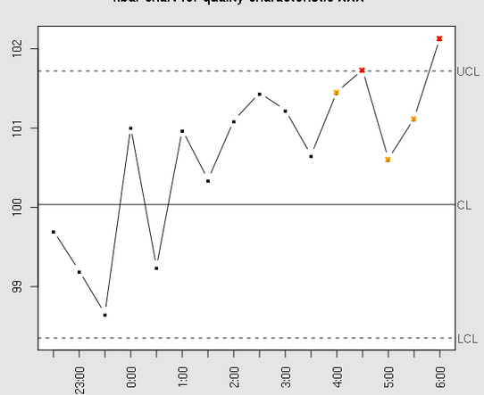
Control Charts
Rule of Seven Non-random
Mean
Control Limits
Out of control
https://www.youtube.com/watch?v=uPTdz8mkxi8
Assignable Cause
Control limits are usually ±3Ʃ
Notes:
For more information on this topic, see the PMBOK Guide 8.1.2.3.

Slide 45
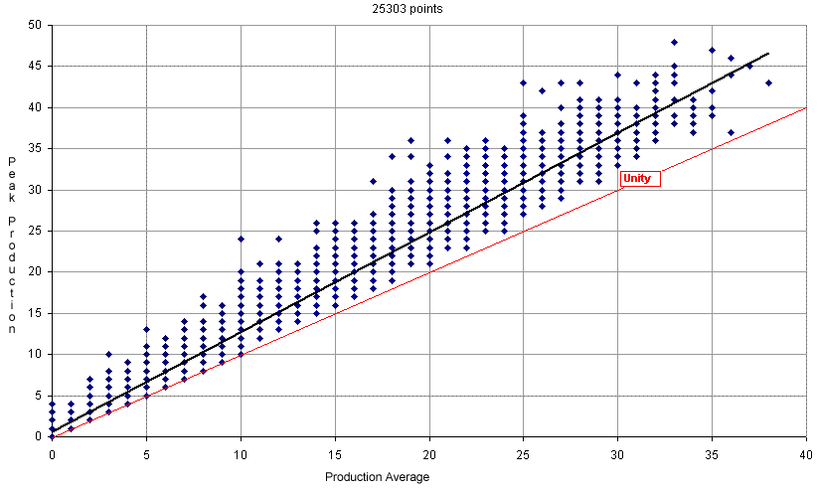
Creating a Scatter Diagram (regression analysis)
Notes:
For more information on this topic, see the PMBOK Guide 8.1.2.3.

Slide 46
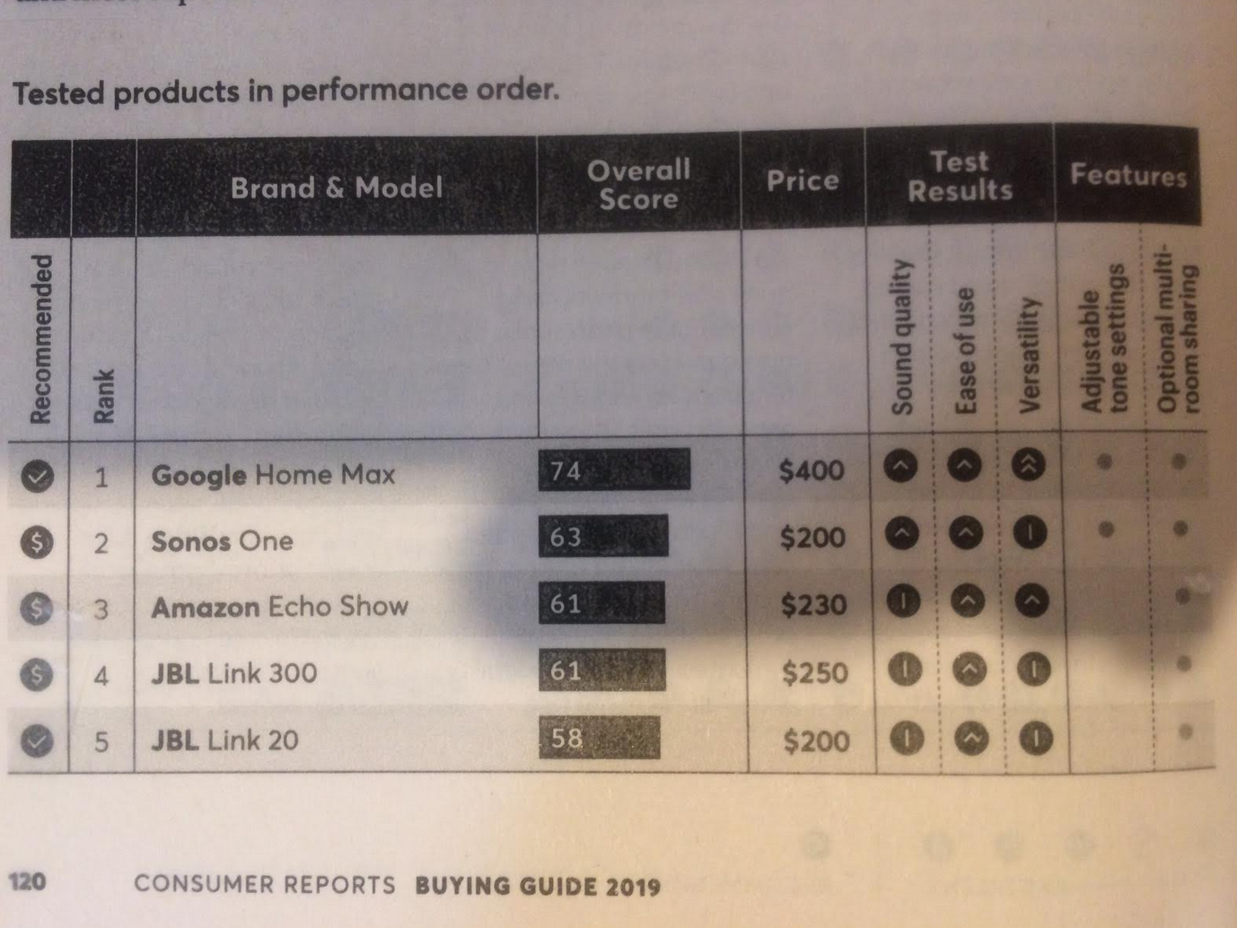
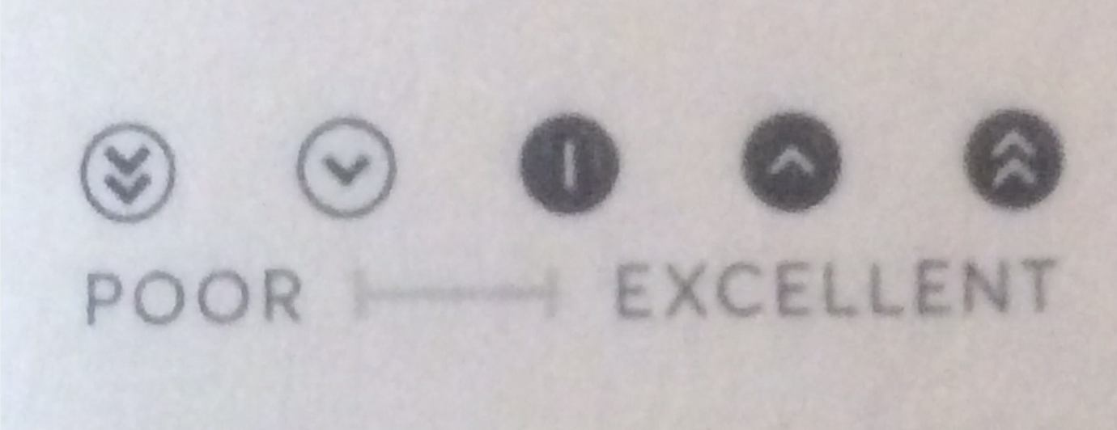
Example of a Needs Analysis Chart

Slide 47
Benchmarking the Project
Comparing two systems
Technology
Materials
Projects
Notes:
For more information on this topic, see the PMBOK Guide 8.1.2.4.

Slide 48
Steps to problem solving (p. 295)
Define the problem
Identify the root cause
Generate possible solutions
Choose the best solution
Implement the solution
Verify solution effectiveness
Notes:
For more information on this topic, see the PMBOK Guide 8.1.2.7.

Slide 49
8.3 Quality Control(p. 298)
Monitoring and controlling and recording results of executing quality management activities in order to assess performance and ensure the project outputs are complete, correct, and meet customer expectations.
The value is verifying that product deliverables and work meet requirements

Slide 50
Data gathering: check sheets
Defect/date | 5/1 | 5/2 | 5/3 | total
Python bug | 1 | 2 | 3 | 6
Bad HTML | 0 | 0 | 0 | 0
Javascript Bug | 4 | 5 | 1 | 10
Angular Bug | 1 | 0 | 0 | 1

Slide 51
Data gathering: Statistical sampling
Statistically selecting a correct sampling size, and only testing that many units

Slide 52
What is 6 sigma
https://www.youtube.com/watch?v=4EDYfSl-fmc

