Slide 1
Plan Human resource Management
Identifying project team needs
Reporting relationships
Assigning roles and responsibilities
Staffing management plan
Staff acquisition
Release of staff
Consideration of organizational policies and structure

Slide 2
Organization Charts
Project Manager
NY Team Leader
Chicago Team Leader
Atlanta Team Leader
San Fran Team Leader
Brian V
Susan F
Mark J
Bob A
Sally A
Tony R
Sheila A
Deepti
Hal I
Gary V
Lawrence T
Frank J
Joe A
Alice P
Shannon U
Molly T
Robert A
Mick Y
Kelly C
Notes:
For more information on this topic see the PMBOK Guide 9.1.2.1

Slide 3
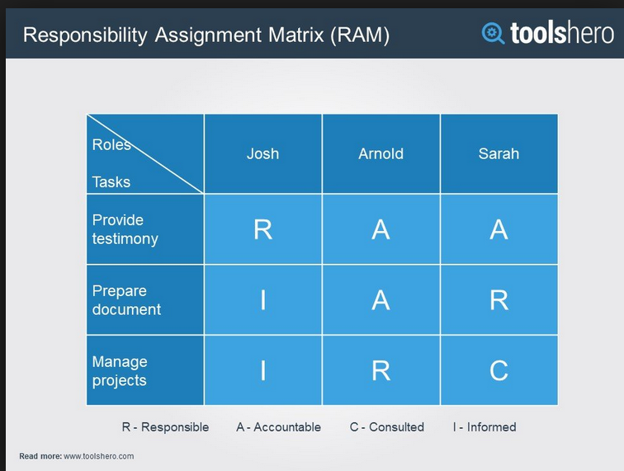
Matrix Chart
Good explanation: https://pmicie.starchapter.com/images/downloads/raci_r_web3_1.pdf
RACI
Chart
Activity | Team Member
 | Sam | Shelly | Ben | Frank | Lloyd | Mark
Web content | R | A |  | C | I
Web design | A | R
App development | I |  | A |  | R
Security | I |  | R | I | I | A
Proofing |  |  |  | A
Testing |  |  |  | R
Payment system | I |  | I | I | I | R
RACI Chart
Responsibility Assignment Matrix
Roles and Responsibilities
See video on next slide
Notes:
For more information on this topic see the PMBOK Guide 9.1.2.1

Slide 4
RACI Video and Pro/Con 7 min
https://www.youtube.com/watch?v=Q97uBi1mQ2g

Slide 5
Maslow’s Hierarchy of Needs
Self- actualization
Esteem
Social
Safety
Physiological
Notes:
For more information on this topic see the PMBOK Guide 9.1.2.3.

Slide 6
Herzberg’s Theory of Motivation
Promote
performance
High
Motivating Agents:
Opportunity
Responsibility
Appreciation
Recognition
Education
Level of performance
Expected Hygiene Agents:
Job security
Paycheck
Acceptable working conditions
Relationships
Must exist first
Low
Notes:
For more information on this topic see the PMBOK Guide 9.1.2.3.

Slide 7
Bruce Tuckman’s Stages of Team Development (important)
Forming
Storming
Norming
Performing
(adjourning)
Please memorize these in order
https://www.youtube.com/watch?v=nRYRZg8YSso
4 min

Slide 8
McGregor’s X and Y
X People
Y People
Self-led
Motivated Capable
Micromanagement
No trust
Lazy
Avoid work
Notes:
For more information on this topic see the PMBOK Guide 9.1.2.3.

Slide 9
Roles and Responsibilities
Role – the label describing the portion of the project the person is accountable.
Authority – apply resources, make decisions, sign approvals.
Responsibility – the work that a project team member is expected to perform.
Competency – the skill and capacity required to complete project activities
Notes:
PMBOK 9.1.3.1

Slide 10
Acquiring the Project Team
Negotiate and influence
Wrong resources affect project’s success
Alternate resources
Costs
Competency
Training
Legal, regulatory, or mandatory criteria
Notes:
For more information on this topic see the PMBOK Guide 9.2.

Slide 11

Acquiring the Project Team
Pre-assignment
Negotiation
Acquisition
Notes:
For more information on this topic see the PMBOK Guide 9.2.2.

Slide 12
Working With Virtual Teams
Geographically dispersed individuals
Experts in different geographical areas
Inclusion of workers from home offices
Project members with varying schedules
People with mobility concerns
The deletion or reduction of travel expenses
Notes:
For more information on this topic see the PMBOK Guide 9.2.2.4.

Slide 13
Multi-Criteria Decision Analysis for Team to determine if a virtual team approach is viable
Availability
Costs
Experience
Ability
Knowledge
Skills
Attitude
International factors
Notes:
For more information on this topic see the PMBOK Guide 9.2.2.5.

Slide 14
Results of team acquisition
Project staff assignments
Resource calendars
Project management plan updates
Notes:
For more information on this topic see the PMBOK Guide 9.2.3.

Slide 15
Develop Project team
Process to improve competencies
Promote team member interaction
Enhance overall project performance
Overall goals of this process:
Improve teamwork
Motivate employees
Reduce turnover rate
Improve overall project performance

Slide 16
Leading Team Development
Interpersonal skills – soft skills
Communication
Emotional intelligence
Conflict resolution
Influence
Team building activities
Forming, storming, norming, performing, and adjourning
Notes:
For more information on this topic see the PMBOK Guide 9.3.2.

Slide 17
Team Development, continued
Ground rules
Colocation – tight matrix
Recognition (thank you letters!, personal acknowledgement)
Personal assessment tools
Attitudinal surveys
Structured interviews
Notes:
For more information on this topic see the PMBOK Guide 9.3.2.

Slide 18
Team Performance Assessments
Improvements in skills
Team competency
Reduced staff turn over rate (keep you high performers!)
Team cohesiveness
Notes:
For more information on this topic see the PMBOK Guide 9.3.3.1.

Slide 19
Manage Project team
Tracking team member performance
Offering feedback to team members
Managing team changes
Influencing team behavior
Resolving conflict

Slide 20
Utilizing Organizational process assets
Organizational process assets can help manage the project team:
Certificates of appreciation
Newsletters
Project websites
Bonus structures
Corporate apparel
Notes:
For more information on this topic see the PMBOK Guide 9.4.1.6.

Slide 21

Conflict Management
Conflict is natural
Team issue
Openness resolves conflict
Focus on issues, not personalities
Focus on present, not past
Notes:
For more information on this topic see the PMBOK Guide 9.4.2.3.

Slide 22
Managing Conflict
Relative importance of the conflict
Time pressure for conflict resolution
Positions of each person involved
Motivation to resolve conflict for short-term or long-term
Notes:
For more information on this topic see the PMBOK Guide 9.4.2.3.

Slide 23
Solving Problems
Withdrawal (avoiding)
Smoothing (accommodating)
Compromising
Forcing
Collaborating
Problem solving (confronting the issue)
Please memorize these and what they mean
Notes:
For more information on this topic see the PMBOK Guide 9.4.2.3.

Slide 24
Relying on Interpersonal Skills
Leadership – aligning, motivating, inspiring
Influencing – organizational structure and authority
Persuasive
Active and effective listening
Aware of project team interactions and issues
Maintaining trust while also managing the project team
Notes:
For more information on this topic see the PMBOK Guide 9.4.2.4.

Slide 25
Making Effective Decisions
Focus on project goals
Follow a decision-making process
Study environmental factors
Analyze information
Develop personal qualities of project team members
Stimulate team creativity
Manage risk
Be approachable
Notes:
For more information on this topic see the PMBOK Guide 9.4.2.4.

Slide 26
Management Styles
Autocratic: The project manager makes all decisions
Democratic: The project team is involved with the decisions
Laissez Faire: the project manager allows the team to lead and make decisions
Exceptional: the project manager manages by exception (reactive)
https://www.youtube.com/watch?v=vilZazhIjoc
.5M views 7 min see next slide

Slide 27
Questions on Brian Tracy’s video
What is the job of a leader?
Is there a single successful leadership style?
“Structural” style is good for what kinds of activities?
In participative style, the friendship model is composed of which 3 elements?
In the servant leader style; what is the “golden rule?”
In a ”freedom” style, what is required?
In a transformational style; what do you ”tap” into; it uses what?

Slide 28
Five Project Management Powers (French and Ravens)
Expert - experienced
Reward - incentive
Formal - positional
Coercive - threatened
Referent – references
Please memorize these
https://www.youtube.com/watch?v=S4V2FlNR_h4
5 Min

Slide 29
Key terms

Slide 30
Adjourning
Once the project is done, the team either moves onto other assignments as a unit, or the project team is disbanded and individual team members go on to other work.

Slide 31
Authority power
Project management team members may have authority over other project team members, may have the ability to make decisions, and perhaps even sign approvals for project work and purchases.

Slide 32
Coercive power
The project manager has the authority to discipline the project team members. This is also known as penalty power.

Slide 33
Collaborate/Problem solving
This approach confronts the problem head-on and is the preferred method of conflict resolution. Multiple viewpoints and perspectives contribute to the solution.

Slide 34
Collective bargaining agreement constraints
Contracts and agreements with unions or other employee groups may serve as constraints on the project.

Slide 35
Competency
This attribute defines what talents, skills, and capabilities are needed to complete the project work.

Slide 36
Compromising
This approach requires that both parties give up something.

Slide 37
Expert power
The project manager’s authority comes both from experience with the technology the project focuses on and from expertise in managing projects.

Slide 38
Forcing power
The person with the power makes the decision.

Slide 39
Formal power
The project manager has been assigned the role of project manager by senior management and is in charge of the project. The project charter is the formal document that gives the project manager “formal” power to use company assets to achieve project goals.

Slide 40
Forming
The project team meets and learns about their roles and responsibilities on the project. Little interaction among the project team happens in this stage as the team is learning about the project and project manager.

Slide 41
Herzberg’s Theory of Motivation
Frederick Herzberg’s theory states that there are “hygiene” factors that only serve as dis-motivators if not present. These are things people just expect, or come to expect. Motivation comes from the organization supplying unexpected positive stimulus (unexpected gifts, unexpected raises, promotions, etc.). But, if a reward is too consistent, it will become a hygiene factor over time.
Please know this for the exam

Slide 42
Hierarchical organizational chart
A chart showing the relationship between superior and subordinate employees, groups, disciplines, and even departments.

Slide 43
Human resource plan
This plan defines staff acquisition, the timetable for staff acquisition, the staff release plan, training needs for the project team, any organizational compliance issues, rewards and recognitions, and safety concerns for the project team doing the project work.

Slide 44
Interpersonal interfaces
This organizational interface considers the formal and informal reporting relationships that may exist among the project team members. The interpersonal interface also considers the job descriptions of the project team members, existing reporting structures between supervisors and subordinates, and existing relationships, if any, that may affect the project work. This interface also considers any cultural or language differences among the project team that may need to be addressed.

Slide 45
Maslow’s Hierarchy of Needs
Abraham Maslow’s theory of the basic needs all humans have and work up a triangle from basic need fulfillment to self actualization.
Please know this for the exam

Slide 46
McGregor’s Theory of X and Y
Douglas McGregor’s theory that states management views workers in the Y category as competent and self-led and workers in the X category as incompetent and needing to be micromanaged.

Slide 47
Norming
Project team members go about getting the project work, begin to rely on one another, and generally complete their project assignments.

Slide 48
Organization chart
Traditional chart that depicts how the organization is broken down by department and disciplines. This chart is sometimes called the organizational breakdown structure (OBS) and is arranged by departments, units, or teams.

Slide 49
Organizational interfaces
The project management team needs to identify which departments are going to be involved in the project.

Slide 50
Organizational structure constraint
The structure of the organization has a direct correlation to the amount of power a project manager has within a project.

Slide 51
Performing
If a project team can reach the performing stage of team development, they trust one another, work well together, and issues and problems get resolved quickly and effectively.

Slide 52
Political interfaces
The hidden goals, personal agendas, and alliances among the project team members and the stakeholders.

Slide 53
RACI chart
A RACI chart is a matrix chart that only uses the activities of responsible, accountable, consult, and inform.

Slide 54
Referent power
The project team personally knows the project manager. Referent can also mean that the project manager refers to the person who assigned him the position.

Slide 55
Responsibility
A responsibility is the work that a role performs.

Slide 56
Reward
The project manager has the authority to reward the project team.

Slide 57
Role
This denotes what a person is specifically responsible for in a project. Roles are usually tied to job titles, such as network engineer, mechanical engineer, and electrician.

Slide 58
Smoothing
This approach smoothes out the conflict by minimizing the perceived size of the problem. It is a temporary solution, but can calm team relations and boisterous discussions.

Slide 59
Staffing management plan
A subsidiary plan of the project management plan that defines staff acquisition, timetables, release criteria, training needs, reward and recognition systems, compliance issues, and safety concerns for the project.

Slide 60
Storming
The project team struggles for project positions, leadership, and project direction. The project team can become hostile toward the project leader, challenge ideas, and try to establish and claim positions about the project work. The amount of debate and fury can vary depending on if the project team is willing to work together, the nature of the project, and the control of the project manager.

Slide 61
Withdrawal
This conflict resolution method sees one side of the argument walking away from the problem, usually in disgust.

