Slide 1
An Example WBS Revised 2019 © 2019 Brian Vanderjack
"Barn Construction"
Brian Vanderjack, PMP, PMI-ACP, MBA
BrianVanderjack@Gmail.com
LS0014

Slide 2
Terms
As is
No warranty
Use at your own risk

Slide 3
Introduction

Slide 4
Goal
Define WBS
Explain “decomposition”
Define “work packages”
Exhibit a WBS in “pictorial form” and “outline form”
Share specific examples of how to use the WBS

Slide 5
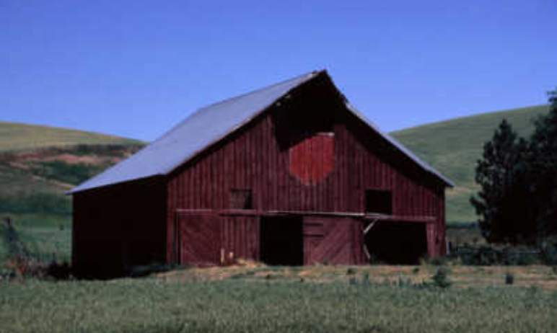
Barn Defined:
A barn is a structure that farmers use to hose cows, horses etc. in. They also keep their farm equipment in their barns; like tractors etc.
Clipart.com

Slide 6
Why is the WBS Useful?
Documents what needs to get done.
Organizes work.
Great tool to show people what you have in mind.

Slide 7
Work Breakdown Structure (WBS) Defined
Organizes work in hierarchy format
For each level down, tasks have a more limited scope, that is they are more narrowly defined
Can be either pictorial (like an organizational hierarchy chart) or in an outline like format

Slide 8
WBS Defined (PMBOK 6th Ed. P. 726)
“A hierarchical decomposition of the total scope of work to be carried out by the project team to accomplish the project objectives and create the required deliverables.”

Slide 9
2
What the WBS
Does For You
Allocate Labor
Expense
Allocate Non-Labor Expense
Budget
WBS!
Determining
Work Sequence
Responsibility Matrix
Assigning
Ownership
Time Line
Defining What
to do First
(C) 2007 Brian Vanderjack

Slide 10
Work Package Defined
At the lowest level of your WBS you’ll find the work packages.
This represents the components of the project that will be managed as separate tasks.
They are not ordered when looking left to right on the pictorial WBS. At the same level of decomposition in the outline format, there is no order. This activity is left to the project schedule.
Their size is dictated by the duration that the project manager can manage.

Slide 11
Work Package Defined (PMBOK 6th ed. P. 726)
“The work defined at the lowest level of the work breakdown structure for which cost and duration are estimated and managed.”

Slide 12
WBS Examples

Slide 13
WBS; Outline Form
Barn Construction
1.1.0. Foundation
1.1.1 Excavation*
1.1.2 Footers & Slab*
2.1.0. Structure
2.1.1 Frame & Roof*
2.1.2 Siding*
* These are work packages

Slide 14
Comment on Pictorial WBS Form
The pictorial form of the WBS, for a project of anything larger than a very small project, will:
Likely not fit on a sheet of paper, or,
It will be too small to read on a PC screen
But, in terms of a nice way to learn about WBSs, it works quite well. So, for the remainder of this presentation, the pictorial form will be used.

Slide 15
Pictoral Form
Barn Construction
WBS
Dig a post hole
Structure
Foundation
1.1.0
2.1.0
Excavation*
Footers & Slab
Frame and Roof
Siding
1.1.1
1.1.2
2.1.1
2.1.2
*Boxes with red fonts are
work packages

Slide 16
Decompose; Class Question
What does that mean??
It means each level down is more subdivided than the previous level.
The result of all this decomposing is the list of work packages that you will want to manage to.

Slide 17
Decomposition Defined (PMBOK 6th ed p. 704)
“A technique used for dividing and subdividing the project scope and project deliverables into smaller, more manageable parts”

Slide 18
WBS is Used in Creating...
Responsibility matrix
Work package based estimating
Project Schedule

Slide 19
Given This WBS…
Barn Construction
Foundation
Dig a post hole
Structure
Excavation
Frame & Roof
Siding
Footers & Slab

Slide 20
Example Map of WBS to “Responsibility Matrix” (1 of 2)
Barn Construction
Foundation
Dig a post hole
Structure
Excavation
Tom
Frame & Roof
Bull
Siding
Arun
Footers & Slab
Xin Xin

Slide 21
Example Responsibility Matrix (2 of 2)
Who | Responsibility
Tom | Excavation
Xin Xin | Footers & Slab
Bull | Frame & Roof
Arun | Siding

Slide 22
Example of Work Package Based Estimating (1 of 2)
Barn Construction
Foundation
Dig a post hole
Structure
Excavations
$250K
Frame & Roof
$175K
Sidings
$50K
Footers & Slab
$750K

Slide 23
Example Budgeting by Work Package (2 of 2)
Task | Cost
Excavation | $250K
Footers & Slab | $750K
Frame & Roof | $175K
Siding | $50K

Slide 24
Schedule Matrix
# | Tasks (in order) | Requires | Who | Duration in days
1 | Perform Excavation |  | Xin Xin | 15
2 | Set footers and slab | 1 | Tom | 2
3 | Build Frame & Roof | 2 | Bull | 1
4 | Siding | 3 | Arun | 1

Slide 25
Schedule (Gantt Chart)
# | Tasks | Re-quires | Who | Duration In days
1 | Perform Excavation |  | Xin Xin | 15
2 | Set footers and slab | 1 | Tom | 2
3 | Build Frame & Roof | 2 | Bull | 1
4 | Siding | 3 | Arun | 1
1
1
2
5
0
5
0

Slide 26
Comment on These Three Deliverables
There are other items that the WBS feeds into.
These are among the most important.

Slide 27
About the WBS Dictionary
Behind the items in the WBS is something called the WBS dictionary
It contains detailed information on each item in the WBS (e.g. budget etc.), including work packages.
“A document that provides detailed deliverable, activity, and scheduling information about each component in the work breakdown structure”(PMBOK P. 726)

Slide 28
WBS Hints

Slide 29
How to create a WBS
What is the Delphi Technique:
https://www.youtube.com/watch?v=NVWgeoZPX2U
How to create a WBS:
https://www.youtube.com/watch?v=FklYonNknRs

Slide 30
Work Package Points

Slide 31
Hint: Costs
PMs typically don’t set up the cost allocation methodology – get help
Could be direct, indirect, capital, expense, etc.
There are Sarbanes-Oxley implications on this - take this seriously.
Share billing rates with team members at your own peril

Slide 32
Summary

Slide 33
The WBS Provides Input to…
Responsibility matrix
Schedule building
Work package based estimating
Other processes too

Slide 34
2
What the WBS
Does For You
Allocate Labor
Expense
Allocate Non-Labor Expense
Budget
WBS!
Determining
Work Sequence
Responsibility Matrix
Assigning
Ownership
Time Line
Defining What
to do First
(C) 2007 Brian Vanderjack

Slide 35
An Example WBS
"Build a Barn"
Brian Vanderjack, PMP, MBA

