Slide 1
Cost Management PMBOK 6th ed p 231-270

Slide 2
Please note
This is an abridged work
If you intend to take the PMP or CAPM exam, please refer directly to the 6th ed. of the PMBOK.
Provided as is, no warranty implied or stated.
Not responsible for incidental or consequential damages

Slide 3
Cost defined: Dictionary.com
…the price paid to acquire, produce, accomplish, or maintain anything

Slide 4
Profit (google dictionary)…
…a financial gain, especially the difference between the amount earned and the amount spent in buying, operating, or producing something

Slide 5
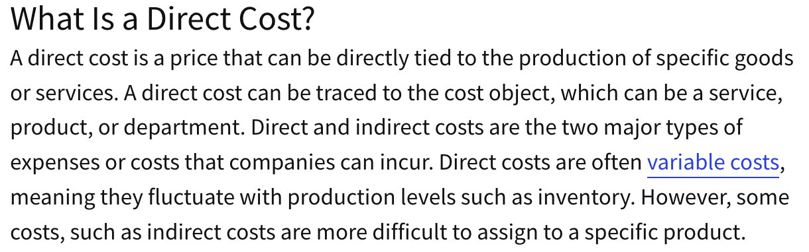
https://www.investopedia.com/terms/d/directcost.asp

Slide 6
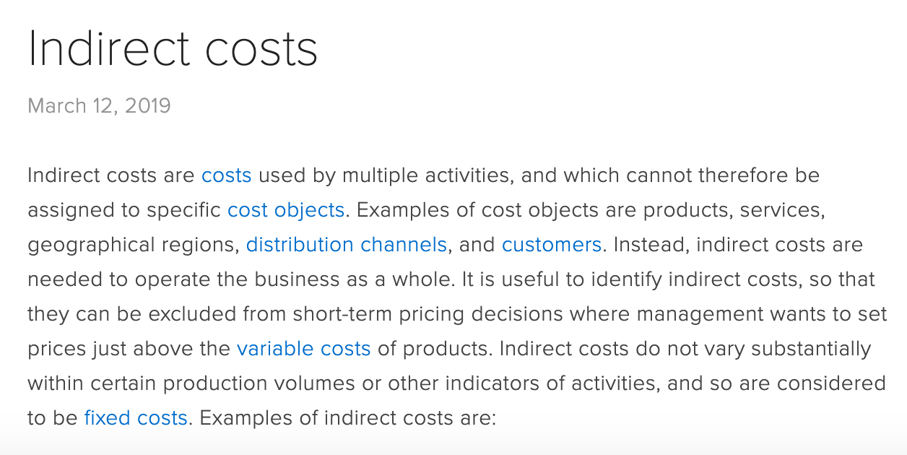
https://www.accountingtools.com/articles/what-are-indirect-costs.html

Slide 7
Capital Expense
“A capital expenditure is an amount spent to acquire or significantly improve the capacity or capabilities of a long-term asset such as equipment or buildings. … The asset's cost (except for the cost of land) will then be (depreciated) over the ‘useful life*’ of the asset. “
https://www.accountingcoach.com/blog/capital-expenditure-revenue-expenditure
*Tax regulations determine the “useful life”. (BV)

Slide 8
Definition of Revenue Expenditure
A revenue expenditure is an amount that is spent for an expense that will be matched immediately with the revenues reported on the current period's income statement.
https://www.accountingcoach.com/blog/capital-expenditure-revenue-expenditure
…. and deducted immediately, for full value on taxes. Contrast to Capital Expense. (BV – see next slide!)

Slide 9
Capital Expense vs. Revenue expenditure
Always have your knowledgeable accountant help you with this as people can go to jail over stating a capital expense incorrectly as a revenue expenditure (bv)

Slide 10
Project cost management includes the processes involved in… (p. 231)
….Planning, estimating, budgeting, financing, funding, managing, and controlling costs to that the project can be completed within the approved budget.

Slide 11
Project Cost Management is primarily concerned with… (p. 233)
“the cost of the resources needed to complete project activities.”

Slide 12
Considerations include…(p 233)
Maintaining & supporting the product or service

Slide 13
In Agile… (p.234)
Detail estimates, when needed, are typically created just in time (at the last minute.)

Slide 14
Plan cost management (p. 235)
What it is: the “definition (as to) how project costs will be estimated, budgeted, monitored, and controlled.
The Benefit is: guidance as to how cost will be managed throughout the project.

Slide 15
p. 236
“The project charter provides the pre-approved financial resources from which the detailed costs are developed.”

Slide 16
Factors (pp. 236-237)
Organizational culture
Market conditions
Currency exchange rates
Productivity differences in different parts of the world

Slide 17
Expert judgment in cost (p. 237)
Previous or similar projects
Information in the industry, discipline, and application area
Cost estimating and budgeting
Earned value management

Slide 18
Data Analysis – funding options (p. 238)
Self-funding
Funding with equity
Funding with debt
Borrow $ from the bank
Issue bonds

Slide 19
Data Analysis – ways to acquire project resources (p. 238)
Making
Purchasing
Renting/leasing

Slide 20
Accuracy – (p. 238)
Acceptable range of estimates (e.g. +/- 10%)

Slide 21
Cost estimate defined (p. 241)
“A quantitative assessment of the likely costs for resources required to complete the activity. It is a prediction that is based on the information that is available at a given point in time.”

Slide 22
Cost estimate should consider (p. 241)
Alternatives
Trade-offs
Risks
Generally expressed in currency amount (USD, rupees, dong, BTC, yen, euros, etc.)

Slide 23
Cost estimates will… (p. 241)
Typically improve as the project continues (-25% to +75% => -5% to +10%)
The expectation of the level of accuracy will tend to become more exacting

Slide 24
Cost estimate types include … (p. 241)
Labor
Materials
Equipment
Services
Facilities
Inflation allowance
Cost of financing
Contingency costs

Slide 25
Some inputs to a cost estimate (p. 242)
Project scope document
WBS
WBS dictionary
Risk register

Slide 26
Types of estimates (p. 244)
Analogous estimating (just like something else)
Parametric estimating (using statistical software tools)
Bottom-up estimating (totaling the estimates from the work package or activities)

Slide 27
Three Point Estimating (p. 244)
Most likely “cM”
Optimistic “cO”
Pessimistic “cP”
Triangular : (cO + cM + cP)/3
Beta distribution: (cO + 4cM + cP)/6

Slide 28
Contingency Reserves (p. 702)
… identified risks with active responses identified.
(p. 710) management reserves are for work that is unforeseen, but within the scope of the project)

Slide 29
Cost of Quality (huge)(p. 245)
Investment to achieve conformance
Cost of nonconformance (clean up etc.)
Cost of more problems later by making more defective products now.

Slide 30
Basis of Estimates – supporting detail (p. 247)
Assumptions
Known constraints
Risks included in estimates
Accuracy range
General confidence level

Slide 31
Determine Budget (p. 248)
What it is: The process of aggregating the estimated costs of individual activities or work packages to establish and authorized cost baseline.
The Benefit is: determines the cost baseline against which project performance can be monitored and controlled.

Slide 32
Control Costs(p. 257)
What it is: The process of monitoring the status of the project to update the project costs and managing changes to the cost baseline.
The Benefit is: the cost baseline is maintained throughout the project.

Slide 33
Project cost controls include (P. 259)
Influencing the factors that create changes to the authorized cost baseline
Ensuring that all change requests are acted on in a timely manner
Managing actual changes as they occur
Ensuring budget for given time period is not exceeded.
Preventing unapproved changes
Bringing cost overruns back within tolerance levels.

Slide 34
Present Value Video
https://www.youtube.com/watch?v=8AmeJ4CS20E&t=254s

Slide 35
Net Present Value Video (NPV)
https://www.youtube.com/watch?v=HFFkFMfotT0

