Slide 1
API - Application programming interface
Present by HANGLEKHANH

Slide 2
What is API ?
Simple Object Access Protocol (SOAP) and Representational State Transfer (REST)
Some example API.

Slide 3
API
“An application programming interface (API) is a set of routines, protocols, and tools for building software applications.
An API expresses a software component in terms of its operations, inputs, outputs, and underlying types.
An API defines functionalities that are independent of their respective implementations, which allows definitions and implementations to vary without compromising each other.
A good API makes it easier to develop a program by providing all the building blocks.

Slide 4
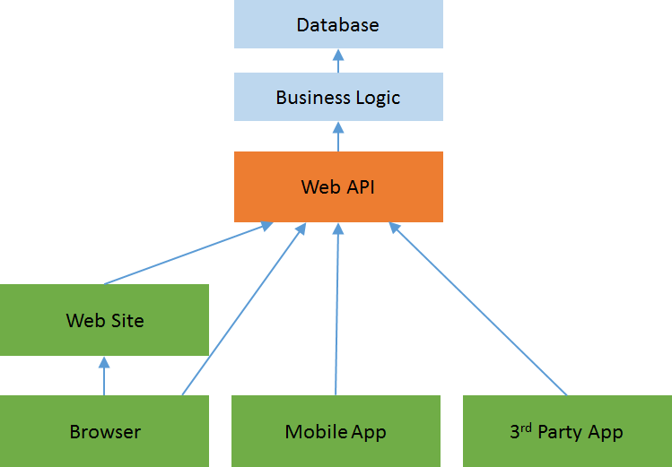

Slide 5
https://www.youtube.com/watch?v=s7wmiS2mSXY

