Slide 1

Food Ordering Website System
Subject: Web Programming - IT4552E
Group 13: Nguyễn Trọng Nghĩa 20184297
Phùng Thu Hằng 20194758
Nguyễn Doãn Hoàng Thư 20184310
Hà Ngọc Hùng 20180091
Instructor: PhD. Đào Thành Chung

Slide 2
Table of contents
Application problem description
System design
Product demo

Slide 3
1. Application problem description
Build a food ordering website system:
Provide graphical interface with many features.
2 types of people interacting with this system: user and administrator.
User can sign up, log in, add or delete items from cart, place order, send feedback.
Administrator:
Can log in as a normal user.
Can add/delete product, update product information and check feedback from user.

Slide 4
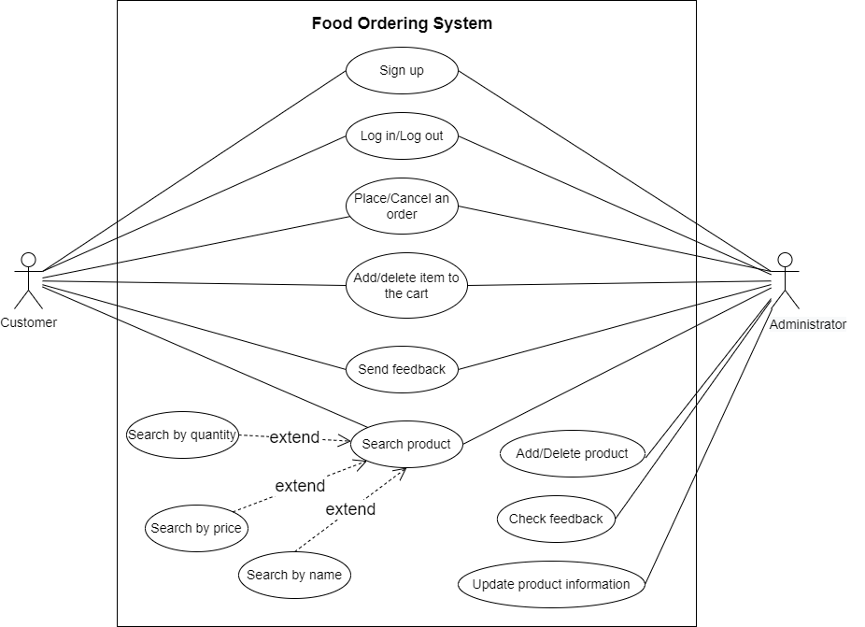
2. System design
Usecase Diagram

Slide 5
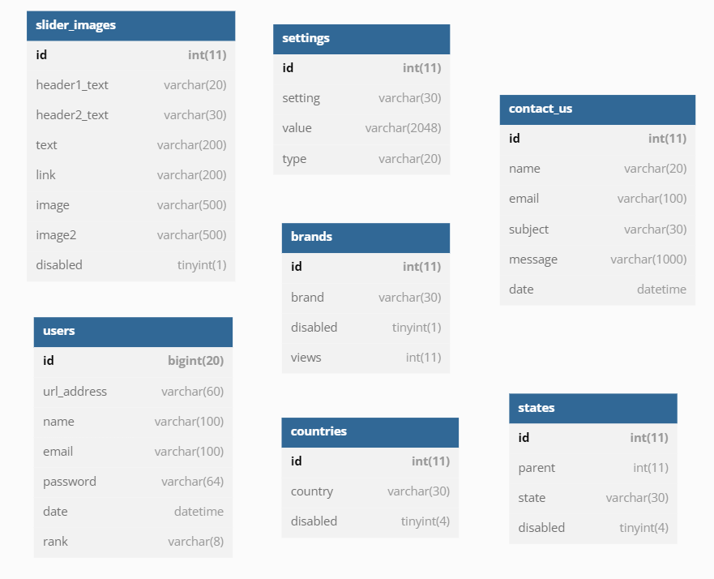
2. System design
Database

Slide 6
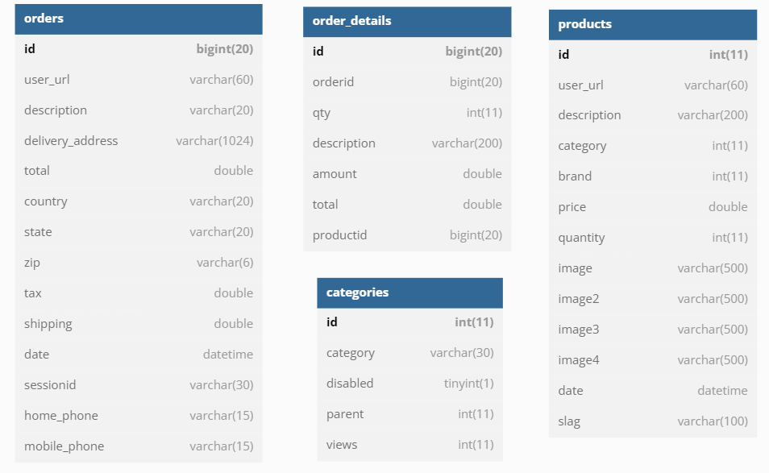
2. System design
Database

Slide 7
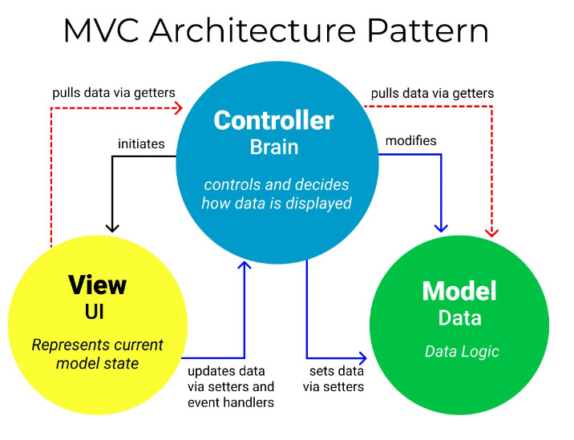
2. System design
MVC

Slide 8
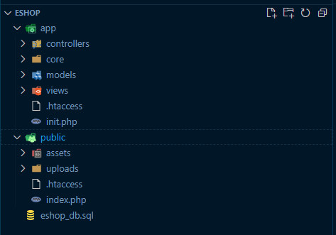
2. System design
MVC
app: core mvc components
public:
assets (javascript, css, fonts, images)
uploads (product images)

Slide 9
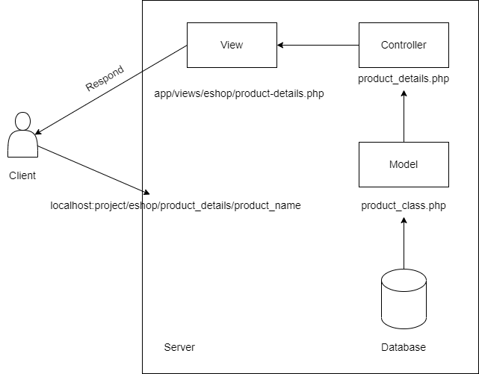
2. System design
MVC

Slide 10
3. Product demo

Slide 11
THANK YOU !

