Slide 1
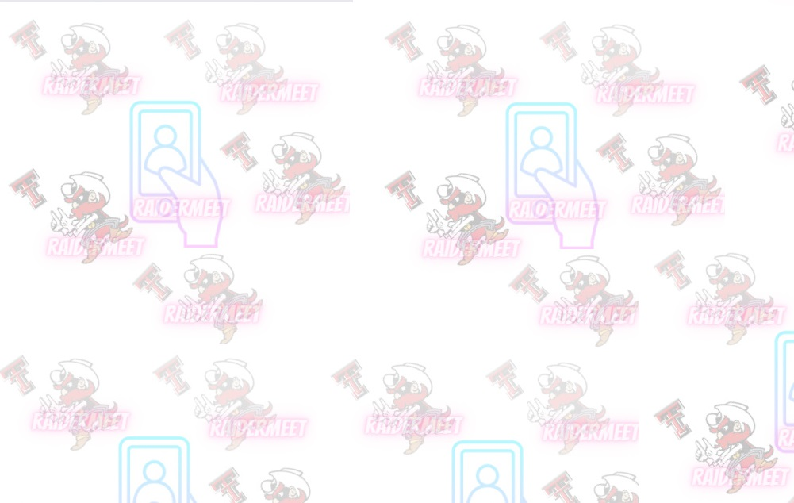
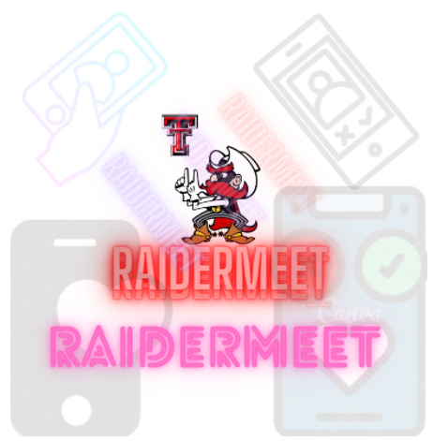
Junwoo Jang
Matthew Silva
Monica Romero
Younghoo Cho

Slide 2
Motivation and Problem
Motivation
COVID-19
Social Isolation since 2020
Little to no contact with new people
New and returning students have a hard time meeting new people
Sometimes we meet new people but don’t connect in a friendship level
Some clubs, sororities, fraternities are expensive
Problem
Make an app for Texas Tech Students to find friends on campus
People can find themselves based on their interests
Needs to be safe and make people accountable for misconduct

Slide 3
The existing approaches/solutions to the problem
Problem:
Not many resources to find friends
Organizations often require payment
Some students aren’t as outgoing as others
Existing apps:
Meetup
Bumble BFF
Solutions:
Meetup is used to meet new people, make friends, find support, grow a business, and explore/share interests.
Bumble BFF utilizes similar features as dating apps, in terms of allowing users to swipe left or right to find a match

Slide 4
The team’s approach/solution to the problem
Problem:
Not many resources to find friends
Organizations often require payment
Some students aren’t as outgoing as others
Team’s approach:
Creating the RaiderMeet application
Solutions:
Create an app dedicated to Texas Tech students
Implement a verification system to ensure the user attends Texas Tech
User friendly
Share common interests about school or hobbies to find friends within the same category
Free to use

Slide 5
The supporting slide addressing why your solution is better than existing ones
Cloud Database
It is easy to use immediately by importing various database functions through Firebase provided by Google.
Security issues are important for light apps with no security experts, and security issues can be solved through the Cloud database.
In-app maintenance, students in charge of maintaining the next app can easily learn and manage the database structure.
User Specification
Only Texas Tech University students can use it to prevent crimes such as phishing.
Each student's information can be checked in the profile, so communication by major and grade is possible.
Texas Tech University Computer Science students can directly manage apps, and based on this, they can gain experience and experience in app development and maintenance.
Android OS - Oreo
OS updates are still being made until Oreo 8.1, so you don't have to worry about OS security issues.
In the case of OS after Oreo, background execution should be considered, but background execution should not be considered until Oreo.
Notes:
The supporting slide addressing why your solution is better than existing ones (1 page, 1 mark) - Slide 4
Younghoo Cho

Slide 6
The Functionalities and Features that Make this Product Unique
Login specific to Texas Tech students (user@ttu.edu)
Texas Tech email can be used to hold student accountable if misconduct occurs
Texas Tech login allows us to have the user’s information. Texas Tech contains name, address, and other important information that may aid police in finding/arresting offender
Students on RaiderMeet can find new people based on their hobbies and interests
Chat function allows people to talk and hopefully meet in person to create a Raider friendship

Slide 7
The software Architecture of the Approach
Authentication
Firebase
(Cloud Database)
Cloud Storage
Realtime Database
Local Database
RaiderMeet App
Data
(User, Chat, Friend, Friend Request)
Services
The RaiderMeet app uses a Cloud Database called Firebase, and data related to the user is stored in Firebase.
The Local database stores and manages data such as images, audio, and text required to implement the RaiderMeet App.
The service provides various functions of an app composed of Java Source Code.
Notes:
The hardware/software architecture of the approach (1 page, 1 mark) - slide 6
Younghoo Cho

Slide 8
The team information and how they worked together - 1/2
Our team planned to make a Hanging out app which has similar design to dating app, but completely different from dating app on purpose. Our team noticed that a lot of people in college but also in new places where they moved had a hard time being alone. For anyone who moved to a new place, it is very difficult for them to adapt to new culture and settle down by themselves. During the research, our team also noticed that there are a lot of college students not only in Texas Tech University but also in other schools who have a hard time getting adapted to new cultures and environments. The main reason was it was hard for them to make real friends and new friends, since there have not been many opportunities going on especially during COVID. There are multiple reasons why our team chose to make a hanging out app, but not a dating app. But one of the main reasons was to help people’s loneliness. Based on the research, we felt more need to help people through our app. Another main reason why we decided not to make a dating app is because a lot of people just ended up doing dating apps even though they actually do not want to date anyone, but just want friends. They cannot find the right app to make friends because there are only dating apps popular in the app market. During this project, our team had a hard time overall because at first, we could not even debug our codes and test them. It was because a lot of HP-branded computers have issues with Android Studio and three of us were using HP-branded laptops. At first, we were testing our codes through one teammates’ computer, but this was very inefficient and very inconvenient. Later on, we could figure out the issues and we ended up fixing it. It was very sad and a little unfair for our team because even though our team started our project early, there were issues so that our progress was not very fast because we were stuck at debugging issues just because of the computer. I appreciate it to my team again for we did so great and being patient brought us to a situation where we could very successfully finish our project very well in a short period of time with enough knowledge.

Slide 9
The team information and how they worked together - 2/2
Overall, this project was very interesting. During the development process, our team decided to divide each function into each role. This way was way more efficient because each of us can only focus on our own parts so that there will be no errors and even though there are errors, it can be easily found and fixed. I took the chat part and I made the chat part actually work so that messages can go back and forth with each other between two users. I did this through the real time database that can save the chat contents and the information of the users who we talked to. First, we had a hard time with the database part that actually save our datas to make this app run perfectly, not to be a dummy app. Professor said in class that he does not want anything to be a dummy app. So, all the coding was not very hard as much as figuring out the database part. Our team successfully could figure out the database but It was hard for us to find the real time database because this is a chatting app that requires the database that saves datas in real time. However, I ended up finding the database called Google Firebase. It was very easy to set up and it was free. The biggest advantage of using firebase was we did not have to change anything in the database, whenever we modify our codes on Android Studio. Most databases require modifications together whenever developers modify their code, but firebase did not. Thus, we ended up applying the .json(firebase) to our project and it successfully worked to make the chat go back and forth, and save the chat contents.

Slide 10
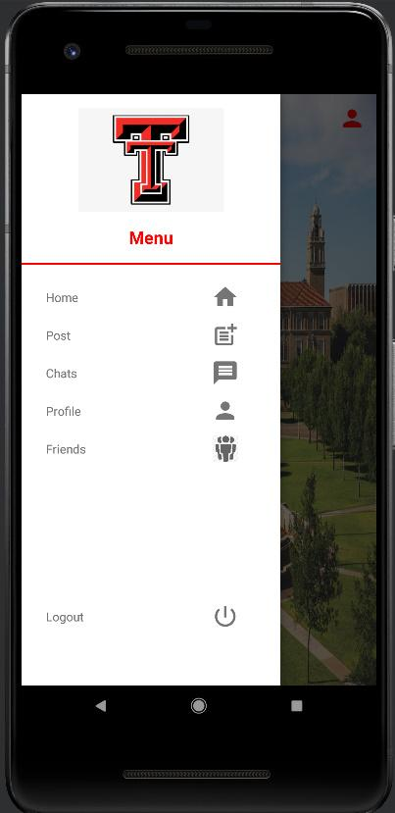
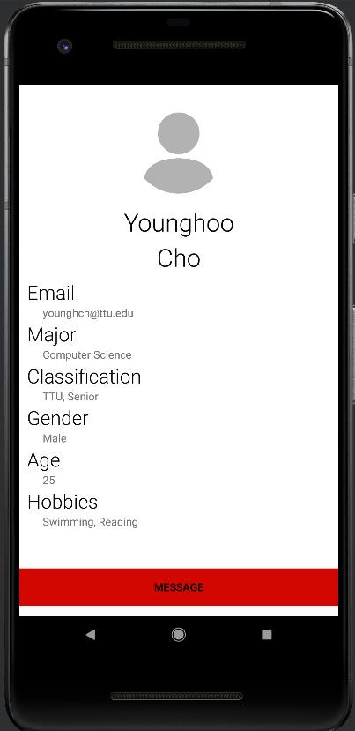
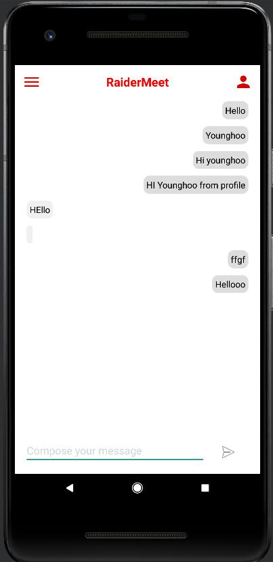
The contribution of each team member - Junwoo Jang -1/2
A user can chat through “Chats” in the drawer(menu)
A user can chat through “Message” in one’s profile
They both are in one, same database to contain same chat contents and to be connected with each other

Slide 11
The contribution of each team member - Junwoo Jang - 2/2
add single_message_layout.xml to /res/layout/
replace activity_message.xml in /res/layout with new file
replace message.xml in /res/layout with new file
/res/layout/nav_toolbar.xml:
Line 22:
"GitTogether" -> "@string/app_name"
/res/values/strings.xml:
Line 19:
"Messages" -> "Chats"
/res/layout/nav_drawer.xml:
Line 86:
Uncomment LinearLayout for Chats button to make it show in the drawer
These part:
<LinearLayout
android:layout_width="match_parent"
android:layout_height="wrap_content"
android:orientation="horizontal"
android:gravity="center_vertical"
android:onClick="ClickMessage">
<TextView
android:layout_width="0dp"
android:layout_height="wrap_content"
android:layout_weight="1"
android:text="@string/messages"
android:padding="12dp"
android:layout_marginStart="16dp"
android:layout_marginLeft="16dp" />
<ImageView
android:layout_width="wrap_content"
android:layout_height="wrap_content"
android:layout_marginEnd="48dp"
android:src="@drawable/ic_message"
android:layout_marginRight="48dp" />
</LinearLayout>
Add ChatsActivity.java, Message.java, MessageActivity.java to src and replace
MainActivity.java:
Line 158:
"UserMessages.class" -> "ChatsActivity.class"
Navigation.java:
Line 57:
"UserMessages.class" -> "ChatsActivity.class"
PostActivity:
Line 184:
"UserMessages.class" -> "ChatsActivity.class"
PostViewActivity.java:
Find (Line 121):
if (usr.userId.equals(dataSnapshot.getKey())) {
tmpUsr = ....
}
Replace:
if (usr.userId.equals(dataSnapshot.getKey())) {
tmpUsr = ....
tmpUsr.userID = usr.userID;
}
ProfilePage.java:
Line 137:
"UserMessages.class" -> "ChatsActivity.class"
UserMessages.java: DELETE the file
UserProfileActivity.java:
Line 83:
replace onClick() contents with:
Intent intent = new Intent(getApplicationContext(), MessageActivity.class);
if (uId != null) {
intent.putExtra(MessageActivity.EXTRA_CONTACT_UID, uId);
}
startActivity(intent);
AndroidManifest.xml:
Declaration of activity:
Change UserMessages -> ChatsActivity
res/drawable/rounded_corner1.xml && rounded_corner2.xml:
Replace with the new files
add activity_chats.xml to /res/layout/
add chat_item.xml to /res/layout/
PostViewActivity.java
MessageActivity.class->ChatsActivity.class
Line 178:
public void ClickMessage(View view){
//Redirect activity to Messages
com.example.radiermeet2.Navigation.redirectActivity(this, com.example.radiermeet2.MessageActivity.class);
}
FriendsAcitivty.java
MessageActivity.class->ChatsActivity.class
Line 59:
public void ClickMessage(View view){
//Redirect activity to Messages
Navigation.redirectActivity(this, MessageActivity.class);
}

Slide 12
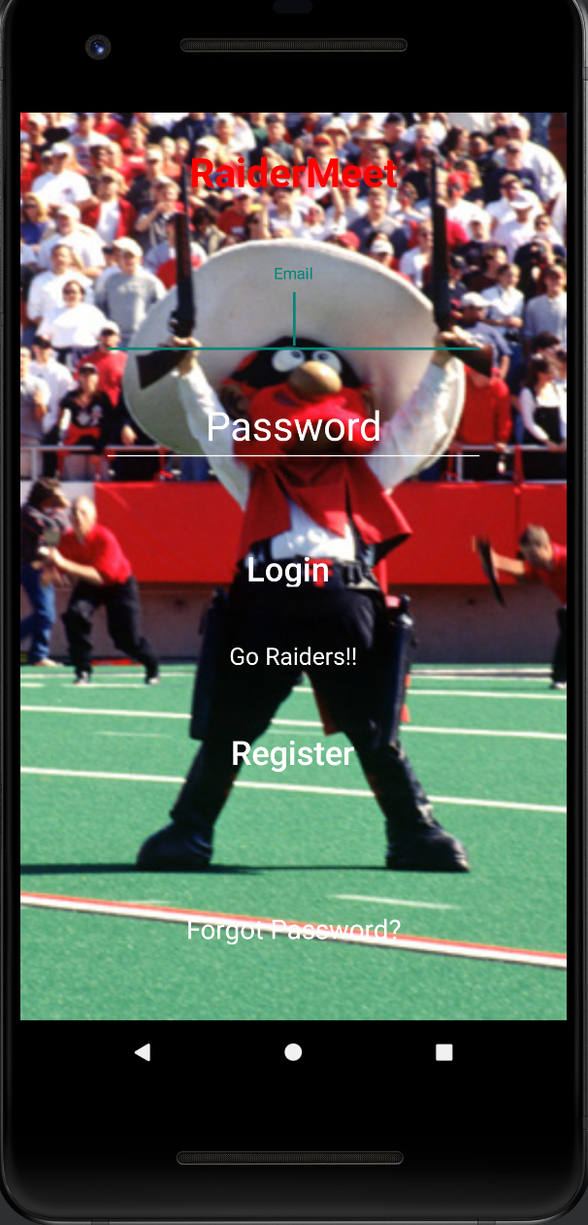
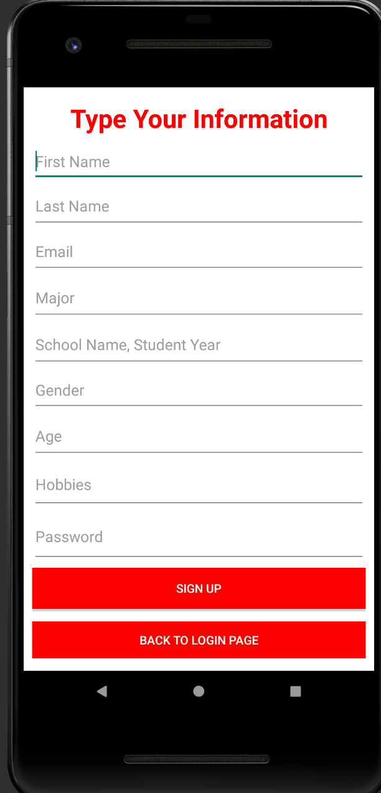

The Contribution of Each Team Member - Younghoo Cho
Firebase
The cloud database was set up to be used.
Authentication, Firebase database, Realtime database, Cloud storage were activated and used.
Login page
A page where users can log in to an existing account to use the app
It includes the function of sending a password change email to each user account email when a password is forgotten.
signup page
It is a page where new users, not existing users, create new accounts.
The user's information is entered and the new account email is stored in the cloud database.

Slide 13
The contribution of each team member - Matthew Silva
User profile -
Input user profile information such as major, name, etc.
Upload profile picture
Edit profile -
Update current profile information/picture
View other users -
Display profile information of other users

Slide 14
The contribution of each team member - Monica Romero
Friends Function
Add Friends
Search For People to be Friends with
Shows a List of Results According to your Search
Friend Requests
Friend Request Information Stored in our Database
Allow you to Send, Accept, Decline, or Cancel friend requests
Friend List
Shows you a RecyclerView list of all your friends according to our firebase database

Slide 15
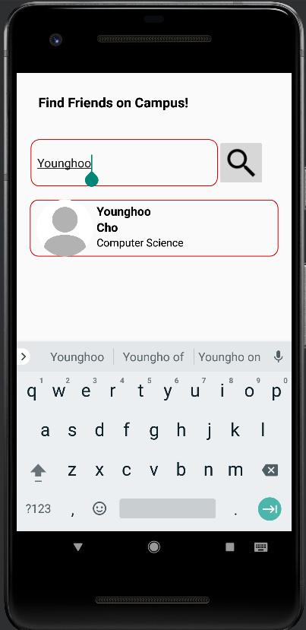
Two snapshots of running application

Slide 16
The future plan for development - 1/2
Our team is actually planning to release this app on the market and we have in mind to further update this app, after seeing reactions from our future users. Currently, we reflected all of our plans and ideas that we can think of for now to prevent issues and that will be useful for using this app. However, there will be unexpected problems or expectations that our future users will want. We are going to reflect all these in the next version. Additionally, our members were not very proficient with Android Studio to build this app, but now, we have better skills and knowledge in this field. We know the details and what functions will be useful for this app. We are going to continuously update our app based on feedback from users. Newer versions will come out with more sophisticated but simpler functions and designs. Additionally, our team is planning to build our own website for RaiderMeet to communicate with our users. Unlike other dating apps, we are planning to make customer service with phone numbers as well, not just through email customer service that a lot of platforms do. Our team thinks communication is very important between developers and customers and a lot of platforms do not operate this part very well. However, unlike other platforms, our team considers customer service very seriously. Additionally, there were some functions that we wanted to add but we could not due to limitations of our skills and knowledge. For example, log-in, we are planning to do the log-in system through an AI system that recognizes if the user is providing the correct student ID card of Texas Tech and checks if the user’s face is matched with the student ID.

Slide 17
The future plan for development - 2/2
This system will not cause issues like borrowing or trading one’s id and password, because some people, who are not students, but want to use the app, can buy the student’s account through the Texas tech students. This was one of the main reasons why we decided not to put the TTU login system through the web page. After being verified with the AI system, RaiderMeet will remember not only the account but also the device and save the device information in the database so that the user does not need to do the verification process every time they log in. For the chat parts, we currently have basic messaging functions, but we are planning to add a few more functions. First one we are thinking of is putting audio calls and video calls. However, because some users may feel uncomfortable with doing this with strangers, we will put limitations on letting users use this function. We will let users see the “call” button, after users get close with each other based on the frequency of chats going back and forth with each other for days. Also, currently, we don't have any sharing pictures, voice records, or location sharing, so we are planning to add these in chat functions as well, after our team knows deeper about this field. Also, there are parts that we thought rather not to put, but currently we are thinking about putting those back, because we think it makes our program more unique and useful.

Slide 18
Thank you!

