Slide 1
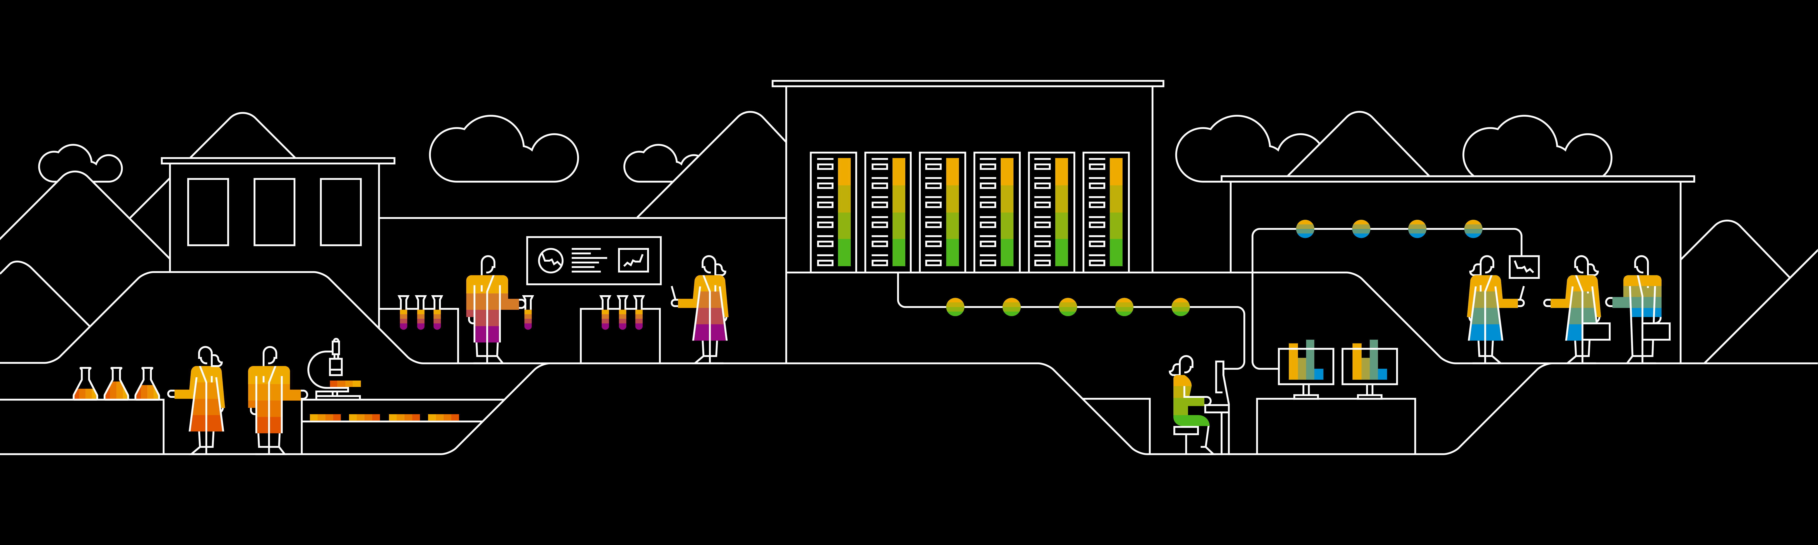
Writing Testable Code in Java Backlog for Rebate Engine Exercise

Slide 2
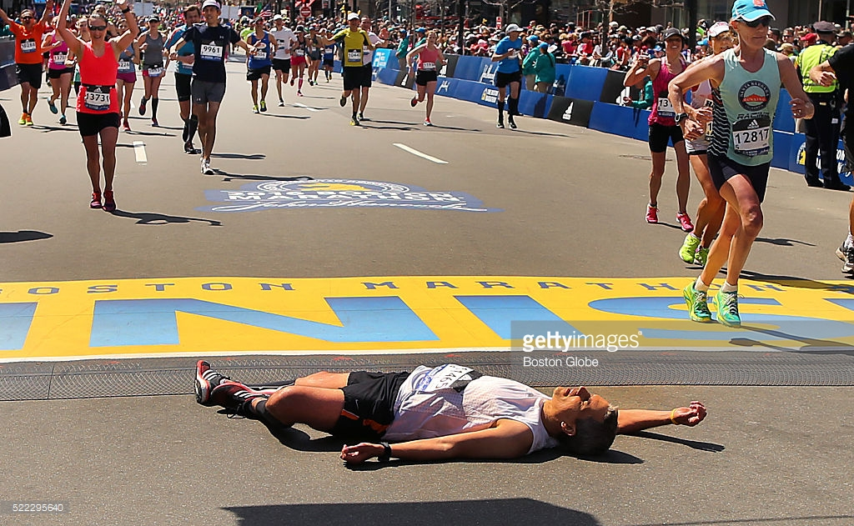
You are not expected to finish all backlog items ! there is way too much … so you can practice more later

Slide 3
BLI 1.1: Look at initial state of Rebate Engine
Pseudo Backlog Item: “Look at the code”
There is already a method computeRebate() in the class RebateEngine that takes WebShoppingCart and returns total rebate amount (Accumulated rebate amount).
Context / Usage
The Rebate Engine computes rebate for each item in the cart, stores the rebate in the corresponding field ‘rebateAmount’ (of the Cart Item) and specifies a reason comment in the ‘rebateReason’ (of the Cart item)
Rebates are computed by rebate rules which will come later
Acceptance Criteria
Read and Run the unit tests (of rebate engine)
Shopping Cart
Rebate Engine
Call shopping cart
Items table
ID | Cat | Name | Quant | SP | R
Rebate Rule
Rebate Rule
Rebate Rule
Firing rule sets rebate fields

Slide 4
BLI 2.1: Item-ID Rule with Amount Off Typically done by trainer together with the class
Example
“Buy 2 of <item with ID> and get 5$ off the second item”
Backlog Item
Define a rule class that implements these behaviors:
The rebate rule is applied when its (rabate rules) requiredItemID (e.g. a EAN / barcode number) matches the item ID of an item in the cart AND the quantity of that item in the cart is greater or equal to the requiredQuantity (here 2) of the rule
When the rule triggers, set the rebate for the item (in the cart) to the rebate specified in the rule.
Hints:
You need to loop over the line items of the cart.
Acceptance Criteria
Unit tests, 100% coverage
Tests for rule that triggers and for cases when it doesn’t trigger. Consider boundaries.
Rule
Shopping Cart
Reqd ID | Reqd quant | amtOff |  | Comment
1 | 2 | 5 |  | “buy 2 of Item ID and get 5 $ off”
ID | Quant | Std Price | Rebate |  | Comment
1 | 3 | 15 | 5 |  | ID match, Quant > required quant ➔ rule triggers, amount off applied
ID | Quant | Std Price | Rebate |  | Comment
1 | 1 | 15 | 0 |  | Rule doesn’t trigger because quantity is not sufficient

Slide 5
BLI 2.2: Compute total rebate
Backlog Item
Rebates are applied to individual cart items and stored in the rebate field on cart item level.
Provide a method that gets (computes) the total rebate amount for the whole cart (adding all rebates of the items)
Notes
The Cart is already computing the total standard price based on standard prices of items and their quantities. You can see this in the Web UI.
Acceptance Criteria
Rules
Shopping Cart and Rebate
When computing with the rebate engine
Then the rebate total should be 12.00
Reqd ID | Reqd quant | amtOff |  | Comment
1 | 2 | 5 |  | “Buy 2 of Item Id 1 and get $5 off”
2 | 3 | 7 |  | “Buy 3 of Item Id 2 get $7 off”
ID | Quant | Std Price per item | Rebate |  | Comment
1 | 3 | 10 | 5 |  | Rule applies, 5 amount rebate
2 | 4 | 80 | 7 |  | Rule applies, 7 amount rebate

Slide 6
BLI 2.3: Item-ID Rule with Percent Off
Example
“Buy 3 of <Item-Id> and get 50% off the second item”
Backlog Item
Extend the existing rule with the feature that a discount can be specified as percentOff.
Hint:
See next backlog item for issues with interactions of amountOff and percentOff.
Acceptance Criteria
Unit tests with 100% coverage
Rule
Shopping Cart and Rebate
Reqd ID | Reqd quant | %Off |  | Comment
2 | 3 | 50 |  | “buy 3 of Item Id 2 and get 50% off on the price of Item
ID | Quant | Std Price per item | Rebate |  | Comment
2 | 4 | 100 | 50 |  | ID match, Quant > required quant ➔ rule triggers, percent off applied
2 | 1 | 100 | 0 |  | Rule doesn’t trigger as Rule doesn’t meet criteria.

Slide 7
BLI 2.4: Item-ID Rule Constraint for Amount and Percent Off
Backlog Item: Constraint for ALL rebate rules
Ensure these constraints are met and throw an exception if not (see below for details):
Either amountOff or percentOff has to be specified (i.e. be > 0) but not both.
None of them can be negative
Hint
Use your own existing exception class WebShopConfigError
For an example of how to test an exception
https://github.com/junit-team/junit4/wiki/exception-testing
Acceptance Criteria
Unit tests that verify that the exception is thrown in the right cases

Slide 8
BLI 2.5: Item-ID Multiple sets of items in quantity
Backlog Item
When a cart item contains a larger quantity of the same item so that the rebate rule applies ‘multiple times’, then the rebate is applied for each set of items.
Acceptance Criteria
Unit tests, 100% coverage
Spec Example:
Rule
Shopping Cart and Rebate
Reqd ID | Reqd quant | %off | amtOff |  | Comment
1 | 2 | 0 | 5 |  | “buy 2 and get 5 $ off”
ID | Quant | Std Price per item | Rebate |  | Comment
1 | 7 | 15 | 15 |  | For each 2 items, there is a rebate=5; since there are 2 “sets of 2” (quant), there are two rebates of 5 applied

Slide 9
BLI 2.6: Add validity period
Backlog Item
Each rule has a validity period defined by a validFrom and validTo date (both inclusive)
When the ‘current date’ is within the validity period, the rule may be applied. Otherwise the rule is not active and is not applied on shopping cart item.
When date boundaries are not given, the rule applies ‘always’ (as long as it would be in the rule DB)
Example
“DVDs are 10% for all of next week” (validFrom to validTo)
Hint
Pass the current date as part of the computeRebate() method on the Rebate Engine. Apply the rule on cart/ items if it is active.
Acceptance Criteria
Unit tests, 100% coverage
Rules outside of the validity period shall not be applied to the cart. Test a case with in and out of period.

Slide 10
BLI 2.7: Rule name and item rebate reason
Backlog Item
Each rule must have a rule name that is used to give a human readable definition of the rule semantics.
This name (e.g. “Buy 2 items of X and get the second 20% off”) must be assigned into the cart item into the field rebateReason in case the rule is applied.
Acceptance Criteria
Rule
Shopping Cart and Rebate
Reqd ID | Reqd quant | %Off | Amount Off | Rule name
1 | 2 | 0 | 5 | Buy 2 quantities of item id 1 and get Rebate of amount 5.
2 | 3 | 50 | 0 | Buy 3 quantities of item id 2 and get Rebate of 50 percent.
ID | Quant | Std Price per item | Rebate | Rebate Reason
1 | 3 | 10 | 4 | Buy 2 quantities of item 1 and get Rebate of amount 5.
2 | 2 | 80 | 0

Slide 11
BLI 2.8: Add Apply-to parameter for Item-ID rule
Backlog Item
Add a ‘applyTo’ parameter to all ITEM rules that can have these values
‘ONE’: discount / rebate is only applied to one item (quantity = 1)
‘ALL’: discount is applied to all items of the cart-item that the rule triggered for
By default ‘applyTo’ is set to ‘ONE’.
Hint: BLI 2.5 only refers to the ‘apply-to’ ONE parameter.
Acceptance Criteria
Spec Example
Rules
Shopping Cart and Rebate
Reqd ID | Reqd quant | amtOff | %Off | Apply_to |  | Rule Name
1 | 2 | 5 | 0 | ONE |  | Buy 2 quantities of item id 1 and get Rebate of amount 5.
3 | 3 | 0 | 20 | ALL |  | Buy 3 quantities of item id 3 and get Rebate of 20 percent on each Item.
ID | Quant | Std Price per item | Rebate |  | Comment
1 | 3 | 10 | 5 |  | ID match, Quant > required quant ➔ rule triggers, amount off applied
3 | 4 | 80 | 64 |  | Discount applied to all; standard price = 80 (per item), total rebate (4*80*20/100 = 64)

Slide 12
BLI 2.9: New Rebate Rule based on Category like Item-ID rule
Backlog Item
We need to support a new rule type that provides the same functionality as the existing Item-ID rebate rule but that now uses the category field to identify items that trigger (instead of item IDs)
Other than the trigger on category, this rule should have the same features as the previous rule for item ID (validity, applyTo, percentOff, amountOff, …)
Notes
For this backlog item: The quantity considered for the trigger is only taken for one cart line item at a time! This means that we cannot specify “buy any two DVDs and …” but the rule would only apply to multiple copies of the same DVD.
For now, disregard issues of rule interaction.
Acceptance Criteria
100% test coverage
Spec Example:
Rules
Shopping Cart and Rebates
Reqd Category | Reqd quant | %off | amtOff |  | Rule Name
DVD | 2 |  | 5 |  | Buy 2 DVDs and get 5 off
Name | Quant | Std Price per item | Category | Rebate |  | Comment
X | 3 | 15 | DVD | 5 |  | Category match, Quant > required quant ➔ rule triggers, amount off applied
Y | 1 | 15 | DVD | 0 |  | Quant not large enough, rule doesn’t trigger
Z | 5 | 15 | DVD | 10 |  | Same for category: For each 2 items, there is a rebate=5; since there are 2 “sets of 2” (quant), there are two rebates of 5 applied

Slide 13
BLI 3.1: Simple Cart Level Rule
Backlog Item: Implement a cart rule that can handle this case:
“When the total shopping cart value (after rebates) is greater than X, you get an additional Y% off”
Context
We want to offer a new kind of rule that applies to the whole cart as opposed to individual cart line items.
Calculated ‘Cart rebate amount’ and corresponding ‘Cart rebate reason’ are stored in fields cartRebateAmount and cartRebateReason of WebShoppingCart.
Notes
Cart rules must also obey the validity period, Rule Name
Acceptance Criteria / Example
Cart Rule
Shopping Cart and Rebate
Totals
Effective Item total = (2* 100) – 0 (Item Rebate Amount) = 200
Cart level rebate = 10 * 200 /100 = 20.0
Reqd amount | %Off | Rule name
100 | 10 | Spend more than 100$ and get an additional 10% off
ID | Quant | Std Price per item | Category | Rebate |  | Comment
1 | 2 | 100 | DVD | 0 |  | As effective item total (standard Item total – Item rebate) is above required amount 100, cart rebate is applied.

Slide 14
BLI 3.2: Cart Rebate Rule applied after Item Level Rule
Backlog Item
Rebate Engine should apply the item level rule first and then Cart Rule should be applied on Cart.
Hint:
Use a new class RebateRuleProvider to hold different set to hold the item and cart rules and provide this to rebate engine.
Acceptance Criteria / Example
Item Rule
Cart Rule
Shopping Cart and Rebate
Effective Items total = 5*15-10+ 5*90 = 515
Cart level Rebate 10% = 515*10/100 = 51.5
Total Rebate Amount = 10.0 + 51.5 = 61.5
Reqd ID | Reqd quant | amtOff | %Off | Apply_to | Rule name
1 | 2 | 5 | 0 | ONE | Buy 2 quantities of item 1 and get Rebate of amount 5.
4 | 3 | 7 | 0 | ALL | Buy 3 quantities of item 4 and get Rebate of amount 7.
Reqd amount | %Off | Rule name
500 | 10 | Spend more than 500 and get an additional 10% off
ID | Quant | Std Price per item | Rebate |  | Comment
1 | 5 | 15 | 10 |  | Item Rule 1 yields rebate of 5, total price of this cart item is 75 – 10 = 65.
3 | 5 | 90 |  |  | No discount for item 3. Full price is 5x90 = 450.

Slide 15
BLI 4.1: Multiple Item Rules – non-interacting
Backlog Item
Define multiple rules that are active at the same time and make sure everything works, i.e. that rules do not interfere with each other when they apply to different items in the cart.
At this point we assume that the rules do not interact, i.e. there is no cart item where two rules apply.
Acceptance Criteria
Rules
Cart Rules
Shopping Cart and rebates
Effective Cart Total = (15*5) – 10 + (50*5) – 35 + (100*3) - 60
= 65 + 215 + 240 = 520
Total Rebate = 10 + 35+ 60 + (520*10/100) = 157
Reqd ID/ Category | Reqd quant | amtOff | percentOff | Apply_to | Is Active today? | Comment
1 | 2 | 5 | 0 | ONE | Yes | Buy 2 quantities of item 1 and get Rebate of amount 5.
4 | 3 | 7 | 0 | ALL | Yes | Buy 3 quantities of item 4 and get Rebate of amount 7.
DVD | 2 | 0 | 20 | ALL | Yes | Buy 2 quantities of category DVD and gets Rebate of 20 percent.
1 | 2 | 10 | 0 | ALL | No | Buy 2 quantities of Item 1 and get Rebate of Amount 10 for ALL
Reqd amount | %Off | Rule name
500 | 10 | Spend more than 500 and get an additional 10% off
Name | ID | Category | Qty | Std Price per item | Rebate |  | Comment
A | 1 |  | 5 | 15 | 10 |  | ID match, Quant > required quant ➔ rule triggers, amount off applied
B | 4 |  | 5 | 50 | 35 |  | Discount applied to all; standard price = 50 (per item), total rebate = 5x7 = 35
C |  | DVD | 3 | 100 | 60 |  | Discount applied to all. 3*(20/100)*100 = 60

Slide 16
BLI 4.2: Multiple Interacting Item Rules: Higher discount wins
Backlog Item
When two rules that trigger on the same line item of a cart, the one with the higher discount wins.
Both for Item Id and Item Category.
Acceptance Criteria
Spec Example
Rules
Shopping Cart and rebates
Also create test for multiple interacting rules for Item Category.
Reqd ID | Reqd quant | amtOff | Apply_to |  | Comment
5 | 2 | 5 | ONE |  | “buy 2 and get 5 off”
5 | 4 | 12 | ONE |  | “buy 4 and get 12 off”
ID | Quant | Std Price per item | Rebate |  | Comment
5 | 3 | 25 | 5 |  | Only first rule fires, 5 $ off
ID | Quant | Std Price per item | Rebate |  | Comment
5 | 5 | 25 | 12 |  | Competing rebates: rule1 yields 2x5=10, rule 2 yields 1x12=12. Rule 2 wins

Slide 17
BLI 5-1: Active Rebate Rule Controller
Backlog Item
Create an controller with endpoint /api/v1/activeRebateRules which returns a list of active rules. (Item and Cart rules together.)
The response should be of format
{"activeRules":[
"Item rule1",
"Item Rule2",
"Cart Rule“…
]}
Acceptance Criteria
Controller tested.
When you launch the web shop UI, you should be able to see active rebate rules. (The code to call endpoint to get Active Rules and parse rules and display in UI is already available).

Slide 18
BLI 5.2: Integrate Rebate Engine with Web Shop
Backlog Item
Integrate Rebate Engine with Web Shop.
Acceptance Criteria
Correct rebate amount and rebate reason shown at Individual Item level
Correct cart level rebate amount and rebate reason shown on UI.
Correct Final amount value shown on UI.
Exploratory testing on UI.

