Slide 1
VUE SSR

Slide 2
SSR vs CSR
VUE SSR
SSR vs pre-rendering

Slide 3
CSR
SSR
同构

Slide 4
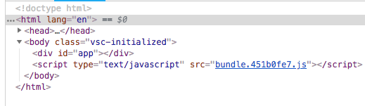
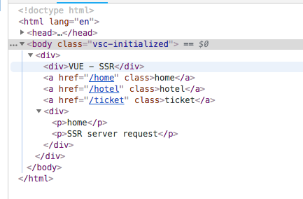
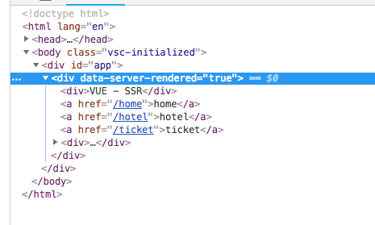
SPA
hydrate

Slide 5
VUE SSR

Slide 6
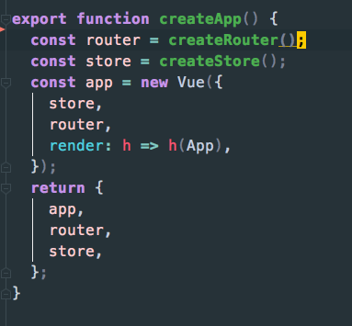
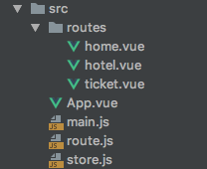
Universial Application code
app.js

Slide 7
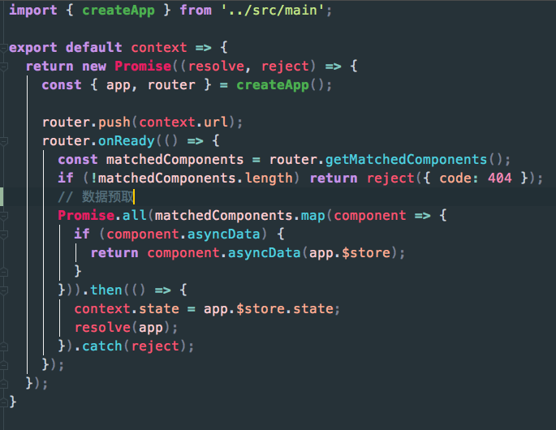
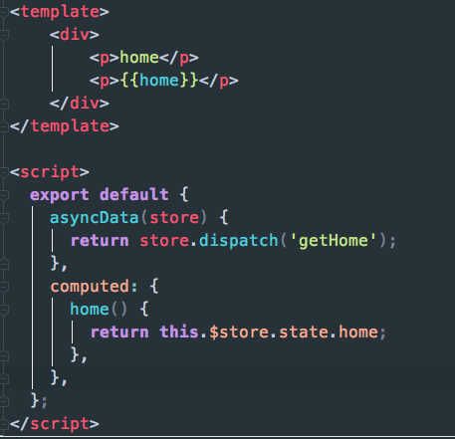
server entry
server bundle
数据预取

Slide 8
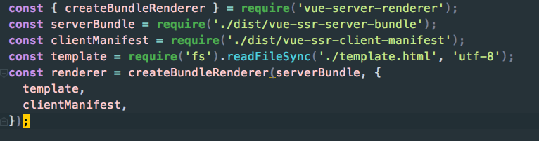
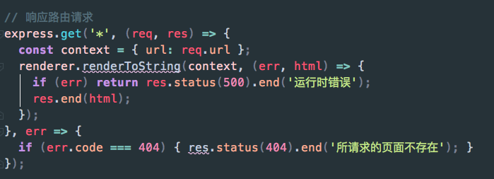
node server

