Slide 1

Columbia Capstone Project: Lifecycle
26th Sep 2022

Slide 2
Agenda
0
Team Presentation
1
Introduction to the problem
Steps
Error metrics
2
3

Slide 3
Team Presentation

Slide 4

About me
· Biochemistry degree at University of Barcelona
· Master in Bioinformatics & Biostatistics
· Co-founded a company about DeepLearning for skin-cancer detection
· 2-years as an Expert Data Scientist at Novartis Pharma
Eric Matamoros
Expert Data Scientist @Novartis

Slide 5
Introduction to the problem

Slide 6
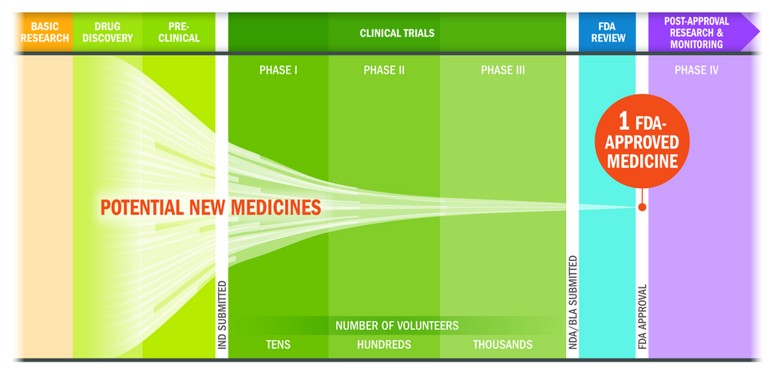
The drug production process is an expensive and long process

Slide 7
Typical lifecycle curve upon approval of a drug
Product launch
Gx Entry
Growth
Maturity
Decline
sales
R&D
Commercialization

Slide 8
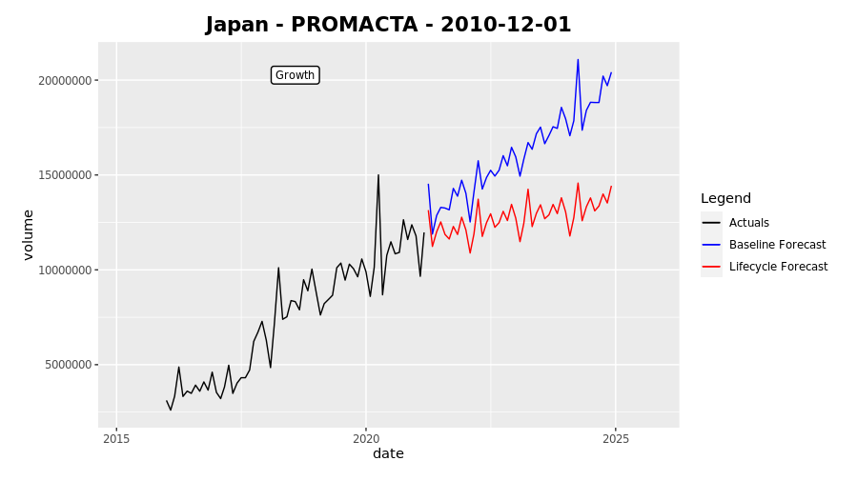
Challenge: Definition
The main goal of the Capstone Project is to improve the benchmark forecasts by modelling the lifecycle scenario. Particularly, the challenge focuses on modelling Decline-Maturity // Growth-Maturity transition by understanding the behavior of past cases.
Maturity
Growth-Maturity
Growth
Volume
Benchmark
Stabilized brand
Transition moment

Slide 9
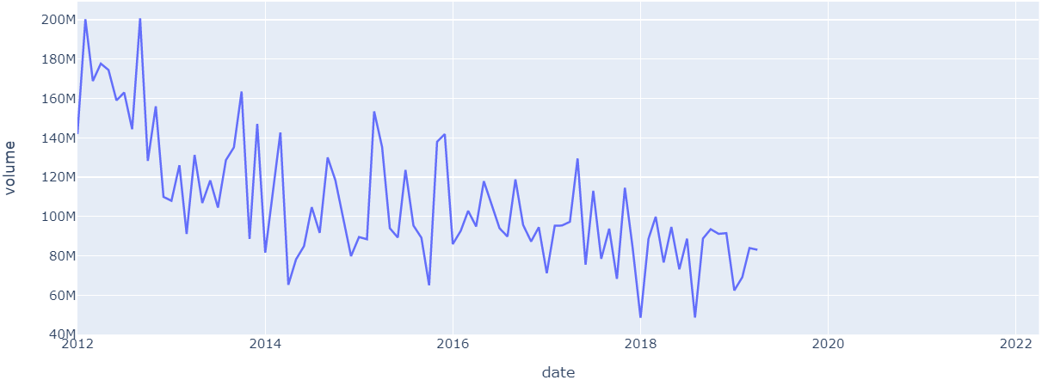
Challenge: Definition
The main goal of the Capstone Project is to improve the benchmark forecasts by modelling the lifecycle scenario. Particularly, the challenge focuses on modelling Decline-Maturity // Growth-Maturity transition by understanding the behavior of past cases.
Decline-Maturity
Decline
Maturity
Transition moment

Slide 10
Information Provided in Datasets
Date of start forecast: 2019-04-01 Target variable: Volume
Date of end forecast: 2022-04-01
Information
Explanation
Volume
·Number of monthly units sold per drug in each country.
Competitors Date
·Entry date of a competitors in the market (one country-drug can have multiple competitors).
Launch Date
·Date when the brand was launched in the market. Approval timelines are different in each region.
Indication Date
·Date of entry of an indication. An indication reflects a therapeutic use of a drug. E.g. a drug with two indications will be useful for treating two diseases or two conditions of a same disease
Population
·Population for each country and year.
Prevalence
·Ratio resulting from the number of patients going through hospital divided by the population
Stage Name
·Identified stages and respective category. Can be Growth, Maturity or Decline.
Therapeutic Area
·Numeric value representing the area of action of each drug.

Slide 11
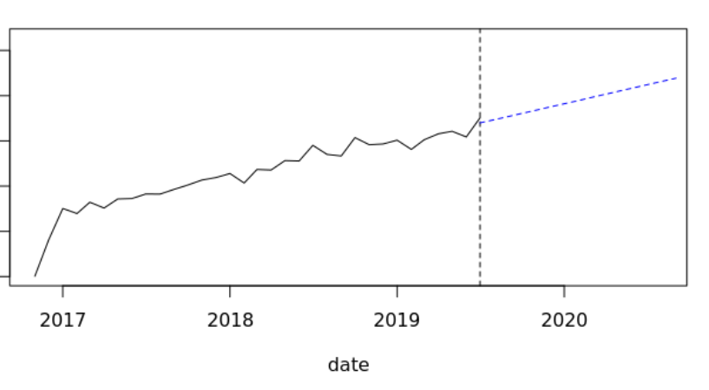
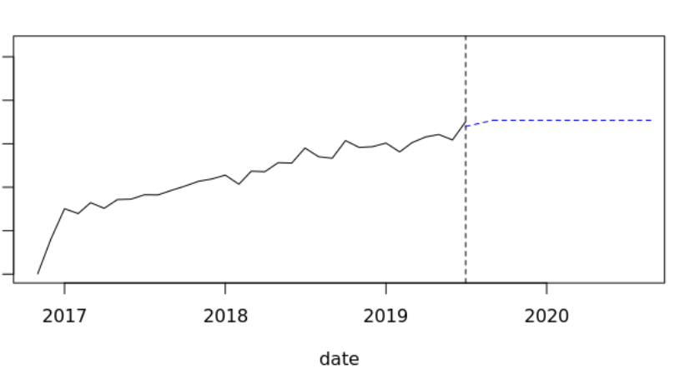
Challenge: Tasks
Part 1: Predict transition moment
Part 2: Predict stabilization upon transition
Predicts in time when a transition happens. It could be there is no transition happening.
Adjusts forecast based on the expected transition point in time from step 1
Benchmark
Stabilized Benchmark

Slide 12
Steps

Slide 13
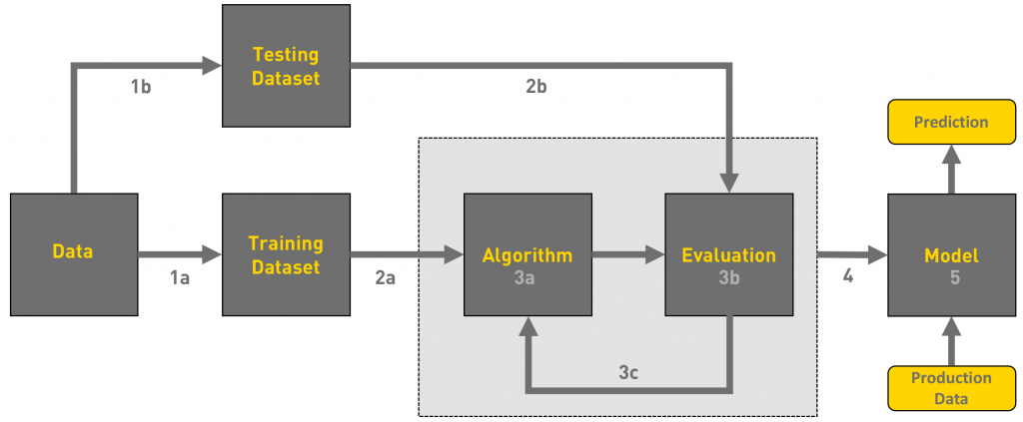
Usual workflow of a ML project
Train/Test split
Load data
Data pre-processing
Feature Engineering
Train algorithm on training data
Evaluate performance on testing data
Deploy model in production environment
Reference: https://towardsdatascience.com/workflow-of-a-machine-learning-project-ec1dba419b94

Slide 14
Steps
· Exploratory Data Analysis (EDA) of the datasets.
analyse datasets, merge them into a master dataframe, get familiar with the target variable,
features’ distribution,
· Data pre-processing & feature engineering
integrate date-related variables, cleaning of missings, outlier detection, one-hot encoding,
create benchmark forecasts,
· Training algorithm & metrics collection
train-test split, hyperparameter tuning, cross-validation, compute error metrics, final training
· Store model
Store model as a pickle (serialized) or any other supported format

Slide 15
Metrics

Slide 16
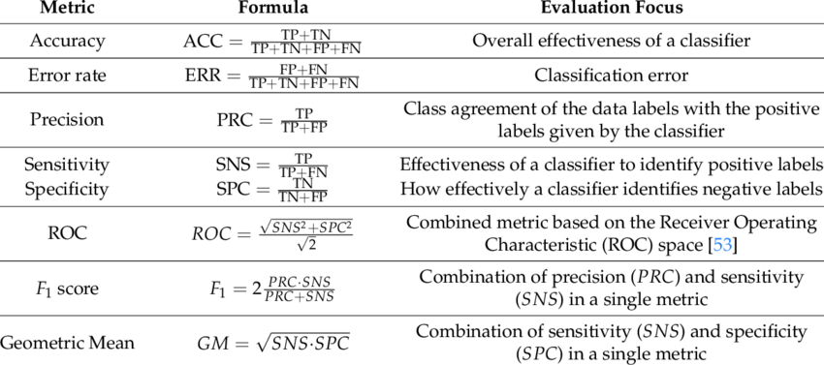
Metrics
CLASSIFICATION
Fi = Predicted forecast point
Ai = Real point
Source: https://medium.com/@MohammedS/performance-metrics-for-classification-problems-in-machine-learning-part-i-b085d432082b

Slide 17
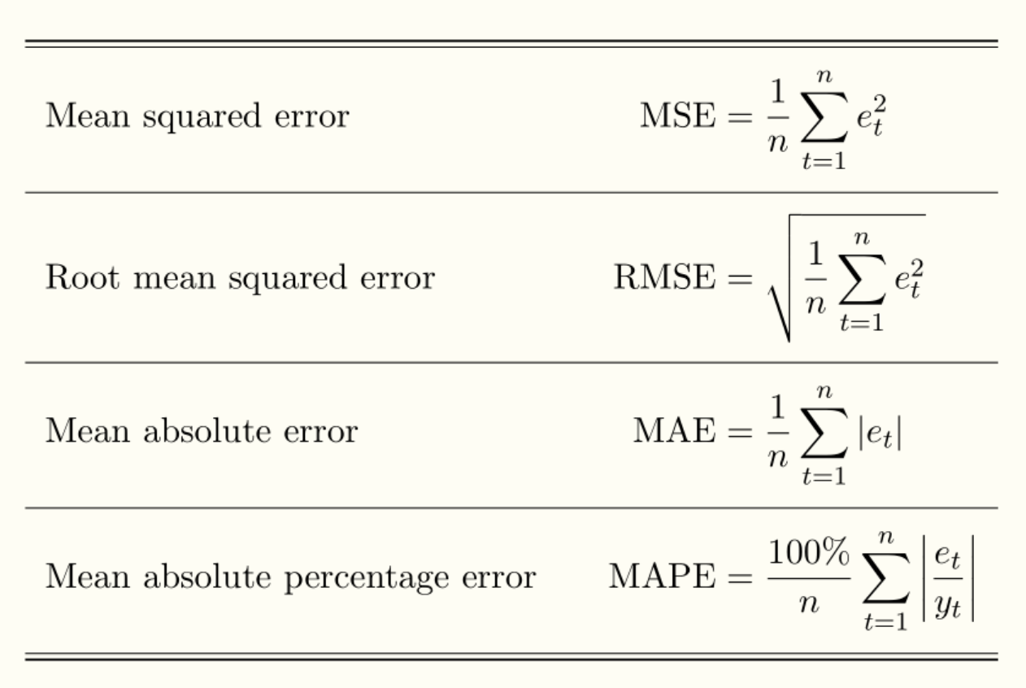
Metrics
REGRESSION
Source: https://medium.com/@MohammedS/performance-metrics-for-classification-problems-in-machine-learning-part-i-b085d432082b

Slide 18
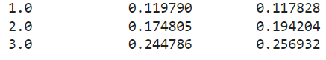
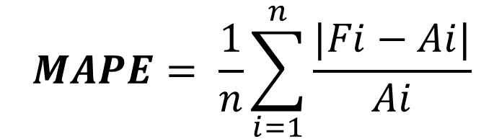
Final Evaluation Metric
$$MAPE= \frac{1}{n}\sum_{i=1}^{n}{\frac{|Fi−Ai|}{Ai}}$$
SAMPLE
Fi = Predicted forecast point
Ai = Real point
Year of Forecast
Error LC
Error Benchmark

Slide 19
Thank you for your attention!

