Slide 1
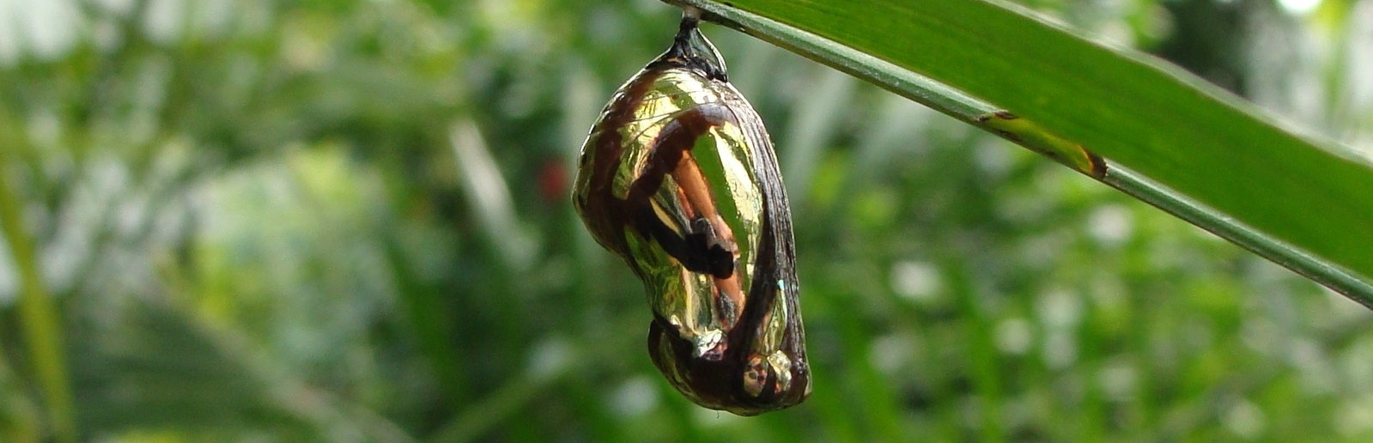
Datathon: Lifecycle
20th October 2022

Slide 2
Agenda
1
Pharmaceutical industry & Lifecycle of a product
Introduction to the Challenge
Datasets
Metrics
Presentation to the jury
2
3
4
5

Slide 3
Pharmaceutical industry & Lifecycle of a product

Slide 4
Typical lifecycle curve
Product launch
Gx Entry
Growth
Maturity
Decline
sales
R&D
Commercialization

Slide 5
A more complex lifecycle curve
Gx entry
Introduction
Growth
Maturity
Second Growth
Second Maturity
Decline Post
Gx Entry
Commercialization

Slide 6
Introduction to the Challenge

Slide 7
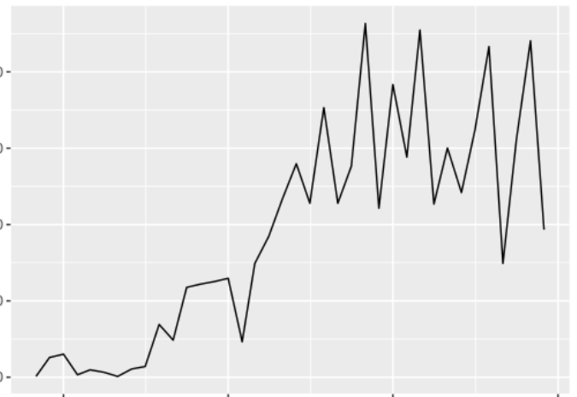

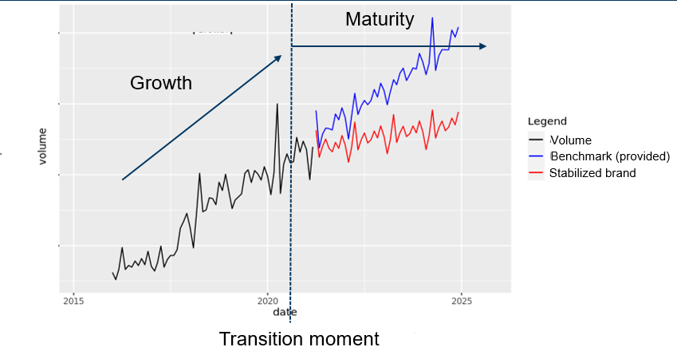
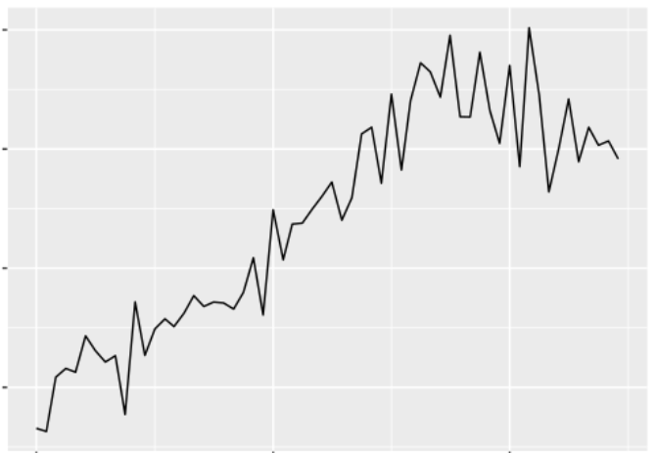
Challenge: Definition
Participants will be provided with a set of brands from the Novartis portfolio. The challenge consists in leveraging information from past brands that transitioned from Growth-Maturity with the aim to model this transitions in a test set.
Forecast start: 2019-04-01
Forecast end: 2020-04-01

Slide 8
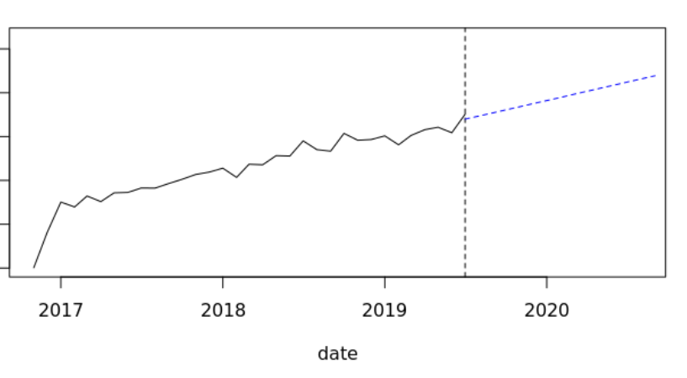
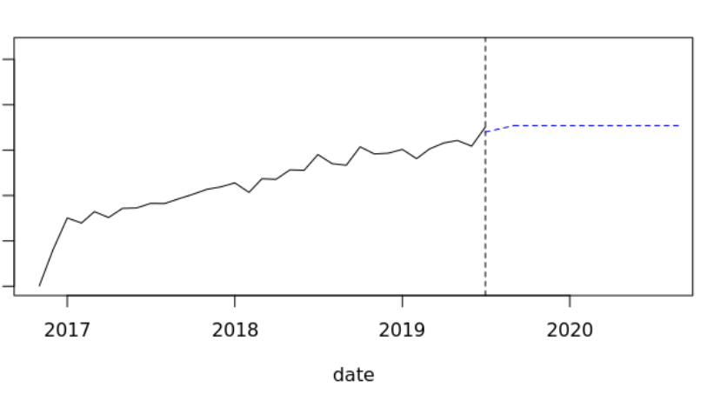
Challenge: Tasks
Part 1: Predict transition moment
Part 2: Predict stabilization upon transition
Predicts the point in time when a transition happens for each brand in the test-set. It could be there is no transition happening.
Adjust benchmark forecast based on the expected transition point in time from step 1
Is there transition: 0 0 0 1 0 0 0 0 0
Benchmark
Stabilized Benchmark
If a brand has no predicted transition, in the submission file we must input the forecasting start date.

Slide 9
Datasets

Slide 10
Information Provided in Datasets
A file with the metadata of each
dataset will be provided to each group
Information
Explanation
Volume
·Number of monthly units sold per drug in each country.
Stage Name
·Identified stages and respective category.
Business Unit
·Numeric value that identifies the business area of the drug.
Competitors Date
·Entry date of a competitors in the market (one country-drug can have multiple competitors).
Launch Date
·Date when the brand was launched in the market. Approval timelines are different in each region.
Indication Date
·Date of entry of an indication. An indication reflects a therapeutic use of a drug. E.g. a drug with two indications will be useful for treating two diseases or two conditions of a same disease
Population
·Population for each country and year.
Prevalence
· Number of patients being treated with a particular condition.
Benchmark Forecasts
·Forecasts created through a simple seasonal-trend extrapolation based on the recent stage (or the last 18-months).
Therapeutic Area
·Numeric value representing the area of action of each drug.
Regulatory Designations
· Indicates the country-brands that had a fast-track approval. This distinctive is given by FDA for drugs with high potential or usage.

Slide 11
Metrics

Slide 12
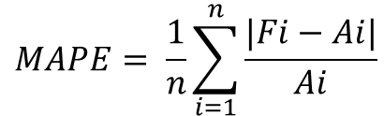
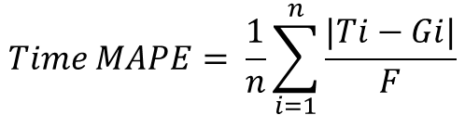
Metrics
Part 1: Predict transition moment
Part 2: Predict stabilization upon transition
$$Time MAPE= \frac{1}{n}\sum_{i=1}^{n}{\frac{|Ti−Gi|}{F}}$$
$$MAPE= \frac{1}{n}\sum_{i=1}^{n}{\frac{|Fi−Ai|}{Ai}}$$
Fi = Predicted forecast point
Ai = Real point
Ti = Predicted date of transition
Gi = Ground-truth transition date
Fi = Forecasting horizon. Equals to 36

Slide 13
Presentation to the jury

Slide 14
Key Performance Indicators
Top 10 teams with the lowest error on Metric 1 (Time APE) will move to the second phase.
Top 5 teams with the lowest error on Metric 2 (Med. APE) will present to the jury.
Prepare a 5-minute presentation that needs to reflect the following points:
· Profile of a brand that transitions from a growing to a mature scenario.
· Problem solving. Describe the solution proposal from a DS point-of-view.
· Understand business needs and how your product could help improve the business needs

Slide 15
Thank you for your attention!

