Slide 1
Our objective is to build sound-proof boxes for behavioural experiments in mice.
For this scope we arranged three different setups (Setup I, II, and III) using various materials, and recorded the obtained attenuation of different frequency tones played by speakers positioned inside the apparatus.
This graph reports the dB recorded playing different frequencies by the microphone placed inside (mic inside) or just outside the boxes (mic outside) using the different setups.
Although for lower frequencies the attenuation is strong but not absolute, for higher pitch its almost total in all three the setups: however, the characteristic of the materials employed (see Mat&Met) prompted us to choose the third one.

Slide 2
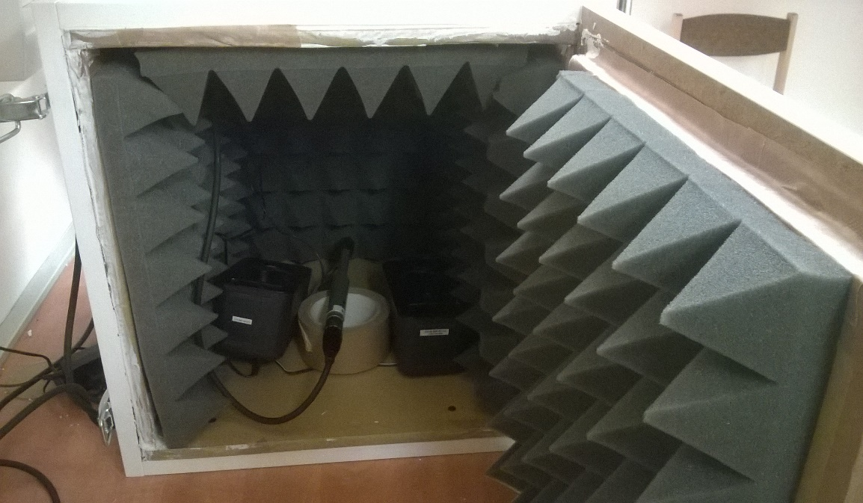
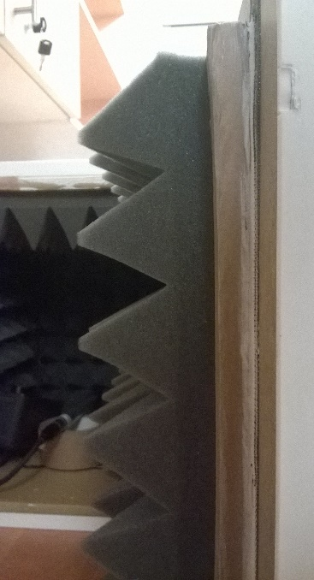
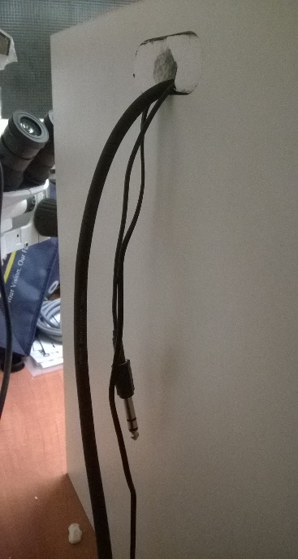
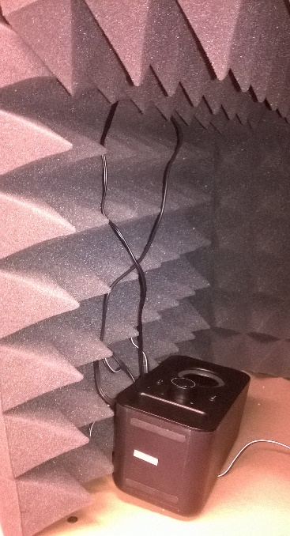
A
A
Setup I
A - This setup is built in the 40cm box using the Silence Sheet and the Alfacoustic Pyramids
B – Section of the setup, from right to left: the 2cm wooden structure of the box, the 2cm sound absorbing sand layer and the 7cm foam pyramids
C – The cables are passed through the side opening and a dedicated hole in the Silence Sheet corked with polystyrene
D – The wires fall dawn from the intersection between the foam panels
B
C
D

Slide 3
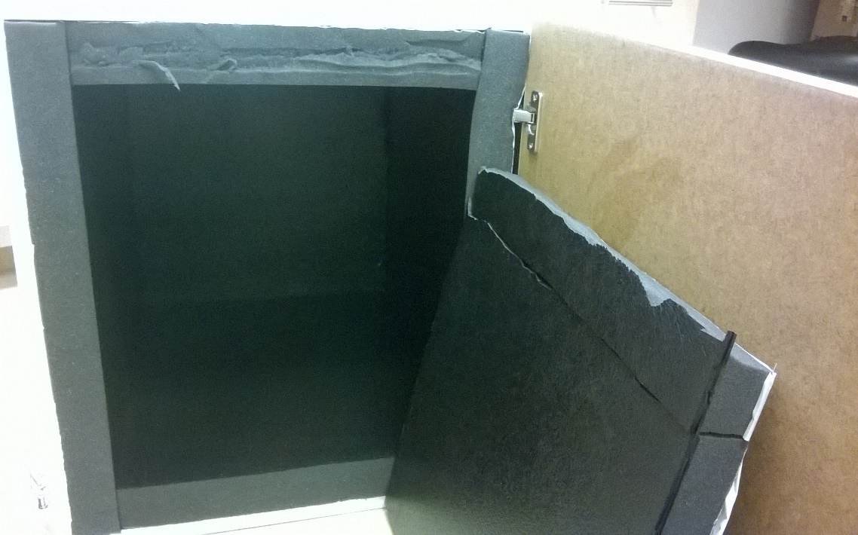
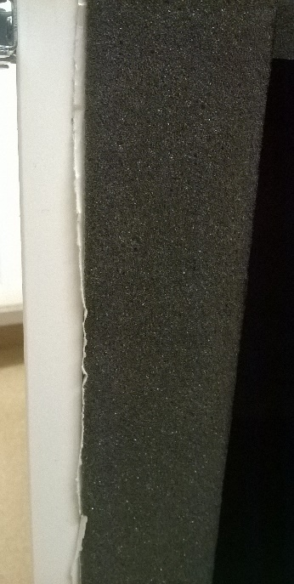
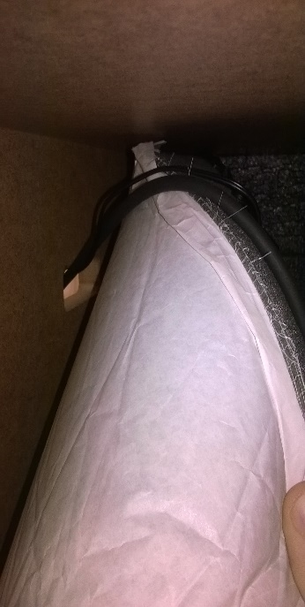
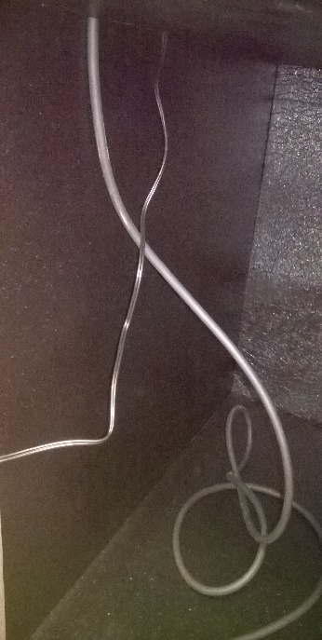
A
Setup II
A - This setup is built in the 125cm³ box using the Hanno Protecto 20 sound absorbing foam
B – Section of the setup, from left to right: the 2cm wooden structure of the box, the 2cm sound absorbing foam and the 7cm foam pyramids
C – The cables are passed through the side hole bending temporarily the foam panels on the wall
D – the wires fall dawn from the intersection between the panels, avoiding to pierce them
B
C
D

Slide 4
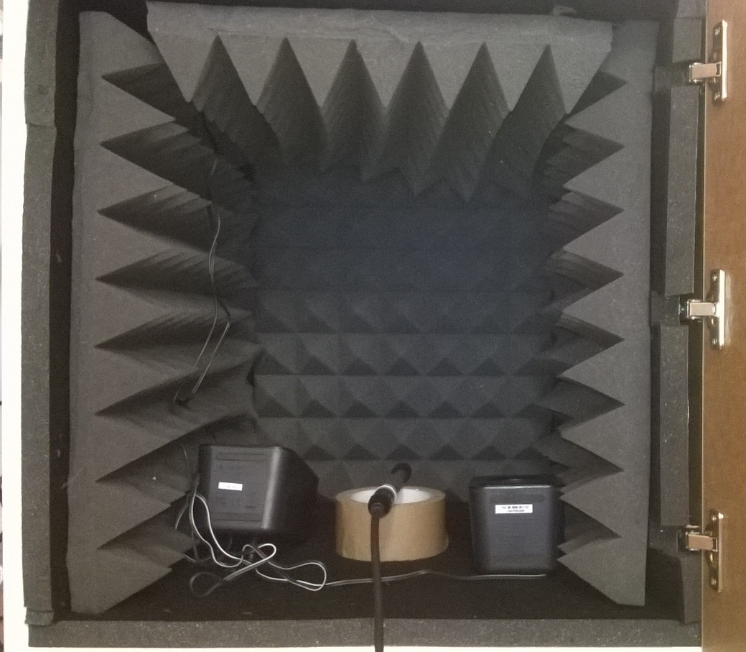
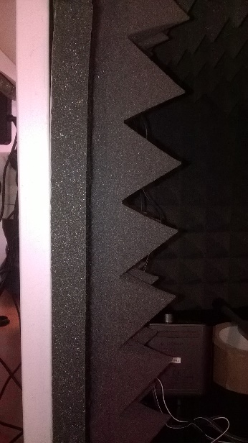
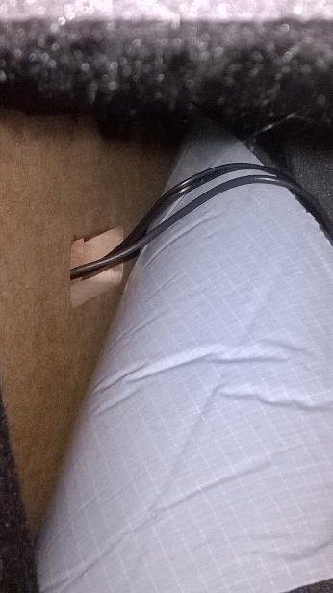
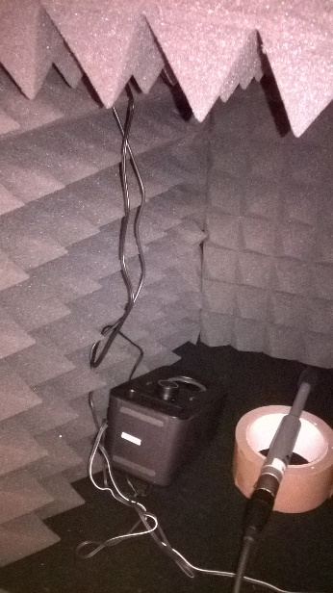
A
Setup III
A - This setup is built in the 50cm box using the Hanno Protecto 50 sound absorbing foam and the Alfacoustic Pyramids
B – Section of the setup, from left to right: the 2cm wooden structure of the box, the 2cm sound absorbing foam and the 7cm foam pyramids
C – The cables are passed through the side hole bending temporarily the foam panels on the wall
D – the wires fall dawn from the intersection between the panels, avoiding to pierce them
B
C
D

Slide 5
Materials & Methods
Sound-attenuation
Sound Absorbing Foam Hanno Protecto
We used two different models (Hanno Protecto 50 and 20) in two different measures (2cm and 5cm, respectively). Easy to cut, the panels have a covered adhesive film on one side, which however we did not used: indeed, if cut precisely to fit the box, this foam is rigid enough to stand alone, allowing us to remove or bend it whenever needed
http://techfoam.hu/hangelnyelo-szivacsok?set_lang=en
Alfacoustic Pyramids
A 7cm sound attenuating foam with pyramidal extrusion, essential to avoid resonance effects when playing tones observed in Setup II. Easy to cut, less easy to fix. However, its structure helps to prop one layer with the other, so that the pieces can stand without the necessity of glue or tape
http://www.muziker.hu/hangtechnika/studio-eszkozok/akusztikai-elemek/p/215894-alfacoustic-Pyramids-7cm
Silence Sheet
A 15mm sand film between two 2mm paper sheets that restrain it. In spite of the efficacy, its heavy weight and the spillage of particles that inevitably follow the cutting of the panel are not negligible side-effects. Once cut from the original piece, the open side must be sealed with tape, and the obtained board must be fixed at the walls of the box with silicone
http://www.parafa.net/web/index.php?option=com_content&view=article&id=1&Itemid=58

Slide 6
Sound Generation and Recording
EMM-6 Electret Measurement Microphone
A calibrated microphone designed for measurement and critical recording applications. It needs a phantom power to function.
http://www.daytonaudio.com/index.php/emm-6-electret-measurement-microphone.html
PreSonus AudioBox iOne
Sound card with phantom power for microphone alimentation, also speakers are connected to it. It comes with a professional software. Simply, it was the cheapest at the shop.
Multimedia Speakers Z150
Speakers
http://www.logitech.com/en-us/product/multimedia-speakers-z150
Software
We are now using two different freeware. The first one, TrueRTA, permits the measurement of dB SPL contemporary to the generation of tones at a chosen frequency, but has a rough scale (1 Octave), while the second one, Audacity, permits to track the audio signal more precisely but on the negative dB scale. However, we just started to use it, so their true potential is still to be discovered.

Slide 7
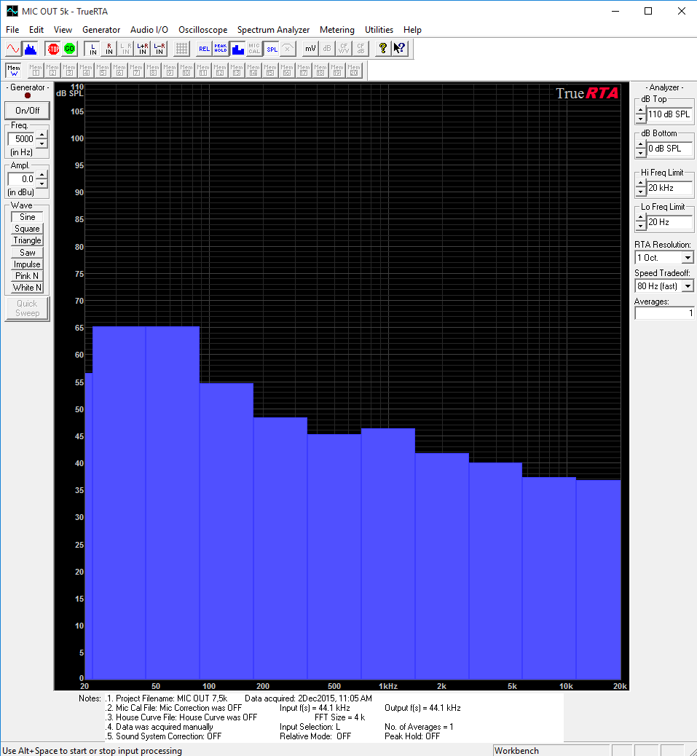
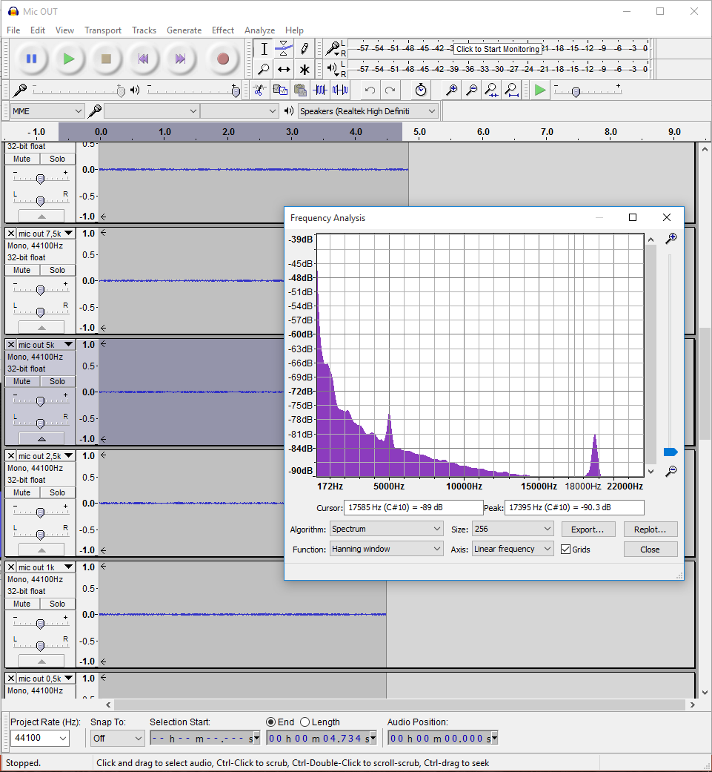
Those are two comparative screenshot of the freeware in use in the same situation, i.e. while detecting outside the box a 5kHz tone played from the speakers inside it (TrueRTA on the left, Audacity to the right)
https://www.trueaudio.com/rta_selection_guide.htm http://audacityteam.org/download/

