Slide 1
Deep Learning in Medical Image Analysis
Chris Yao

Slide 2
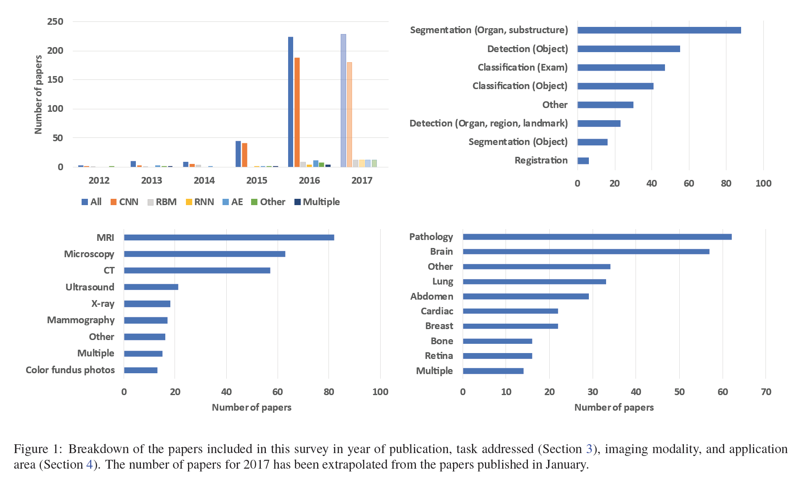
Overview

Slide 3
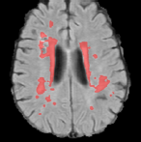
Brain MRI Image Analysis
Disorder classification (AD, MCI, Schizophrenia)
Tissue/anatomy/lesion/tumor segmentation
Lesion/tumor detection and classification
Survival/disease activity/development prediction
Image construction/enhancement
Other
Segmentation of lesions in the brain
(Ghafoorian et al., 2016)

Slide 4
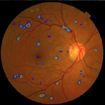
Retinal Image Analysis
Color fundus images: segmentation of anatomical structures and quality assessment
Color fundus images: detection of abnormalities and diseases
Work in other imaging modalities
Diabetic retinopathy classification
van Grinsven et al., 2016

Slide 5
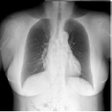
Chest X-ray Image Analysis
Nodule detection
Image retrieval
Pathology detection
Tuberculosis detection
Frontal/lateral classification
Bone suppression in x-rays
(Yang et al., 2016)

Slide 6
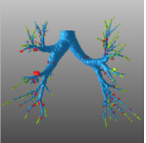
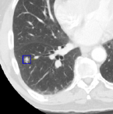
Chest CT Image Analysis
Segmentation: airway
Nodule detection and analysis
Interstitial lung disease
Other applications
Leak detection in airway tree segmentation
(Charbonnier et al., 2017)
Nodule classification (LUNA16)
(Dou et al., 2016)

Slide 7
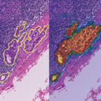
Digital Pathology Images
Nucleus detection, segmentation, and classification
Large organ segmentation
Detection and classification of disease
Other pathology applications
Breast cancer metastases detection in lymph nodes (CAMELYON16)
(Wang et al., 2016)

Slide 8
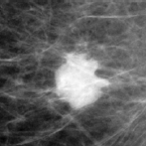
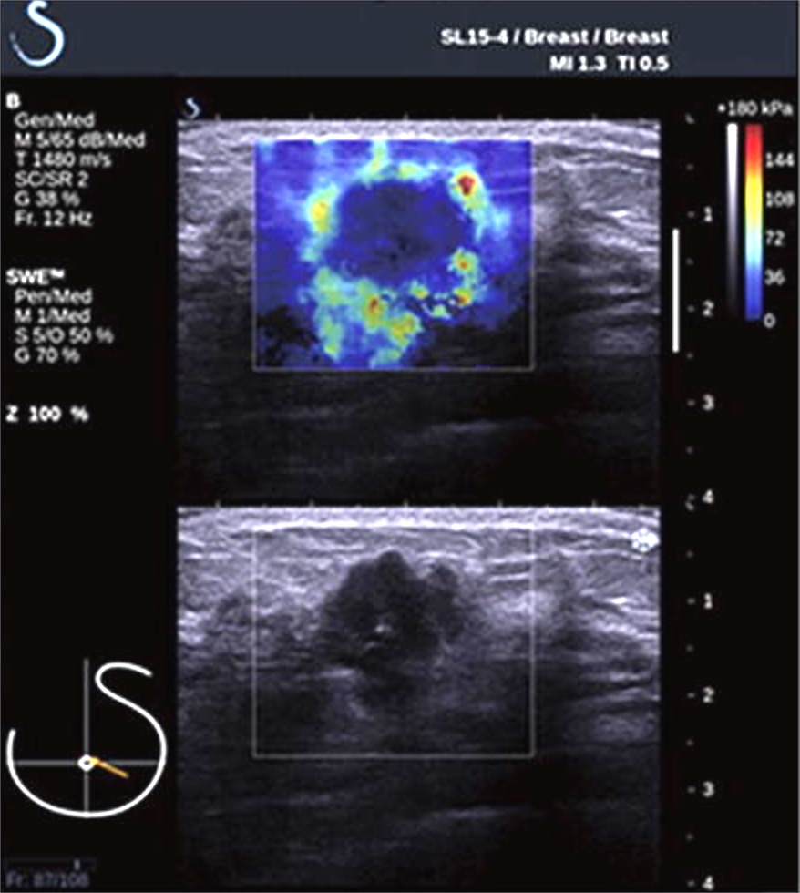
Breast Image Analysis
Mammography
Tomosynthesis
Ultrasound
Mammographic mass classification
(Kooi et al., 2016)
Breast tumor classification with shear-wave elastography
(Zhang et al., 2016)

Slide 9
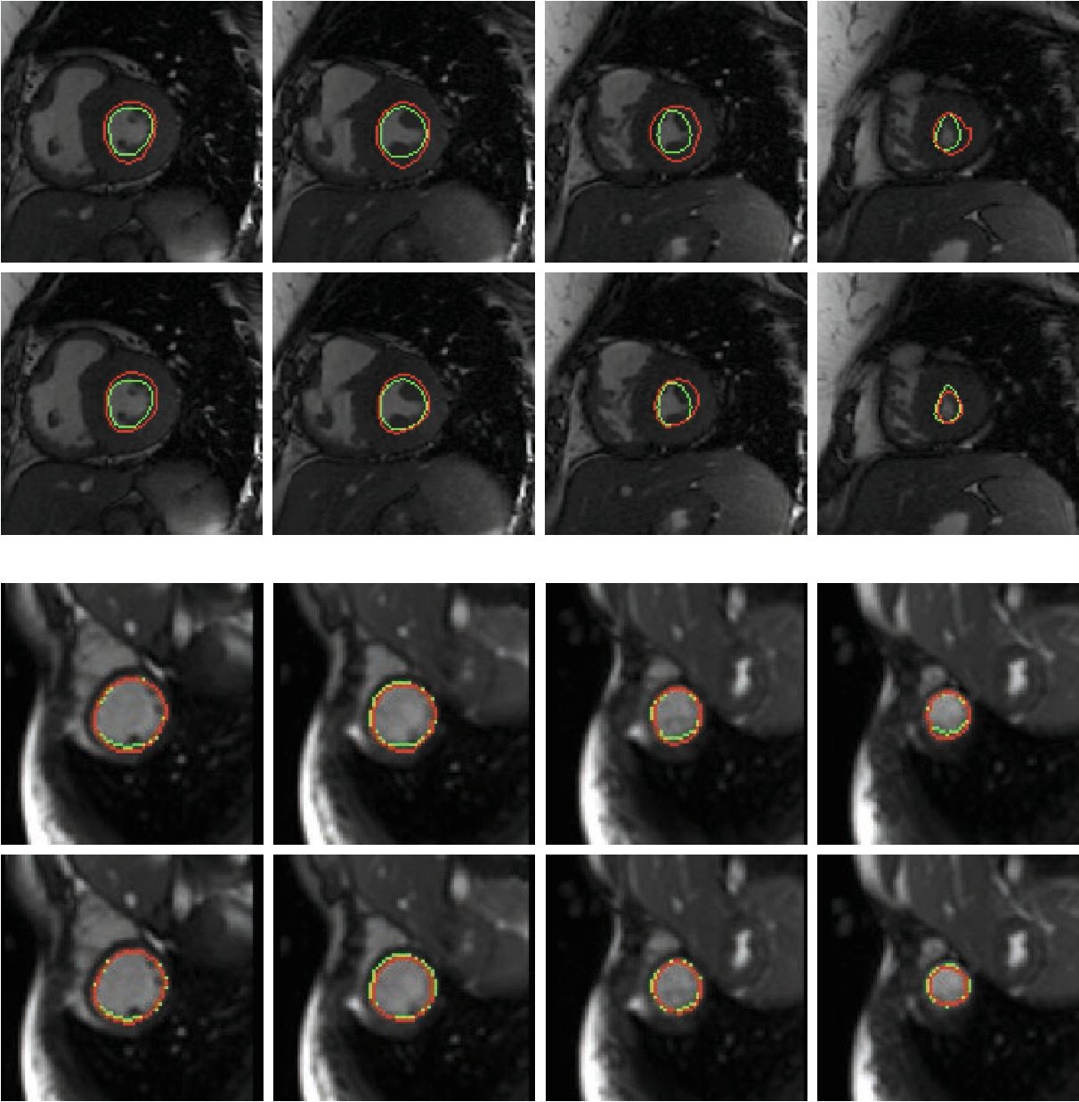
Cardiac Image Analysis
MRI
Ultrasound
CT
Left ventricle MRI images segmentation (MICCAI & PRETERM)
(Tran et al., 2016)

Slide 10
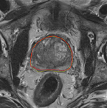
Abdominal Image Analysis
Multiple: segmentation of liver, spleen and kidneys
Segmentation tasks in liver imaging
Kidneys: CT, Ultrasound
Pancreas segmentation in CT
Colon: Colonoscopy, CT
Prostate segmentation in MRI
Prostate
Bladder
Prostate segmentation (PROMISE12)
(Yu et at., 2017)

Slide 11
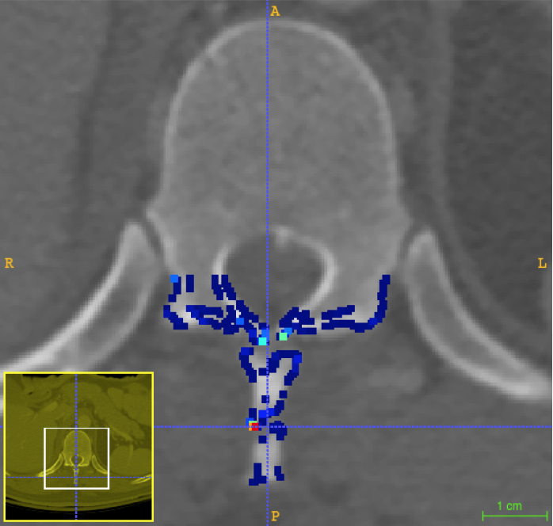
Musculoskeletal Image Analysis
MRI
CT
Ultrasound
X-ray
Posterior-element fracture detection on spine CT
(Roth et al., 2016)

Slide 12
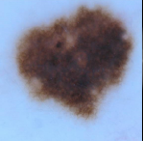
Various Image Analysis
Fetal imaging
Dermatology
Lymph nodes
Other
Skin lesion classification
(Esteva et al., 2017)

Slide 13
Key Aspects of Successful Methods
Expert knowledge about the task
Augmentation and pre-processing techniques
Architecture design with unique task-specific properties
Model hyper-parameter optimization

Slide 14
Unique Challenges
Unavailability of annotations/labeling for image data
Time consuming
Label noise
Classification/Segmentation: simplified binary task with highly heterogeneous classes
Class imbalance
Useful information outside medical images

