Slide 1
Interpretation of Calvin Filesystem Paper
Yuhang li , Deming Ren
2023/10/13

Slide 2
Contents
Background
Architecture
The file of an update
Conclusion

Slide 3
Background
Metadata management(Avoiding high synchronization overhead)
A special machine dedicated to storing and managing all metadata(problem：Unable to scale horizontally)
A shared-disk abstraction that coordinates all concurrent access(problem：hot and geography problem）
Design：
WAN replication solves regional problem
Calvin DB solves consistency and scalability problem

Slide 4
Contents
Background
Architecture
Block Store
Metadata Managerment
The file of an update
Conclusion

Slide 5
Block Store
Variable-Size Immutable Blocks
file store in a sequence of blocks
variable size(1 B to 10 MB)
Immutable(once written)
Block Storage and Placement
globally unique blockID
assigned to a block “bucket”
each bucket is assigned to block servers
every CalvinFS node caches the bucket map

Slide 6
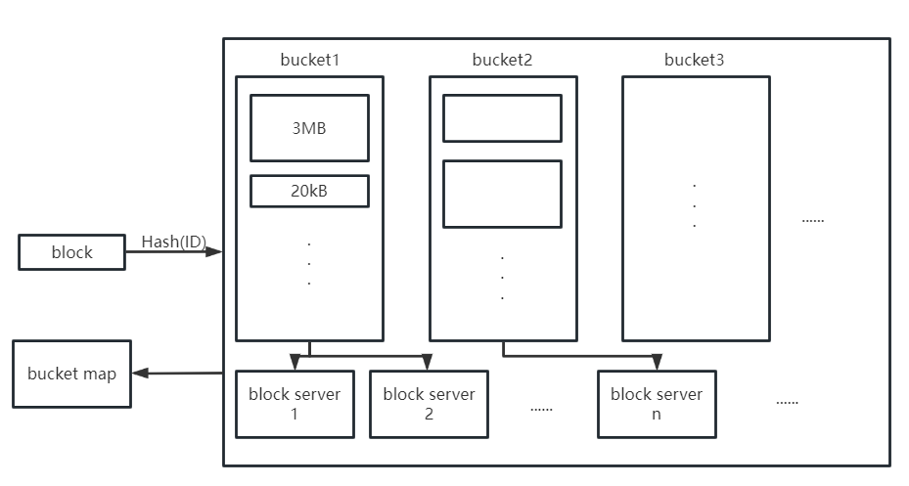
Block Store

Slide 7
Contents
Background
Architecture
Block Store
Metadata Managerment
The file of an update
Conclusion

Slide 8
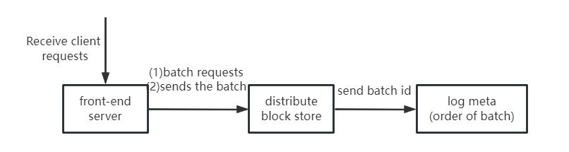
Calvin DataBase
Log
front-end servers
distributed block store
meta-log servers
Storage Layer
CalvinFS metadata is stored in key-value
CalvinFS metadata is hashed to different storage node’ memory
Scheduler
Schedule execution in the order in which the logs appear

Slide 9
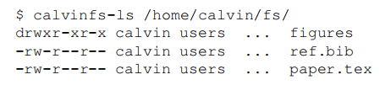
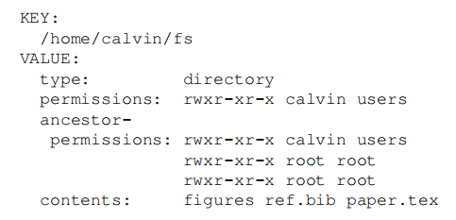
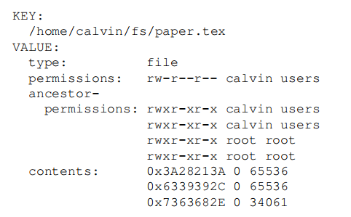
key-value store
For path /home/calvin/fs/ ：
-------------------------------------------------------------------
fs directory metadata： |
|
|
|
|
|
|
paper.tex metadata：

Slide 10
Transaction Operations
Read(path)
Create{File,Dir}(path)
Resize(path, size)
Write(path, file offset, source, source offset, num bytes)
Delete(path)
Edit permissions(path, permissions)
$ echo "import antigravity" > /home/calvin/fly.py
Create
Resize
Write

Slide 11
OLLP
Analyse:
The purpose of the Analyze phase is to determine the read and write-sets of the transaction
Run:
detect whether the read and write set of the transaction has changed

Slide 12
Contents
Background
Architecture
The file of an update
Conclusion

Slide 13
The file of an update
$ echo "import antigravity" > /home/calvin/fly.py
(1)Write File Data
(2)Construct Metadata Operation
(3)Append Transaction Request to Log
(4)Apply Update to Metadata Store

Slide 14
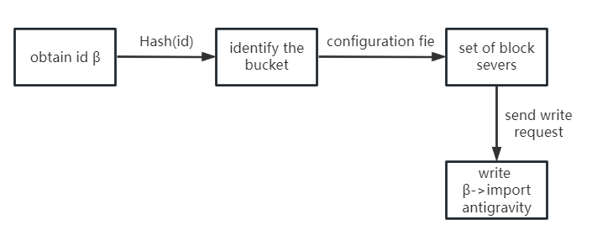
Write File Data

Slide 15
Construct Metadata Operation
Compound transaction request
(1) create file /home/calvin/fly.py
(2) resize the file to 18 bytes
(3) write β:[0,18) to byte range [0,18) of the file

Slide 16
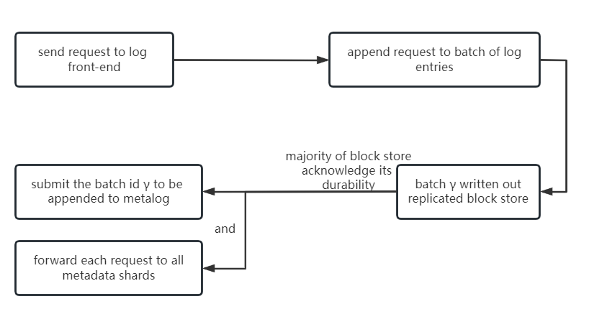
Append Transaction Request to Log

Slide 17
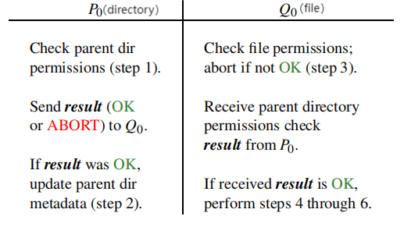
Apply Update to Metadata Store
1.Check parent directory permissions
2.Update parent directory metadata
3.Check file permissions
4.Create file metadata entry
5.Resize file metadata entry
6.Update file metadata entry’s contents

Slide 18
Contents
Background
Architecture
The file of an update
Conclusion

Slide 19
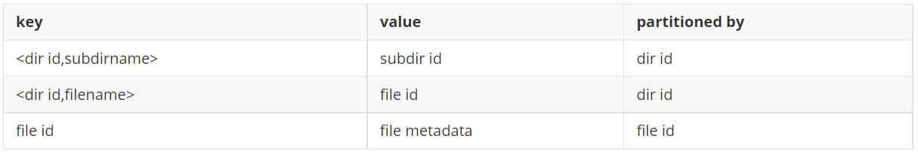
Conclusion
Metadata management advantage
Obtaining metadata only requires one read
Metadata management shortage
The cost of moving file and changing file permission is high
Current metadata management

Slide 20
Interpretation of Calvin Filesystem Paper
Thanks
10/13/2023

