Slide 1
Interpretation of Calvin Filesystem Paper
Yuhang li , Deming Ren
2023/10/13

Slide 2
Contents
Background
Architecture
The file of an update
Conclusion

Slide 3
Background
Metadata management(Avoiding high synchronization overhead)
A special machine dedicated to storing and managing all metadata(problem：Unable to scale horizontally)
A shared-disk abstraction that coordinates all concurrent access(problem：hot and geography problem）
Design：
WAN replication solves regional problem
Calvin DB solves consistency and scalability problem

Slide 4
Contents
Background
Architecture
Block Store
Metadata Managerment
The file of an update
Conclusion

Slide 5
Block Store
Variable-Size Immutable Blocks
a CalvinFS file is stored in a sequence of blocks
Blocks may be anywhere from 1 byte to 10 megabytes
Once the block is written, it will remain immutable
Block Storage and Placement
Each block is assigned a globally unique ID， and is assigned to a block “bucket” by hashing its ID.
Each bucket is assigned to a certain number of block servers
Every CalvinFS node also caches a copy of the bucket map

Slide 6
Contents
Background
Architecture
Block Store
Metadata Managerment
The file of an update
Conclusion

Slide 7
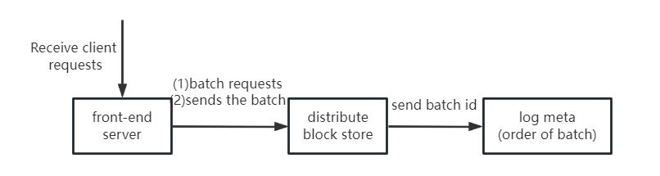
Calvin DataBase
Log
front-end servers
distributed block store
meta-log servers
Storage Layer
CalvinFS metadata is stored in key-value
CalvinFS metadata is hashed to different storage node’ memory
Scheduler
Schedule execution in the order in which the logs appear

Slide 8
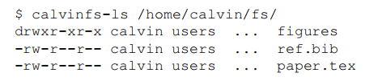
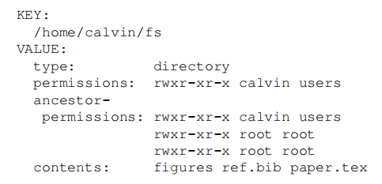
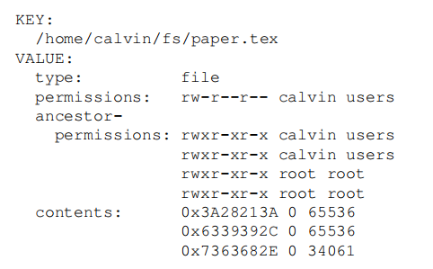
key-value store
For path /home/calvin/fs/ ：
fs directory metadata：
paper.tex metadata：

Slide 9
Transaction Operations
Read(path)
Create{File,Dir}(path)
Resize(path, size)
Write(path, file offset, source, source offset, num bytes)
Delete(path)
Edit permissions(path, permissions)
$ echo "import antigravity" > /home/calvin/fly.py
Create
Resize
Write

Slide 10
OLLP
Analyse:
The purpose of the Analyze phase is to determine the read and write-sets of the transaction
Run:
detect whether the read and write set of the transaction has changed

Slide 11
Contents
Background
Architecture
The file of an update
Conclusion

Slide 12
The file of an update
$ echo "import antigravity" > /home/calvin/fly.py
(1)Write File Data
(2)Construct Metadata Operation
(3)Append Transaction Request to Log
(4)Apply Update to Metadata Store

Slide 13
Write File Data
(1)obtain a block id β from a block store server
(2)β is hashed to identify the bucket(also lookup bucket map)
(3) sends a block write request (β → import antigravity) to each of those block servers

Slide 14
Construct Metadata Operation
Compound transaction request α
(1) create file /home/calvin/fly.py
(2) resize the file to 18 bytes
(3) write β : [0,18) to byte range [0,18) of the file

Slide 15
Append Transaction Request to Log
(1) The CalvinFS front-end sends the Compound transaction request α to a Calvin log front-end
(2) a Calvin log front-end appends α to (unique id γ)batch of log entries
(3) batch γ is written out another asynchronously replicated block store
(4) submit the batch id γ to be appended to metalog, and it it goes through the batch in order,forwarding each transaction request to all metadata shards

Slide 16
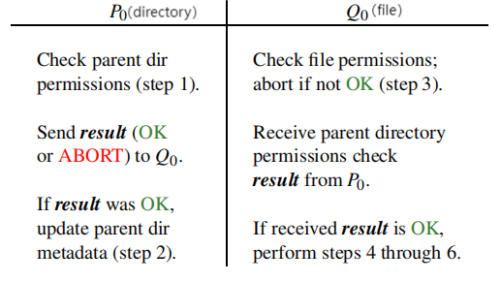
Apply Update to Metadata Store
1.Check parent directory permissions
2.Update parent directory metadata
3.Check file permissions
4.Create file metadata entry
5.Resize file metadata entry
6.Update file metadata entry’s contents

Slide 17
Contents
Background
Architecture
The file of an update
Conclusion

Slide 18
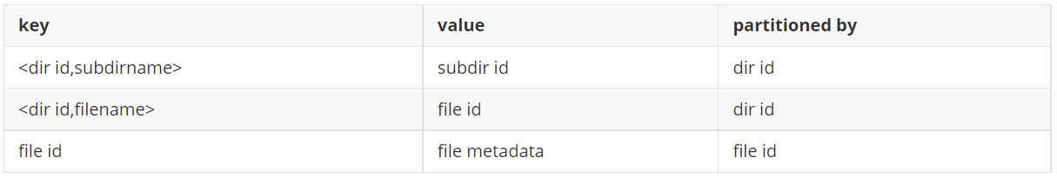
Conclusion
Metadata management advantage
Obtaining metadata only requires one read
Metadata management shortage
The cost of moving file and changing file permission is high
Current metadata management

Slide 19
Interpretation of Calvin Filesystem Paper
Thanks
10/13/2023

