Slide 1
Optimization of metadata management in CubeFS
Yu-Ang Cao, Ruida Xu
2023/07/11
Notes:
CubeFS 元数据管理优化

Slide 2
Contents
General architecture of distributed file systems.
Metadata management of distributed file systems.
The solution for CubeFS metadata management.
Future work.

Slide 3
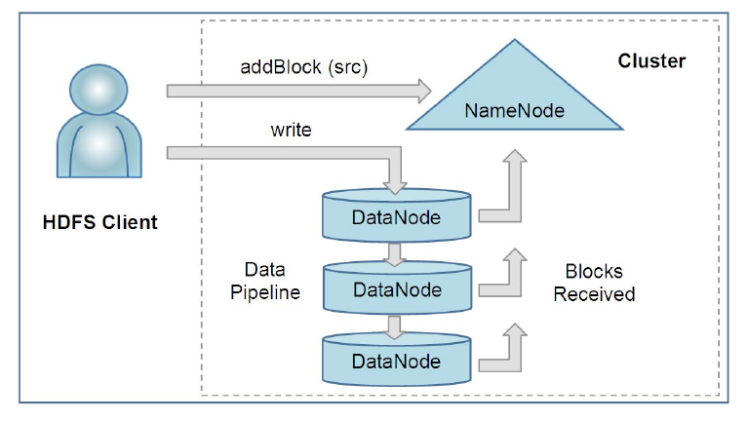
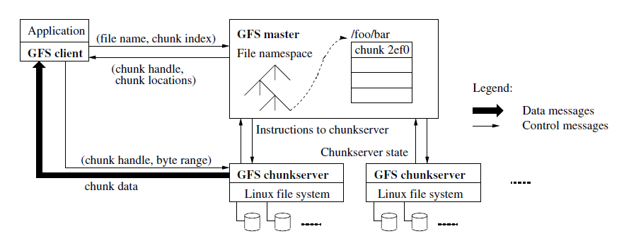
Initial Design of Metadata Management
GFS [1]
HDFS [2]
A metadata server.
Only a single server for metadata operations.
Limited scalability.
Notes:
Gfs图重画

Slide 4

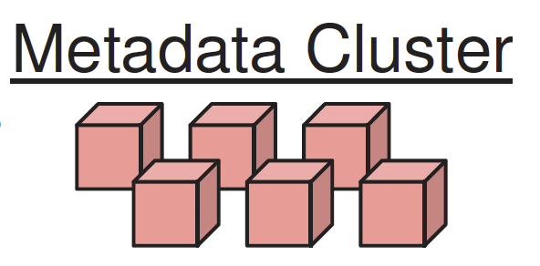


General architecture of distributed file systems
Metadata operations
Metadata storage
File I/O
Use a distributed metadata cluster to improve scalability.
How to distribute the metadata into the cluster?

Slide 5
Contents
General architecture of distributed file systems.
Metadata management of distributed file systems.
The solution for CubeFS metadata management.
Future work.

Slide 6
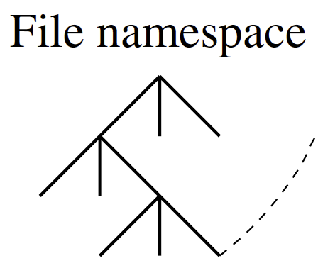
Distributed Metadata Management
How to distribute the metadata into the cluster?
Subtree partition.
Use distributed KV store.
Notes:
Use distributed kv store. 需要重写

Slide 7
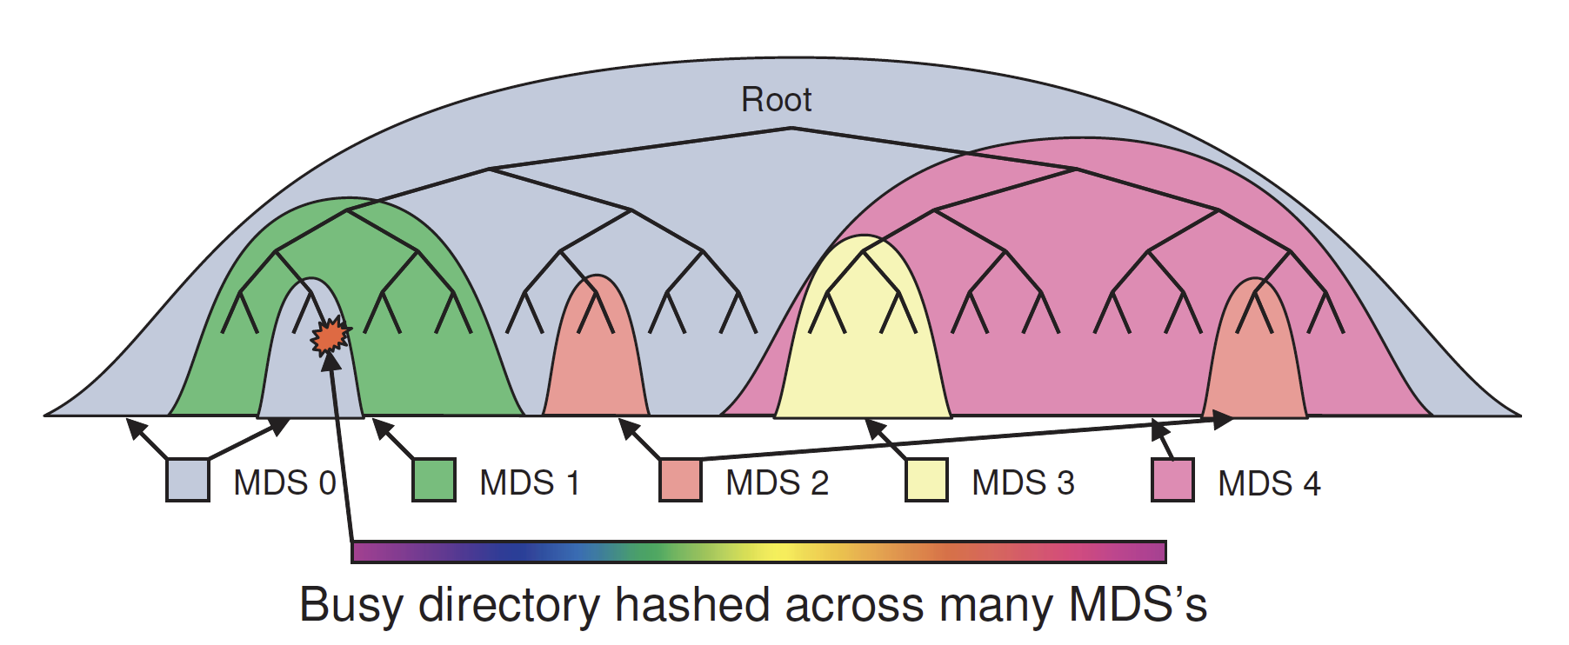
Distributed Metadata Management - Subtree partition
Subtree partition in ceph [3]:
Put hot subtree to different servers for load balance.
But it has locality problem and metadata migration problem.

Slide 8
Distributed Metadata Management – Distributed KV Store
Use a distributed key-value store to store the namespace tree.
Key | Value
/home/a/a.txt | File metadata
/home/a/ | Dir metadata
Key | Value
/home/a/a.txt | File metadata
Key | Value
/home/a/a.txt | File metadata
…
…
…
Distributed KV store

Slide 9

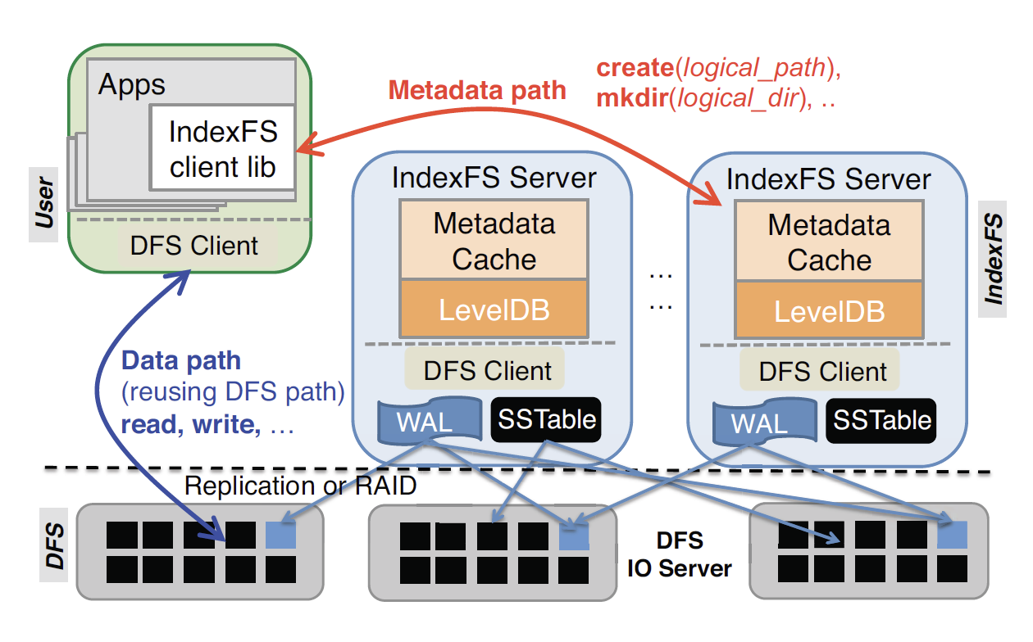
Distributed Metadata Management – Distributed KV Store
Giraffa [4] (USENIX ;login: 2017) replaces the single master of HDFS with a cluster, which stores the file namespace in an HBase (a distributed data store) table.
HDFS
…
A single metadata server
Distributed kv store
IndexFS [5] (SC’14) uses LevelDB to store the metadata and dynamically partitions large directories into different servers using hash functions.
CalvinFS [6] (FAST’15) is a geographically distributed file system. It uses a distributed KV store which support transactions to store metadata.
InfiniFS [7] (FAST’22): decouple directories metadata and group them for locality. It also stores metadata in a KV store.
Notes:
有空把locofs也写上

Slide 10
Contents
General architecture of distributed file systems.
Metadata management of distributed file systems.
The solution for CubeFS metadata management.
CubeFS architecture and metadata management.
The problem and solution for CubeFS metadata management.
Future work.
Notes:
架构介绍+元数据管理+元数据管理存在的问题+初始解决方案

Slide 11
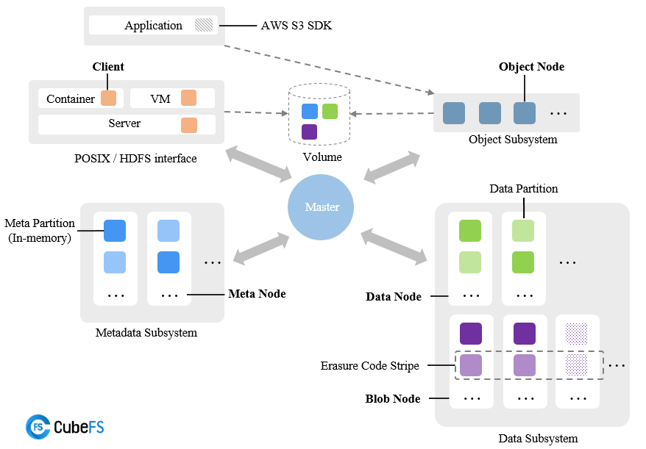
CubeFS Architecture

Slide 12
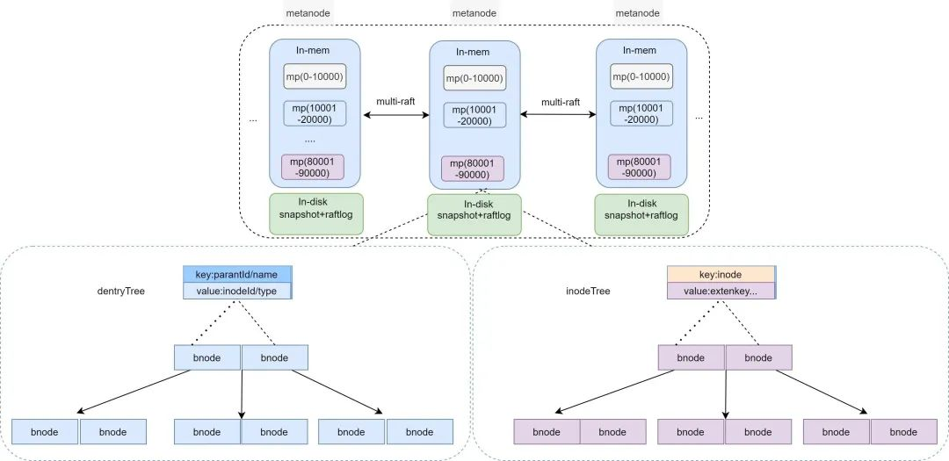
CubeFS Metadata Management
Use multi-raft to replicate metadata partitions.
Each mp (metadata partition) manages a range of inode.
Notes:
重画这个图

Slide 13
Metanode Architecture: Overview
Multiple metanodes (>=3). Sync by Multi-Raft.
2 Btrees: (without extendTree (store xattr), and multipartTree (for ObjectNode) )
inodeTree: [Inode.Inode uint64] -> [*Inode]
dentryTree: [<ParentId, Name>(uint64, string)] -> [*Dentry]

Slide 14
Implementation: B-Tree
B-Tree:
Using Google open source B-Tree impl. with golang.
Add concurrent read & write feature by RWmutex.
https://github.com/google/btree
BTreeItem Interface
Implementation of Less() and Copy() functions needed

Slide 15
Implementation: MetaNode
MetaNode
ParID(uint64) | MetaPartition
… | …
Partitions
connPool
State
…
MetaManager
listen
bindIp
raftStore
…
dentryTree *BTree
inodeTree *BTree
Metanode

Slide 16
Implementation: inode & dentry
dentryTree: (Dentry)
Key: ParentId + name
value: Inode + type
inodeTree: (Inode)
Key: Inode
Value: Type, Attr, Extents…
Dentry
ParentId | uint64
Name | string
Inode | uint64
Type | uint32
Inode
Inode | uint64
Type | uint32
Uid | uint32
… | …
Extents | *SortedExtents

Slide 17
Implementation (Lookup (client))
Client (e.g. FUSE got a lookup request)
FUSE
Lookup Request
1. Lookup_ll
make packets
Step 1. Get inode number by pinode + filename
sdk/meta/meta.go (metaWrapper)
client/fs/dir.go
Step 2. Get inode by inode number
Step 3. Create file/dir instance and return
2. InodeGet_ll
Send to leader partition (by TCP)
metanode
metanode
metanode

Slide 18

Implementation (Lookup (metanode))
Metanode (FUSE got a lookup request)
Request Packets
HandleMetadataOperation
Deserialize packets
Lookup Request
Search Trees
InodeGet Request
Response Packets
Lookup Response
InodeGet Response
MetaManager

Slide 19
Problems in Metadata Management
The two B-trees in each mp consume too much memory.

Slide 20
Current Solution
Hot data: Stay in B-trees.
Cold data: Save to the disk.
Do hot and cold identification at the granularity of mp.
Put the cold data into the RocksDB on the disk.
Problems
The data will switch between hot and cold and the conversion between RocksDB and B-tree will happen.
Coordinate the RocksDB log and metanode log.
The way to snapshot the metanode, which has B-trees and RocksDB.
Notes:
以mp为粒度检测冷热，冷的mp在所有机器上都转成rocksdb，热的保留b树。
未来工作：优化冷热转换时rocksdb和b树之间相互转换的开销。

Slide 21
Future Work
Optimize the cost of conversion between RocksDB and B-tree.
Fine-grained hot and cold identification.
Optimize the access speed to the cold data.
New partition method for load balancing.

Slide 22
Reference
[1] Ghemawat, Sanjay, Howard Gobioff, and Shun-Tak Leung. "The Google file system." Proceedings of the nineteenth ACM symposium on Operating systems principles (SOSP 03). 2003.
[2] Shvachko, Konstantin, et al. "The hadoop distributed file system." 2010 IEEE 26th symposium on mass storage systems and technologies (MSST 10). IEEE, 2010.
[3] Weil, Sage A., et al. "Ceph: A scalable, high-performance distributed file system." Proceedings of the 7th symposium on Operating systems design and implementation (OSDI 06). 2006.
[4] Shvachko, Konstantin V., and Yuxiang Chen. "Scaling namespace operations with giraffa file system." USENIX; login (2017).
[5] Ren, Kai, et al. "IndexFS: Scaling file system metadata performance with stateless caching and bulk insertion." Proceedings of the International Conference for High Performance Computing, Networking, Storage and Analysis (SC 14). IEEE, 2014.
[6] Thomson, Alexander, and Daniel J. Abadi. "{CalvinFS}: Consistent {WAN} Replication and Scalable Metadata Management for Distributed File Systems." 13th USENIX Conference on File and Storage Technologies (FAST 15). 2015.
[7] Lv, Wenhao, et al. "{InfiniFS}: An Efficient Metadata Service for {Large-Scale} Distributed Filesystems." 20th USENIX Conference on File and Storage Technologies (FAST 22). 2022.

Slide 23
Optimization of metadata management in CubeFS
Thanks

