Slide 1
CubeFS Metanode
Ruida Xu
2023/7/11

Slide 2
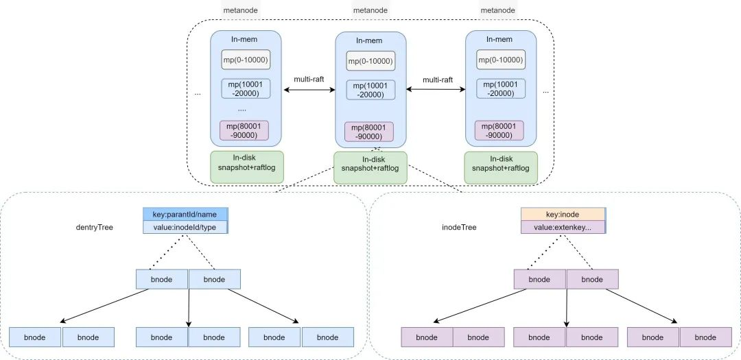
Architecture: Overview
Multiple metanodes (>=3). Sync by Multi-Raft.
2 Btrees: (without extendTree (store xattr), and multipartTree (for ObjectNode) )
inodeTree: [Inode.Inode uint64] -> [*Inode]
dentryTree: [<ParentId, Name>(uint64, string)] -> [*Dentry]

Slide 3
Implementation: B-Tree
B-Tree:
Using Google open source B-Tree impl. with golang.
Add concurrent read & write feature by RWmutex.
https://github.com/google/btree
BTreeItem Interface
Implementation of Less() and Copy() functions needed

Slide 4
Implementation: MetaNode
MetaNode
ParID(uint64) | MetaPartition
… | …
Partitions
connPool
State
…
MetaManager
listen
bindIp
raftStore
…
dentryTree *BTree
inodeTree *BTree
Metanode

Slide 5
Implementation: inode & dentry
dentryTree: (Dentry)
Key: ParentId + name
value: Inode + type
inodeTree: (Inode)
Key: Inode
Value: Type, Attr, Extents…
Dentry
ParentId | uint64
Name | string
Inode | uint64
Type | uint32
Inode
Inode | uint64
Type | uint32
Uid | uint32
… | …
Extents | *SortedExtents

Slide 6
Implementation (Lookup (client))
Client (e.g. FUSE got a lookup request)
FUSE
Lookup Request
1. Lookup_ll
make packets
Step 1. Get inode number by pinode + filename
sdk/meta/meta.go (metaWrapper)
client/fs/dir.go
Step 2. Get inode by inode number
Step 3. Create file/dir instance and return
2. InodeGet_ll
Send to leader partition (by TCP)
metanode
metanode
metanode

Slide 7

Implementation (Lookup (metanode))
Metanode (FUSE got a lookup request)
Request Packets
HandleMetadataOperation
Deserialize packets
Lookup Request
Search Trees
InodeGet Request
Response Packets
Lookup Response
InodeGet Response
MetaManager

