Slide 1
Interpretation of InfiniFS Papers
Yuhang li
2023/09/15

Slide 2
Contents
Background and Motivation.
Challenges of Scalable Metadata.
The solution for InfiniFS metadata challenges.
Conclusion.

Slide 3
Background and Motivation
Problem:
Modern datacenters contain a huge numbers of files, which can easily exceed the capacity of one single instance of current distributed filesystems.
Current resolution:
A datacenter is divided into relatively smaller clusters, each of which runs a distributed filesystem instance separately.
One single large-scale filesystem spanning the entire datacenter is desirable.
Global data sharing.
High resource utilization.
Low operational complexity

Slide 4
Contents
Background and Motivation.
Challenges of Scalable Metadata.
High metadata locality and good load balancing
The latency of path resolution
The overhead of coherence maintenance for client-side metadata cache becomes overwhelming
The solution for InfiniFS metadata challenges.
Conclusion.

Slide 5
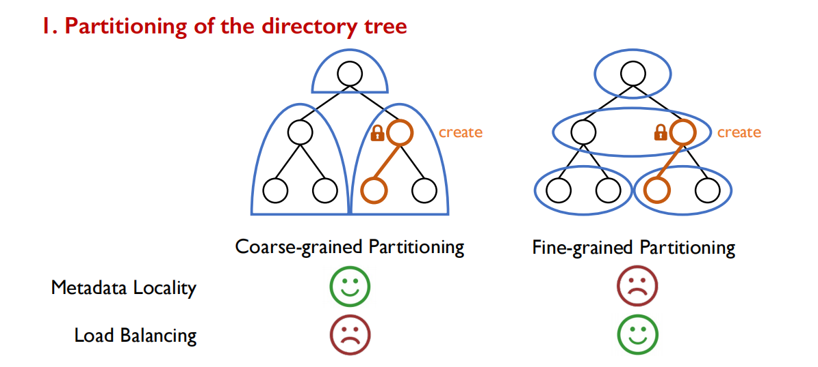
High metadata locality and good load balancing

Slide 6
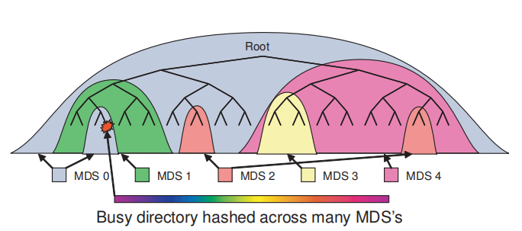
Cephfs adopts coarse-grained adaptive load balancing
When a directory becomes a hotspot, it will be hashed into multiple MDS.
However, they suffer from the high overhead of frequent metadata migrations, when workloads are diverse and vary frequently.

Slide 7
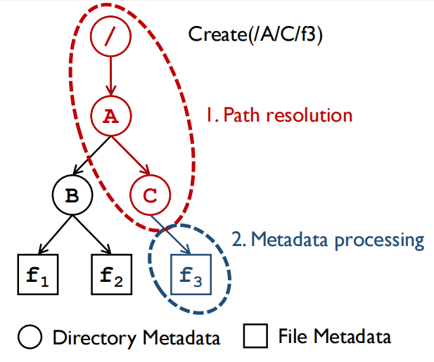
Metadata operations
Metadata operations typically involve two critical step.
Path resolution
Metadata processing

Slide 8
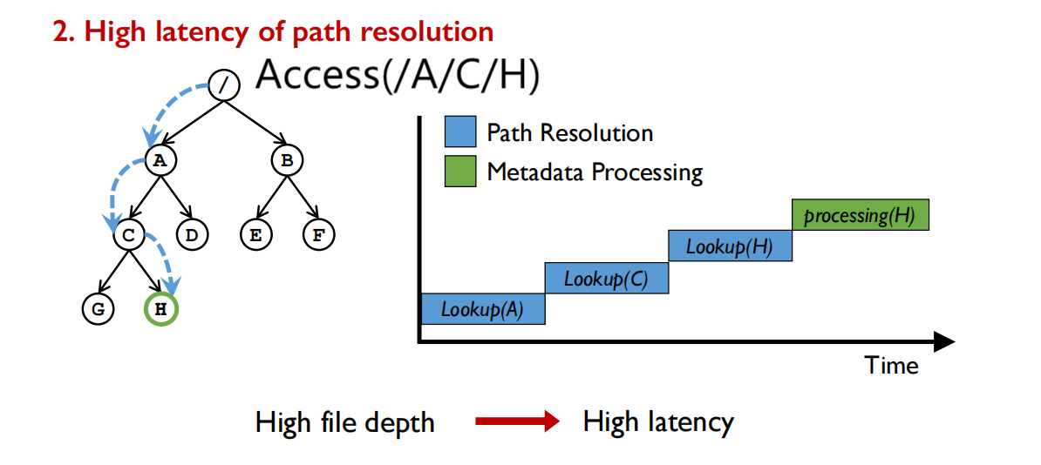
The latency of path resolution

Slide 9
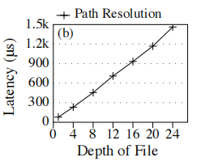
A naive path resolution mechanism based on Tectonic
The latency of path resolution increases linearly with the depth of files

Slide 10
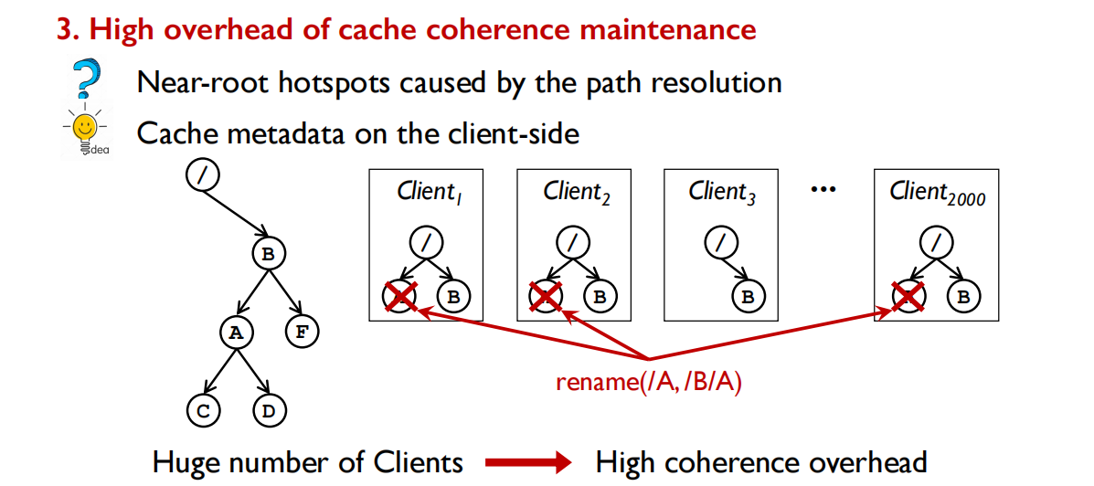
The overhead of coherence maintenance for client-side metadata cache

Slide 11
Contents
Background and Motivation.
Challenges of Scalable Metadata.
The solution for InfiniFS metadata challenges.
Conclusion.

Slide 12
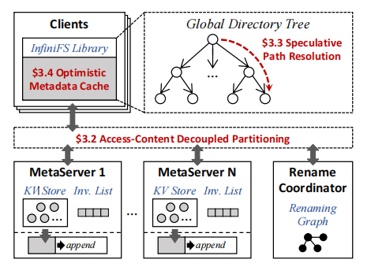
InfiniFS Architecture
Clients
Global Directory tree
Optimistic Metadata cache
Metadata Server
KV Store
Invalidation list
Rename Coordinator
Check concurrent directory rename
Broadcasts modification information

Slide 13
The resolution of these challenges
High metadata locality and good load balancing
Access-Content Decoupled Partitioning
The latency of path resolution
Speculative Path Resolution
The overhead of coherence maintenance for client-side metadata cache becomes overwhelming
Optimistic Access Metadata Cache

Slide 14
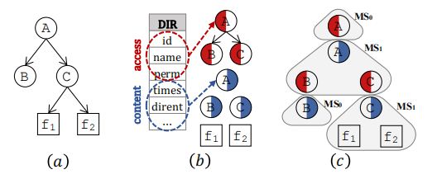
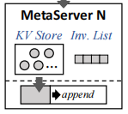
Access-Content Decoupled Partitioning
Decoupling directory metadata
Access metadata
Content metadata
Grouping for locality
Access metadata with the parent
Content metadata with the children
Hash Partitioning for load balancing
KV store
Access metadata
Content metadata
File metadata

Slide 15
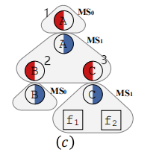
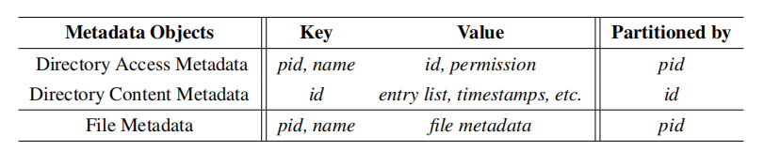
Access-Content Decoupled Partitioning
Access A/C/f1
We use ID 1 to find MS1
We use <1,C> as the key to get C’s ID equals 3
We use ID 3 to find MS1
We use <3> as the key to get C’s entry list
We use <3,file1> as the key to get file1 metadata
KV store
Access metadata
Content metadata
File metadata

Slide 16
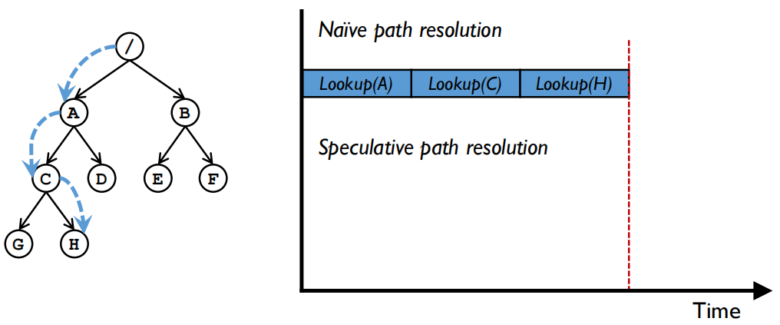
Speculative Path Resolution
A naive path to access /A/C/H

Slide 17
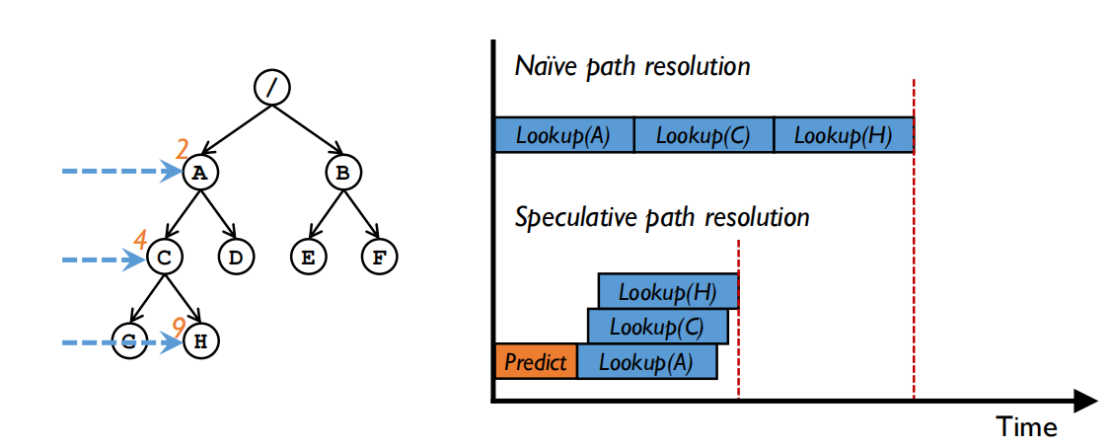
Speculative Path Resolution
Use Predictable Directory ID and Parallel Path Resolution

Slide 18
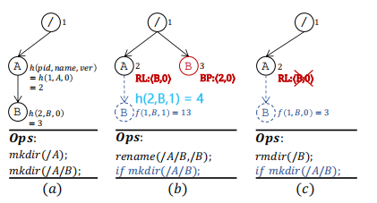
Predictable Directory ID
Creating
hash(parent id,directory name,name version)
Renaming
rename-list(RL):<directory name, name version>
back-pointer(BP):<birth parent’s ID, name version>
Deleting
when deleting a renamed directory,we use the BP of the directory to erase the RL of its birth parent

Slide 19
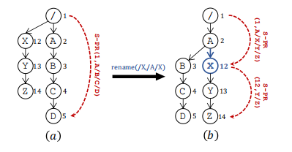
Parallel Path Resolution
Path resolution in parallel with the following two steps
Predicted dictory IDS：calculate the hashing result along the path with 0 as the version number
Lookup in parallel：check the access permission and compare speculative ID with ID stored in metadata server
Repeate step 1 and 2 until the resolving completes

Slide 20
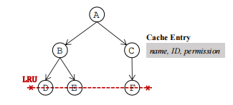
Optimistic Access Metadata Cache
Cache organization
Only caches access metadata
InfiniFS organizes cache entries in a tree structure based on the filesystem hierarchy, and links the leaf entries as a least recently-used (LRU) list

Slide 21
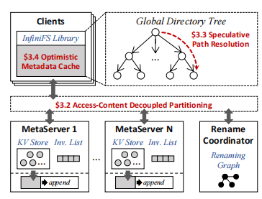
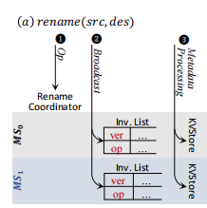
Optimistic Access Metadata Cache
Lazy cache invalidation
InfiniFS sends the directory rename operation to the rename coordinator to detect orphaned loops(consistency)
broadcast the rename information to metadata servers instead of client

Slide 22
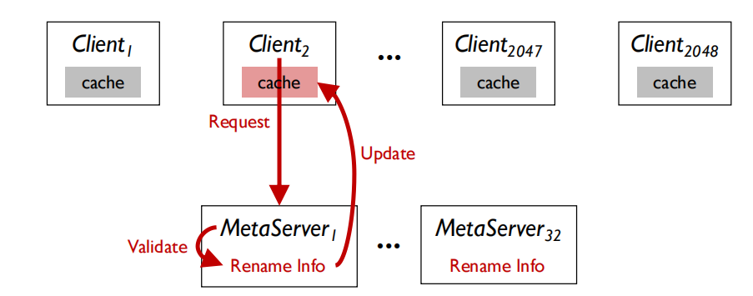
Optimistic Access Metadata Cache
when a client contacts metadata server through the following steps
A client sends the request along with the pathname and version
Metadata server compare the pathname against rename operations in the invalidation list
If the server finds the request is invalid，it will return the information of these new rename operations. The client then updates the cache and version

Slide 23
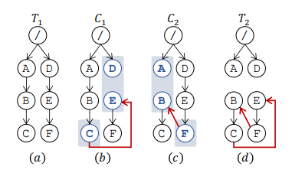
Orphaned Loop(Consistency)
Orphaned Loop:
C1 rename E to be a chlid of C
C2 rename F to be a child of B
Due to concurrency,B,C,E and F will become an orphanded loop
Resolution:
Tracks the source and destination path
Delete these path after the rename operation completes

Slide 24
Contents
Background and Motivation.
Challenges of Scalable Metadata.
The solution for InfiniFS metadata challenges.
Conclusion.

Slide 25
Conclusion
Key：
Design efficient a large-scale distributed system
Problem：
High metadata locality and good load balancing
The latency of path resolution
The overhead of coherence maintenance for client-side metadata cache
Resolution：
Access-Content Decoupled Partitioning
Speculative Path Resolution
Optimistic Access Metadata Cache

Slide 26
Interpretation of Infinifs Papers
Thanks
2023/09/15

