Slide 1
Interpretation of Facebook’s Tectonic Filesystem Paper
Yuhang li , Deming Ren
2023/09/22

Slide 2
Contents
Background.
Architecture.
Multitenancy.
Tenant-Specific Optimizations.
Conclusion

Slide 3
Background
Facebook’s Previous Storage Infrastructure
Blob Storage：Store binary large objects
Haystack：Store hot blob（IOPS-bound）
f4：Store warm blob (Storage bound)
Warehouse Storage：Store data analytics(Storage bound)
Problem:
Resources could not be shared with other systems
High operation and maintenance costs
Resolution: consolidation and resource sharing

Slide 4
Contents
Background.
Architecture.
Multitenancy.
Tenant-Specific Optimizations.
Conclusion

Slide 5
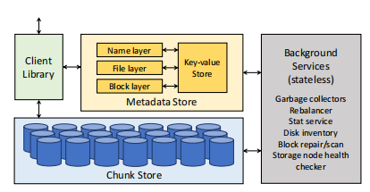
Architecture
Facebook’s Tectonic Architecture
Including:
Metadata Store
Chunk Store
Client Library
Background Services

Slide 6
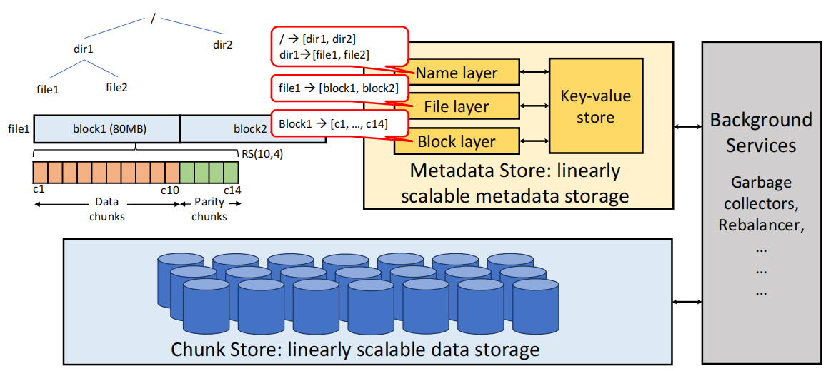
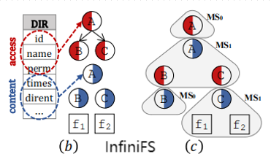
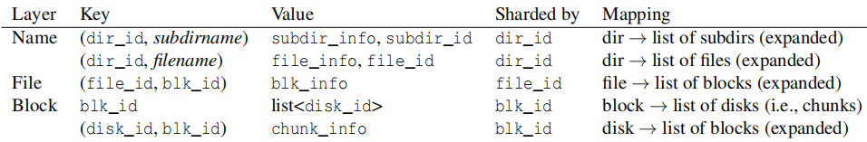
Architecture
Metadata Store and Chunk Store

Slide 7
Contents
Background.
Architecture.
Multitenancy.
Tenant-Specific Optimizations.
Conclusion

Slide 8
Multitenancy
Consider:
How to share resources fairly between tenants?
How to provide performance isolation between tenants?

Slide 9
Multitenancy
Resources
non-ephemeral: Storage capacity
ephemeral: Storage IOPS capacity,metadata query capacity
Distributing ephemeral resources among and within tenants
TrafficGroup（groups of applications within tenant）—— TrafficClass(divided by latency)
Gold
Silver
Bronze
Resources prior：
TrafficGroup within tenant > TrafficGroup other tenants
Gold > Silver > Bronze(TrafficGroup within tenant)

Slide 10
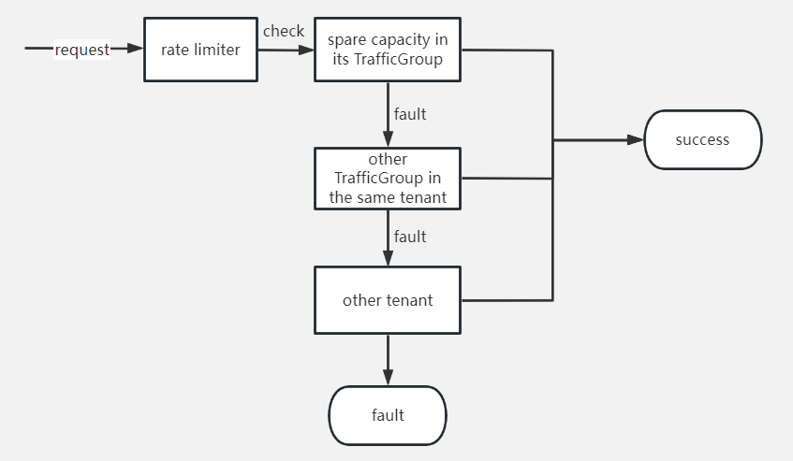
Multitenancy
Resource sharing:
The Client Library use a rate limiter to track resource in each tenant and TrafficGroup

Slide 11
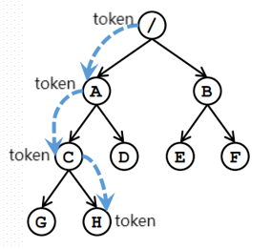
Multitenancy
Multitenant Access Control
Coarse access control:
Prevent one tenant from accessing another’s data
Finegrained access control:
Granting permissions to the next layer along the path using a token based authorization mechanism

Slide 12
Contents
Background.
Architecture.
Multitenancy.
Tenant-Specific Optimizations.
Conclusion

Slide 13
Tenant-Specific Optimizations
Data Warehouse Write Optimizations
RS-encoding:
Saves storage space compared with replication
Hedged quorum writes to improve tail latency
Sends reservation requests to extra nodes
Blob Storage Write Optimizations
Consistent partial block appends for low latency
Once replicated to most disk,the Client confirms successful
Reencoding blocks for storage efficiency
When the block is full,it will use RS encoding

Slide 14
Contents
Background.
Architecture.
Multitenancy.
Tenant-Specific Optimizations.
Conclusion

Slide 15
Conclusion
Low utilization of certain resources in each systems
consolidation and expand Exabyte-Scale
How to share resources in the system
track resources and access control
How to optimize performance as in specialized systems
Data Warehouse and Blob Storage write optimizations

Slide 16
Interpretation of Facebook’s Tectonic Filesystem Paper
Thanks
2023/09/22

