Slide 1
Interpretation of Calvin Filesystem Paper
Yuhang Li , Deming Ren
2023/11/2

Slide 2
Contents
Background
Architecture
The file of an update
Conclusion

Slide 3
Background
Metadata management(Avoiding high synchronization overhead)
A special machine dedicated to storing and managing all metadata(problem：Unable to scale horizontally);
A shared-disk abstraction that coordinates all concurrent access(problem：hot and geography problem）.
Design：
WAN replication solves regional problem;
Calvin DB solves consistency and scalability problem.

Slide 4
Contents
Background
Architecture
Block Store
Metadata Managerment
The file of an update
Conclusion

Slide 5
Block Store
Variable-Size Immutable Blocks
File stored in a sequence of blocks;
Variable size(1 B to 10 MB);
Immutable(once written).

Slide 6
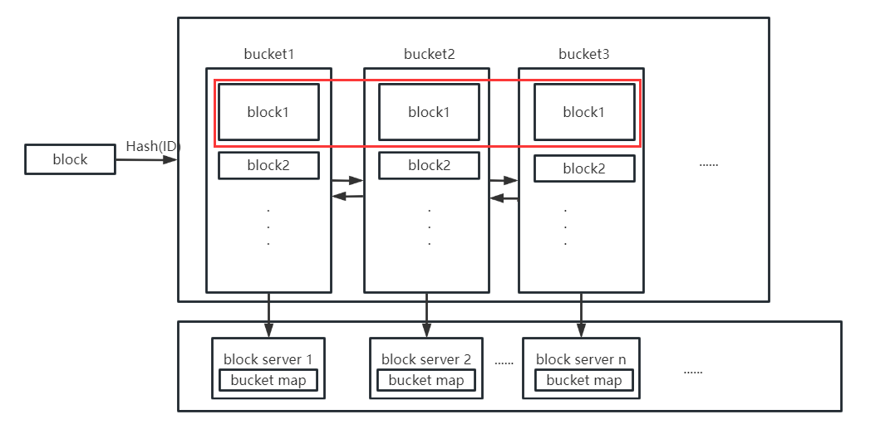
Block Store
Block Storage and Placement

Slide 7
Contents
Background
Architecture
Block Store
Metadata Managerment
The file of an update
Conclusion

Slide 8
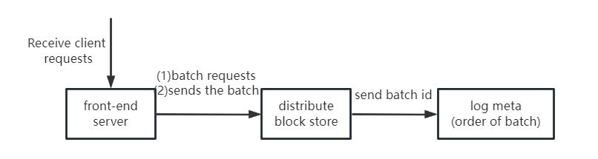
Calvin DataBase
Log
Front-end servers;
Distributed block store;
Meta-log servers.
Storage Layer
CalvinFS metadata is stored in key-value;
CalvinFS metadata is hashed to different storage node’ memory.
Scheduler
Schedule execution in the order in which the logs appear.

Slide 9
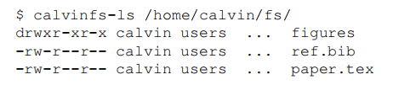
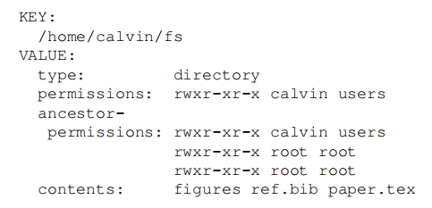
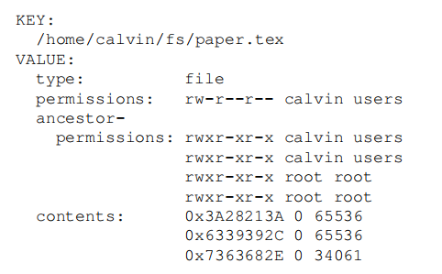
key-value store
For path /home/calvin/fs/ ：
-------------------------------------------------------------------
Metadata of fs directory： |
|
|
|
|
|
|
Metadata of paper.tex：

Slide 10
Transaction Operations
Read(path);
Create{File,Dir}(path);
Resize(path, size);
Write(path, file offset, source, source offset, num bytes);
Delete(path);
Edit permissions(path, permissions).
$ echo "import antigravity" > /home/calvin/fly.py
Create
Resize
Write

Slide 11
OLLP
Analyse:
The purpose of the Analyze phase is to determine the read and write-sets of the transaction.
Run:
Detect whether the read and write set of the transaction has changed.

Slide 12
Contents
Background
Architecture
The file of an update
Conclusion

Slide 13
The file of an update
$ echo "import antigravity" > /home/calvin/fly.py
(1)Write File Data;
(2)Construct Metadata Operation;
(3)Append Transaction Request to Log;
(4)Apply Update to Metadata Store.

Slide 14
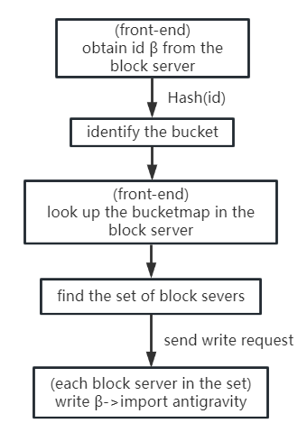
Write File Data

Slide 15
Construct Metadata Operation
Compound transaction request
(1) Create file /home/calvin/fly.py;
(2) Resize the file to 18 bytes;
(3) Write β:[0,18) to byte range [0,18) of the file.

Slide 16
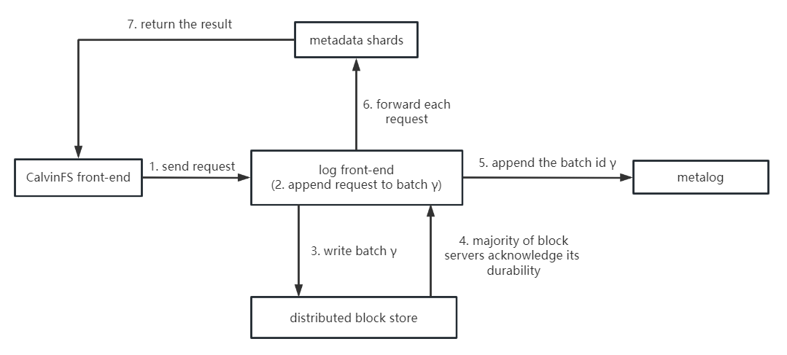
Append Transaction Request to Log

Slide 17
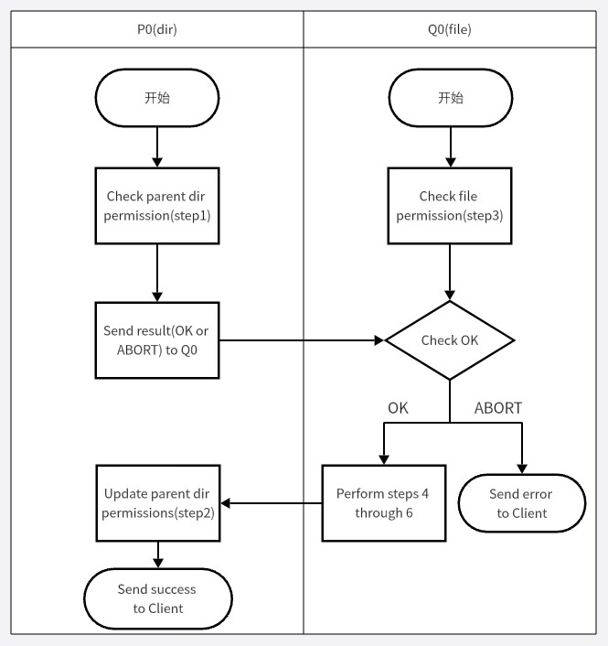
Apply Update to Metadata Store
Directory:
1.Check parent directory permissions;
2.Update parent directory metadata.
File:
3.Check file permissions;
4.Create file metadata entry;
5.Resize file metadata entry;
6.Update file metadata entry’s contents.

Slide 18
Contents
Background
Architecture
The file of an update
Conclusion

Slide 19
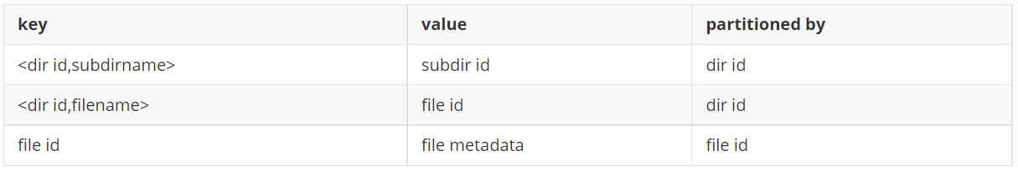
Conclusion
Metadata management advantage
Obtaining metadata only requires one read.
Metadata management shortage
The cost of moving file and changing file permission is high.
Current metadata management

Slide 20
Interpretation of Calvin Filesystem Paper
Thanks
2023/11/2

