Slide 1
LocoFS: A Loosely-Coupled Metadata Service for Distributed File Systems
Deming Ren, Yuhang Li
2023/11/10

Slide 2
Contents
Background
Design
Conclusion

Slide 3
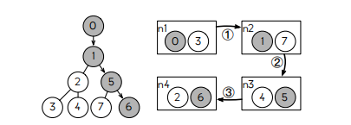
Background
Problems:
Due to the strong dependency of file metadata caused by the use of directory tree structure, the advantanges of KV store couldn’t be fully used. (Such as the long locating latency)
Access 0/1/5/6 ：
(1) Access n1 to get dir 0
(1) Access n2 to get dir 1
(1) Access n3 to get dir 5
(1) Access n4 to get file 6

Slide 4
Background
Problems:
High Overhead in KV(De)Serialization
Such as：IndexFS( store the file metadata of one file all in a single value)
(1)When only a part of the value is modified
(2)We need read or write the whole value
(3)This leads to unnecessary (de)serialization overhead and thereby poorer performance

Slide 5
Background
Design goals:
Reduce the dependencies among file system metadata, so that important operation only need to communicate with one or two servers.
Decouple the file metadata, small value is more friendly to KV stores.

Slide 6
Contents
Background
Design
Loosely-Coupled Architecture
Flattened Directory Tree
Decoupled File Metadata
Conclusion

Slide 7
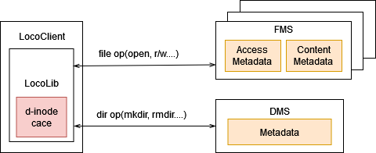
Loosely-Coupled Architecture
Single Directory Metadata Server
(Simplify the Access Control List checking, using full path name as the key.)
Mutiple File Metadata Server
(Use universally unique id of the parent directory and the file name as the key.)
LocoClient
(Use LocoLib as the default
interface, cache the
directory’s inode to
reduce latency.)

Slide 8
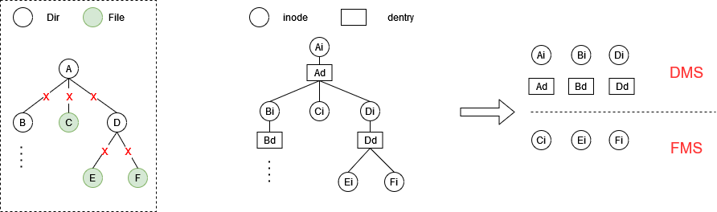
Flattened Directory Tree
KV contents:
Directory: <full path> to <directory inode(uuid, ......)>;
File: <uuid, file name> to <file inode(ctime, ......)>;
Dentry: <uuid> to <entry>.

Slide 9
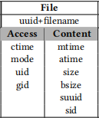
Decoupled File Metadata
Fine-grained File Metadata
Splits file metadata into two parts:
Access: describe the files access right;
Content: describe the files content;
Fix metadata fields to remove (de)serialization
Problem：Indexing metadata is not fixed
Resolution：Sid found server and fid found file offest

Slide 10
Contents
Background
Design
Conclusion

Slide 11
Conclusion
Design goals:
Decouple directory and file metadata, and flatten the directory tree structure to reduce strong file metadata dependencies
Decouple file metadata and fixed metadata fields to reduce file metadata read and write latency
Advantages and disadvantages
Reduced metadata operation latency compared to previous file systems
Single directory metadata server limit file system scalability, and the full path as a key incurs significant overhead in renaming operations compared to current file systems

Slide 12
LocoFS: A Loosely-Coupled Metadata Service for Distributed File Systems
Thanks
2023/11/10

Slide 13
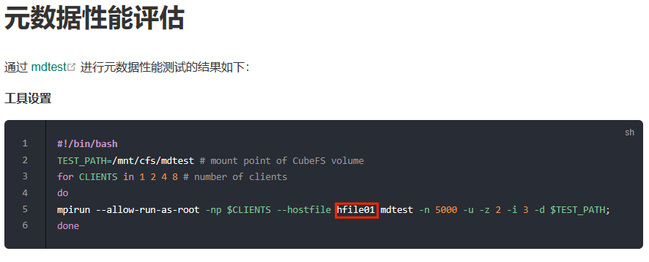
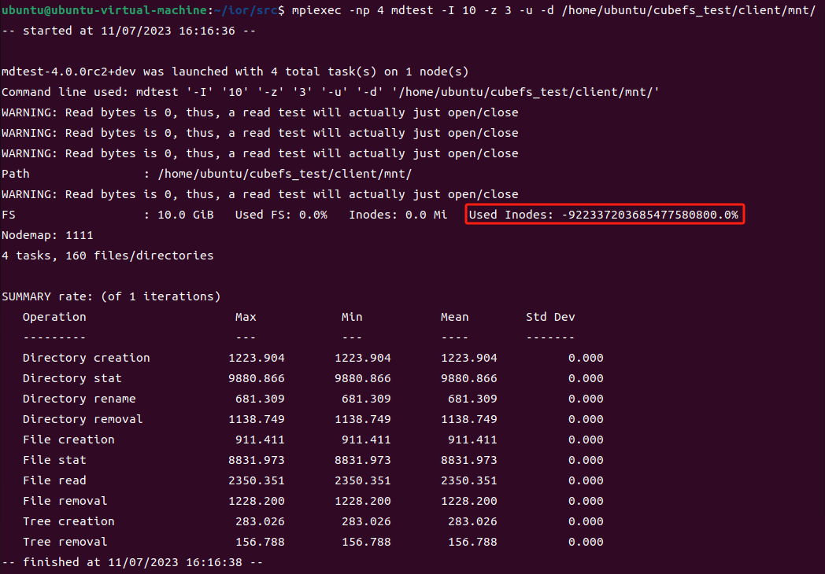
CubeFS Performance Test
1.性能测试配置文件怎么配置？
2.自己测试显示Used Inodes为负的
3.JD分支如何运行并测试？

