Slide 1
The physics of compact objects and experimental improvements on detectors in the gravitational-wave era
Hang Yu
Thesis proposal
April 08, 2017
Notes:
Let’s step back to the linear regime for a moment but consider a more sophisticated NS model. That is, a NS w/ superfluid core. Here I will be talking about resonant tidal excitations in SF NSs.

Slide 2
INTRODUCTION
Adv. LIGO’s detection of GW heralds a new age of GW astrophysics.
It requires both better understanding/modeling of the astrophysical sources,
and more sensitive and robust GW detector.

Slide 3
I. OBSERVABLES IN COMPACT OBJECTS (NEUTRON STARS)
I.1 Traditional E&M signatures: exposing burning ashes in Type-I X-ray bursts
I.2 GW signatures: tidal interactions in coalescing binary NSs

Slide 4
EXPOSING ASHES IN TYPE I X-RAY BURSTS (ongoing)
Type I X-ray bursts: run-away thermonuclear burning of H and/or He on the surface of an NS.
A small fraction exhibits strong photospheric expansion.
The freshly synthesized heavy-element ashes can be ejected in rediative wind.
Ashes -> source of opacity -> absorption edges in spectra.
Measure surface gravity via redshift of the edge location.
Constrain EoS.

Slide 6
TIDAL INTERACTIONS IN COALESCING BINARY NS’S
BNS – Sources for ground GW detectors
Orbital energy to NS internal energy – tidal phase shift
Linear dynamic tides – driven H.O.
NS g mode eigenfreq ~ orbital freq
Normal fluid vs. superfluid
Single fluid vs. two-fluid
Different source of bouyancy
The amplitude and frequency of the resonance probes the stratification, composition, and superfluid state of the core of NS.

Slide 7
Superfluid npe\mu NS published: MNRAS, 464, 2622 (2017)

Slide 8
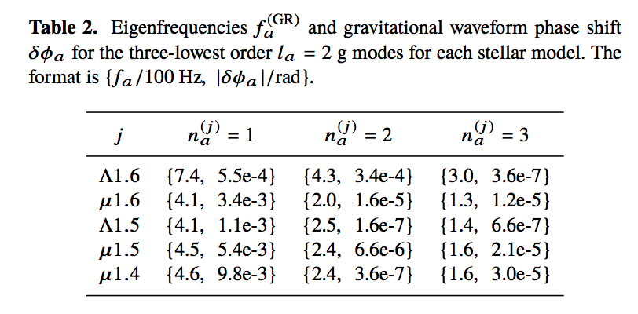
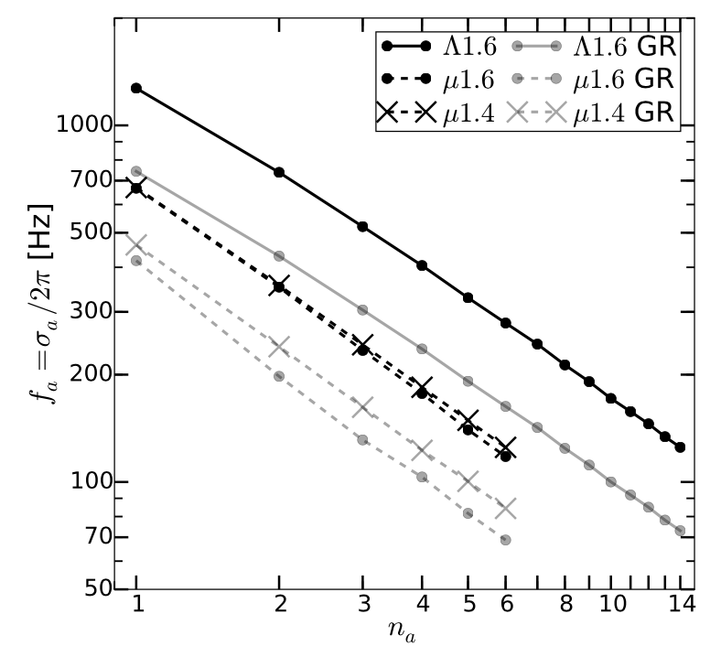
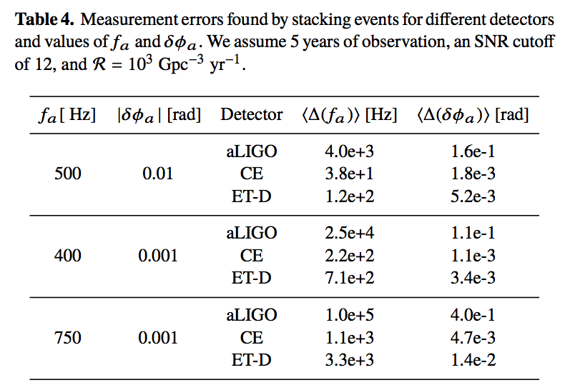
NS with Hyperons in the inner core (submitted to MNRAS)

Slide 9
II. IMPROVING THE PERFORMANCE OF GW DETECTORS
II.1 LIGO commissioning: alignment sensing and control (ASC)
II.2 GWcleaning: feed-forward noise cancellation
II.3 Enhanced chi-sq glitch vetoing
(II.4 Coating thermal noise)

Slide 10
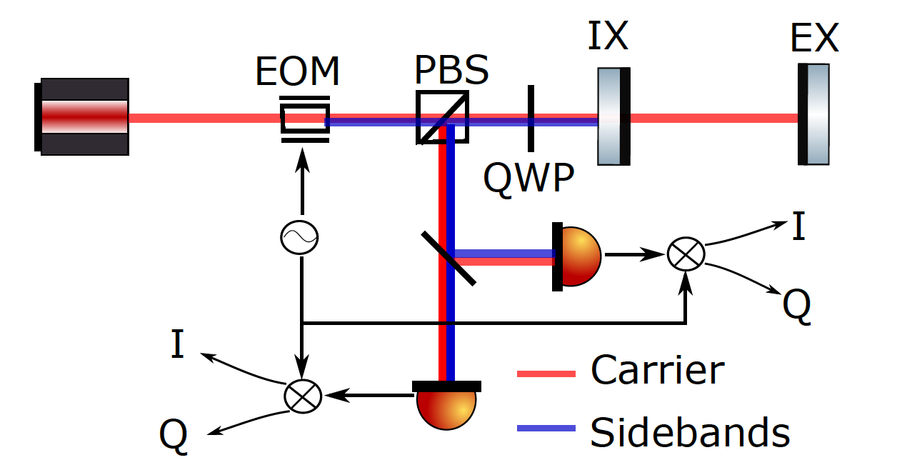
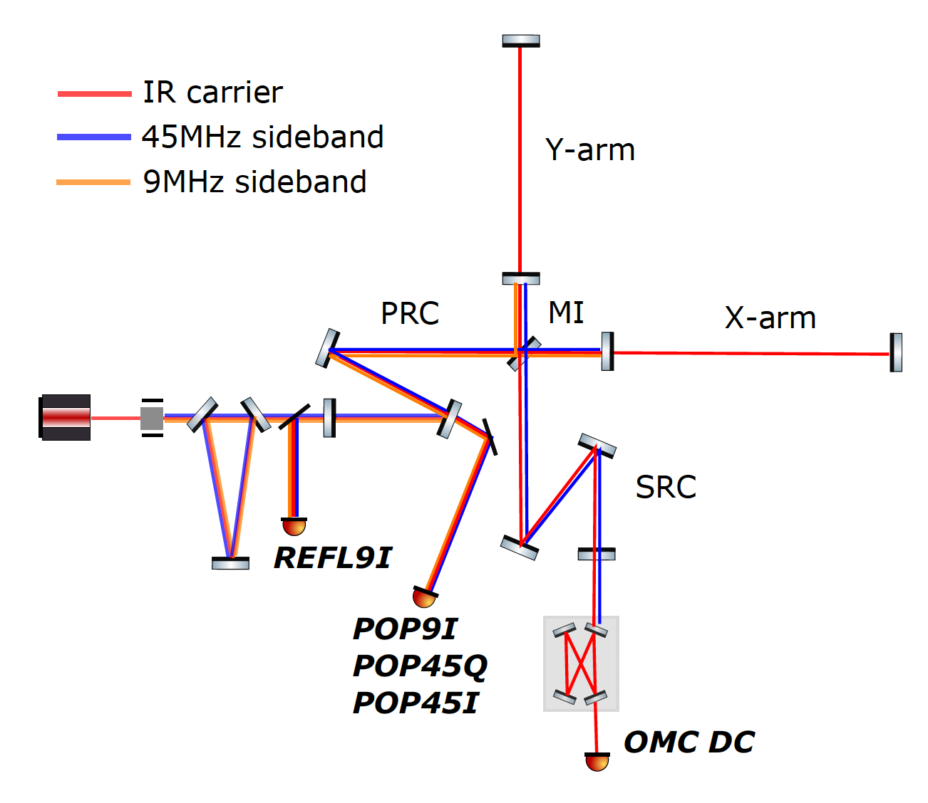
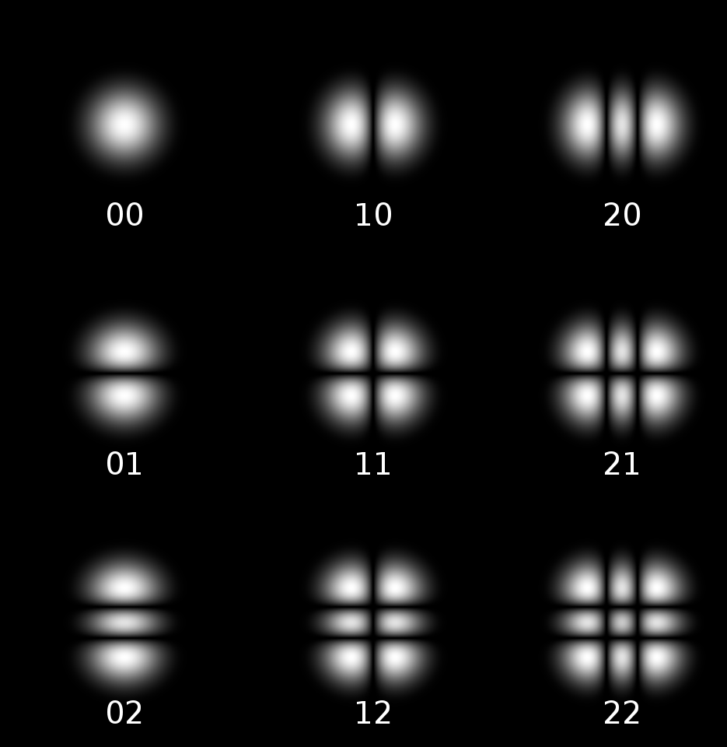
ALIGO ASC
Fig credit:
Martynov 2015, PhD Thesis

Slide 11
Aligning the SRC
SRC ASC signal problematic at LHO
Related to IFO thermal state
Extra absorption at ITMX found -> caused differential thermal lensing
This can potentially explain why SRC ASC signal being bad.

Slide 12
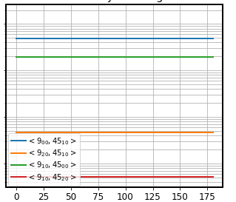
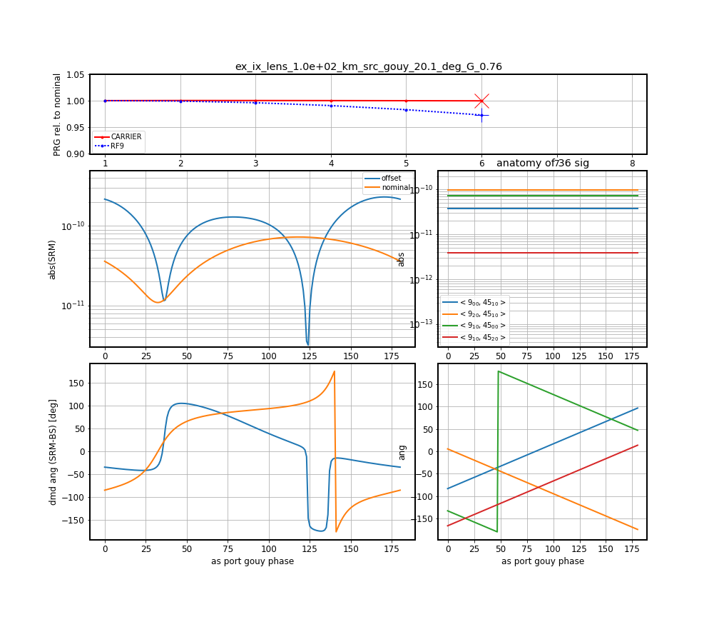
Nominal
Extra 100 km ITMX lens

Slide 13
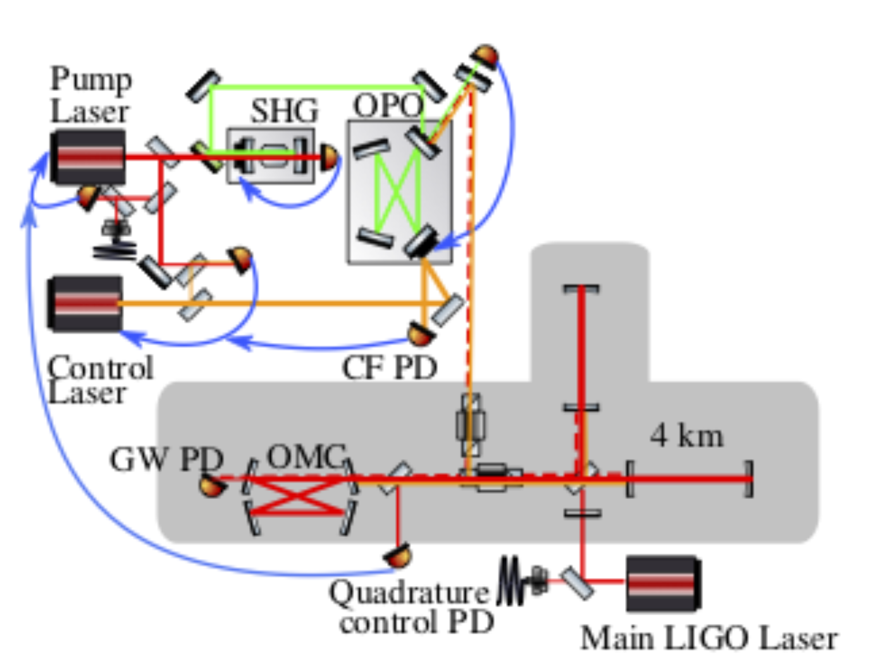
New ASC Scheme for SRC
Utilizing the Control Laser used for squeezed vacuum injection.
Under development.
Dwyer et al 2013

Slide 14
GWCLEANING: FEED-FORWARD NOISE CANCELLATION
Different degrees of freedom are cross-coupled
Local: angle to length; length to angle
Global: seismic to length; length to angle
Decouple via feed-forward

Slide 15
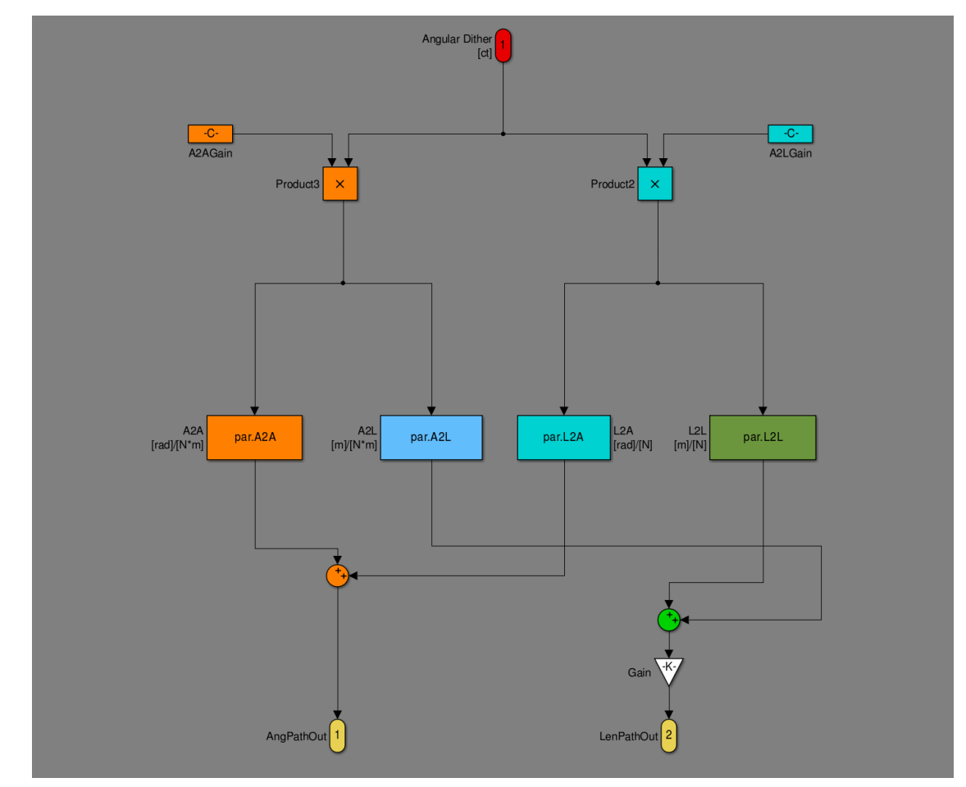
Local Feed-Forward
Local coupling:
Spot mis-centering couples angular motion to length
Suspension system couples length actuation to angular motion
Can be canceled with single-input-single-output system

Slide 16
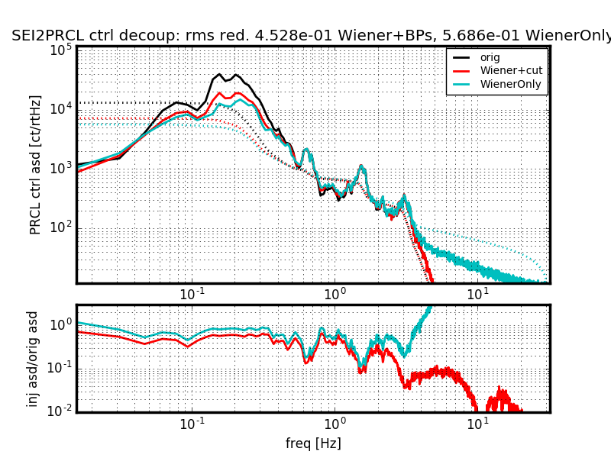
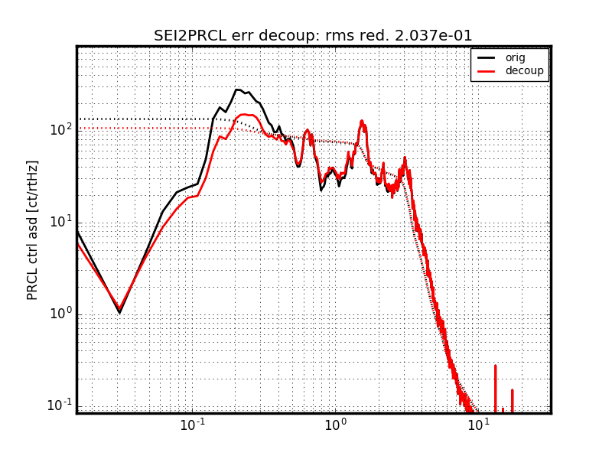
Global Feed-Forward
SEI to LSC

Slide 17
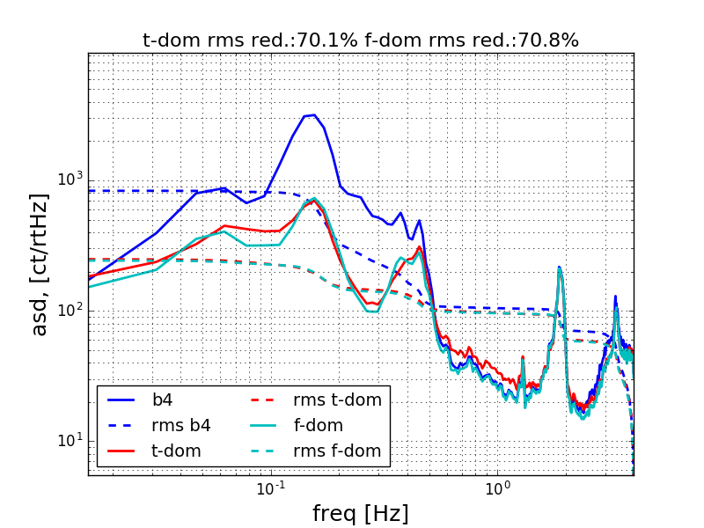
LSC to CHARD P

Slide 18
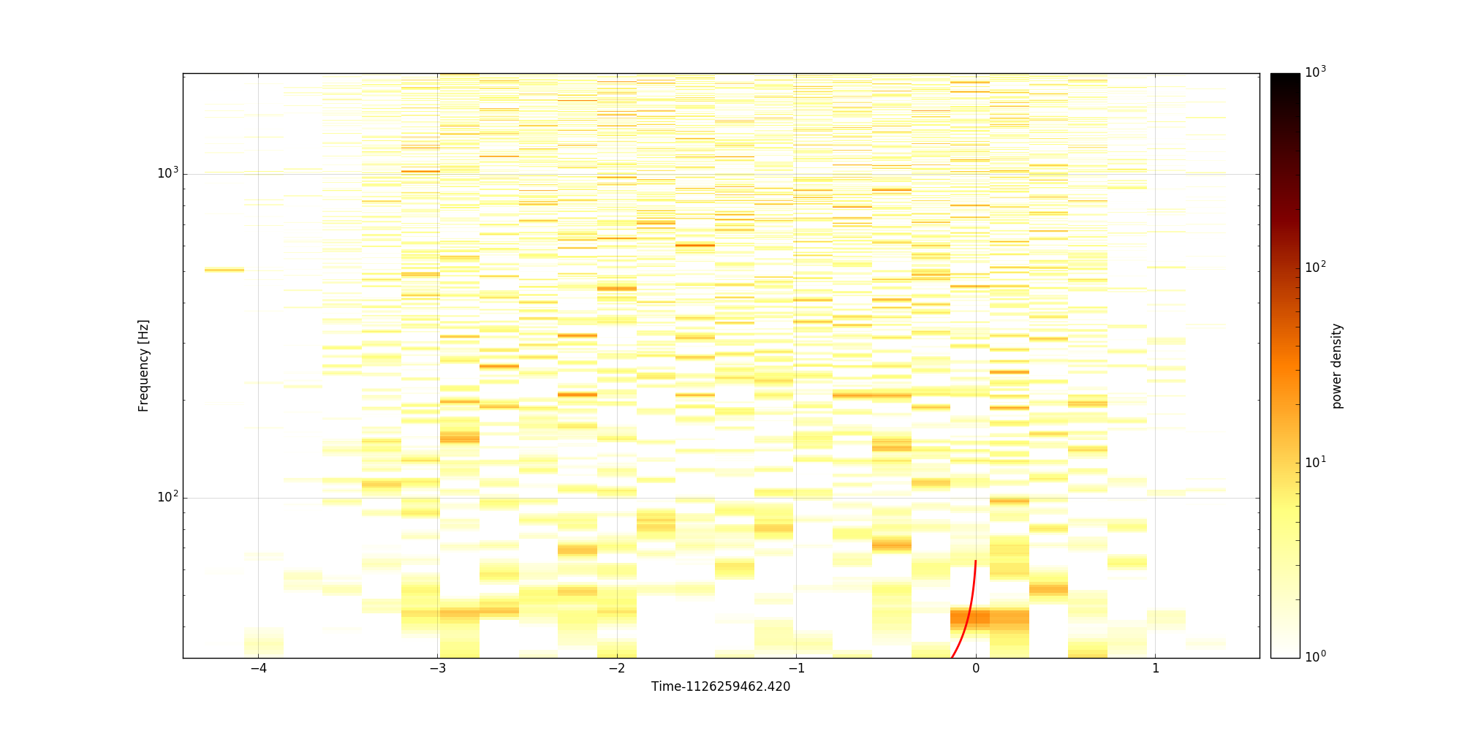
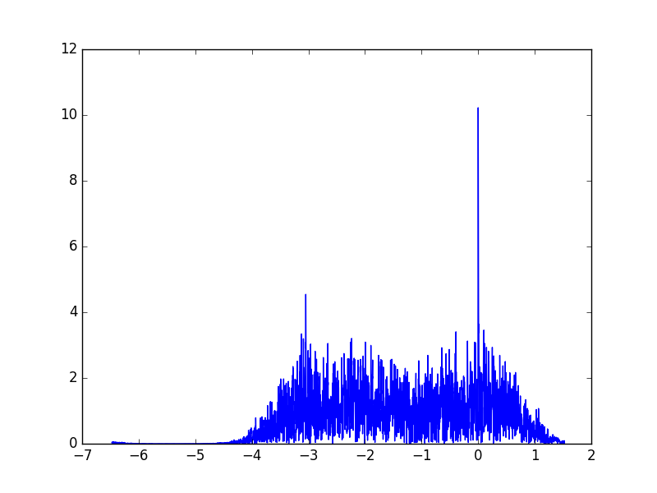
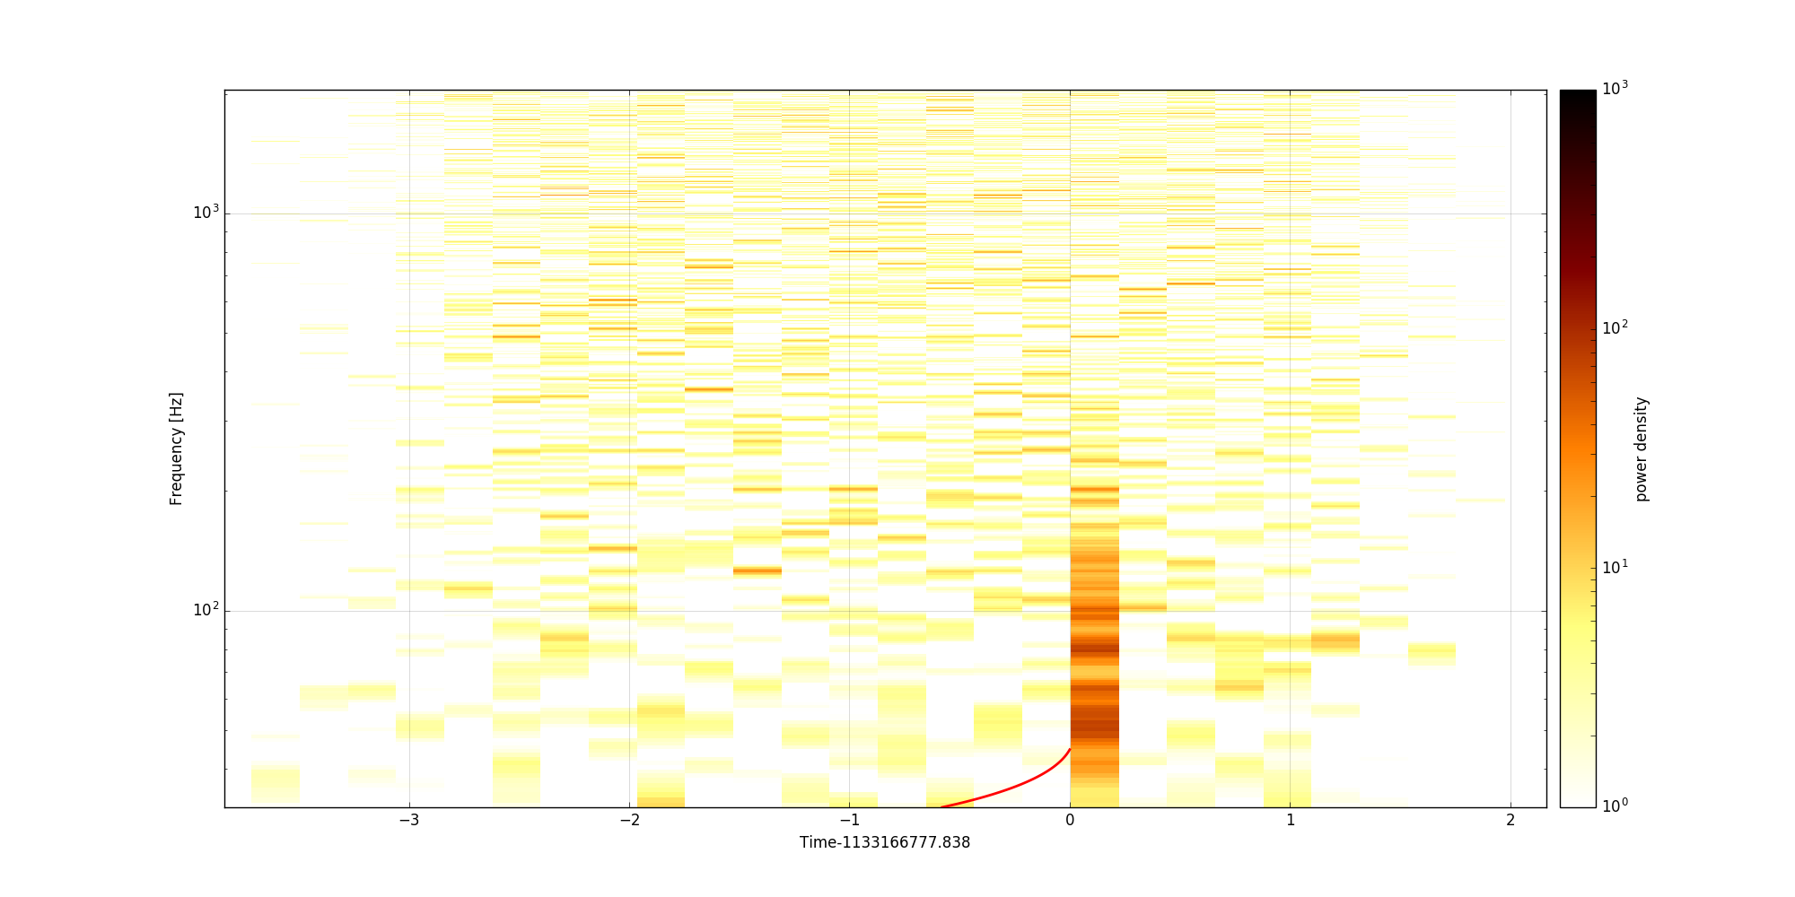
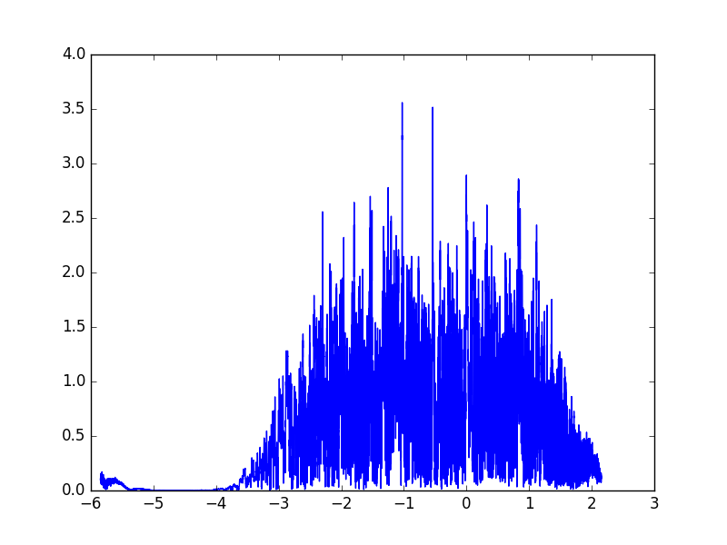
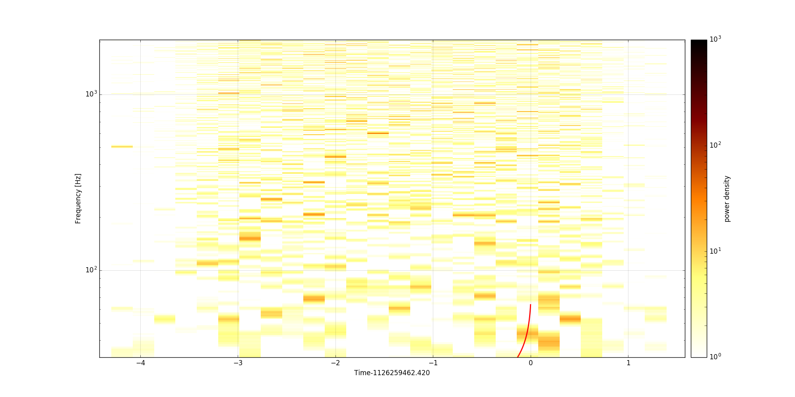
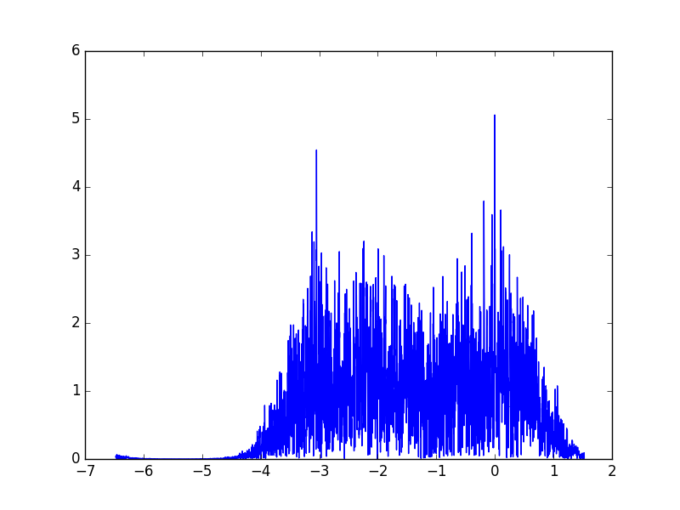
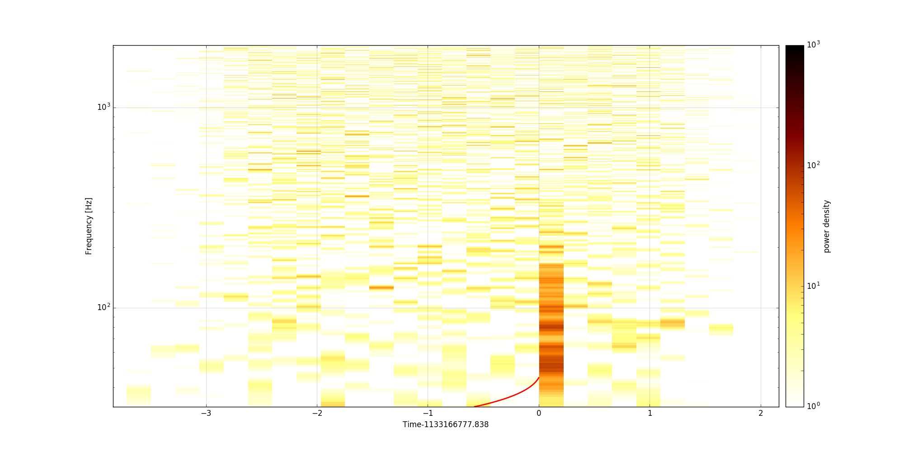
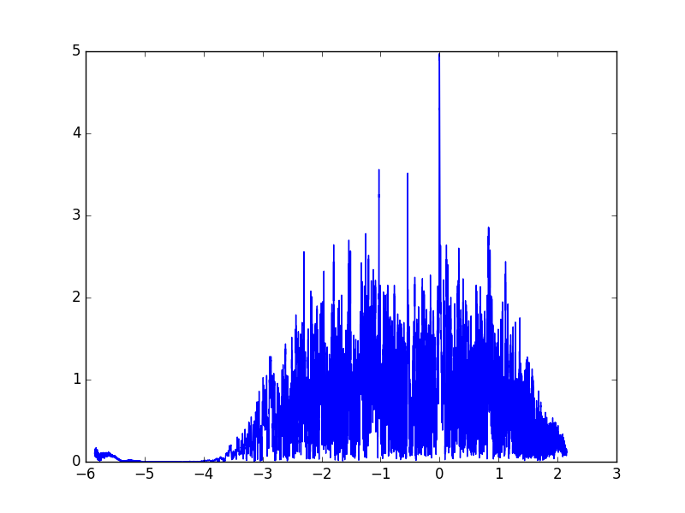
ENHANCED CHI-SQ GLITCH VETOING
GW150914 in L1
A Glitch

