Slide 1
The physics of compact objects and experimental improvements on detectors in the gravitational-wave era
Hang Yu
Thesis proposal
April 26, 2017

Slide 2
INTRODUCTION
Adv. LIGO’s detection of GW heralds a new age of GW astrophysics.
It requires both better understanding/modeling of the astrophysical sources,
and more sensitive and robust GW detector.

Slide 3
I. OBSERVABLES IN COMPACT OBJECTS (NEUTRON STARS)
I.1 GW signatures: tidal interactions in coalescing binary NSs
I.2 Traditional E&M signatures: exposing burning ashes in Type-I X-ray bursts

Slide 4
TIDAL INTERACTIONS IN COALESCING BINARY NS’S
BNS – Sources for ground-based GW detectors
Orbital energy to NS internal energy – tidal phase shift
Linear dynamic tides – driven H.O.
NS g mode eigenfreq ~ orbital freq
Normal fluid vs. superfluid
Single fluid vs. two-fluid
Different source of bouyancy
The amplitude and frequency of the resonance probes the stratification, composition, and superfluid state of the core of NS.

Slide 5
Superfluid npe\mu NS published: MNRAS, 464, 2622 (2017)

Slide 6
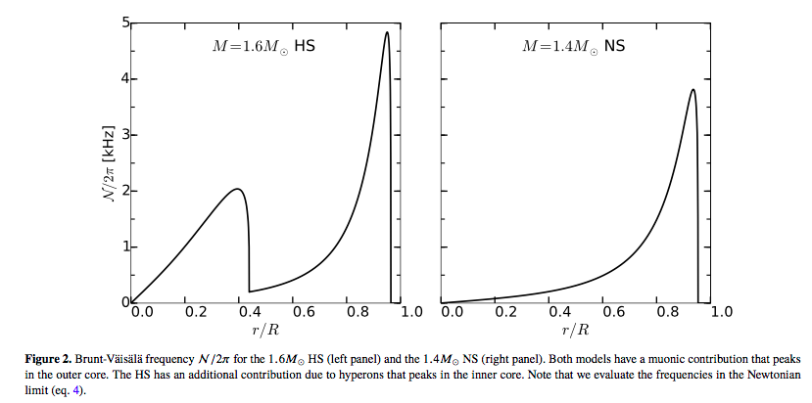
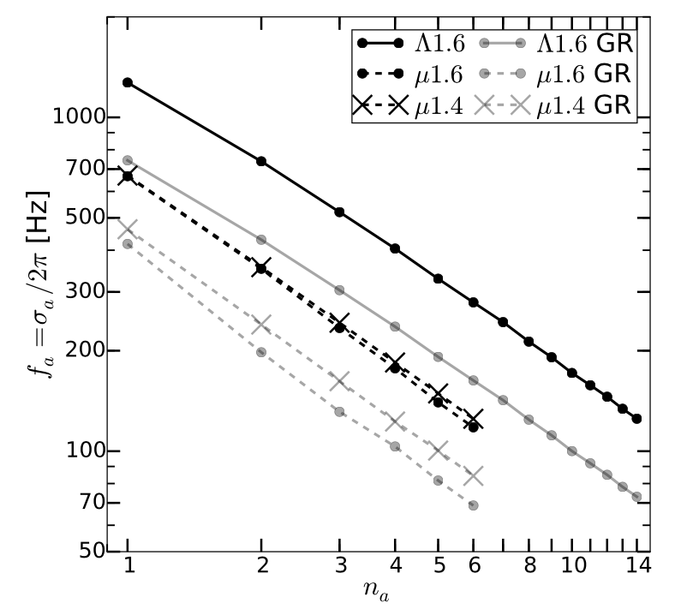
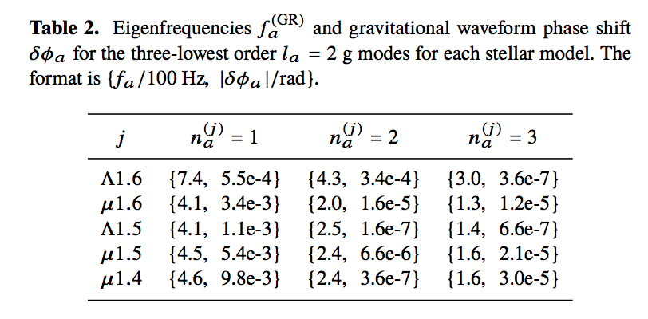
NS with Hyperons in the inner core (submitted to MNRAS)

Slide 7
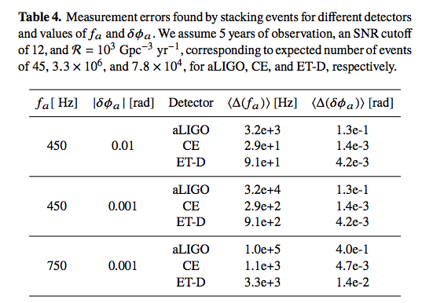
NS with Hyperons in the inner core (submitted to MNRAS)

Slide 8
EXPOSING ASHES IN TYPE I X-RAY BURSTS (ongoing)
Type I X-ray bursts: run-away thermonuclear burning of H and/or He on the surface of an NS.
A small fraction exhibits strong photospheric expansion.
The freshly synthesized heavy-element ashes can be ejected in radiative wind.
Ashes -> source of opacity -> absorption edges in spectra.
Measure surface gravity via redshift of the edge location.
Constrain EoS.

Slide 10
II. IMPROVING THE PERFORMANCE OF GW DETECTORS
II.1 LIGO commissioning: alignment sensing and control (ASC)
II.2 GWcleaning: feed-forward noise cancellation
II.3 Enhanced chi-sq glitch vetoing
(II.4 Coating thermal noise)

Slide 11
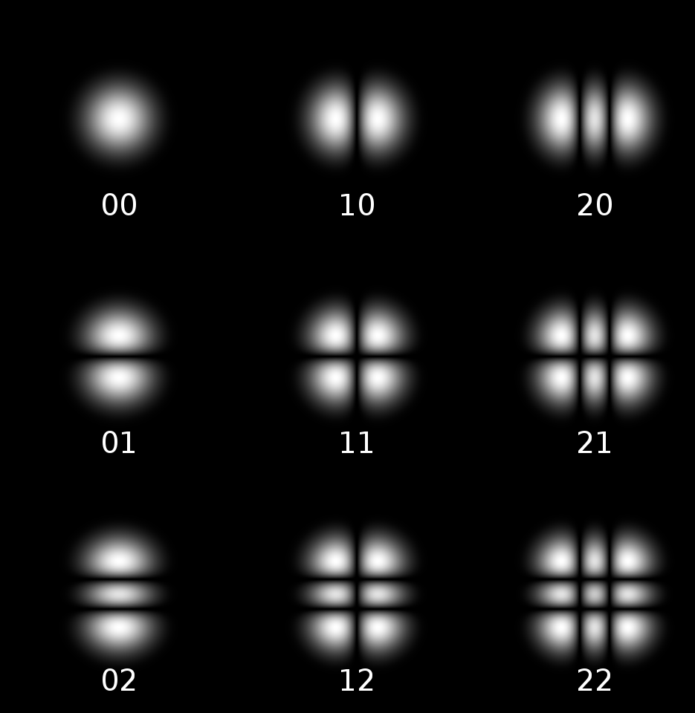
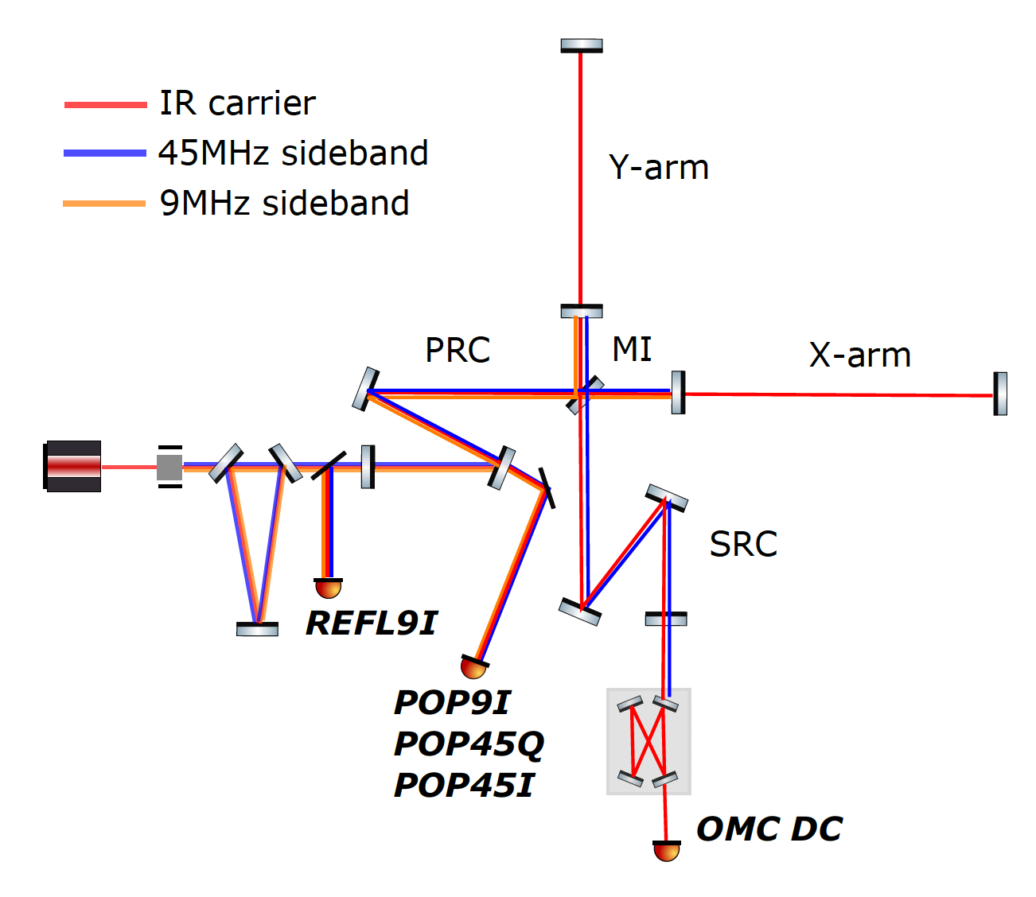
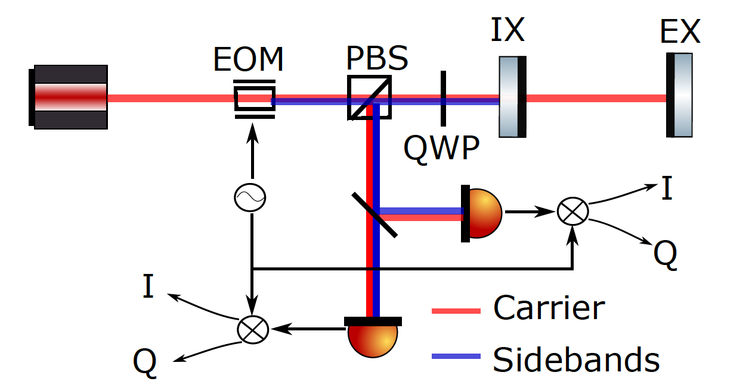
ALIGO ASC
Fig credit:
Martynov 2015, PhD Thesis

Slide 12
Aligning the SRC
SRC ASC signal problematic at LHO
Related to IFO thermal state
Extra absorption at ITMX found -> caused differential thermal lensing
This can potentially explain why SRC ASC signal being bad.

Slide 13
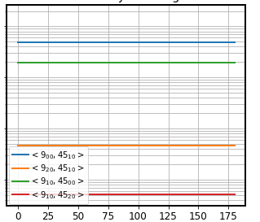
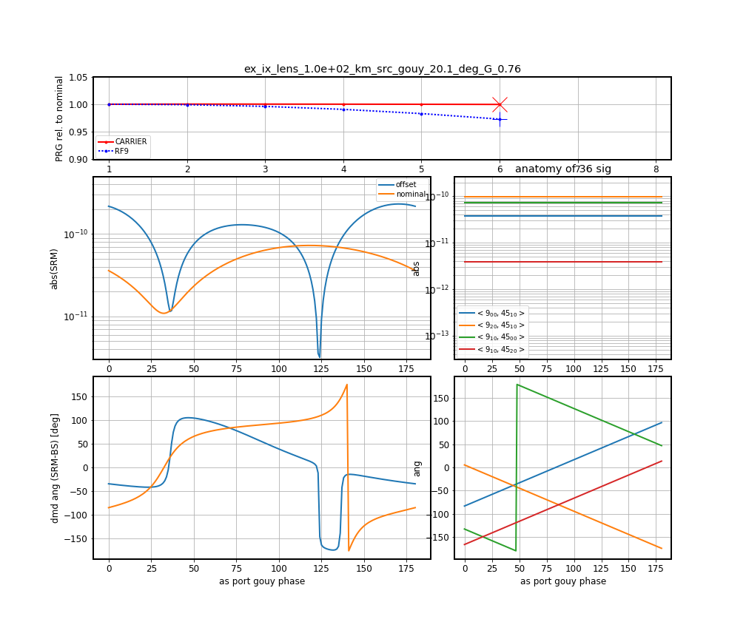
Nominal
Extra 100 km ITMX lens

Slide 14
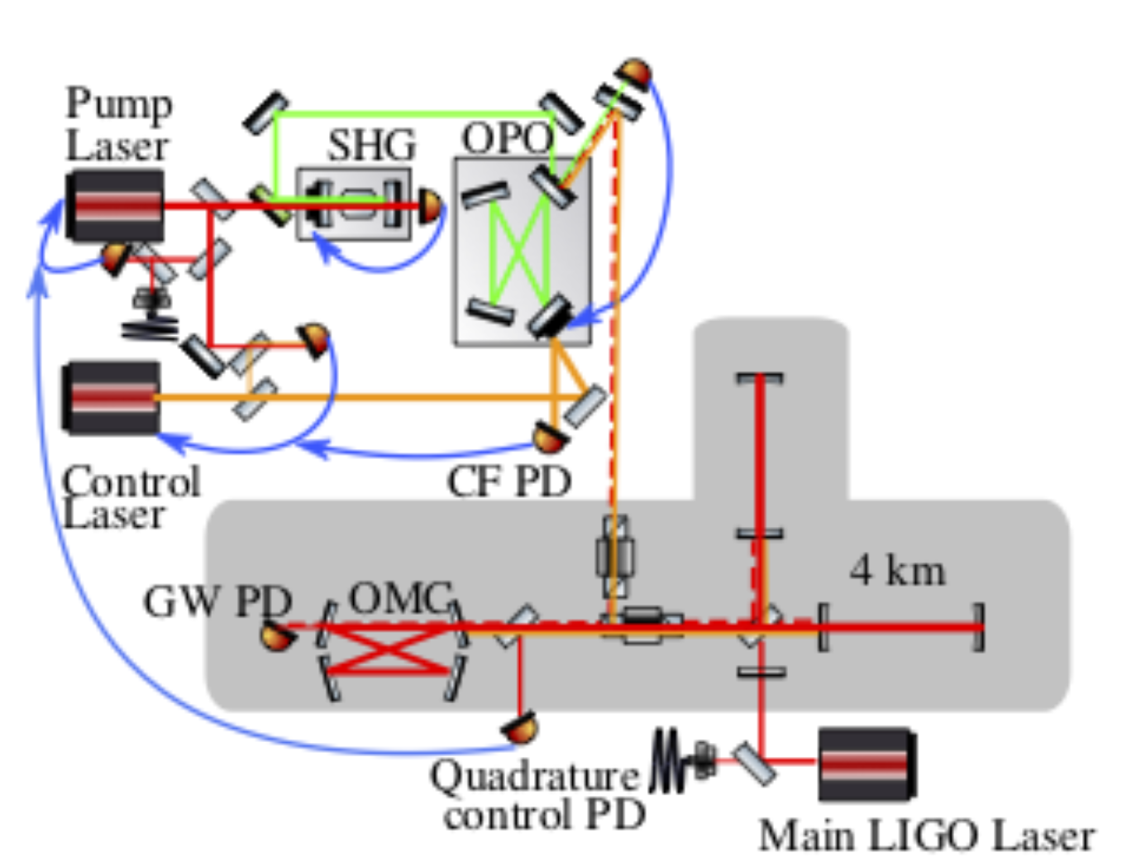
New ASC Scheme for SRC
Utilizing the Control Laser used for squeezed vacuum injection.
Under development.
Dwyer et al 2013

Slide 15
GWCLEANING: FEED-FORWARD NOISE CANCELLATION
Different degrees of freedom are cross-coupled
Local: angle to length; length to angle
Global: seismic to length; length to angle
Suppressing noise via feed-back challenging: high gain to suppress motion, but low bandwidth to avoid sensor noise injection
Decouple via feed-forward

Slide 16
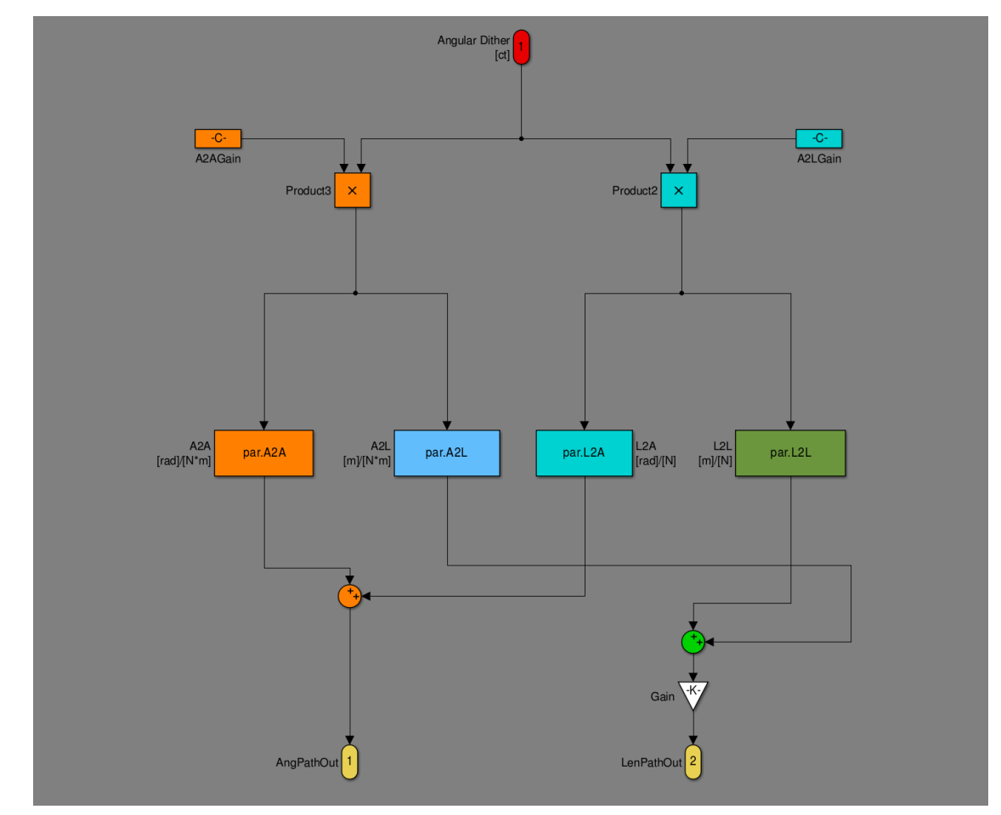
Local Feed-Forward
Local coupling:
Spot mis-centering couples angular motion to length
Suspension system couples length actuation to angular motion
Can be canceled with single-input-single-output system

Slide 17
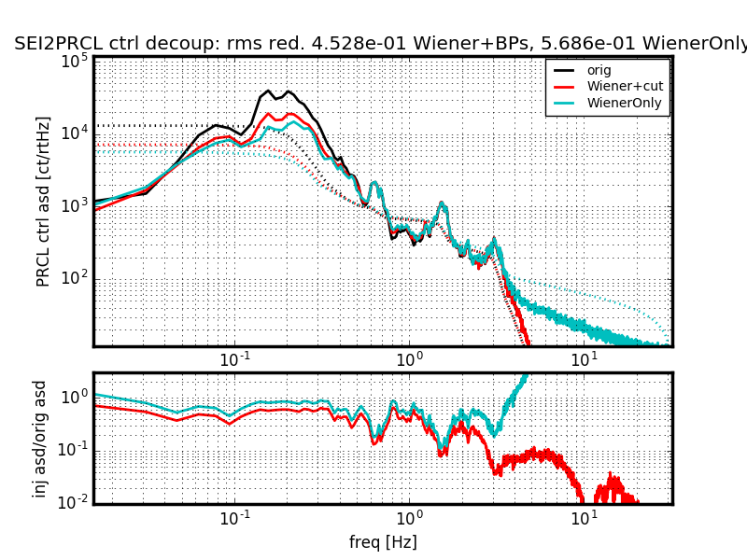
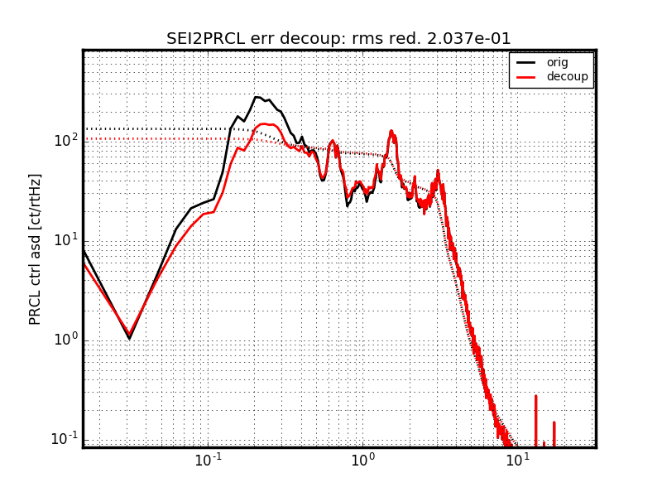
Global Feed-Forward
SEI to LSC

Slide 18
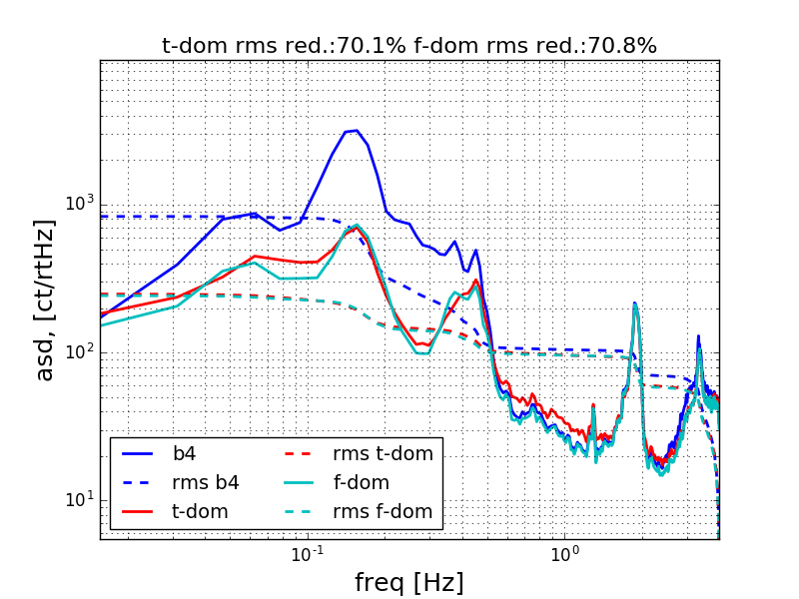
LSC to CHARD P

Slide 19
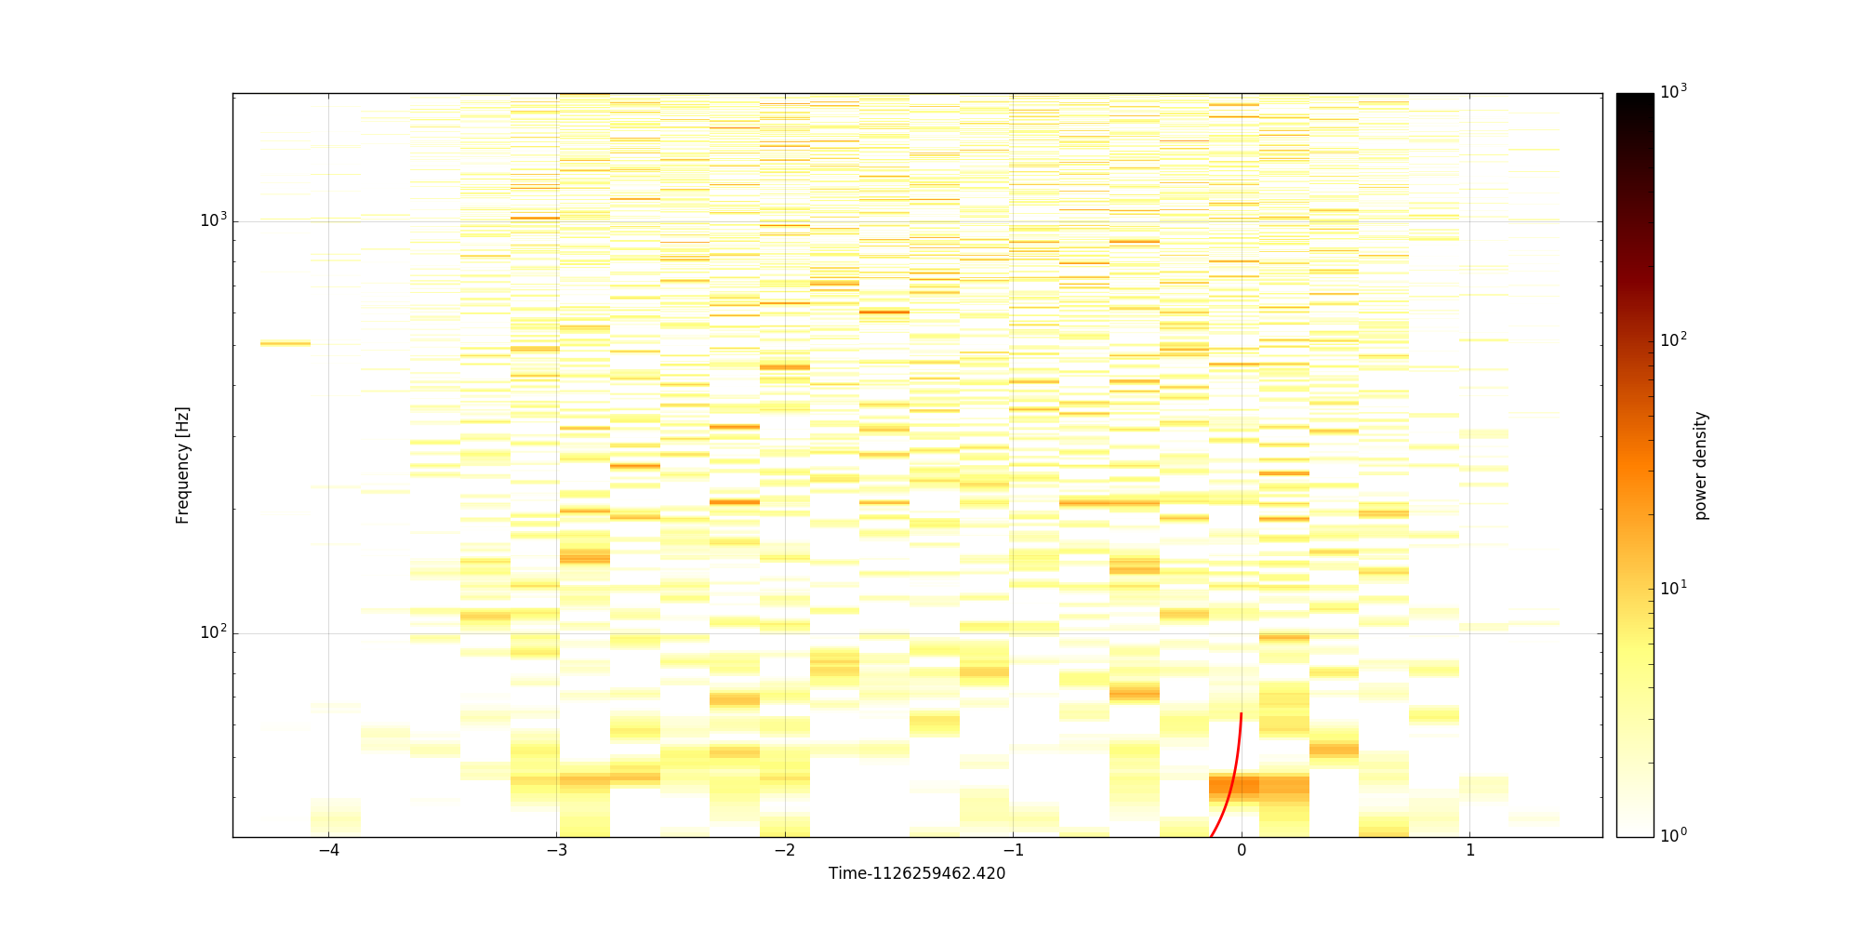
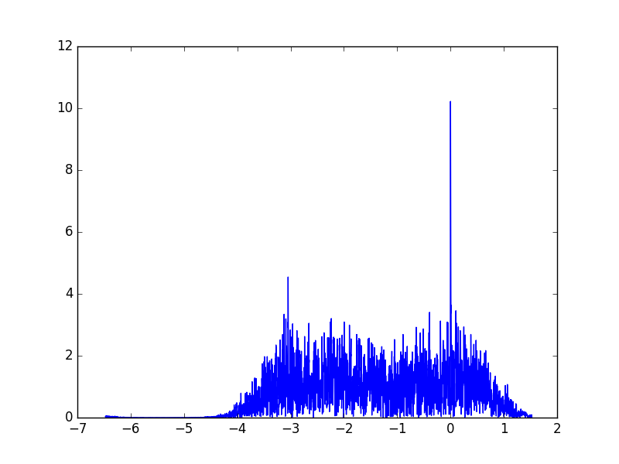
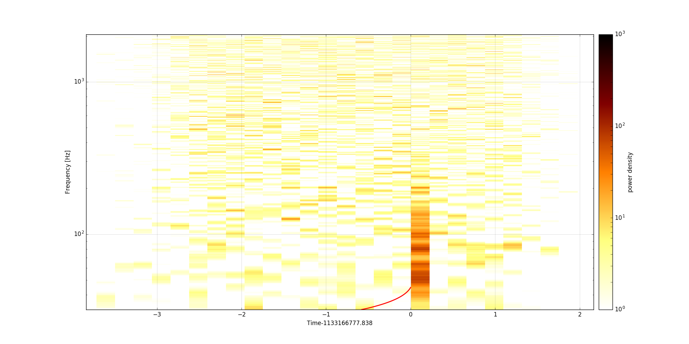
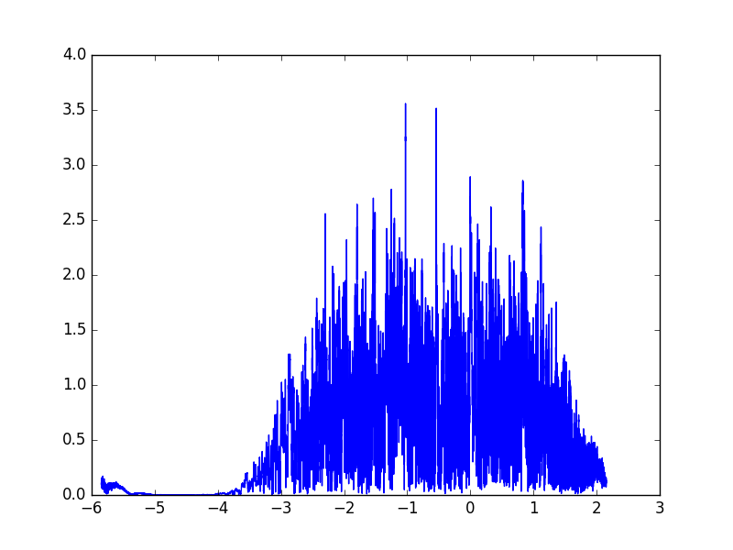
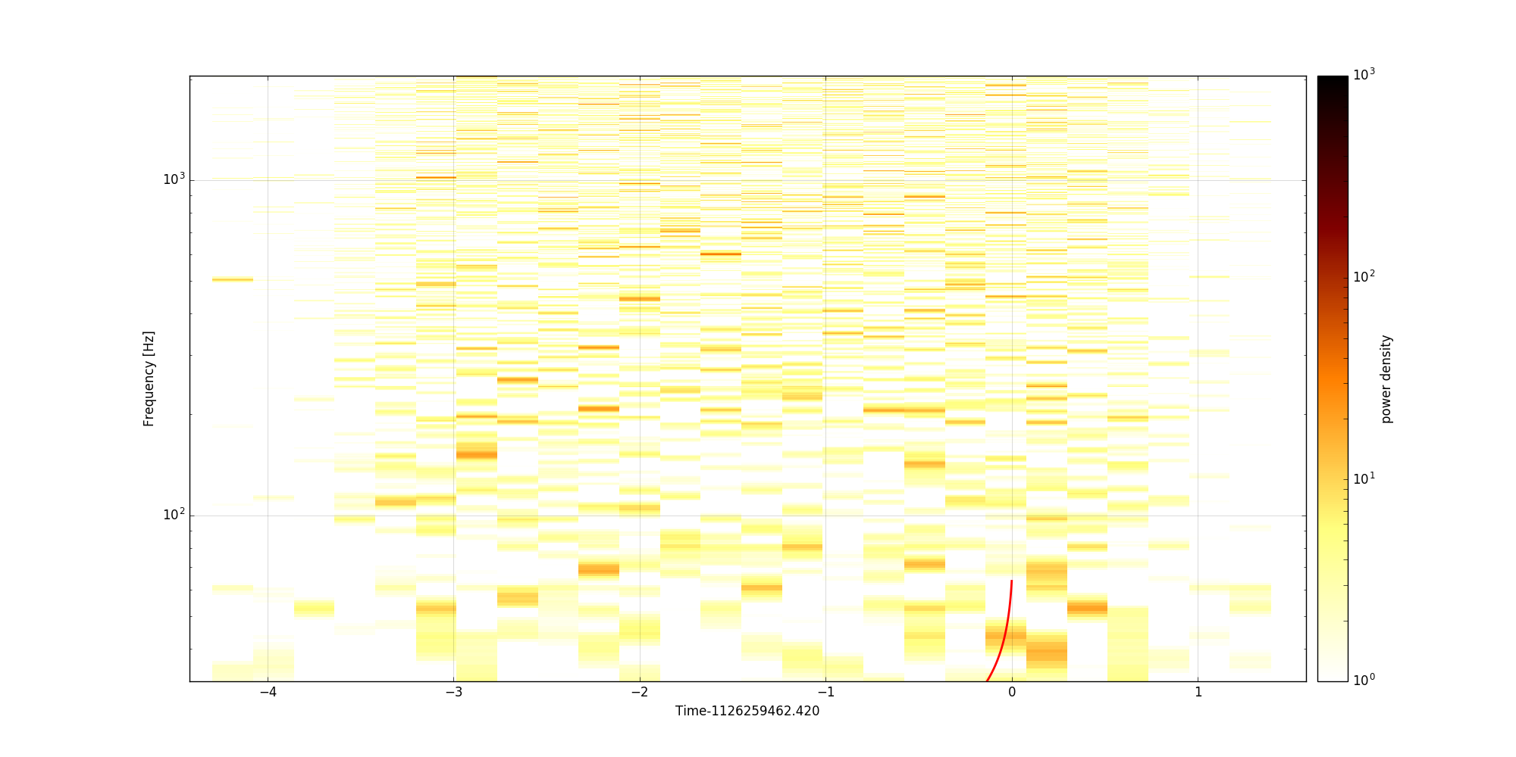
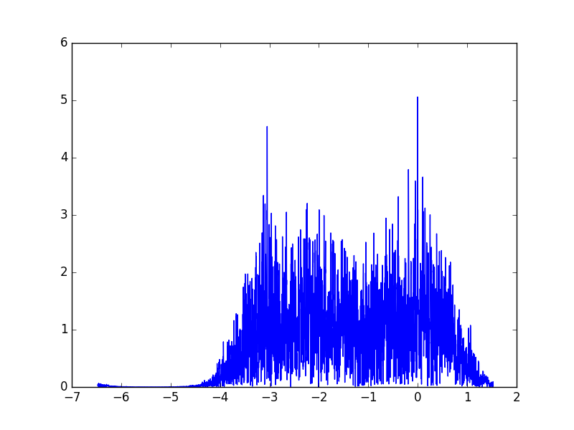
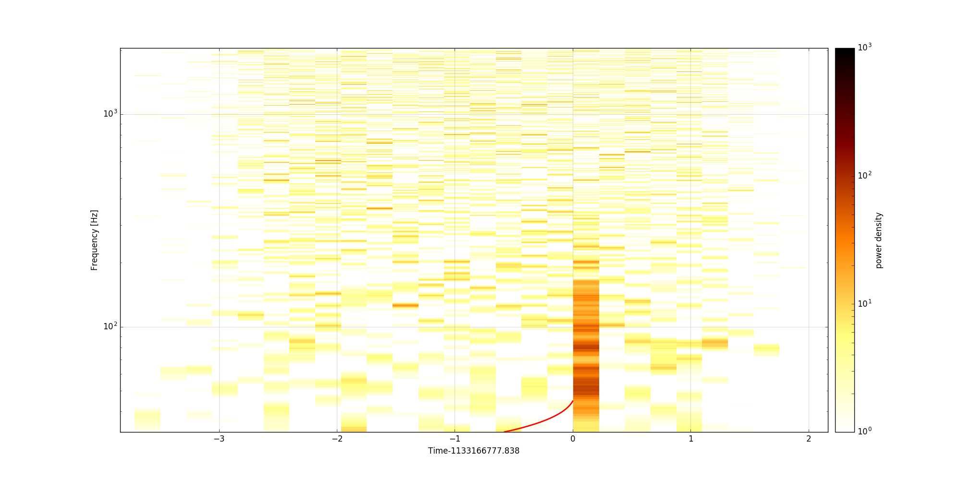
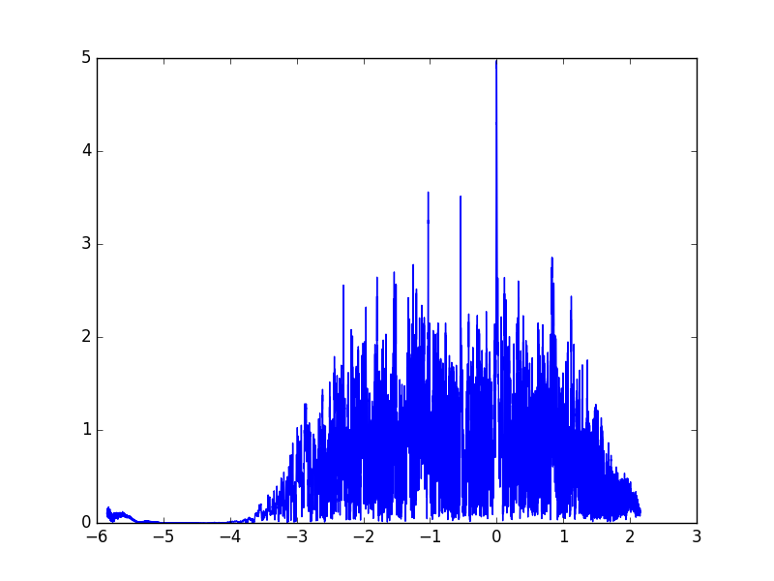
ENHANCED CHI-SQ GLITCH VETOING
GW150914 in L1
A Glitch

Slide 20
TIMELINE:
Superfluid npe\mu NS
X-ray bursts
One more
theoretical work
HS & detectability
May 2016:
Passed Part III
Thesis writing
Sep, 2014:
Arrived at MIT
Passed Part I
2015
2016
2017
2018
2019
2020
Feb 2015:
Passed Part II
May 2017:
Done w/ classes
Graduating
LSC
Fellow
@ LHO
Commissioner @ LHO or LLO ~1yr
CTN
ASC modeling
One more
LIGO work
GWCleaning

