Slide 1



PAC: Assisted Value Factorization with Counterfactual Predictions in Multi-Agent Reinforcement Learning
Hanhan Zhou$^{1}$, Tian Lan$^{1}$, Vaneet Aggarwal$^{2}$
$^{1}$ The George Washington University
$^{2}$ Purdue University

Slide 2
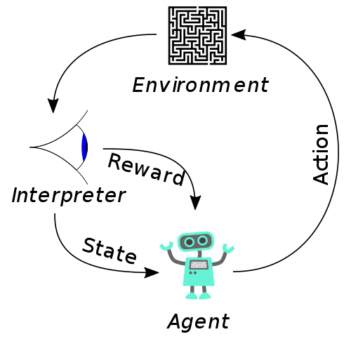
Basics: Reinforcement Learning
Reinforcement learning (RL) is an area of machine learning concerned with how intelligent agents ought to take actions in an environment in order to maximize the notion of cumulative reward. Reinforcement learning is one of three basic machine learning paradigms, alongside supervised learning and unsupervised learning.
*(Wikipedia)

Slide 3
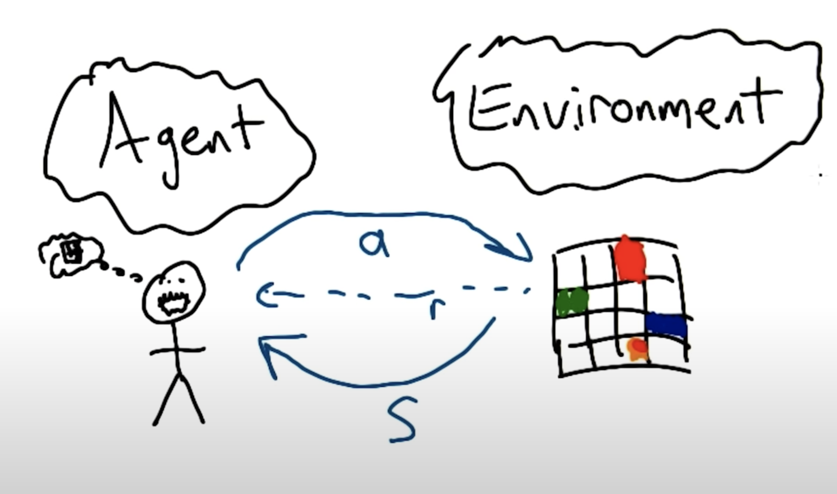
Basics: Reinforcement Learning
Conversation between the environment and the agent
S: state
O: observation
A: action
R: reward
Agent: a policy
Environment: MDP (maybe)
Goal: Maximize the reward(or not)

Slide 4
Basics: Reinforcement Learning
Agent: An autonomous entity,
That can observe the environment
And choose how to act
What we need:
Policy
(or Value Estimation Function)

Slide 5
Basics: Multi-agent Reinforcement Learning
More than one agents interacting with the environments
(Multi-agent Systems are everywhere!)
* can be cooperative or competitive (or even mixed)

Slide 6
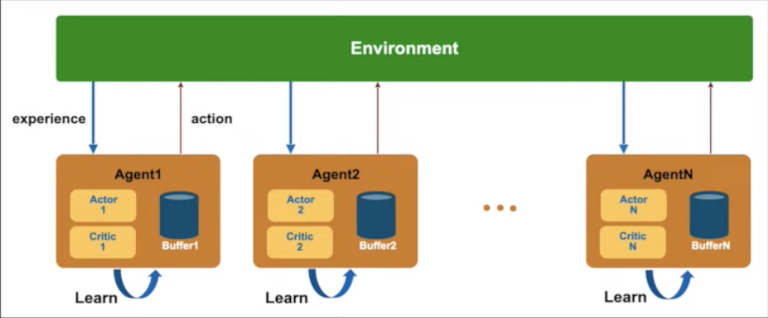
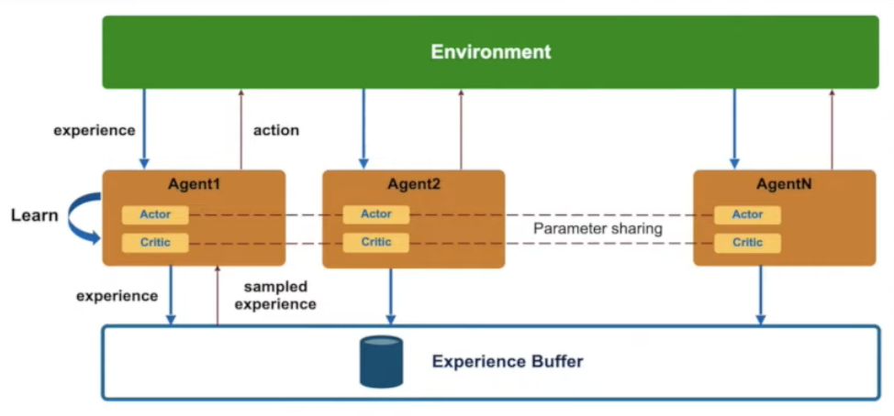
Basics: Multi-agent Reinforcement Learning
Decentralized MARL & Centralized MARL

Slide 7
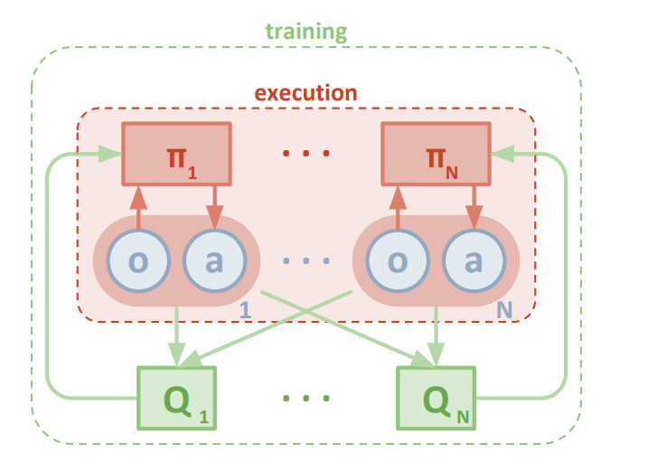
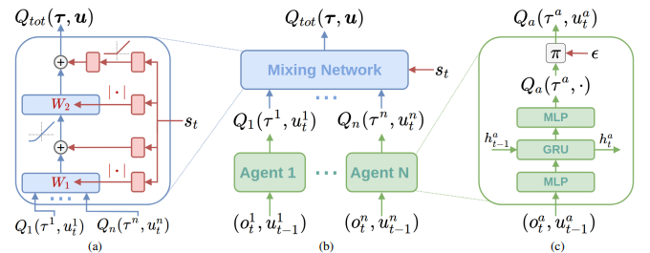
Background
Centralized Training &
Decentralized Execution
Value Function Factorization

Slide 8
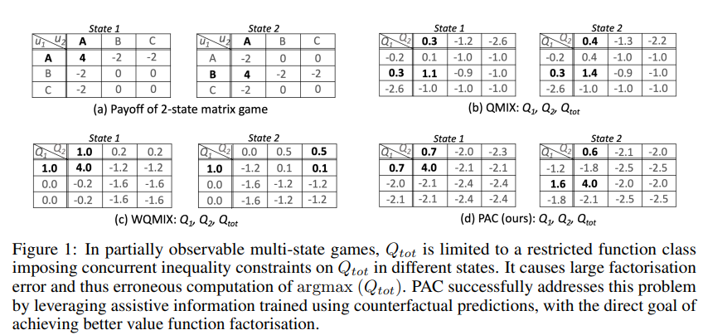
Limitations: A Partially Observable Multi-state Matrix Problem
0.5
0.5
0.5
s1
s2
0.5

Slide 9

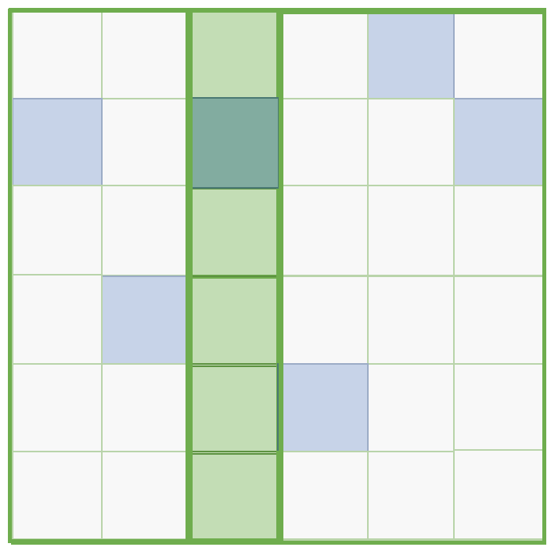












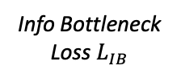








General Framework
$$Q_{tot }(τ_{t},u_{t})$$
$Q_{tot }$
Info Bottleneck
Loss $L_{IB}$
Mixing Network
$$s_{t}$$
$$q_{t}^{1}(u_{t}^{1},τ_{t}^{1},m_{t}^{−1})$$
…
$$q_{t}^{i}(u_{t}^{i},τ_{t}^{i},m_{t}^{−i})$$
…
$$q_{t}^{n}(u_{t}^{n},τ_{t}^{n},m_{t}^{−n})$$
$${\hat{u}}_{t}=({\hat{u}}_{t}^{1},…,{\hat{u}}_{t}^{n})$$
$$m_{t}^{i}$$
Agent 1
Agent $i$
Agent n
$${\hat{u}}_{t}^{i}$$
VAE
$$u_{t}^{i}$$
$${\hat{Q^{ }}}^{∗}$$
$$q_{t}^{i}(⋅,τ_{t}^{i},m_{t}^{−i})$$
$$o_{t}^{i}$$
Local Policy
Local Critic
$${ π}_{i}\left(\text{﹒} | τ_{t}^{i}\right)$$
$${\hat{u}}_{t}^{∗}=({\hat{u}}_{t}^{∗1},…,{\hat{u}}_{t}^{∗n})$$
$$o_{t}^{i}$$
$$m_{t}^{−i}$$
$${\hat{u}}_{i}^{∗}=\operatorname{argmax}{\hat{Q^{∗}}\left(\text{﹒},s_{t},τ_{t},{\hat{u}}_{t}^{−i}\right)}$$
Local Policy Loss $L_{LP}$
Counterfactual Prediction Loss $L_{LF}$

Slide 10
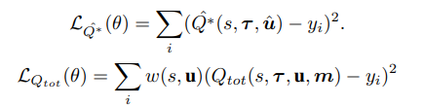
General Framework : Q_tot
$$Q_{tot }(τ_{t},u_{t})$$
$Q_{tot }$
Mixing Network
$$s_{t}$$
$$q_{t}^{1}(u_{t}^{1},τ_{t}^{1},m_{t}^{−1})$$
…
$$q_{t}^{i}(u_{t}^{i},τ_{t}^{i},m_{t}^{−i})$$
…
$$q_{t}^{n}(u_{t}^{n},τ_{t}^{n},m_{t}^{−n})$$
Agent 1
Agent $i$
Agent n
$${\hat{u}}_{t}^{i}$$
$$u_{t}^{i}$$
$$q_{t}^{i}(⋅,τ_{t}^{i},m_{t}^{−i})$$
Local Policy
Local Critic
$${ π}_{i}\left(\text{﹒} | τ_{t}^{i}\right)$$
$$o_{t}^{i}$$
$$m_{t}^{−i}$$
a weighted Qtot utilizing per-agent local critics qi(ui , τi , mi), where mi serves as assistive information aiding value factorization,

Slide 11

General Framework: Q^*
$${\hat{u}}_{t}=({\hat{u}}_{t}^{1},…,{\hat{u}}_{t}^{n})$$
$${\hat{Q^{ }}}^{∗}$$
$${\hat{u}}_{t}^{∗}=({\hat{u}}_{t}^{∗1},…,{\hat{u}}_{t}^{∗n})$$
$${\hat{u}}_{i}^{∗}=\operatorname{argmax}{\hat{Q^{∗}}\left(\text{﹒},s_{t},τ_{t},{\hat{u}}_{t}^{−i}\right)}$$
an unrestricted joint action estimator Qˆ∗ , which serves as a baseline estimator of Q∗ and allows the computation of counterfactual predictions from a quick local search

Slide 12

General Framework : VAE
$$m_{t}^{i}$$
VAE
$$o_{t}^{i}$$
$${\hat{u}}_{t}^{∗}=({\hat{u}}_{t}^{∗1},…,{\hat{u}}_{t}^{∗n})$$
$${\hat{u}}_{i}^{∗}=\operatorname{argmax}{\hat{Q^{∗}}\left(\text{﹒},s_{t},τ_{t},{\hat{u}}_{t}^{−i}\right)}$$
an assisted information generating module, which is able to utilize the deep variational bottleneck method to encode the counterfactual optimal joint action selection

Slide 13


General Framework: Policy Network
$$u_{t}^{i}$$
Local Policy
$$o_{t}^{i}$$
a policy network from the soft-actor-critic framework that’s responsible for decision making

Slide 14
Training Procedure
counterfactual assistance loss
Assistive Info generation loss
factorized soft policy loss, with temperature updating
Factorization Network Loss

Slide 15

General Framework
$$Q_{tot }(τ_{t},u_{t})$$
$Q_{tot }$
Info Bottleneck
Loss $L_{IB}$
Mixing Network
$$s_{t}$$
$$q_{t}^{1}(u_{t}^{1},τ_{t}^{1},m_{t}^{−1})$$
…
$$q_{t}^{i}(u_{t}^{i},τ_{t}^{i},m_{t}^{−i})$$
…
$$q_{t}^{n}(u_{t}^{n},τ_{t}^{n},m_{t}^{−n})$$
$${\hat{u}}_{t}=({\hat{u}}_{t}^{1},…,{\hat{u}}_{t}^{n})$$
$$m_{t}^{i}$$
Agent 1
Agent $i$
Agent n
$${\hat{u}}_{t}^{i}$$
VAE
$$u_{t}^{i}$$
$${\hat{Q^{ }}}^{∗}$$
$$q_{t}^{i}(⋅,τ_{t}^{i},m_{t}^{−i})$$
$$o_{t}^{i}$$
Local Policy
Local Critic
$${ π}_{i}\left(\text{﹒} | τ_{t}^{i}\right)$$
$${\hat{u}}_{t}^{∗}=({\hat{u}}_{t}^{∗1},…,{\hat{u}}_{t}^{∗n})$$
$$o_{t}^{i}$$
$$m_{t}^{−i}$$
$${\hat{u}}_{i}^{∗}=\operatorname{argmax}{\hat{Q^{∗}}\left(\text{﹒},s_{t},τ_{t},{\hat{u}}_{t}^{−i}\right)}$$
Local Policy Loss $L_{LP}$
Counterfactual Prediction Loss $L_{LF}$

Slide 16
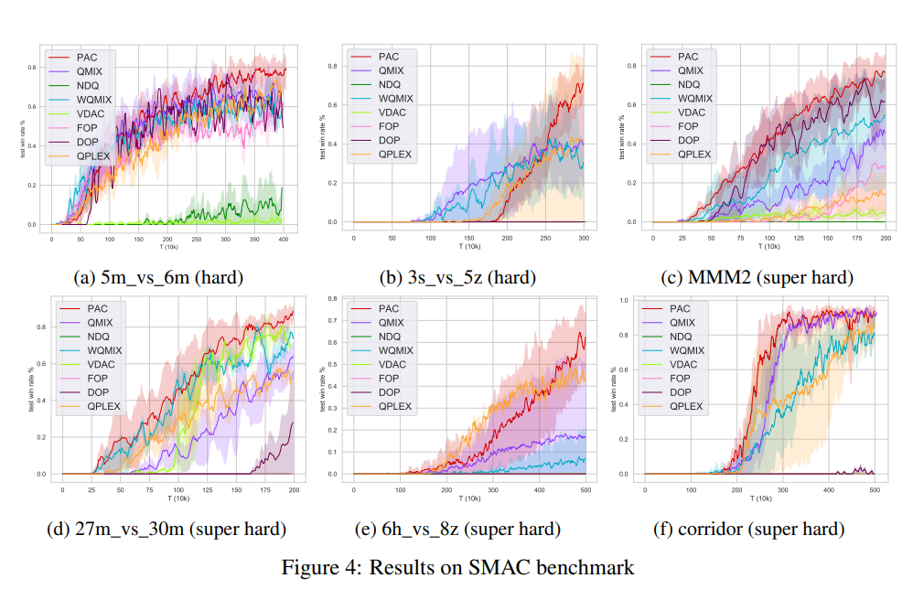
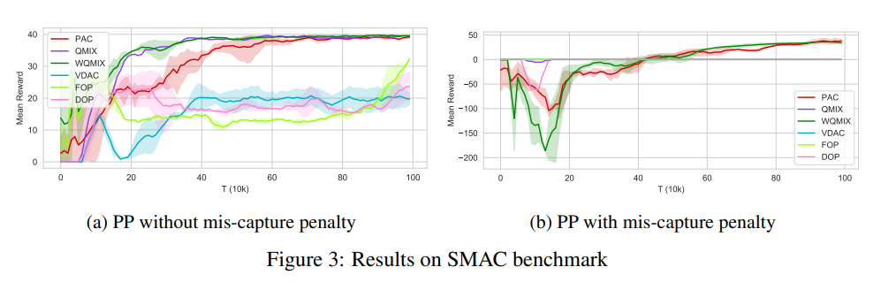
Result
VideoDemos

Slide 17
Summary
*Basics to the Background
Background
Limitations
Our Design
Experiment
HANHAN@GWU.EDU

Slide 18

PAC: Assisted Value Factorization with Counterfactual Predictions in Multi-Agent Reinforcement Learning
Hanhan Zhou$^{1}$, Tian Lan$^{1}$, Vaneet Aggarwal$^{2}$
$^{1}$ The George Washington University
$^{2}$ Purdue University

