Slide 1
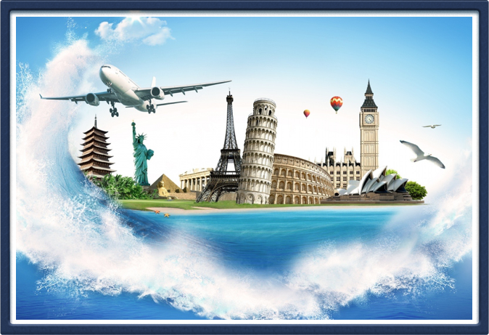
Travel ++
Shruthi Mohan Hanhan Wu

Slide 2


Gossip Queen
Current Hottest Topics
Have Fun on the Road!
Travelista

Slide 3

Dr. Q
Answer Anything
Share Travel Experiences
Multi-Media Answers

Slide 4
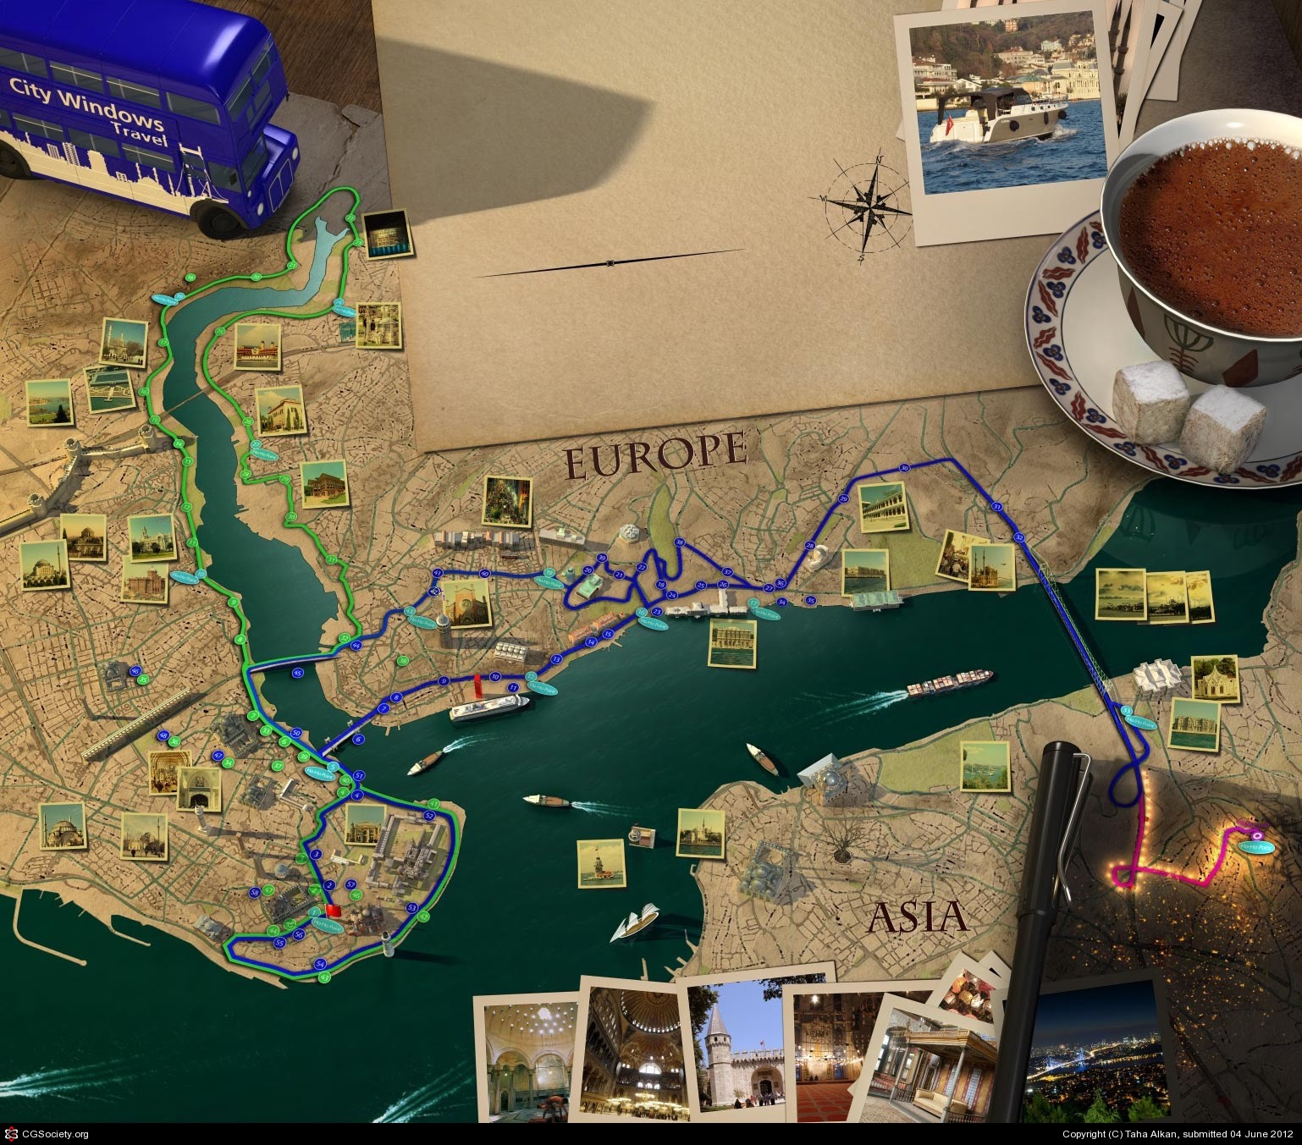
Map Attentive
Smooth Travel Plans
Categorize User Needs

Slide 5
We Are Practical
Sunday | Monday | Tuesday | Wednesday | Thursday | Friday | Saturday
 |  | Mar 1 | 2 | 3 | 4 | 5
6 | 7 | 8 | 9 | 10 | 12 | 13
14 | 15 | 16 | 17 | 18 | 19 | 20
21 | 22 | 23 | 24 | 25 | 26 | 27
28 | 29 | 30 | 31 | April 1 | 2 | 3
4 | 5

