Slide 1
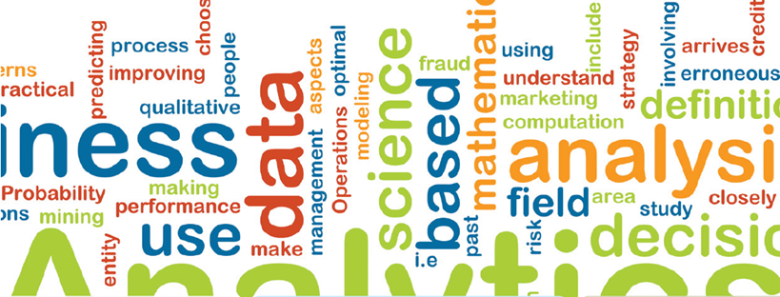
Value Creation of Data
Syed Shariyar Murtaza, Ph.D.
shariyar.murtaza@telus.com

Slide 2
Monetization Group’s Objective
Identification of industry specific needs for value creation of data (or big data)
Demonstrate through a pilot project the value creation of data
Facilitate Canadian industry in embracing big data analytics and push government to increase resources for it

Slide 3
Project Ideas
Create a visual story (exploratory analytics)
Tableau or Watson Analytics
Exploratory or predictive analytics
Weka, Rapid Miner, Rattle (R), etc.
On the availability of programming resources
Web application with an analytical engine
Shiny in R: http://shiny.rstudio.com/
Django in Python: https://www.djangoproject.com/

Slide 4
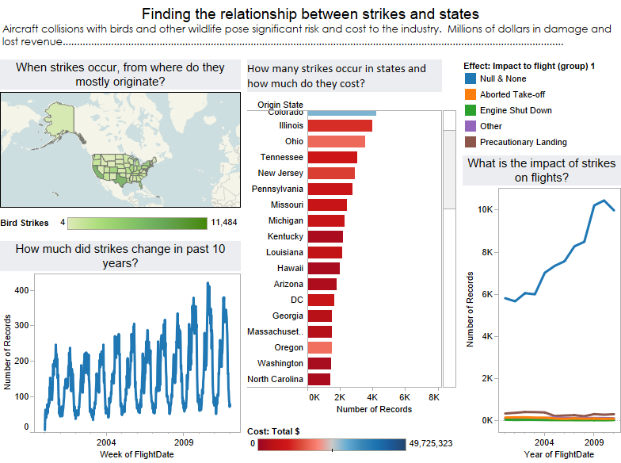
Visual Story

Slide 5
Creating a Visualization Story
Identify research questions from the dataset
Create visualizations for every research questions
Present all of them as a visual story with one common theme

Slide 6
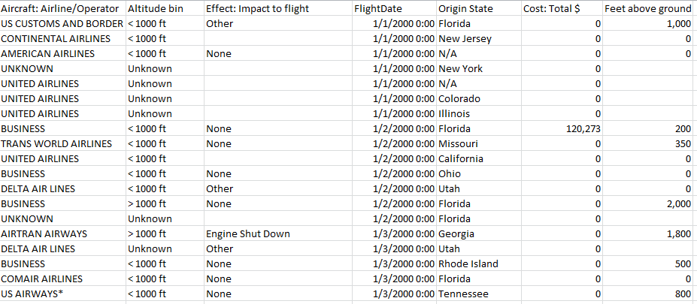
Example Dataset
Describes wildlife strikes to aircrafts in US

Slide 7
Exercise: Identifying Research Questions
When strikes occur, from where do they mostly originate?
How many strikes occur in individual states and how much do they cost?
How much did strikes change in past 10 years?
What is the impact of strikes to flights?

Slide 8
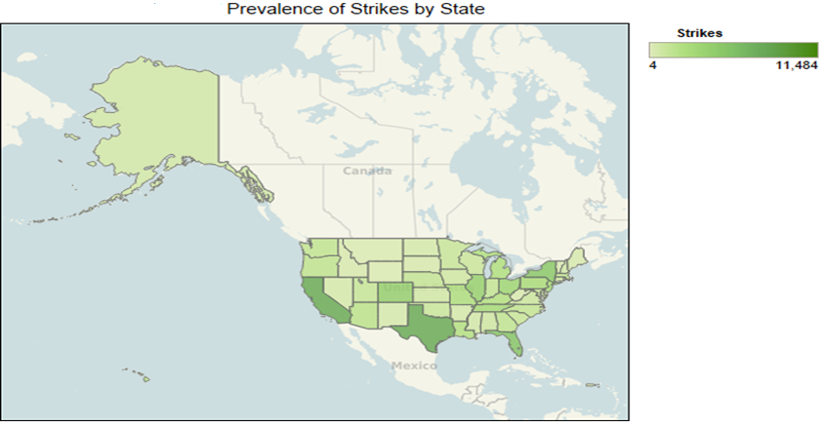
When strikes occur, from where do they mostly originate?
Value (lightness) on
total strikes (Q) for a region

Slide 9
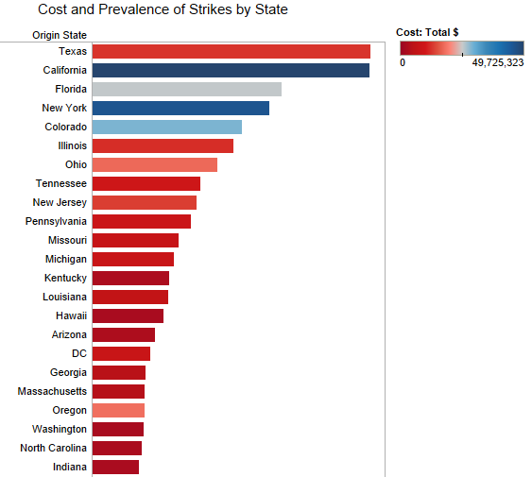
How many strikes occur in individual states and how much do they cost?
Third dimension as value(lightness)

Slide 10
Visual Story

Slide 11
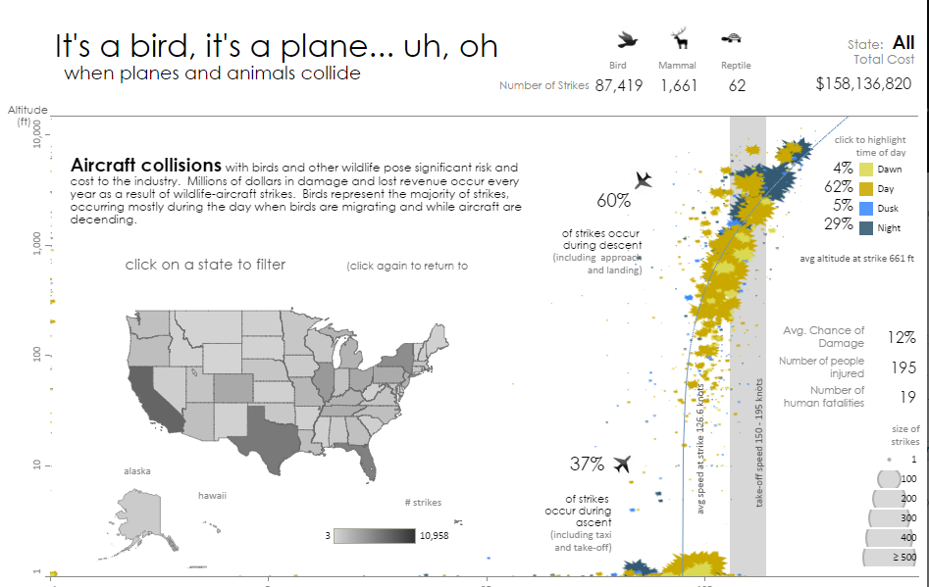
Visual Story

Slide 12
Government’s Procurement Habits
Exploratory Analytics
Investigate the relationship between government’s procurement habit and six key socioeconomic indicators
Government’s procurement data
Total contract value, supplier, contracting city, etc.
Economic indicators
Consumer Price Index, Canadian Dollar Effective Exchange Rate, Gross Domestic Product, Unemployment Rate, Average Weekly Wage Rate, and SP-TSX Composite Index
Notes:
Public Works and Government Services Canada (PWGSC) procures goods and services on behalf of federal departments and agencies.

Slide 13
Dataset
1) Government of Canada Open Data Portal - PWGSC Contract History - information about contracts awarded by Public Works and Government Services Canada (PWGSC) since January 2009, on behalf of federal departments and agencies.
http://open.canada.ca/data/en/dataset/53753f06-8b28-42d7-89f7-04cd014323b0
2) Statistics Canada, CANSIM - Economic indicators, by province and territory
http://www.statcan.gc.ca/tables-tableaux/sum-som/l01/cst01/indi02a-eng.htm
3) Bank of Canada – Summary of Key Monetary Policy Variables
http://www.bankofcanada.ca/rates/indicators/key-variables/

Slide 14
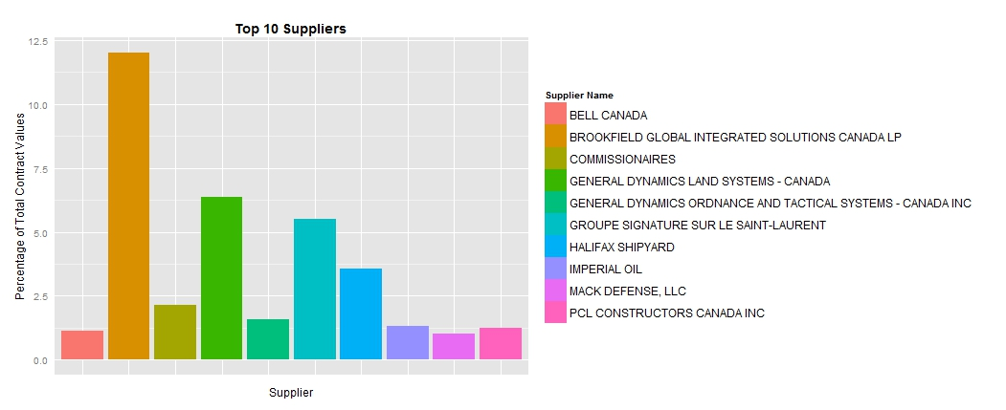
Fundamental Analysis
* 31.96% of all contracts are not subject to an open solicitation process
* 24.33% ($20.26 billion) of spending goes to non-competitive contracts
* 55% of non-competitive dollars went to the top 10 suppliers

Slide 15
Preprocessing
Class | Range ($) | # of Records | % of Records | Total Dollars | % of Dollars | Avg Contract Size
Small | 0 - 250k | 101083 | 83.2% | $4.7 billion | 6% | $47,020
Medium | 250k - 5mill | 18725 | 15.4% | $17.8 billion | 21% | $950,081
Large | 5mill+ | 1685 | 1.4% | $60.7 billion | 73% | $36,043,285
Apply clustering within each group and compare against economic indicators

Slide 16
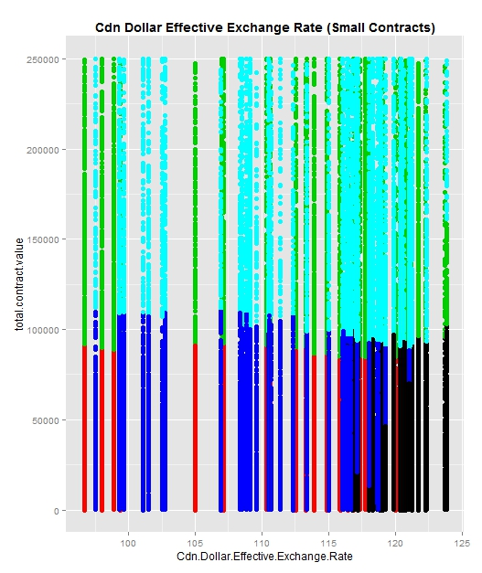
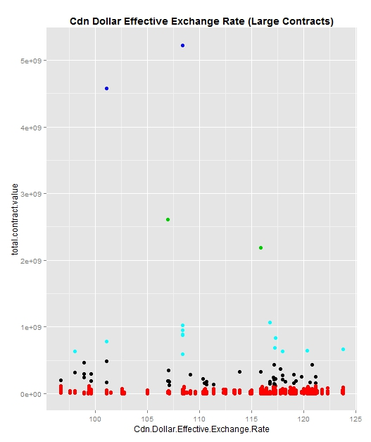
Notes:
Cluster 1 (black) and cluster 2 (red) represent smaller contact values and include over 68% of the data so they are of particular importance.
The Canadian Dollar effective Exchange Rate, S&P TSX Composite Index and Unemployment Rate show higher concentrations of contracts when they are at middle-higher levels. This shows a trend where when the dollar, stock market and unemployment are higher, the number of contacts awarded under 250K increases.
Gross Domestic Product, Consumer Price Index and Average Weekly Wage Rate all look fairly similar with higher concentrations of contracts when they are lower. This shows a trend where when GDP, prices and wages are lower the number of contracts awarded under 250K increases.
Clusters 3 and 5 represent larger contracts and are nearly equal in size which indicates that the economic indicators do not have much influence on higher contract values.

Slide 17
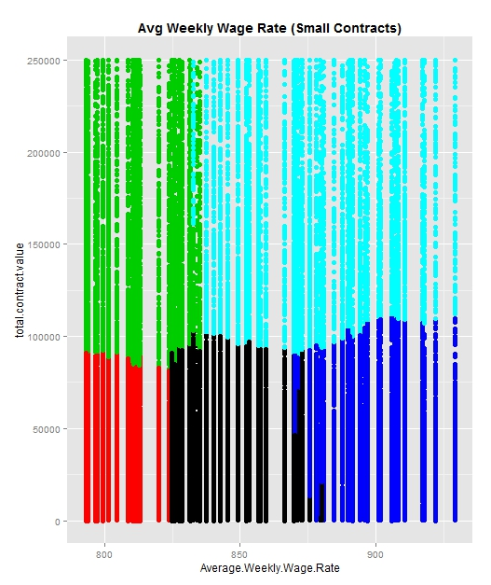
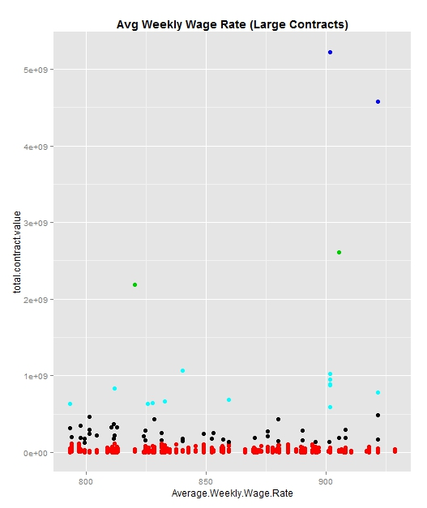

Slide 18
Trend of Stock Price
Predictive Analytics
Dataset:
Yahoo Finance
Ticker name | Day 1 | Day 2 |  |  |  | Day 8 | Day 9 | Day 10 | Price Trend
Aapl | 203 | 201 |  |  |  | 190 | 196 | 198 | rising
sar | 12 | 14 |  |  |  | 13 | 12 | 9 | falling
dds | 23 | 25 |  |  |  | 23 | 21 | 19 | falling
ssc | 342 | 324 |  |  |  | 322 | 345 | 399 | rising
Train a classification algorithm to predict
Ticker name | Day 1 | Day 2 |  |  |  | Day 8 | Day 9 | Day 10 | Price Trend
ddf | 20 | 20 |  |  |  | 19 | 16 | 18 | ?
gds | 120 | 140 |  |  |  | 130 | 120 | 90 | ?
fcc | 231 | 251 |  |  |  | 213 | 214 | 196 | ?

Slide 19
Public Datasets
US Government Datasets:
14 Categories
Agriculture, Business, Health, Ecosystem, Climate, Consumer, Energy, etc.
https://www.data.gov/
Health Data Initiative by US Department of Health and Human Services
Find a right specialist, compare the quality of service at hospitals, etc. https://www.healthdata.gov/
19

Slide 20
Public Datasets
Medicare Data
Compare quality of care at Medicare certified hospitals
https://data.medicare.gov/data/hospital-compare
US Department of Labor
Weekly Fatalities Report
Entrepreneurship support dataset
http://www.dol.gov/open/data.htm
NYC Open Data
Dataset of millions of Taxi trips
City notices, land-sales, public hearings and contracts
https://nycopendata.socrata.com/

Slide 21
Public Datasets
US General Service Administration
Technology, travel, real estate, acquisition, etc.
http://www.gsa.gov/portal/category/105839
Canadian Open Government Datasets
Immigration, travel, business, benefits, etc.
http://open.canada.ca/en
Statistics Canada
Community surveys, EI surveys, Cancer registry
http://www.statcan.gc.ca/eng/rdc/data

Slide 22
Public Datasets
Canadian Climate Datasets
http://climate.weather.gc.ca/
University of California Irvine Datasets
Variety of ready to use datasets for machine learning tasks
air quality, alcohol consumption, etc.
http://archive.ics.uci.edu/ml/
Crowd Flower
Football strategy, gender classifier, sentiment analysis, etc.
http://www.crowdflower.com/data-for-everyone/

Slide 23
Thank you

