Slide 1
Module-A-Introduction
Programming Computers
Information
Languages and C Compilers

Slide 2
Objectives
Programming Computers
  Accidents
  Software Development
  Hardware
Information
  Fundamental Units
  Representations
  Addressing Information
  Program Instructions

Slide 3
Objectives…
Languages and C Compilers
  Programming Languages
  Why C as a First Language?
  Compiling C Programs
  Some Notable Features

Slide 4
Programming Computers
Introduce the art of software development
"The most likely way for the world to be destroyed, most experts agree, is by accident. That's where we come in. We're computer professionals. We cause accidents." Nathaniel Borenstein (1991).

Slide 5
Accidents
  In May 2004, the Royal Bank of Canada informed the public that some of its transactions had not been properly reflected in its client balances. The bank faced a class-action suit for damages of $500 per customer and a possible loss of $165 million in service fees.
  In July 2004, the Canadian Imperial Bank of Commerce reported that its computer system had been affected by glitches. The system had double dipped about 60,000 personal lines of credit.

Slide 6
Accidents…
  In June 1996, the European Space Agency Ariane 5 maiden rocket self-destructed after going out of control because of a software error.
  In October 1992, the computer aided dispatch system of the London Ambulance Service started malfunctioning. In one case, the ambulance arrived 11 hours late at a stroke victim's house - 5 hours after the caller had made their own way to the hospital.

Slide 7
Accidents…
To minimize such accidents, we build quality into the software that we develop. We design it for, amongst other features:
  Usability
  Correctness
  Maintainability
    Understandability
    Modifiability
  Portability

Slide 8
Accidents…
We achieve quality through
  robust and user-friendly interfaces
  structured programming
  comprehensive testing
  internal documentation
  standards compliance

Slide 9
Software Development
The programs that we develop are simulations of solutions to stated problems.
The process includes problem analysis, algorithm design, program coding, program testing and program maintenance.
A program is a set of instructions that computer hardware will execute.

Slide 10
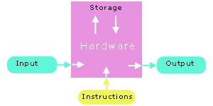
Software Development…

Slide 11
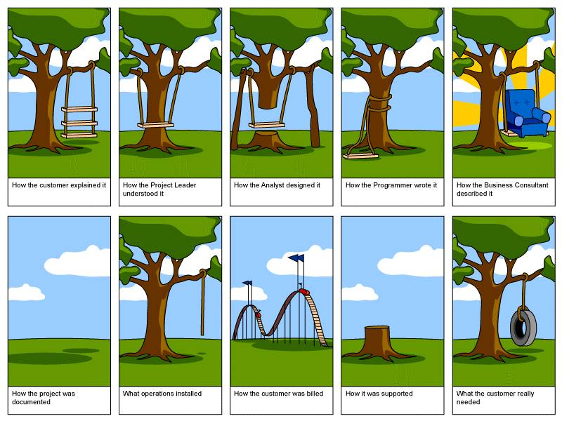
Software Development Caricatures

Slide 12
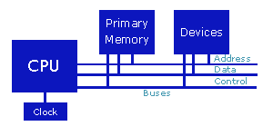
Hardware

Slide 13
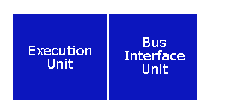
Hardware…
Central Processing Unit
CPU memory is volatile - the contents of the registers are lost as soon as power is turned off.

Slide 14
Hardware…
Primary Memory
  Primary memory holds the information accessed by the CPU.
  Primary memory is also volatile.
  The popular term for primary memory is RAM (Random Access Memory).

Slide 15
Hardware…
Devices
  Include I/O devices such as a keyboard, a monitor and a mouse…
  Storage devices such as a floppy drive, a hard drive and a CD-ROM drive (secondary storage).
  Each device interfaces with the system buses through a device controller.

Slide 16
Hardware…
The most expensive and fastest memory - registers - is reserved for the CPU.
  CPU transfers information at less than 10 nanoseconds
  primary memory transfers information at about 60 nanoseconds
  a hard disk transfers information at about 12,000,000 nanoseconds

Slide 17
Summary
Programming Computers
  Accidents
  Software Development
  Hardware
Q&A

Slide 18
Information
Summarize the low-level features of programming.
Program information consists of instructions and data.
How is this information stored?
What does a program instruction look like?
How do we make program instructions readable?

Slide 19
Fundamental Units
John von Neumann selected binary (base 2) digits as the EDVAC's fundamental unit.
The vast majority of modern computers process and store information in binary digits.
We call a binary digit a bit.

Slide 20
Fundamental Units…
The fundamental addressable unit of primary memory is the byte.
One byte consists of 2 nibbles. One nibble consists of 4 consecutive bits.
Byte
Nibble |  |  |  | Nibble
Bit | Bit | Bit | Bit | Bit | Bit | Bit | Bit
00000000 <- possibility 0 00000001 <- possibility 1 00000010 <- possibility 2 00000011 <- possibility 3 00000100 <- possibility 4 ... 00111000 <- possibility 104 ... 11111111 <- possibility 255

Slide 21
Fundamental Units…
The natural unit of the CPU is a word. A word is the size of the general registers - the unit of memory within the CPU.

Slide 22
Representations
Hexadecimal Representation
  Base 16: 0,1,..,9, A, B, C, D, E, F
  Each hexadecimal digit represents 4 bits of information.
  The 0x prefix identifies the number as a hexadecimal number: 0x5C

Slide 23
Representations…
Octal Representation
  Base 8: 0,1,2,..,7
  Set of 3 consecutive bits forms an octal digit
  The prefix 0 identifies the number as an octal number: 031

Slide 24
Addressing Information
Each byte of primary memory has a unique address, start from zero
  Kilo or k (=1024): 1 Kilobyte = 1024 bytes
  Mega or M (=1024k)
  Giga or G (=1024M)
  Tera or T (=1024G)
  Peta or P (=1024T)
  Exa or E (=1024P)

Slide 25
Addressing Information…
Addressible Memory
  The maximum size of addressable primary memory depends upon the size of the address registers

Slide 26
Program Instructions
Each program instruction consists of an operation and operands
The CPU performs the operation on the values stored as operands or on the values stored in the operand addresses.
The addresses are either register names or primary memory addresses

Slide 27
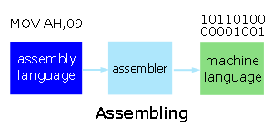
Program Instructions…
Assemblers

Slide 28
Summary
Information
  Fundamental Units
  Representations
  Addressing Information
  Program Instructions
Q&A

Slide 29
Languages and C Compilers
Use operating system utilities to edit, compile and run programs
Programs that perform relatively simple tasks and are written in assembly language contain a large number of statements.
Assembly language is a low-level language, close to the hardware.
To make our programs shorter, we use higher-level languages.

Slide 30
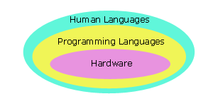
Programming Languages

Slide 31
Programming Languages…
5 generations:
  Machine languages.
  Assembly languages.
  Third-generation languages. These are languages with instructions that describe how a result is to be obtained (C, Pascal, C++, Java…).
  Fourth-generation languages. These are languages with instructions that describe what is to be done without specifying how it is to be done (eg:SQL).
  Fifth-generation languages are the closest to human languages. They are used for artificial intelligence, fuzzy sets, and neural networks (eg: Prolog, Matlab)

Slide 32
Programming Languages…
The higher the level, the closer to the human languages and the further from native machine languages
  Each third generation language statement ~ 5-10 machine language statements.
  Each fourth generation language ~ 30-40 machine language statements.

Slide 33
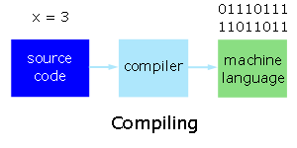
Interpreters and Compilers
When we code a program in a high level language, we write source code. We translate this code into machine language statements using either
  an interpreter, or
  a compiler.

Slide 34
Why C as a First Language?
C is one of the most popular languages in use globally
Some reasons for learning programming using the C language include:
  C is English-like,
  C is quite compact - has a small number of keywords,
  A large number of C programs need to be maintained,
  C is the lowest in level of the high-level languages,
  C is faster and more powerful than other high-level languages, and
  The UNIX, Linux and Windows operating systems are written in C and C++.

Slide 35
Why C as a First Language?...
Speed
Language | Time to Run
Assembly | 0.18 seconds
C | 2.7 seconds
Basic | 10 seconds
Comparative times for a Sieve of Eratosthenes test

Slide 36
Compiling C Programs
/* My first program */
/* p_1.c */
/* Author your name here... */
/* Date … */
main()
{
printf("This is Programming Fundamental\n");
}

Slide 37
Compiling C Programs…
Standards
  The most recent standard to which C compiler writers try to adhere is ANSI/ISO 9899-1999 or C99 for short.
  If we write our source code to this standard or even better the earlier C89, we can expect our code to compile on most platforms.

Slide 38
Some Notable Features
Comments
  /* */
  We use comments to document our programs and to enhance their readability. C compilers ignore all comments.
Whitespace
  We use whitespace to improve program readability and to display the structure of our program's logic. C compilers ignore all whitespace

Slide 39
Some Notable Features…
Case Sensitivity
  C language is case sensitive.
  C compilers treat the character 'A' as different from the character 'a'

Slide 40
Summary
Languages and C Compilers
  Programming Languages
  Why C as a First Language?
  Compiling C Programs
  Some Notable Features
Q&A

